Slide 1

The Impact of Coronavirus on Online Learning in Higher Institution of Education (Students Perspective).
8th Annual Research Forum - day 2
Dr. Hasan Razzaqi
Assistant Professor
Multimedia Science Department
Ahlia University
24th March 2021

Slide 2

Outline
Research Background
Problem definition
Research Question
Aim and Objectives
Theoretical Framework
Methodology
Data Analysis and Finding
Discussion
Conclusion

Slide 3

Research Background
Covid 19 pandemic crisis had a direct impact on education nationally and internationally level (Agnoletto and Queiroz, 2020).
Covid-19 has changed the education system related to curriculum, teachers’ functions, student engagement and assessments (Daniel, 2020).
Covid-19 has changed the way of teaching the future generations by redefining the role of teachers (Luthra and Mackenzie, 2020).
Covid-19 caused three fundamental changes in the global education (Tam and El Azar, 2020).

Slide 4
Research Background
One advantage of Covid-19 is that it teaches us the importance of life skills needed in the future era and opens up a wider role for technology in supporting education (Widodo et al. 2020).
Online learning is one of the main alternatives to learning during the Covid-19 pandemic and it has implemented at various levels of education with various platforms (Widodo et al. 2020).
The rapid growth and popularity in the internet, distance education, and the pandemic crisis have made online education grown rapidly (Demuyakor, 2020).
E-learning is the use of technology to enhance teaching and learning activities (Doculan, 2016).
Technology will reshape the universities by 2030 (Murphy, 2020; UNESCO, 2020).

Slide 5
Problem definition
The implementation of online learning is not supported by an in-depth study of educational institutes, educators and students’ willingness.
Furthermore, the student willingness in online learning is not assessed comprehensively from the aspects like;
    Equipment Capability.
    Technology skills.
    Self-directed learning skills.
    Motivation.
    Perceived usefulness.

Slide 6
Research Question
Question 1: What is the student’s perception of the effectiveness and credibility of Course Content for online learning?
Question 2: What is the level of students’ knowledge of the CONVID-19 pandemic?
Question 3: How much satisfied are the students with the “Learning Resources” available?
Question 4: What are the expected challenges that students are likely to encounter during the online teaching and learning?

Slide 7
Aim
To examine the impact of Coronavirus on Online Learning in Higher Institution of Education from Students Perspective.

Slide 8
Objective
To study the various challenges associated with online learning.
To study impact of Corona virus on higher institute of education, educators and students.
To determine factors impacting students’ willingness in online learning.
To derive findings from data gathering to achieve the aim.

Slide 9
Theoretical framework
In this study, Online Collaborative Learning (OCL) Model is used because OCL helps investigating how students and educational institutions accept and use technology for teaching and learning.
Online Collaborative Learning (OCL) is theory focuses on the internet as a source of learning through raising collaboration and building of knowledge. (Harasim, 2017).
Harasim (2012) recognizes the benefits of moving teaching and learning to the Internet and largescale networked education.

Slide 10
Methodology
Quantitively method.
A survey (questionnaire) was used as source of data gathering.
The questionnaire has 37 questions divided four categories; Demographic Information, Students’ knowledge on the CONVID-19, Online Learning in Higher Education, Expected challenges).
Likert scale: (Strongly agree = 5, Agree = 4, Neutral = 3, Disagree = 2, Strongly disagree = 1)
A total of 92 Reponses were recorded. (95% Confidence Level, 10% Confidence Interval (error margin), Population = 1750).
The primary subjects of the sample is University students.
SPSS / MS Excel was used as statistical data analysis.

Slide 11
Data Analysis and Finding

Slide 12
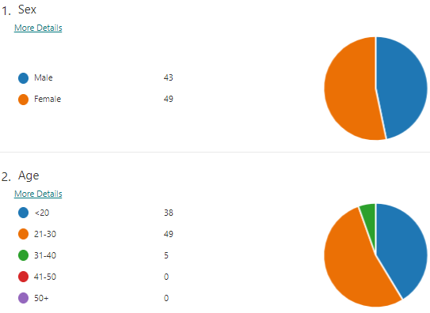
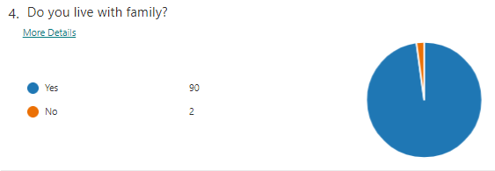
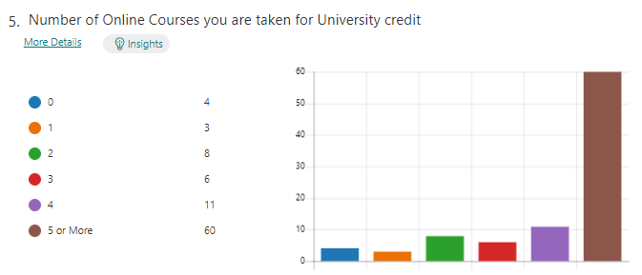
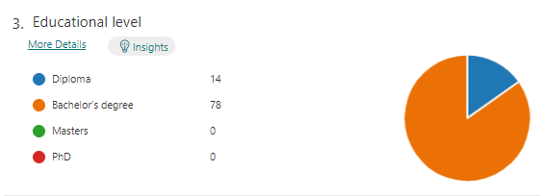
Demographic Information

Slide 13
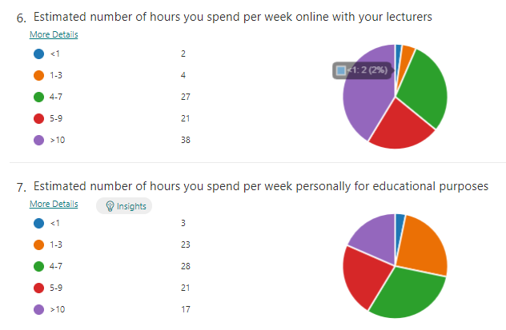

Slide 14
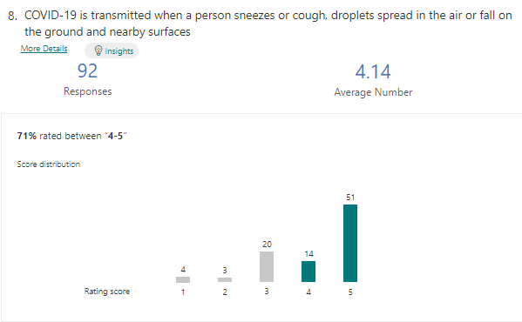
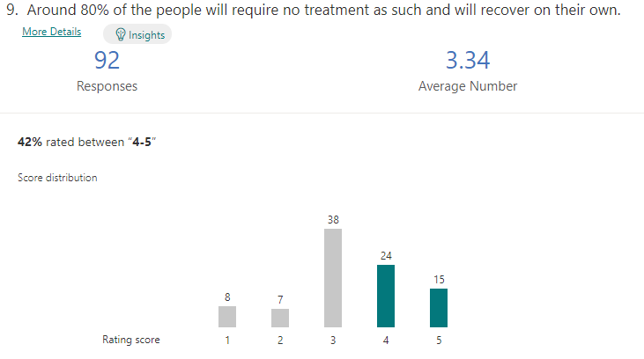
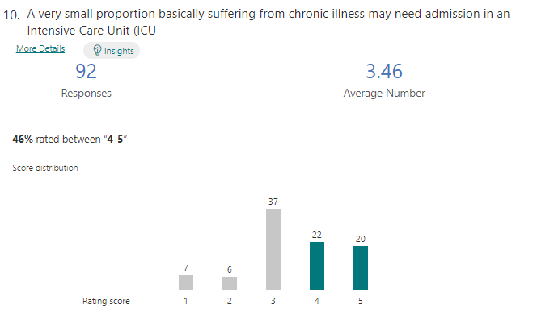
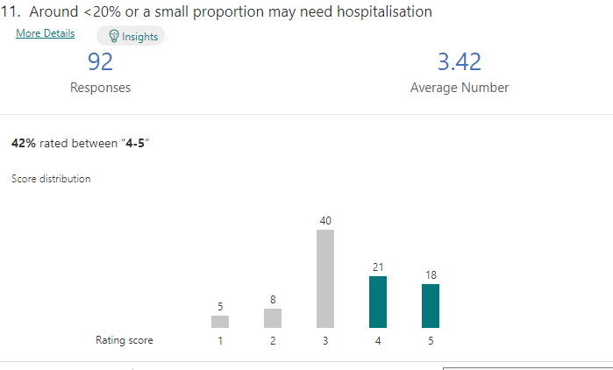
Students’ knowledge on the CONVID-19

Slide 15
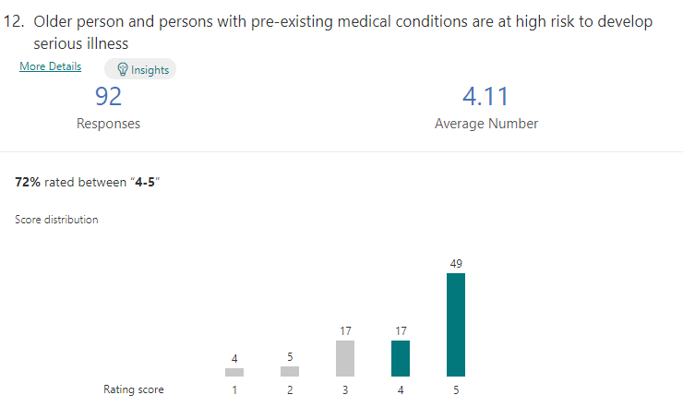
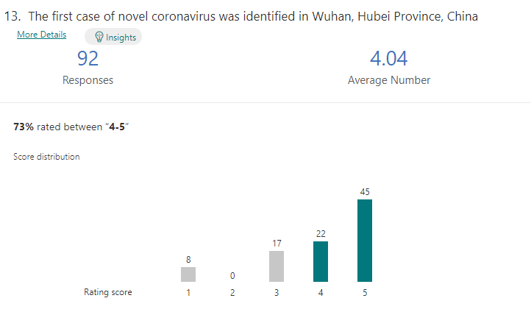
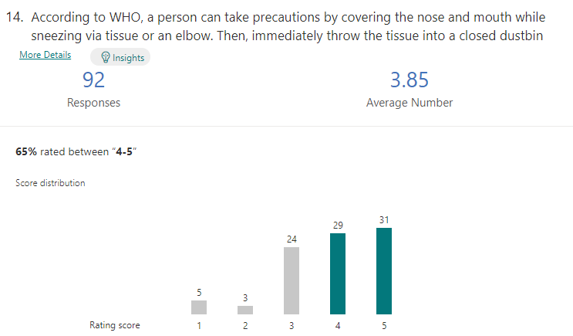
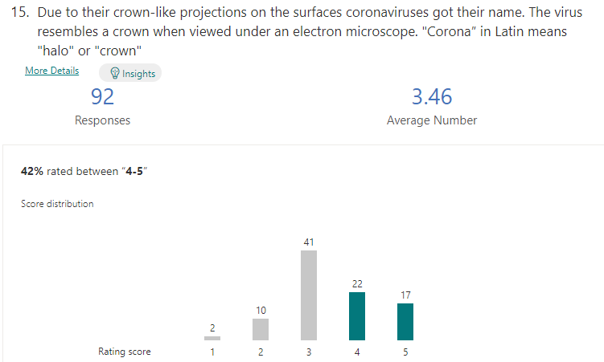
Students’ knowledge on the CONVID-19

Slide 16
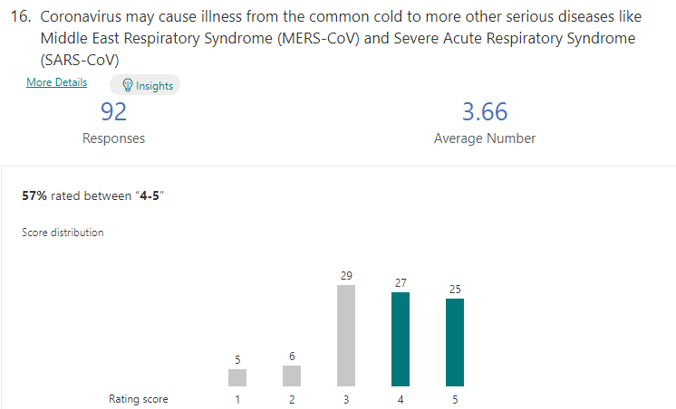
Students’ knowledge on the CONVID-19

Slide 17
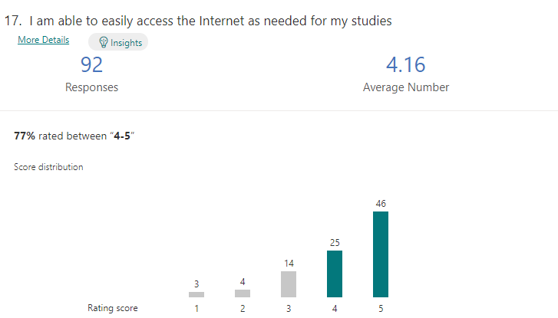
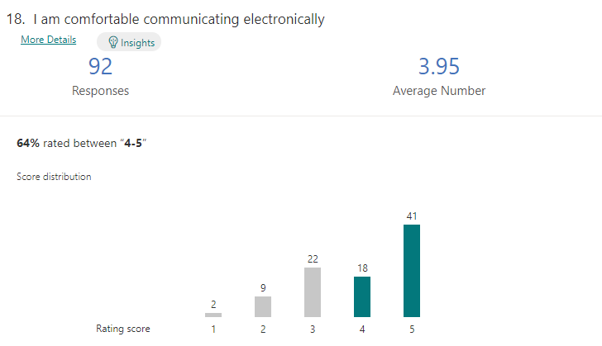
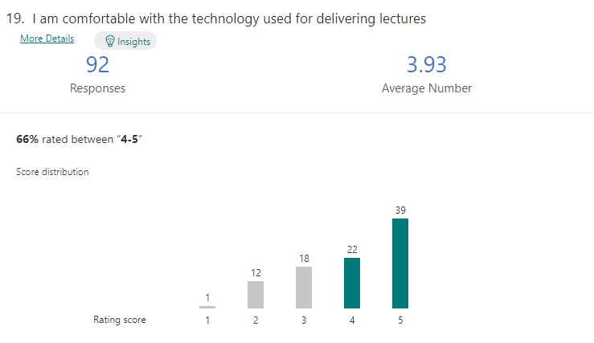
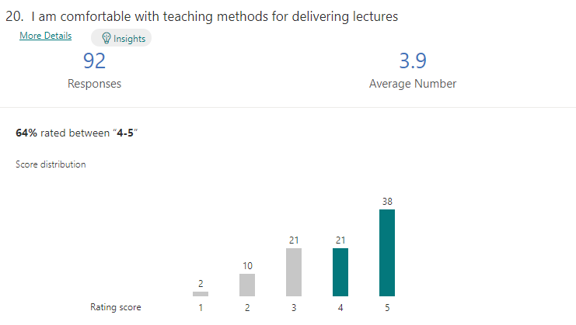
Statements about Online Learning in Higher Education

Slide 18
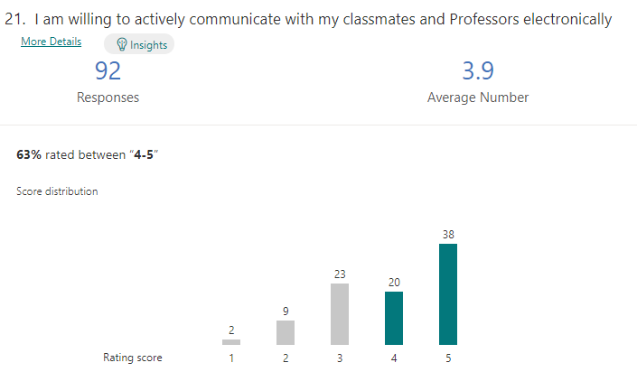
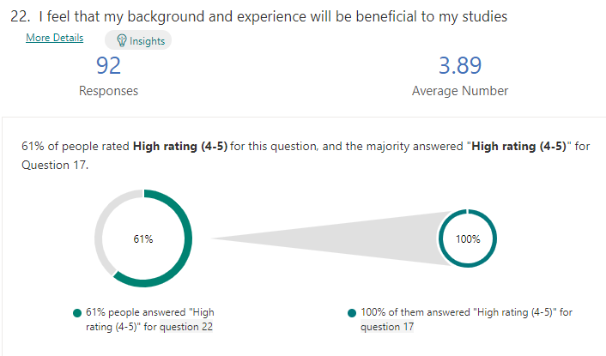
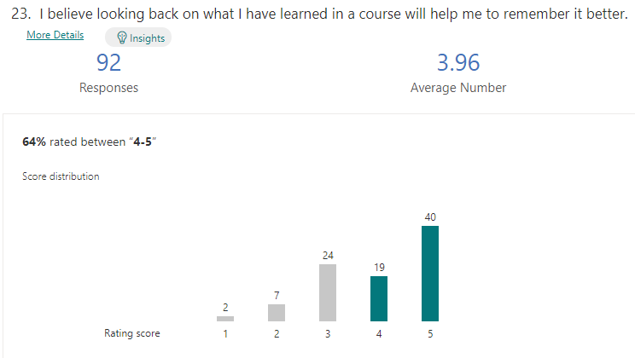
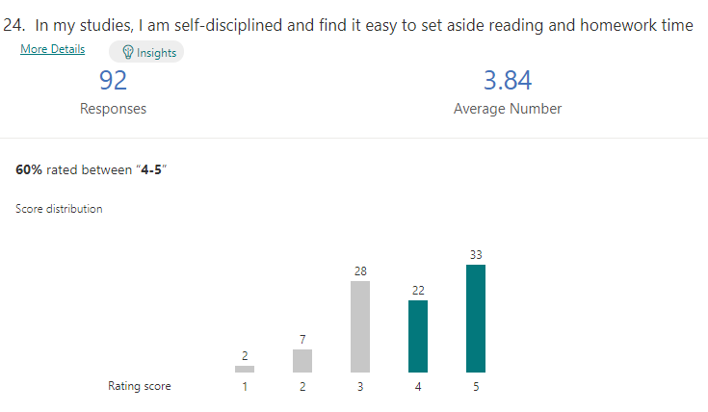
Statements about Online Learning in Higher Education

Slide 19
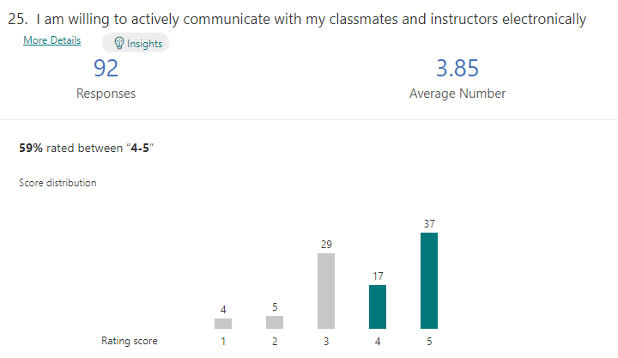
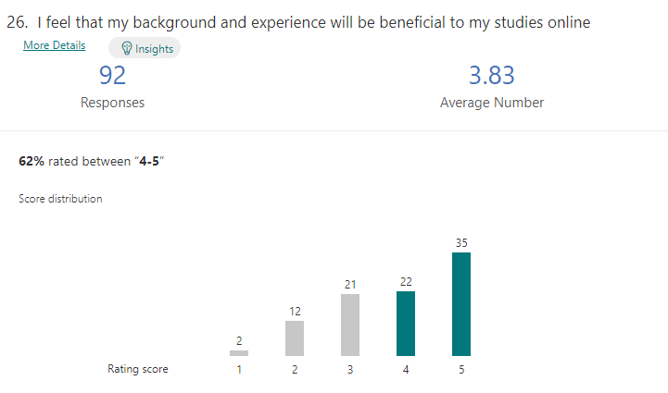
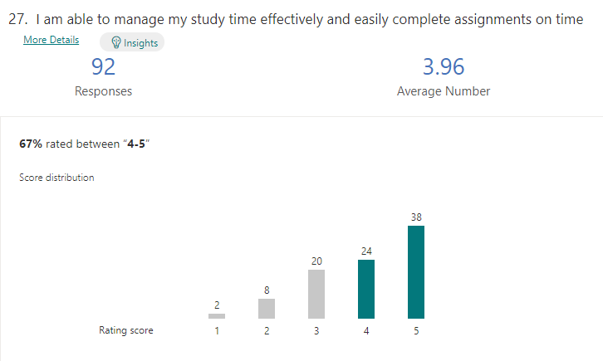
Statements about Online Learning in Higher Education

Slide 20
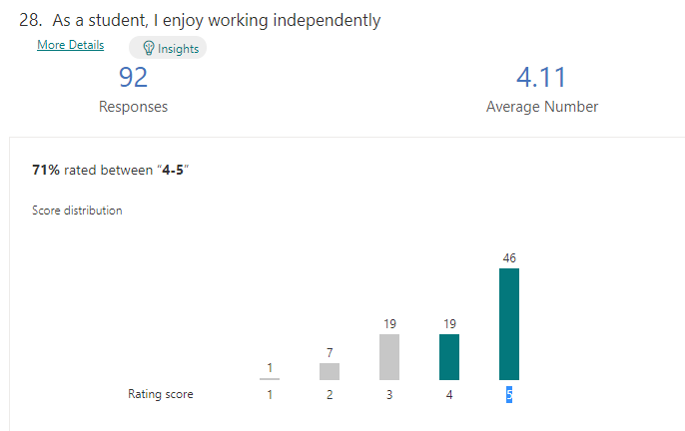
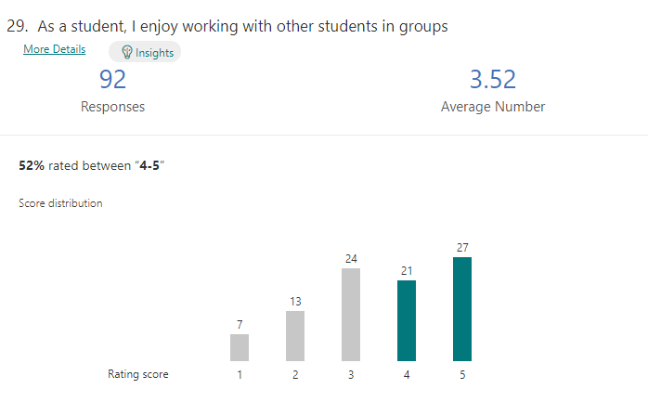
Statements about Online Learning in Higher Education

Slide 21
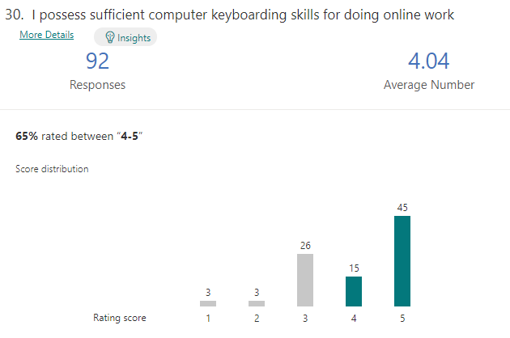
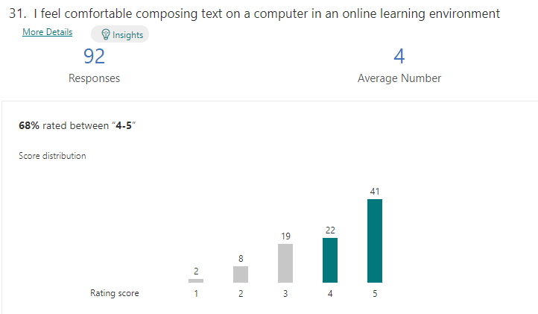
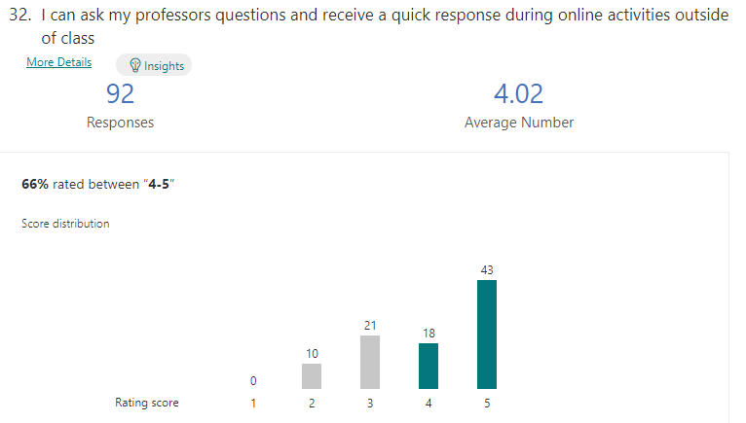
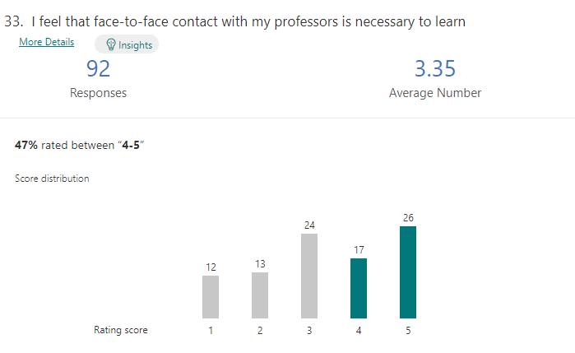
Statements about expected challenges

Slide 22
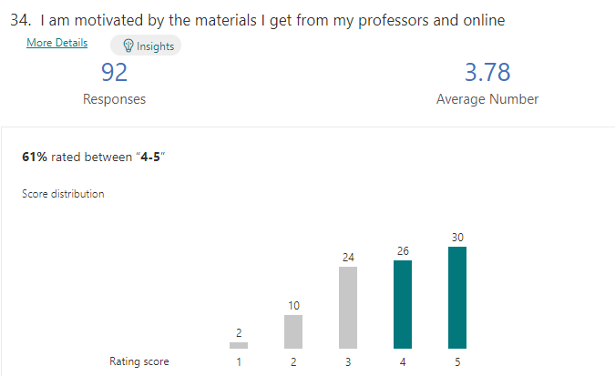
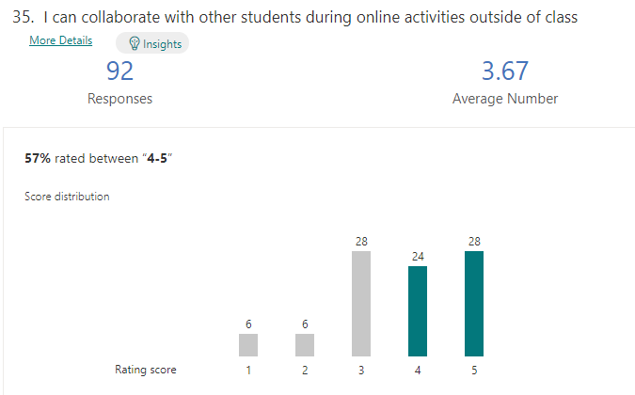
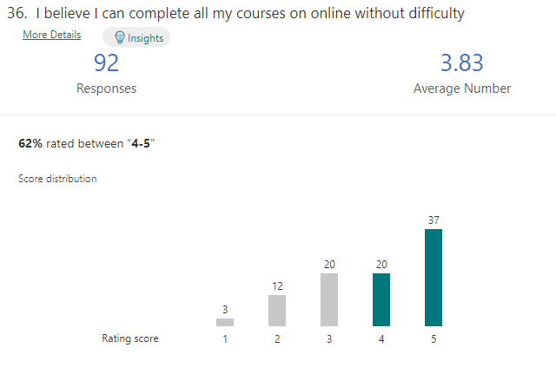

Statements about expected challenges

Slide 23
Data Analysis and Finding
No. | Variables | Items | Reliability
1 | Students Perception of the Effectiveness and Credibility of Course Content for Online Learning | 7 | 0.871
2 | Level of Student’s Knowledge of COVID-19 Pandemic | 9 | 0.915
3 | How Much Satisfied are the Students with “Learning Resources” Available | 13 | 0.937
4 | Expected Challenges the Students are likely to Encounter during the Online Teaching And Learning | 8 | 0.870
 | Total | 37 | 0.898
Table 1. The Reliability

Slide 24
Data Analysis and Finding
No. | Variables | Mean | CV
1 | Student’s Perception of the Effectiveness And Credibility of Course Content for Online Learning | 3.77 | .23
2 | Level of Student’s Knowledge Of COVID-19 Pandemic | 3.72 | .22
3 | How much Satisfied are the Students with “Learning Resources” Available | 3.91 | .24
4 | Expected Challenges that Students are likely to Encounter During the Online Teaching and Learning | 3.82 | .29
Table 2. Mean Scores of Subscales Variables

Slide 25
Discussion
Student’s Perception of the Effectiveness and Credibility of Course Content for Online Learning:
Students perceived online learning is useful as most of students highly agreed to the effectiveness of online learning.
Level of Students Knowledge of COVID-19 Pandemic:
The majority of students know how deadly is COVID-19.
A mean score of 3.72 shows students’ high satisfaction with this dimension.
How much Satisfied are the Students with available Learning Resources:
Learning refers to the use of texts, software, videos together with some other forms of materials recommended by the teacher to help a student meet the required expectations of learning.
A mean of 3.91 shows that students are high satisfied with the learning resources available.

Slide 26
Discussion
Expected Challenges that Students are likely to encounter during Online Teaching and Learning:
The students finding having face-to-face contact with professors during Coronavirus Covid 19 pandemic is not as useful as having contact via online teaching (Queston33). This subscale had a mean score of 3.35 compare to the overall mean of the construct, which was 3.82.

Slide 27
Conclusion
Contribution to Knowledge
Change in Technology has potential to bring out new situations not addressed in the literature.
Contribution to Methodology
Empirical support for answering research question related to impact of Coronavirus on Online Learning.
Contribution to Practice
Educators would know new technological factors that impact Online Learning using Covid 19 crises.

Slide 28
Conclusion
Limitations of Research
  Conducted in Bahrain - small population
  The results of the research may not be generalizable.
Recommendations for Future Research
  Need to carry out research in different countries.
  Need to carrying out an in-depth analysis of online practices.
  Need to carry out an investigation about teaching methods, Online assessment,

Slide 29

Reference
Agnoletto, R., & Queiroz, V.C 2020 COVID-19 and the Challenges in Education CEST, 5(02)
Daniel, S.J. 2020 Education and the COVID 19 Pandemi Prospects. https://doi.org/10.1007/s11125-020-09464-3
Demuyakor, J. 2020, Coronavirus (COVID-19) and Online Learning in Higher Institutions of Education: A Survey of the Perceptions of Ghanaian International Students in China - Online Journal of Communication and Media Technologies, 2020, 10(3), e202018e-ISSN: 1986-3497
Doculan, A.A.D. 2016 E-learning Readiness Assessment Tool for Philippine Higher Education Institutions. International Journal on Integrating Technology in Education, 5 (2), 33-43.
Luthra, P., & Mackenzie, S. 2020 4 Ways Covid-19 Education Future Generations. https://www.weforum.org/agenda/2020/03/4-ways-covid-19-education-futuregenerations/
Widodo, S.F.A., Wibowo, Y.E. and Wagiran, W., 2020, December. Online learning readiness during the Covid-19 pandemic. In Journal of Physics: Conference Series (Vol. 1700, No. 1, p. 012033). IOP Publishing.

Slide 30
Thank you!

