Slide 1

An Innovative Multi-Function Car Park Management System
Dr. Ammar Aldallal
Aysha Al Zallaqi
Amina Mohammed
Telecommunication Engineering Department

Slide 2

Contents
Introduction
Problem statement
Features of the system
Methodology
Conclusion

Slide 3

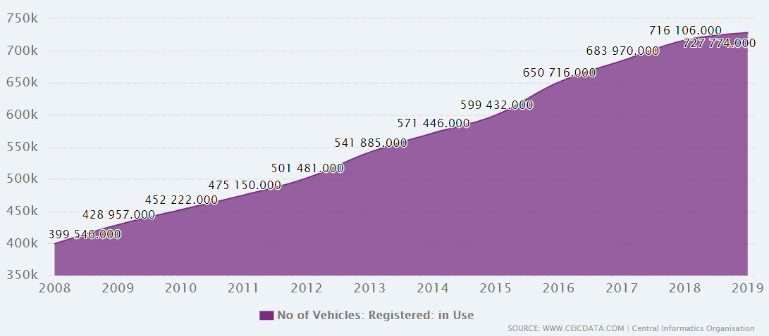
Introduction
The increasing number of car ownership globally has resulted in added stress for drivers.

Slide 4
Introduction
The difficulty car owners face to locate a parking slot for a car.
In certain cases, such as downtown areas it is found that it takes the driver an average of 20 minutes to find a parking slot.
It is found that 30% of traffic congestion is due to chasing an empty car park.
Los Angeles, annually, cars searching for a park burn 47000 gallons of gasoline, produce 730 tons of carbon and create the equivalent of 38 trips around the world.

Slide 5
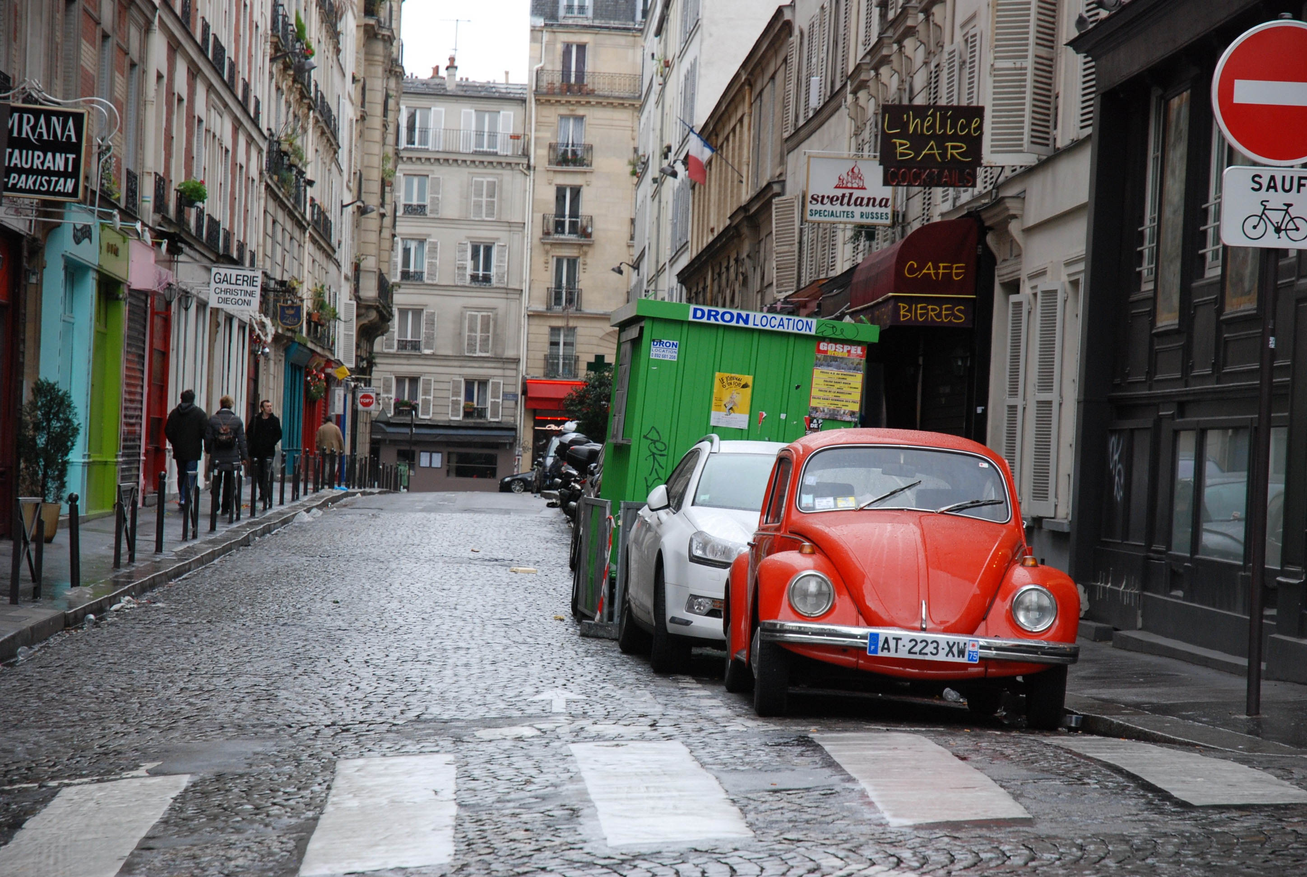
Causes of parking problems
Causes of parking problems

Slide 6
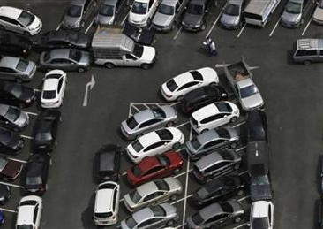
1- Crowded park

Slide 7
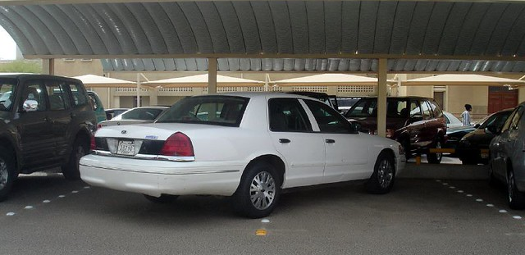
2. Wrong parking inefficient use of existing park capacity or inefficient car park utilization.

Slide 8
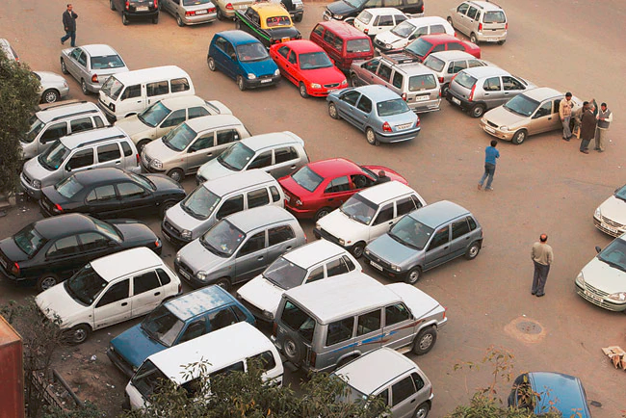
3. Unorganized parking

Slide 9
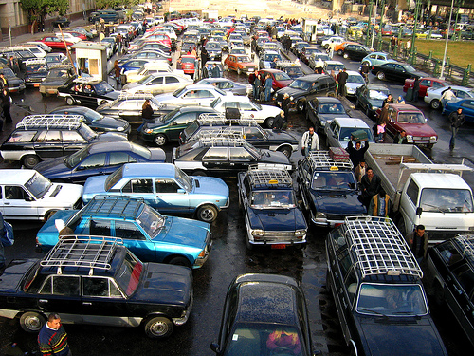
3. Congestion in parking lot

Slide 10


Consequences of parking problems
Waste driver time chasing empty lot.
Consume extra gallons of gasoline.
Produce tons of carbon.
Stress and other health concerns.

Slide 11
Features of the multifunction Smart car park system
The proposed system is characterized with the following:
High utilization of the car park.
Avoid congestion in the car park area.
Save driver time by identifying the location of empty park.

Slide 12
Methodology
1. High utilization of the car park
  Make sure that each car occupies exactly one park slot.
  Infrared sensors are mounted facing the park separation lines.
  Sound Alarm when the line is crossed by the car forcing driver to modify the parking.

Slide 13
Methodology
2. Avoid congestion in the car park area
  Prevent cars entering the parking area if there is no space.
  Controlled gates that opens when there is empty slot.

Slide 14
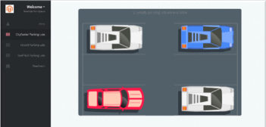
Methodology
3. Save driver time by identifying the location of empty park
Software: Web application.
Hardware:
  Light Dependent Resistor Sensors at each parking lot.
  Raspberry Pi microcontroller (link between hardware and software).

Slide 15
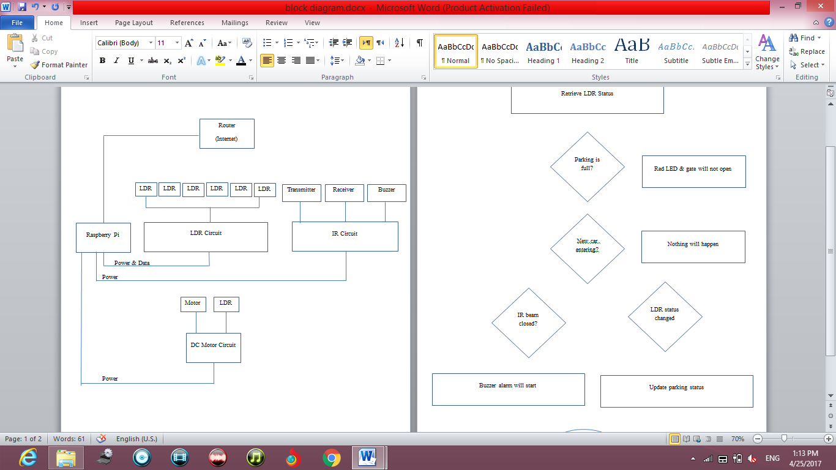
Process diagram

Slide 16
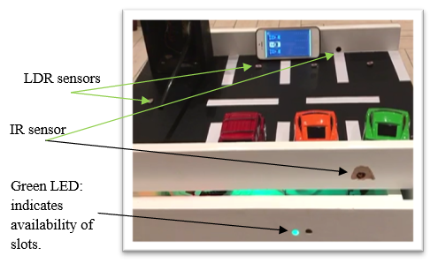
Samples of the Demo model

Slide 17
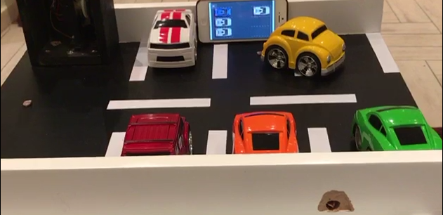
Samples of the Demo model

Slide 18
Samples of the Web Application

Slide 19

Conclusion
In this research a multi-function car park system was developed.
Need to activate innovation unit in AU by contacting college of Engineering and IT during Project Exhibition days.
Find a mechanism to commercialize such projects.
Convert undergraduate projects into papers to increase publications

Slide 20

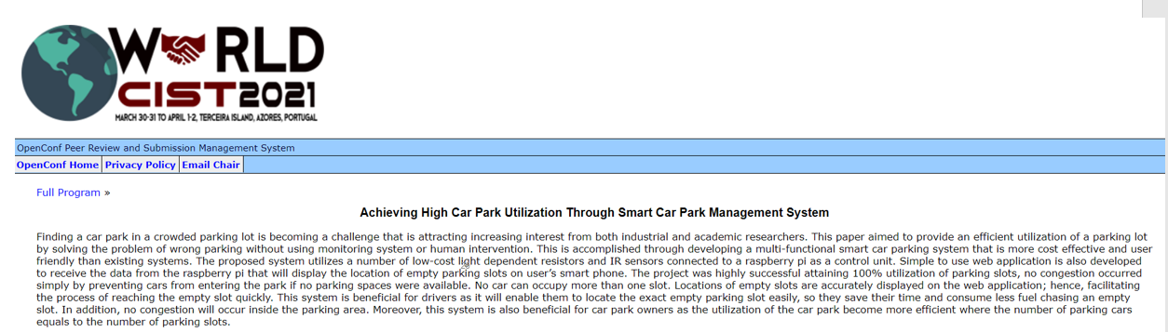
WorldCist'21 - 9th World Conference on Information Systems and Technologies,
Azores, Portugal

Slide 21
Thank you!

