Slide 1
DoS DETECTION FOR IoT NETWORKS USING MACHINE LEARNING
Husain Hameed
PhD Candidate
Supervisors: Prof. Hamed Al-Raweshidy & Dr. Wasan Awad
24th December 2020

Slide 2
Contents
Background & Introduction
Objective
Related Work & Uniqueness
Network Plan & Sample Data
Analysis Results
Conclusion

Slide 3
Background
IoT: refers to physical devices around the world that are connected to the internet.
Artificial Intelligence: Ability of machines to perform human-like tasks.
Machine Learning: It is a set of algorithms that parse data.

Slide 4
Introduction
It is estimated that the number of Internet of Things (IoT) devices will be over 21 billion by 2025 (Camara et al., 2020)
There are plenty of these IoT devices that are insecure and prone to attacks (Davis, Mason and Anwar, 2020)
DoS is one of the Internet security problems that affects IoT devices.

Slide 5
Objective
Test the performance of the following machine learning algorithms in detecting IoT DoS attacks using packet analysis at regular time intervals:
Gaussian Naive Bayes
K-Nearest Neighbors (KNN)
Support Vector Machine (SVM)
Neural Networks

Slide 6
Related Work
Author | Journal | Title | Observations
Lawal et al. 2020 | IEEE ACCESS | Security Analysis of Network Anomalies Mitigation Schemes in IoT Networks | ANN was excluded from the study, None IoT Data Sample
Thamilarasu et al. 2020 | IEEE ACCESS | An Intrusion Detection System for Internet of Medical Things | ANN was excluded from the study
Liu et al. 2020 | 2020 International Conference on Artificial Intelligence | Anomaly Detection on loT Network Intrusion Using Machine Learning | Not all metrics included, None IoT Data Sample
Anthi et al. 2019 | IEEE INTERNET OF THINGS JOURNAL | A Supervised Intrusion Detection System for Smart Home IoT Devices | Not all metrics included

Slide 7
Uniqueness
Combine the following elements in a single study:
Use IoT Data Sample.
Decrease number of attributes to detect DoS.
Include Precision as a performance metric.
Include ANN.

Slide 8
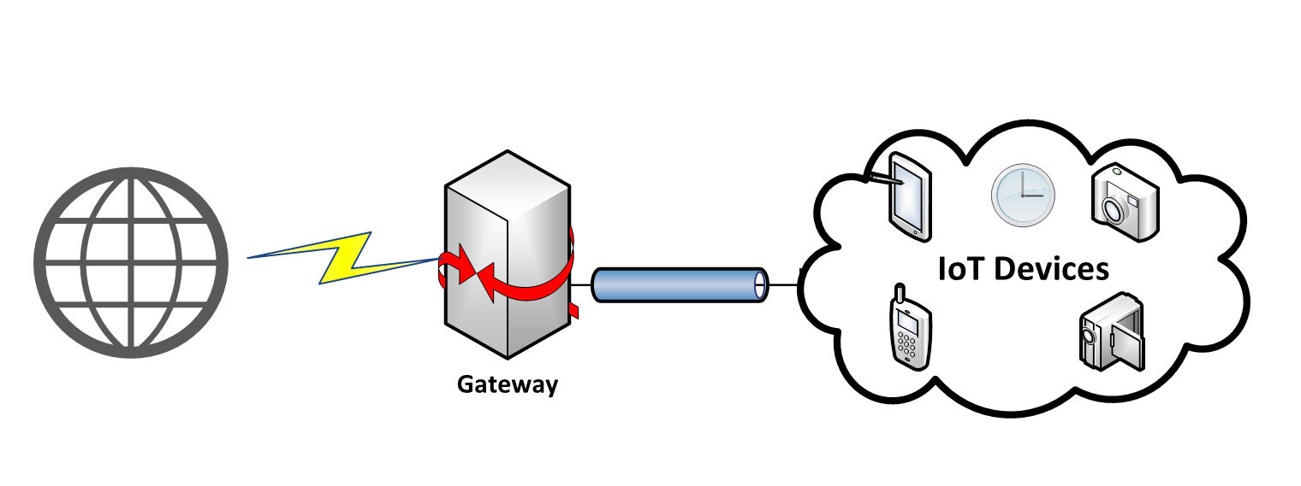
Network Plan
Home gateway router or a middlebox will analyze traffic between consumer IoT devices on the local network (e.g., a smart home LAN) and the rest of the Internet.

Slide 9
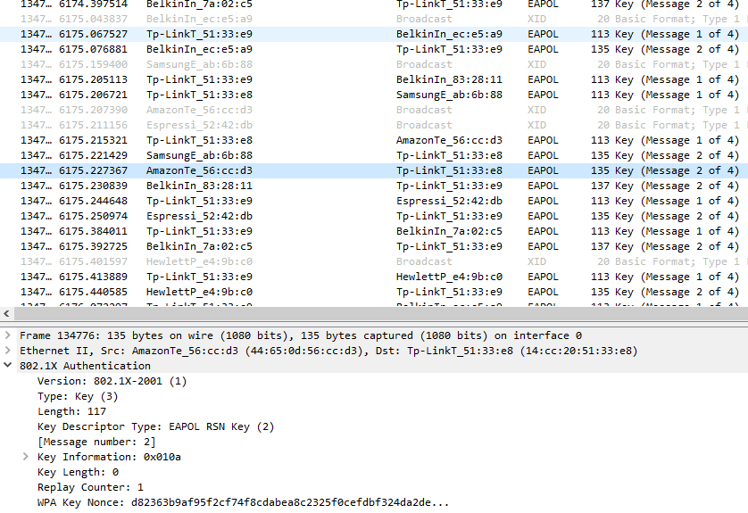
Sample Data
IoT open source data which contains PCAP traces:
A. Sivanathan, H. Habibi Gharakheili, F. Loi, A. Radford, C. Wijenayake, A. Vishwanath and V. Sivaraman, "Classifying IoT Devices in Smart Environments Using Network Traffic Characteristics", IEEE Transactions on Mobile Computing, Aug, 2018.

Slide 10
Data Extraction and Transformation
The extracted data was transformed into segments:
Attack: The data in benign state were tagged with 0 and during attack with 1.
Total length.
Length of selected network protocols.

Slide 11
Analysis Results

Slide 12
Conclusion
KNN and ANN machine learning models can be used to detect the DoS attacks in IoT networks.
ANN performed the best among all the four models achieving an accuracy of %96 with precision of %86 in detecting attacks.
This result encourages further research to evaluate DoS detection in real-world IoT networks using ANN.

Slide 13
Thank you!

