Slide 1

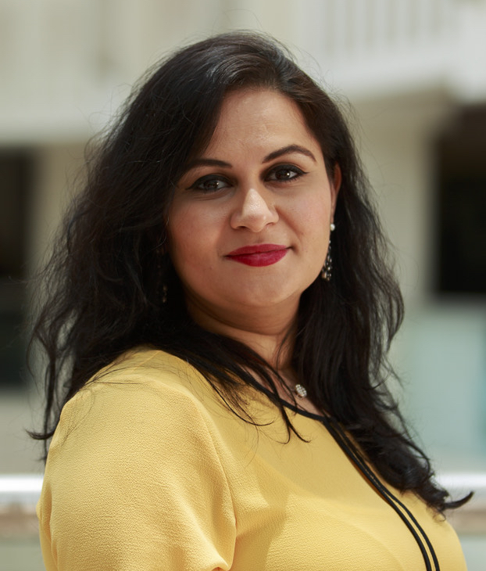
Setting the scene between “In Situ” & “In Context” teaching:
PhD. In Architectural Engineering
With a mere focus:
Interpretation of meanings between in “situ” and “in Context”
Sustainable Design and The Built Environment
Interpretation of Meanings in Interior Design Classes
Presented by: Dr. May Al Saffar
24th March 2021

Slide 2

Contents
An Overview of BSID Program
Observations Between Before and After
Research Question
Research Objectives and Methods
Data Collection and Analysis
Conclusion and Lessons Learned
Recommendations

Slide 3




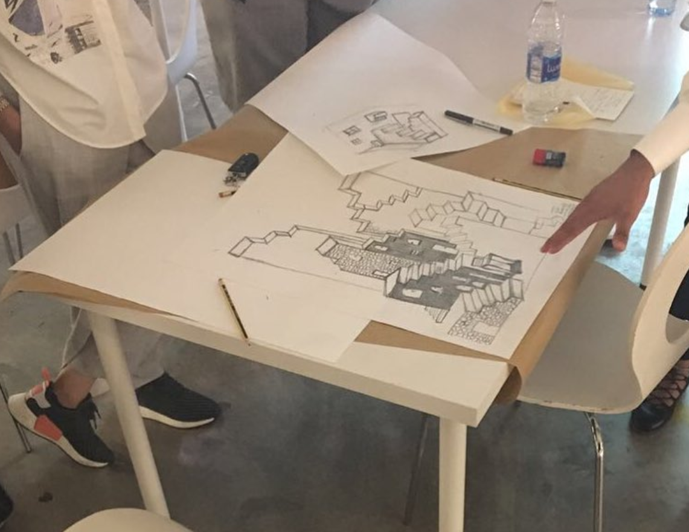
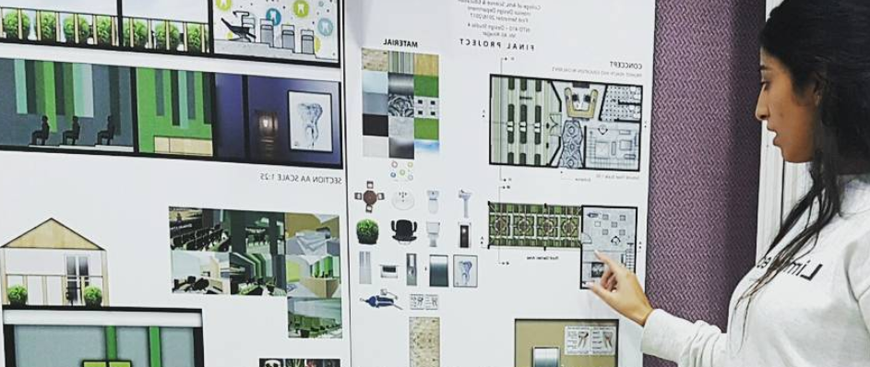


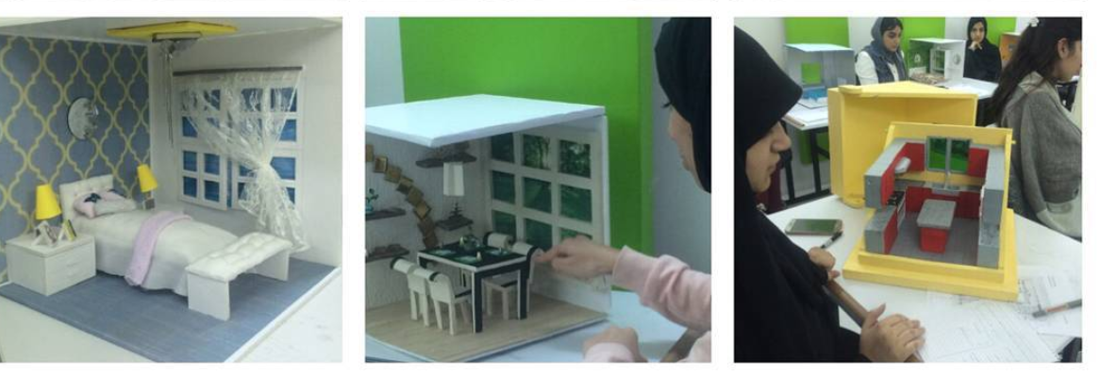
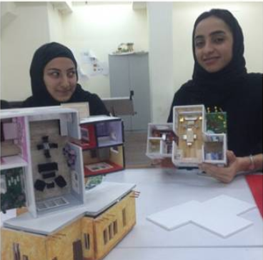

Interior Design Courses @ Ahlia University
Themes
Themes
Theoretical
Practical
Digital

Slide 4

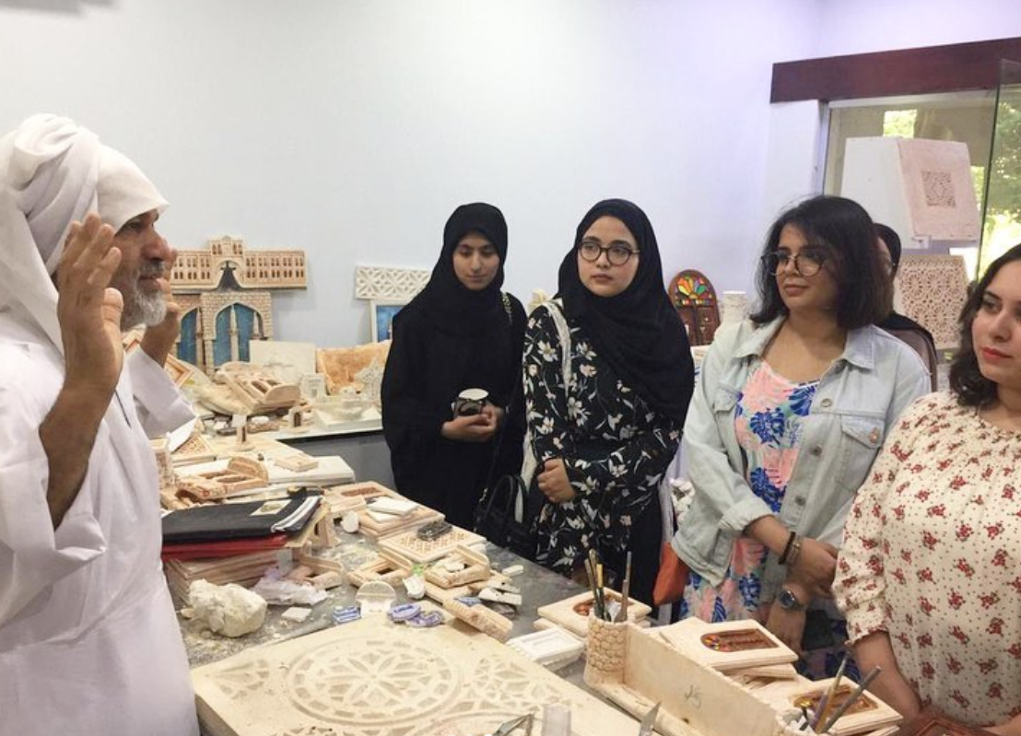
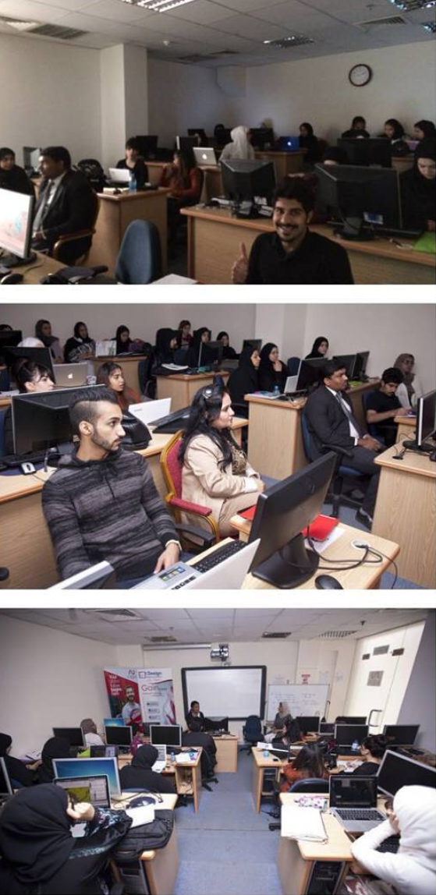
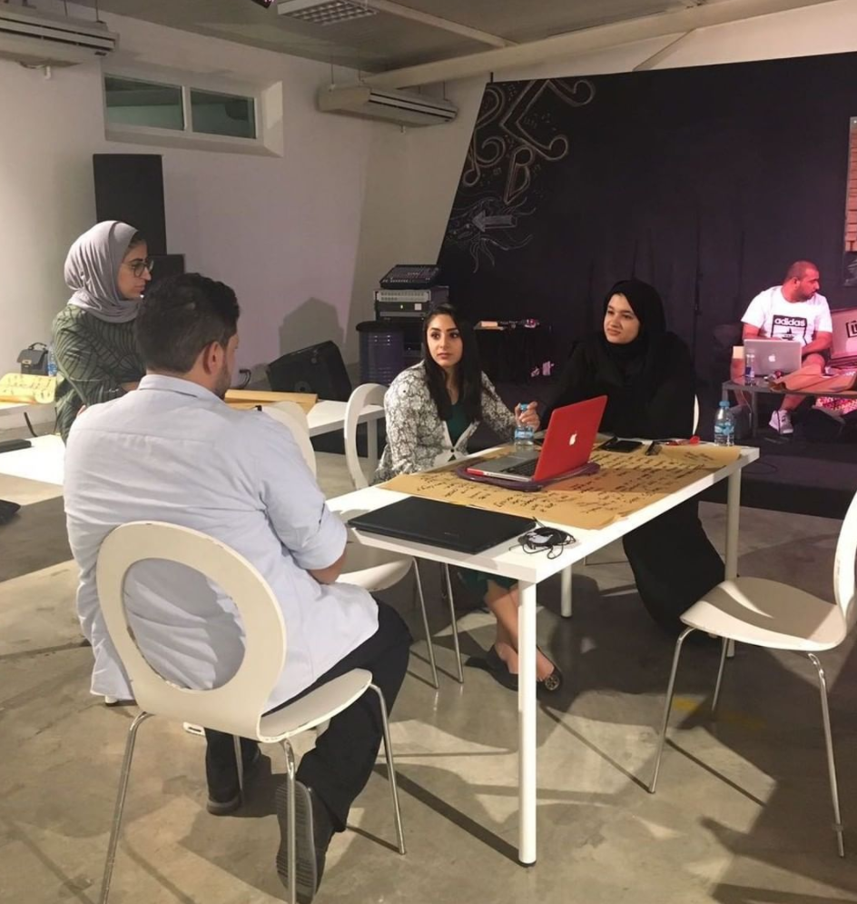
Learning & Experience Support
Site Visits
Internal / External Work Shops
4

Slide 5
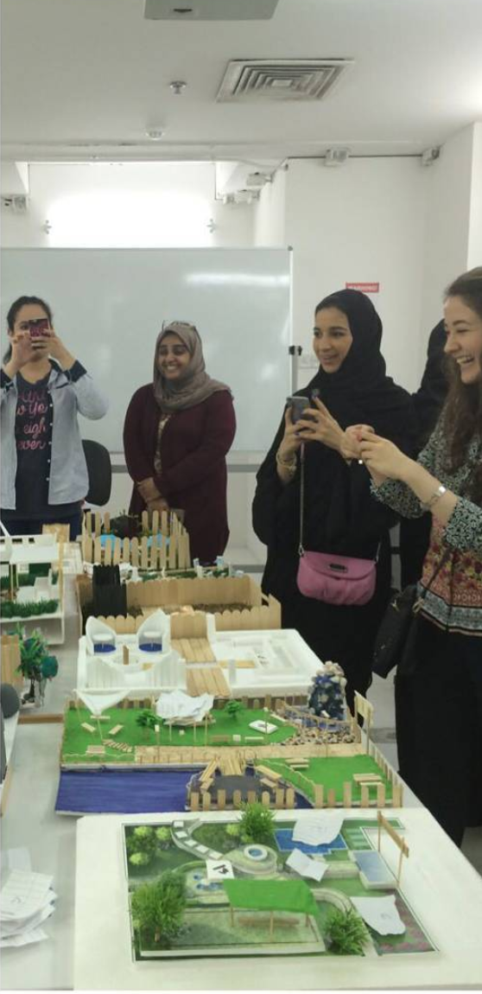
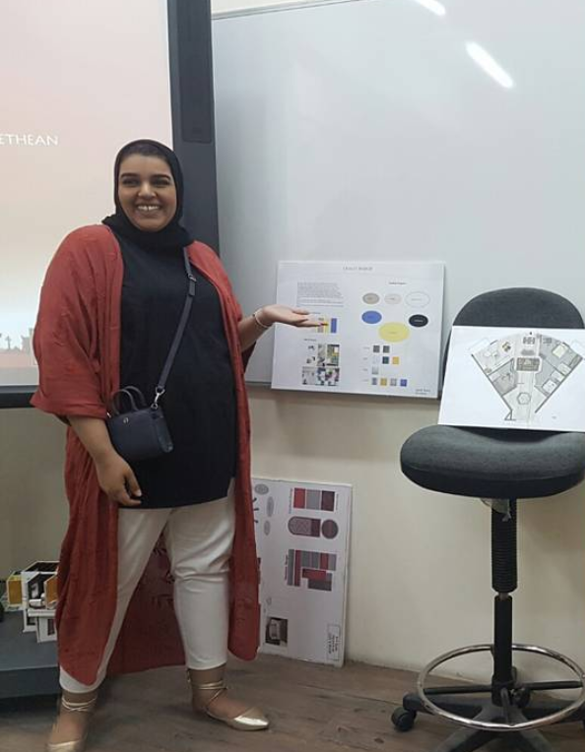
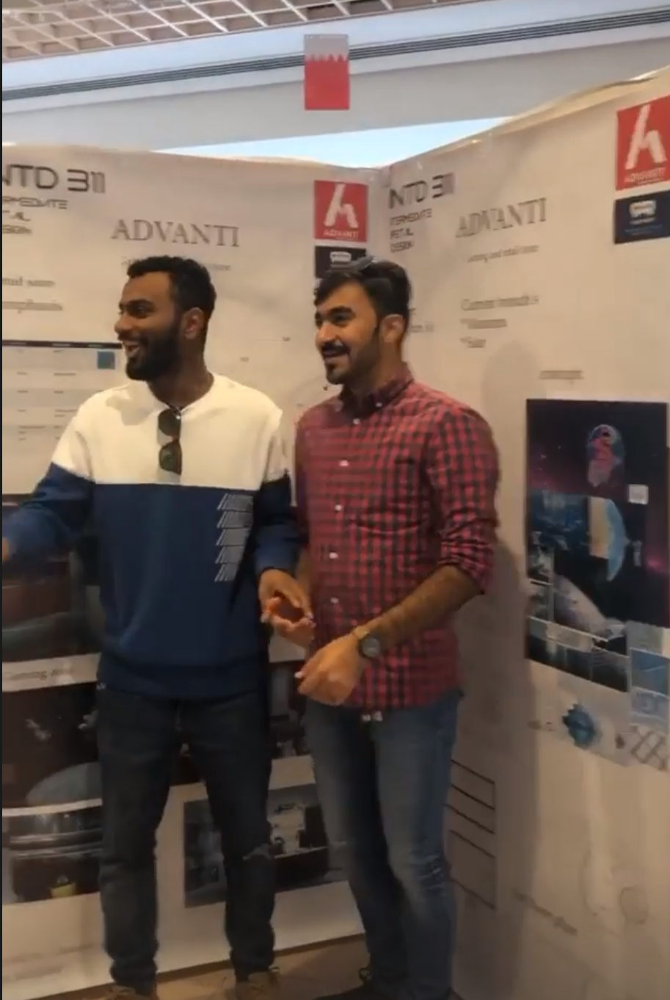
Few Years Back
Life Before Covid-19
Photographing
Presenting
Interacting

Slide 6
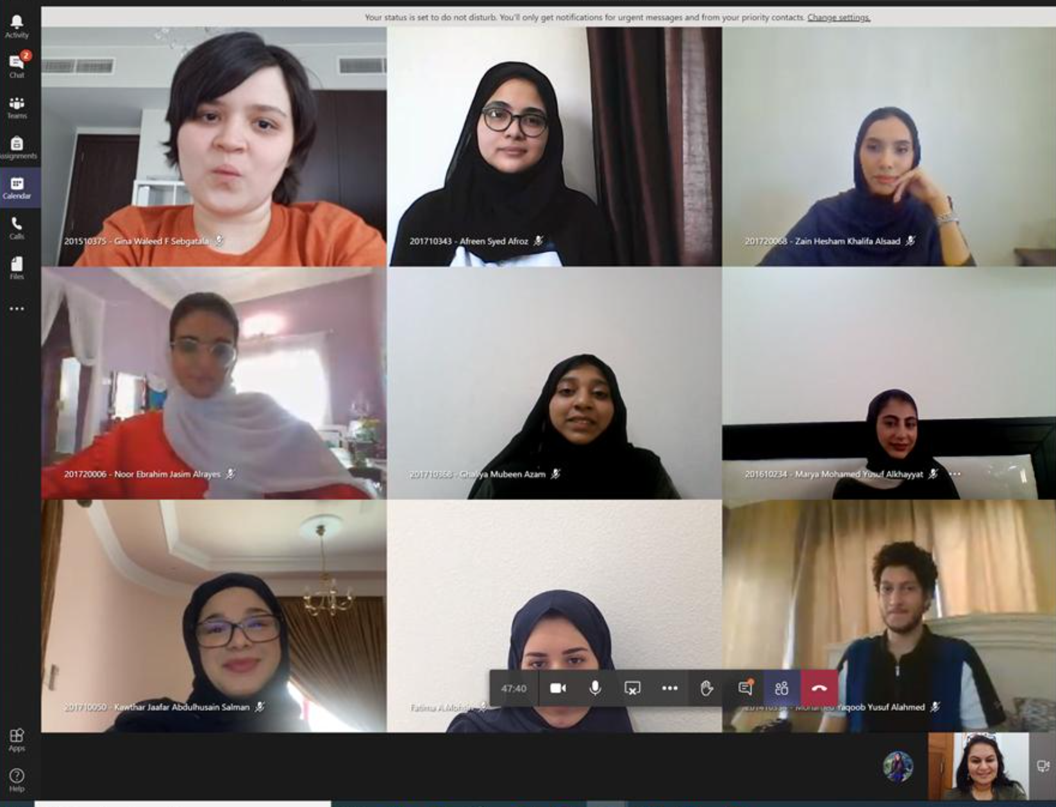
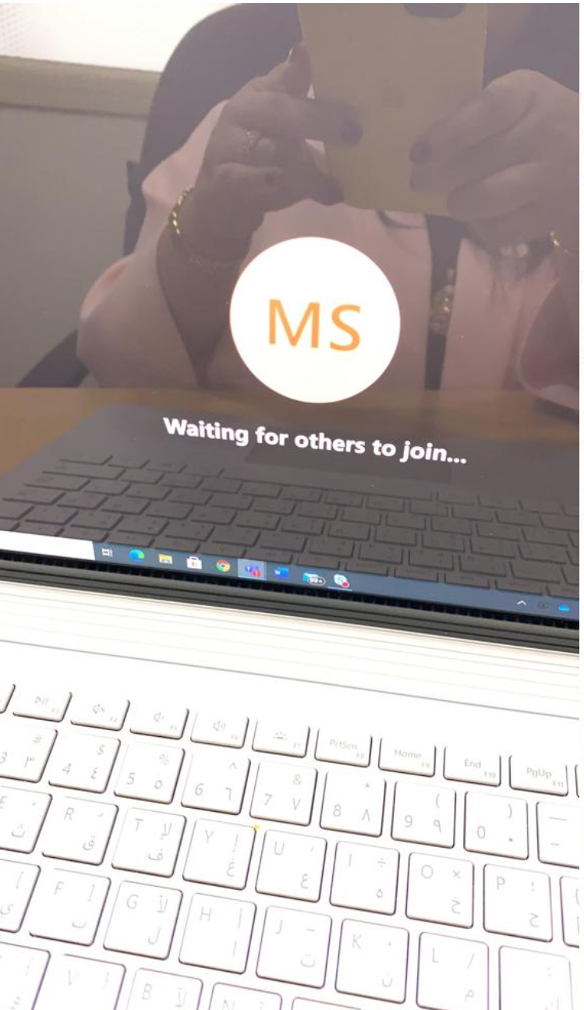
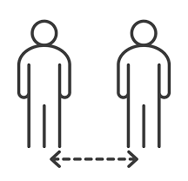

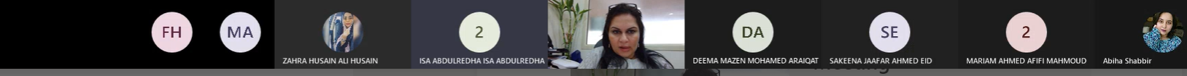
Today
Life During the Covid-19
Once Upon time
My everyday struggle
All the time

Slide 7

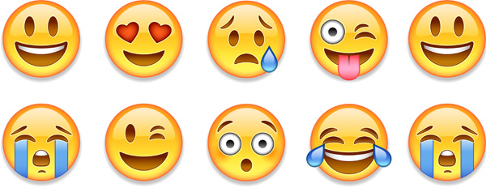
Reflection of CASE
Any Differences??!!
How does meaning-Making Happen?
Before
After
Notes:
Slide 07_
As the meaning making is at the core of this debate. [in the context of historic sites and their HSIC]
Besides the literature, 2 reference case studies were explored - obviously validating these choices will be difficult, but they were selected for being well-known but also being places that I personally visited and experienced and they served to understand the practical configuration, relationships, features?? and their potential role in meaning making .

Slide 8
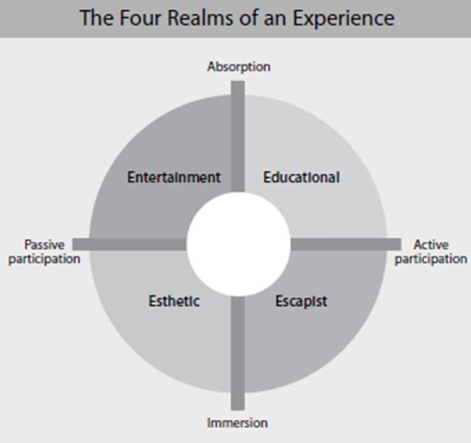
After My Initial Observation
Implantation
Between Past & Present
What purpose are we supposed to serve?
Entertainment
Education
Aesthetics
Escapist
What about the physical and social aspects?

Slide 9
“Meaning-Making”
Teaching has become more challenging than ever
Face to Face
Remotely
How does meaning-Making Happen?
Notes:
Slide 07_
As the meaning making is at the core of this debate. [in the context of historic sites and their HSIC]
Besides the literature, 2 reference case studies were explored - obviously validating these choices will be difficult, but they were selected for being well-known but also being places that I personally visited and experienced and they served to understand the practical configuration, relationships, features?? and their potential role in meaning making .

Slide 10
Research Objectives
To evaluate physical relationships, features and applied learning strategies before and after pandamic
To explore students engagement and emotional experience approaches on Digital and/or Hybrid Learning
& Methods
Documentation
Since Sept. 2019
Satisfaction Survey (n=68)
Since Dec. 2020

Slide 11

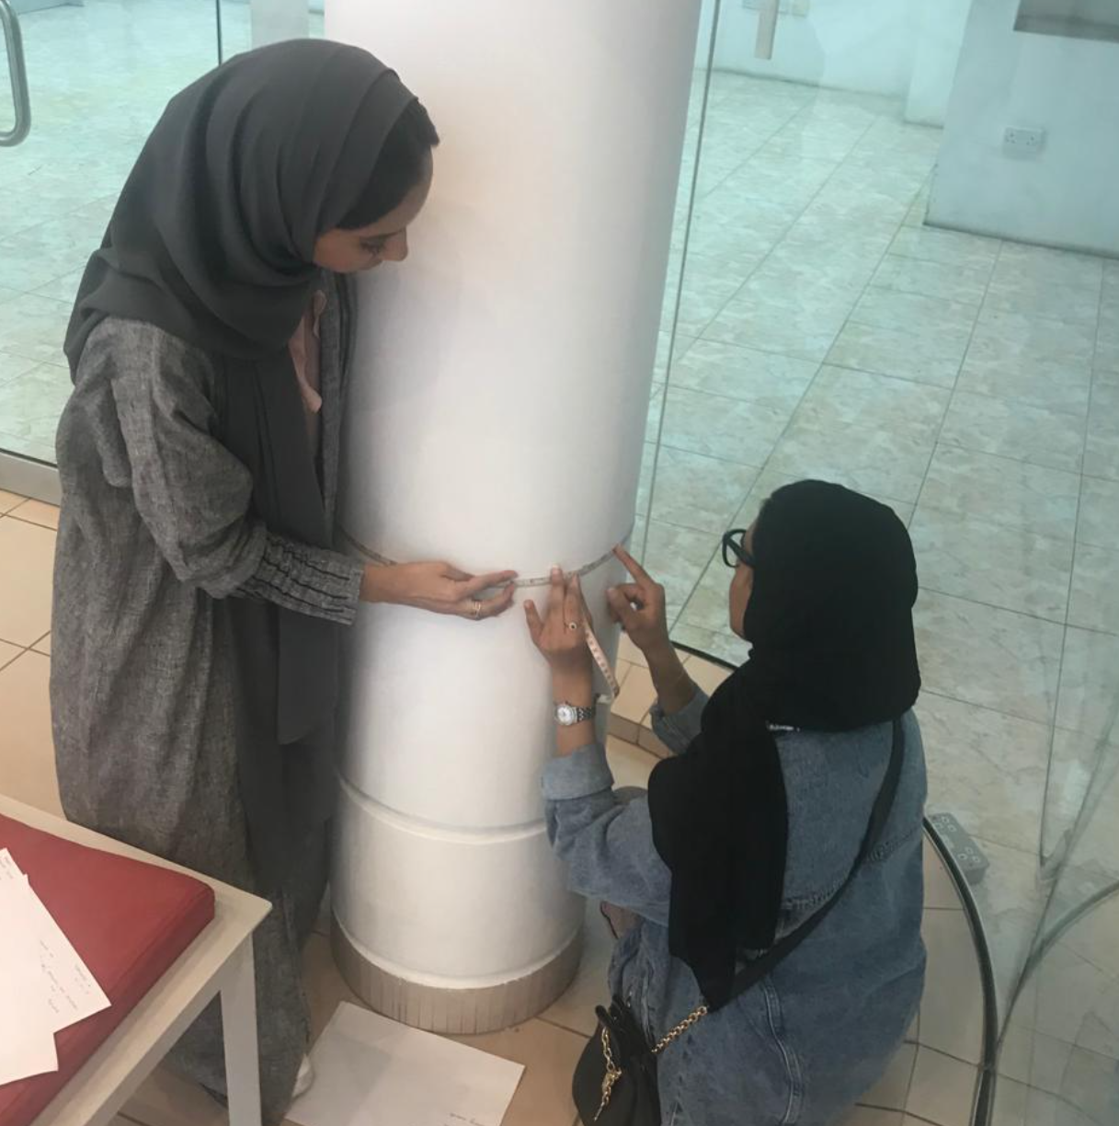
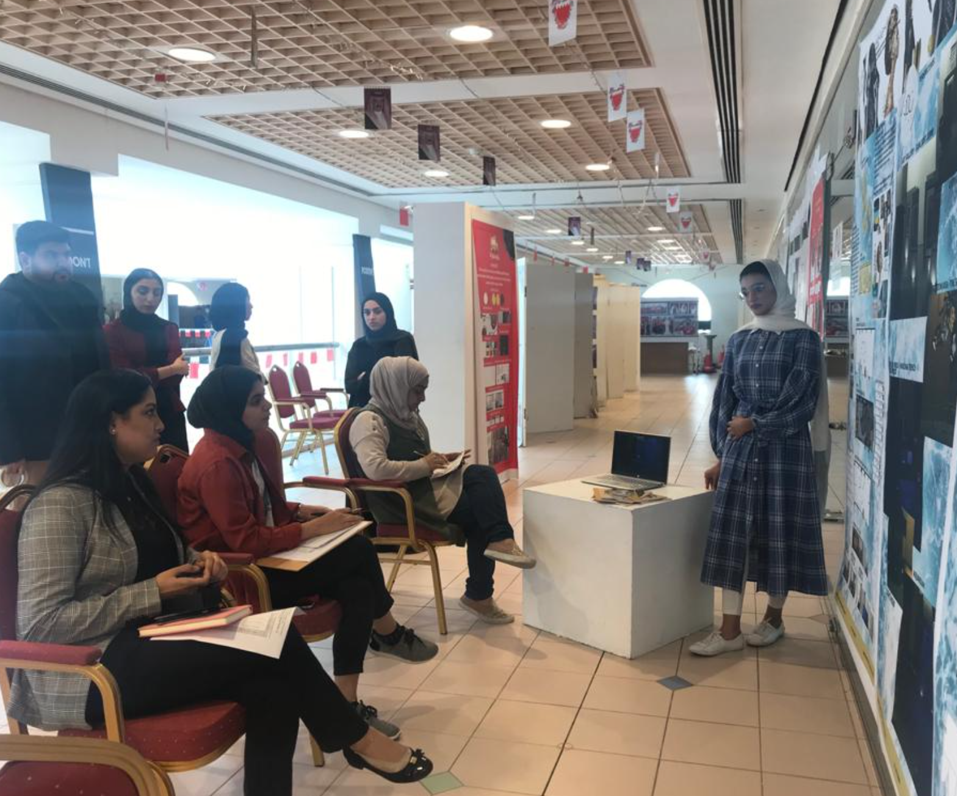
Meaning-Making?
Evidences
Promise: Enjoyment + Leaning
Experience
Confidence/ Responsibility
Physical relationships, features and applied learning strategies
Notes:
Slide 08
The SPECIALIZED literature identified 3 meaning-making variables which are: 1) historic site, 2) historic site interpretation centers, and 3) the interpretation strategies (in situ and in context).
In fact HOWEVER (UNFORTUNATELY?), very few studies have explored the site-related museums dual modes of interpretation, and their contribution to the visitor’s engagement and meaning-making.

Slide 12
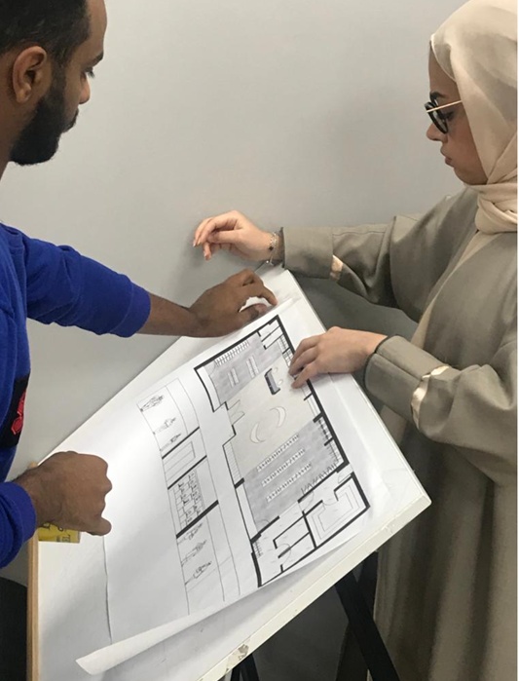
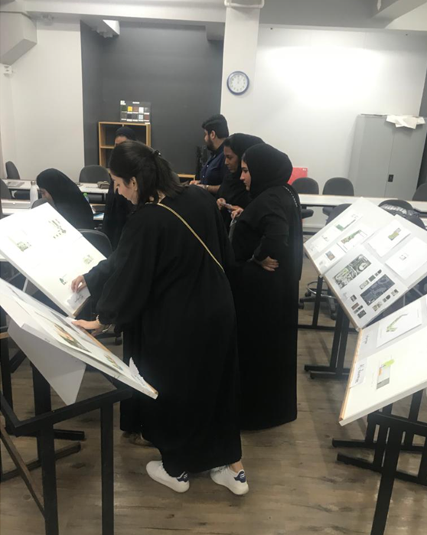
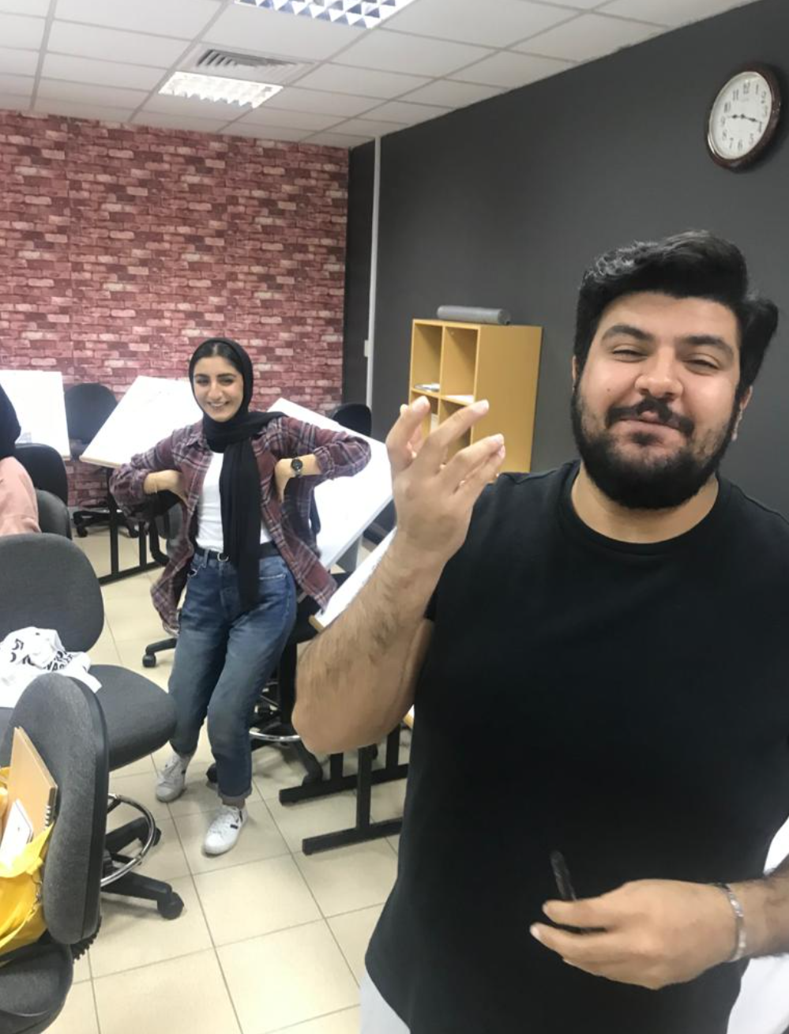
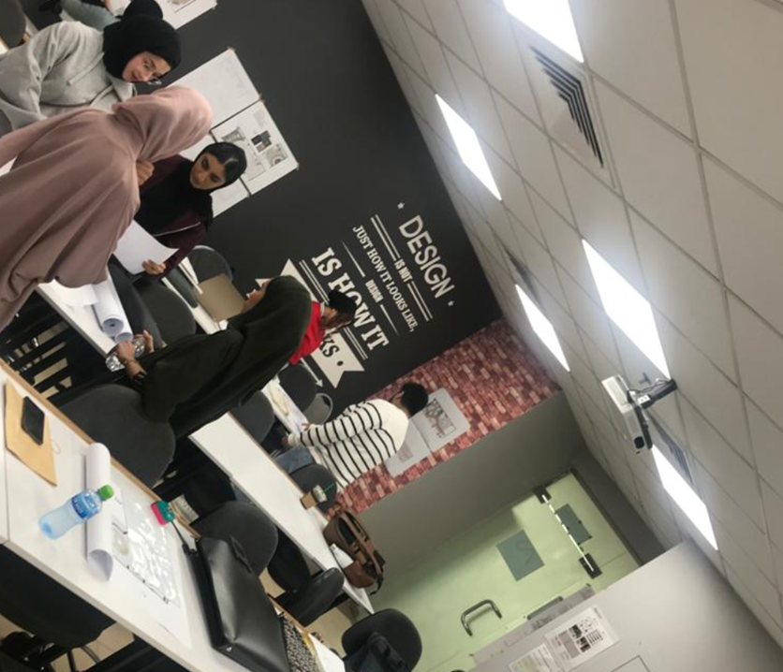
Meaning-Making? (cont.)
Evidences
Team Spirit
Competition
Wasting time
Brain Storming
Students engagement and emotional experience
Notes:
Slide 10
Ultimately these settings are intended to the visitors, and all visitors have their own motivation, Interests, Backgrounds …etc. THESE SETTINGS ARE DESIGNED FOR VISITORS TO EXPERIENCE. IN TURN, VISITORS COME TO SUCH SETTINGS WITH THEIR OWN MOTIVATION, INTERESTS, CULTURAL BACKGROUNDS AND OTHER VARIABLES. This is a suggestions but not must to take
When these variables CHANGE OR EVOLVE, they may have a different impact which lead to the following two inquires.

Slide 13
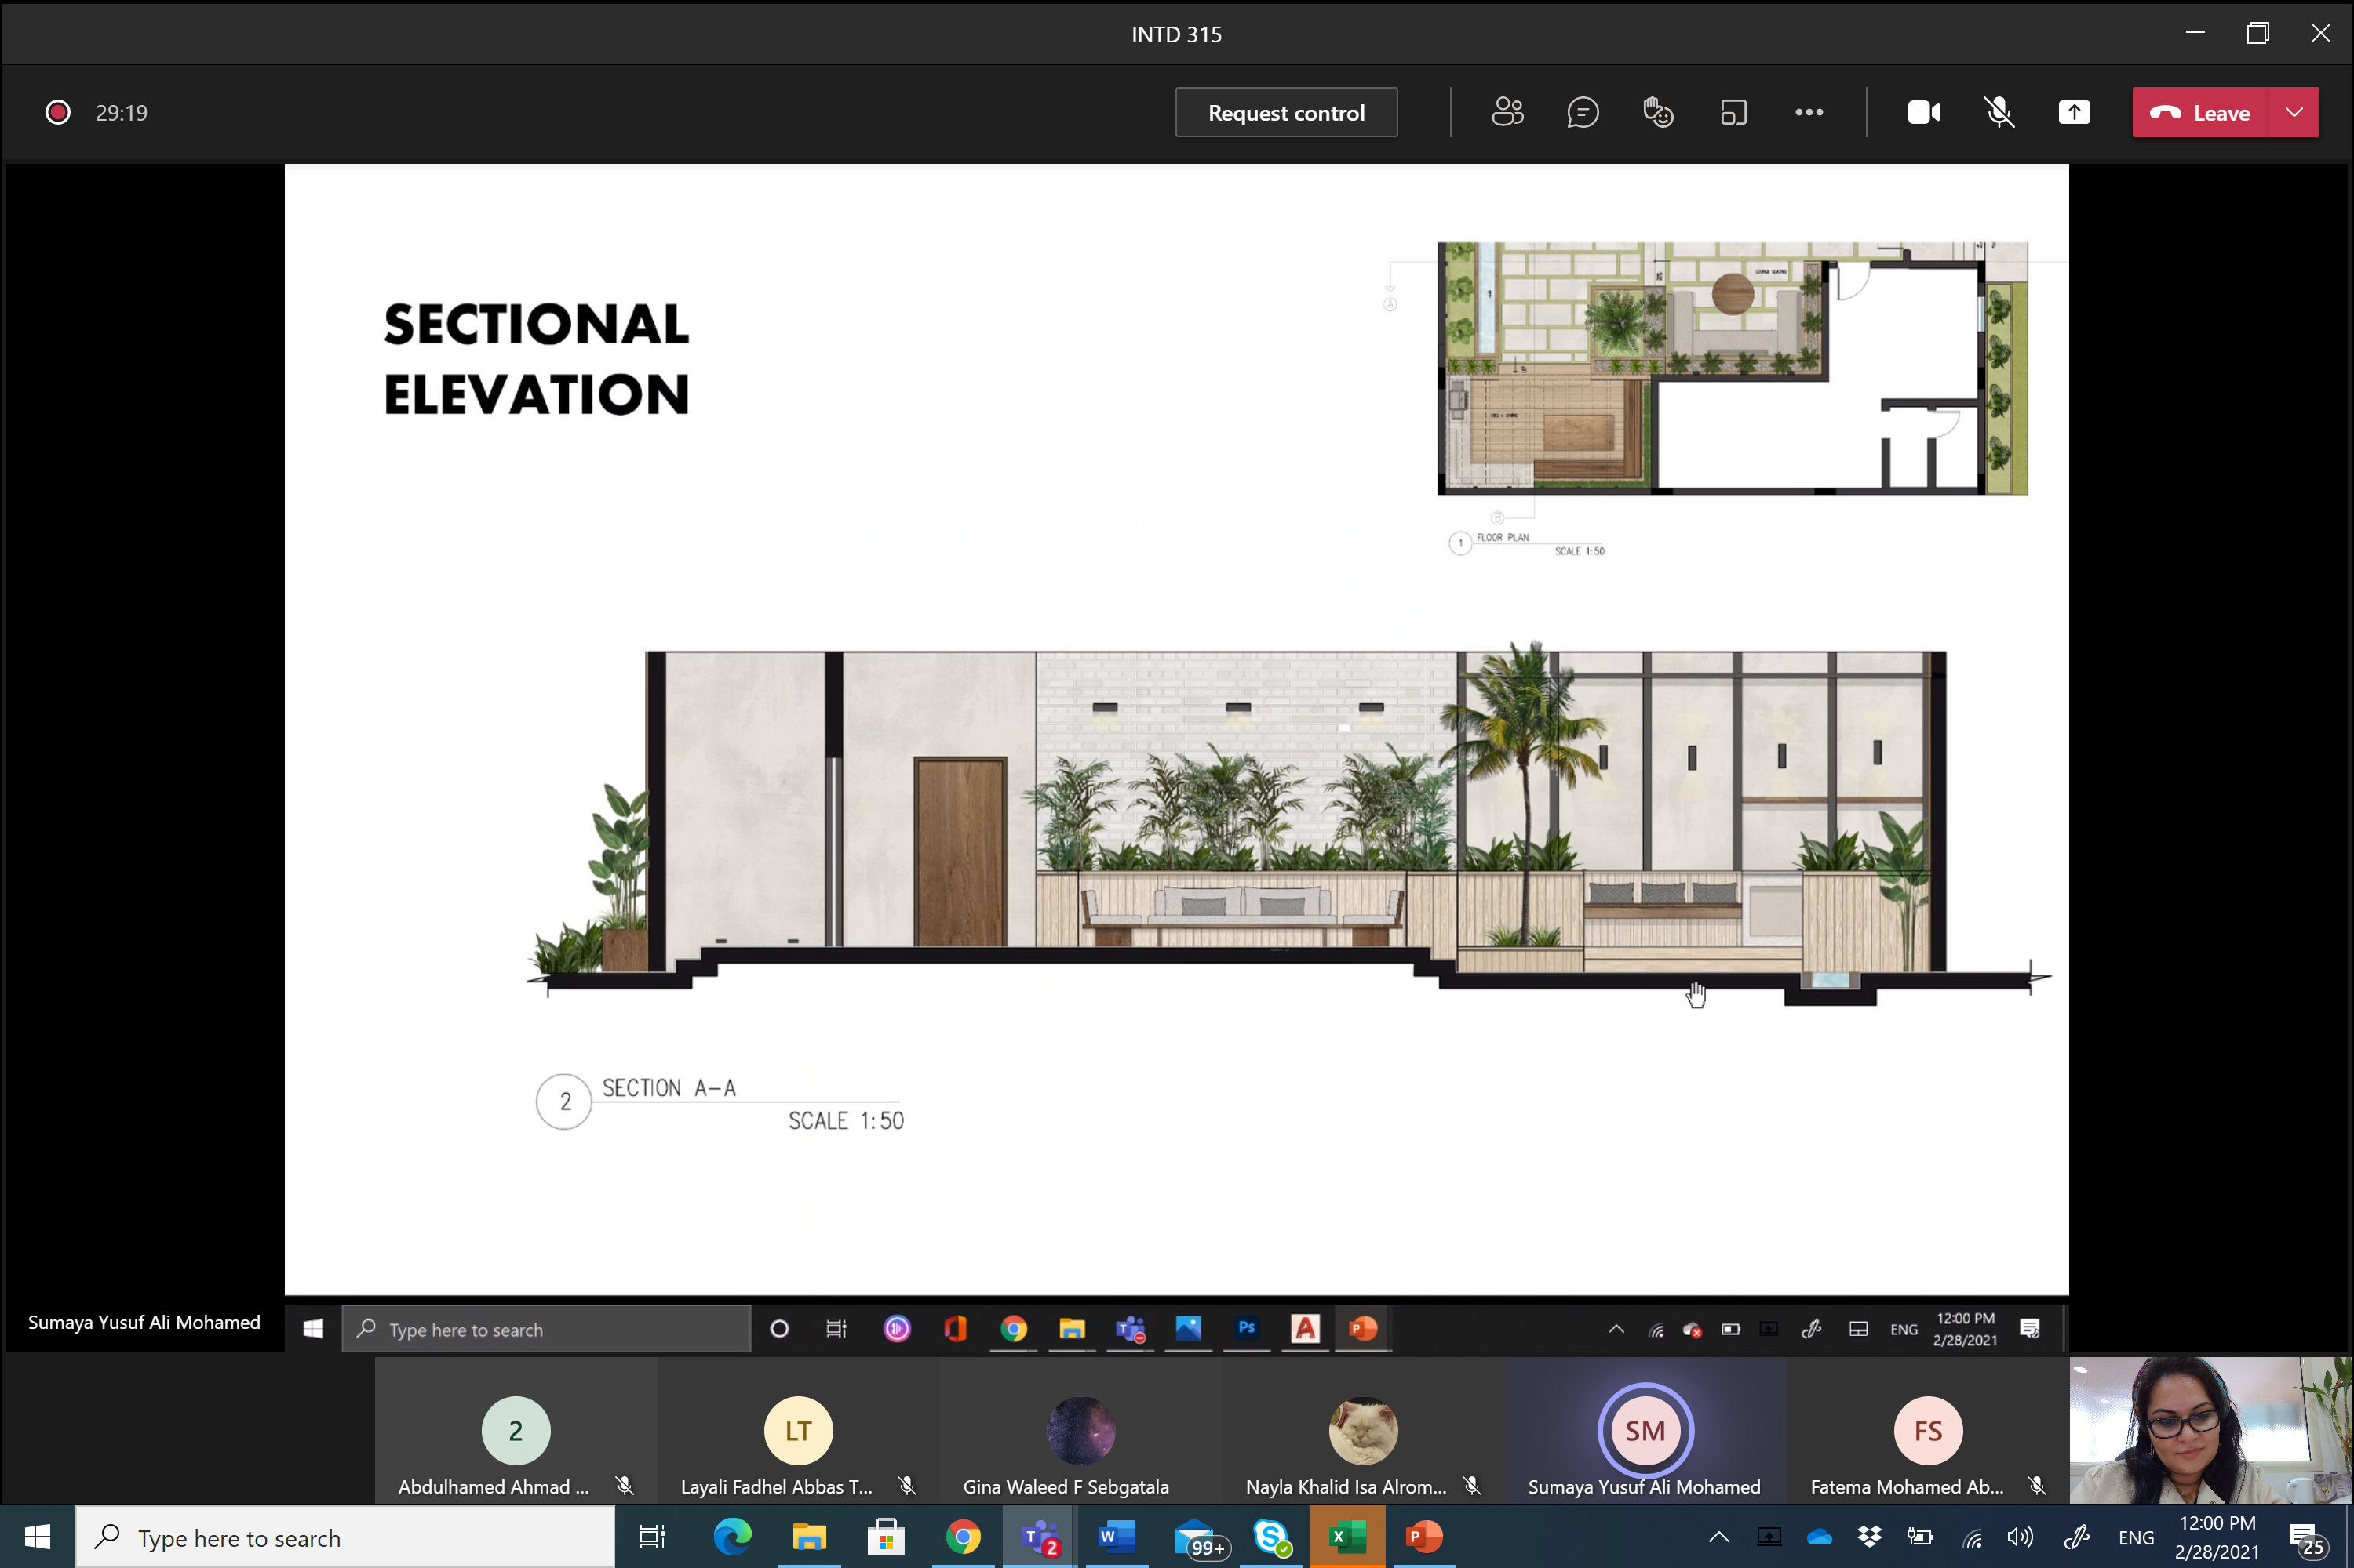
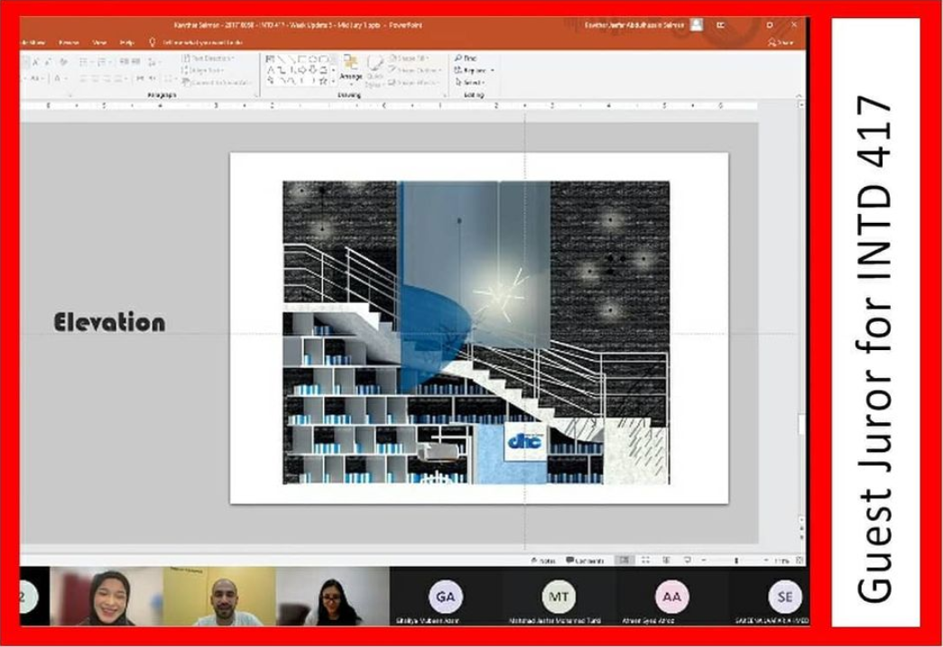


Meaning-Making? (cont.)
Evidences
Marketing
Advertising
Development
Emotional experience
There were 1.40 million social media users in Bahrain in January 2020.
84%
Notes:
Slide 10
Ultimately these settings are intended to the visitors, and all visitors have their own motivation, Interests, Backgrounds …etc. THESE SETTINGS ARE DESIGNED FOR VISITORS TO EXPERIENCE. IN TURN, VISITORS COME TO SUCH SETTINGS WITH THEIR OWN MOTIVATION, INTERESTS, CULTURAL BACKGROUNDS AND OTHER VARIABLES. This is a suggestions but not must to take
When these variables CHANGE OR EVOLVE, they may have a different impact which lead to the following two inquires.

Slide 14
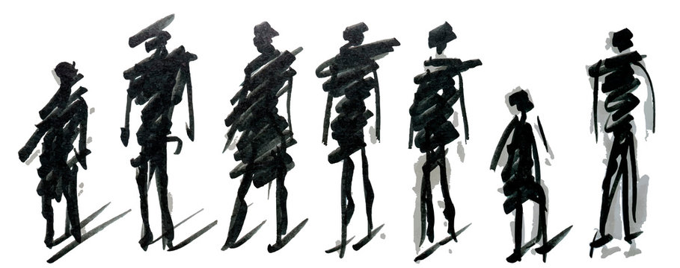
Meaning-Making? (cont.)
Thematic Analysis
We need more communication other than class hours
Students can't graduate as designers without knowing How to (XXXX)
Some Courses needs to focus on analysis of societies with regards to design of space.
المواد العمليه لا بد من عملهم عن قرب و الحضور للجامعه و لو لفتره او وقت معين مع الحفاظ على التباعد الأجتماعي
More group work and engagements in class.
Students Perception (n=68 Students)
ويستطيع الاستاذ ان يتأكد بأن الطالب فهم المادة التي يشرحها او لا
How to apply (XXX) in spaces and not just theoretical information that could be easily forgotten.
Theoretical modules need to be taught in different ways, حشو المعلومات
We need to see examples of previous work to know what is expected

Slide 15
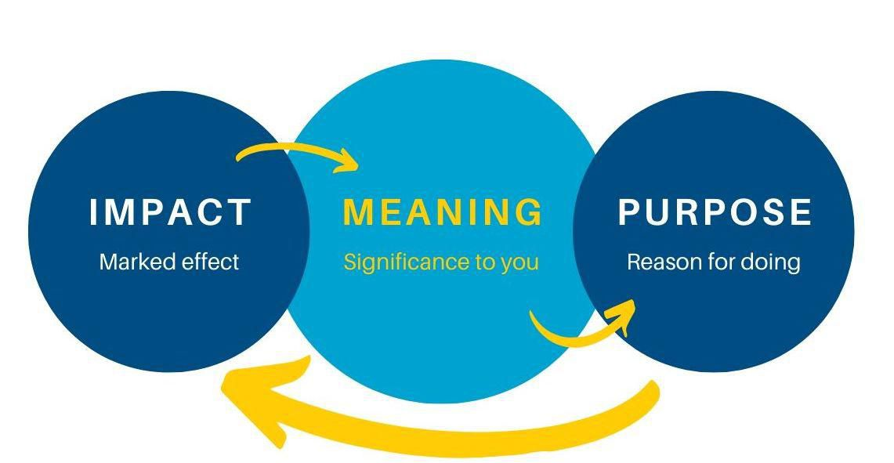
Background
Interests
Learning
Career
Needs
Students do not simply learn “about” something; instead, they also learn “to be” and “to do” something.

Slide 16
The Research Focus
How???
Meaning Making
Remote OR Digital Learning
Students
Engagement
“In Situ”
Notes:
Slide 10
Ultimately these settings are intended to the visitors, and all visitors have their own motivation, Interests, Backgrounds …etc. THESE SETTINGS ARE DESIGNED FOR VISITORS TO EXPERIENCE. IN TURN, VISITORS COME TO SUCH SETTINGS WITH THEIR OWN MOTIVATION, INTERESTS, CULTURAL BACKGROUNDS AND OTHER VARIABLES. This is a suggestions but not must to take
When these variables CHANGE OR EVOLVE, they may have a different impact which lead to the following two inquires.

Slide 17
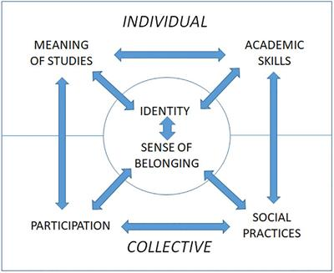
Personal significance
Academic teaching–learning practices
Perceived opportunities Offered
In Context
Knowledge acquisition
Self-concepts, values, attitudes, believes
Own meanings & preferences
In Situ and In Context
Model for student engagement.
Korhonen, V. (2012).

Slide 18

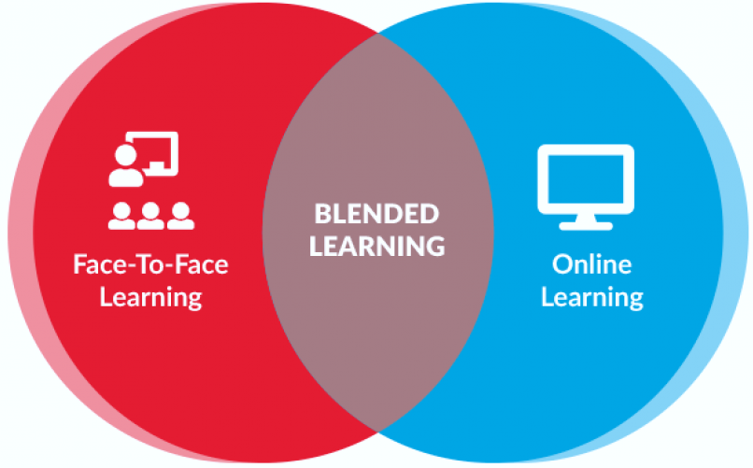
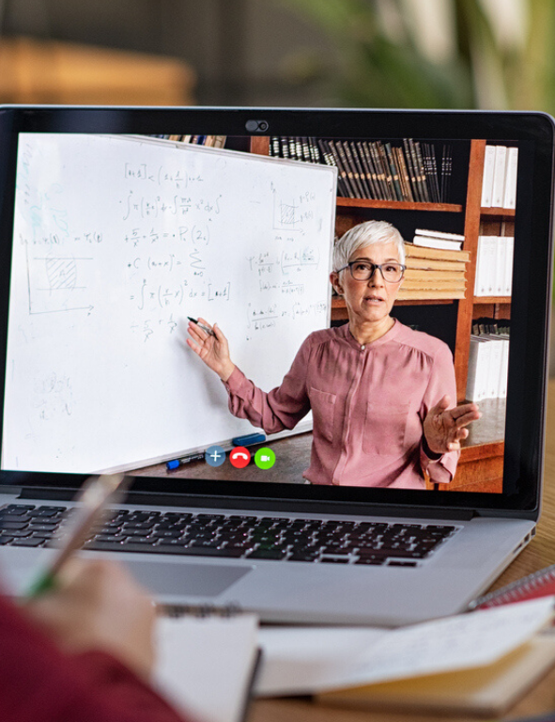
How is it going to look like Post Covid -19?

Slide 19
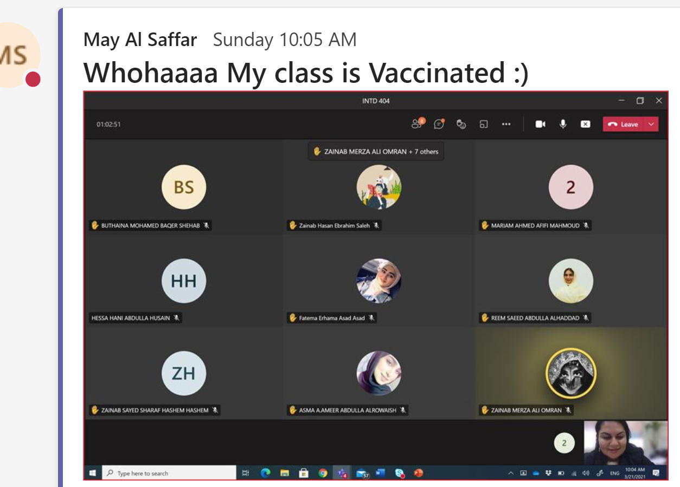
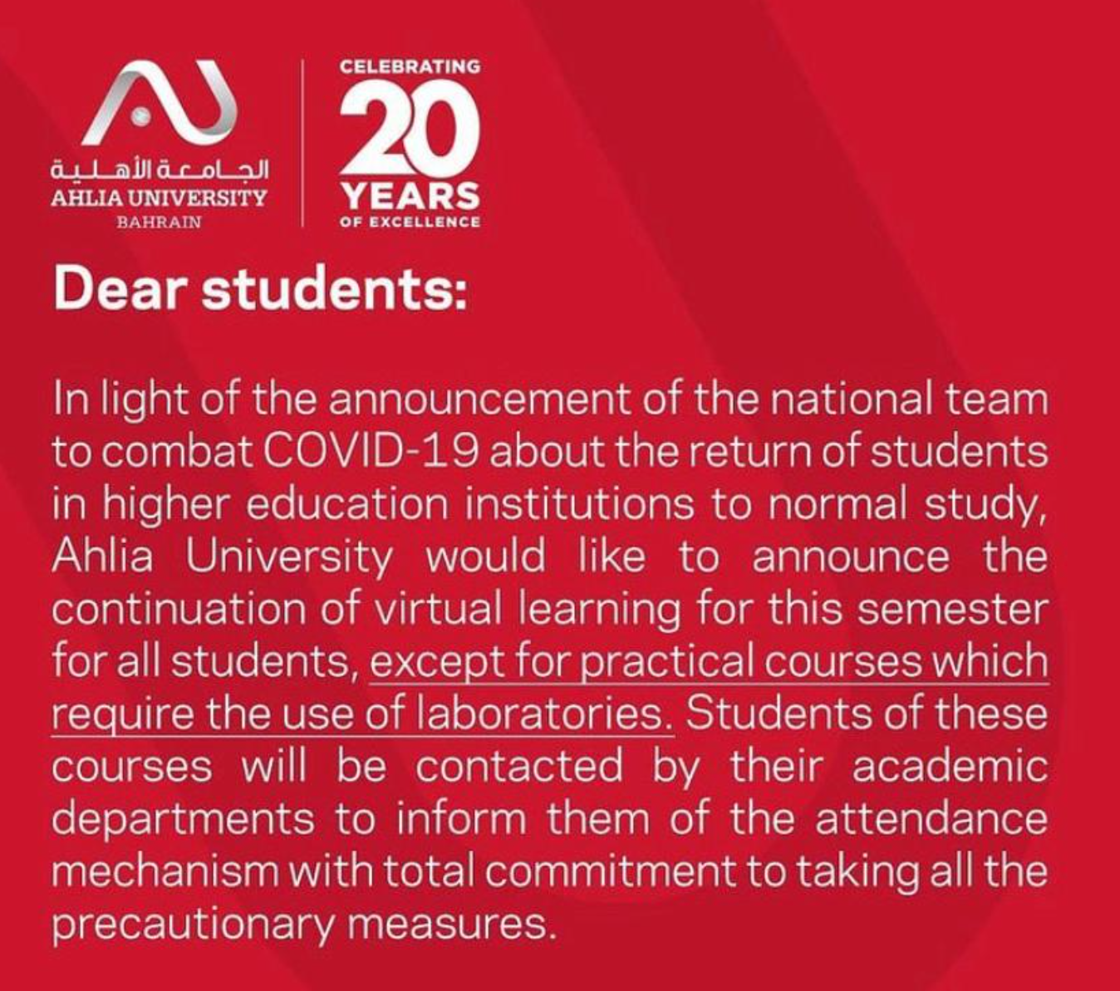
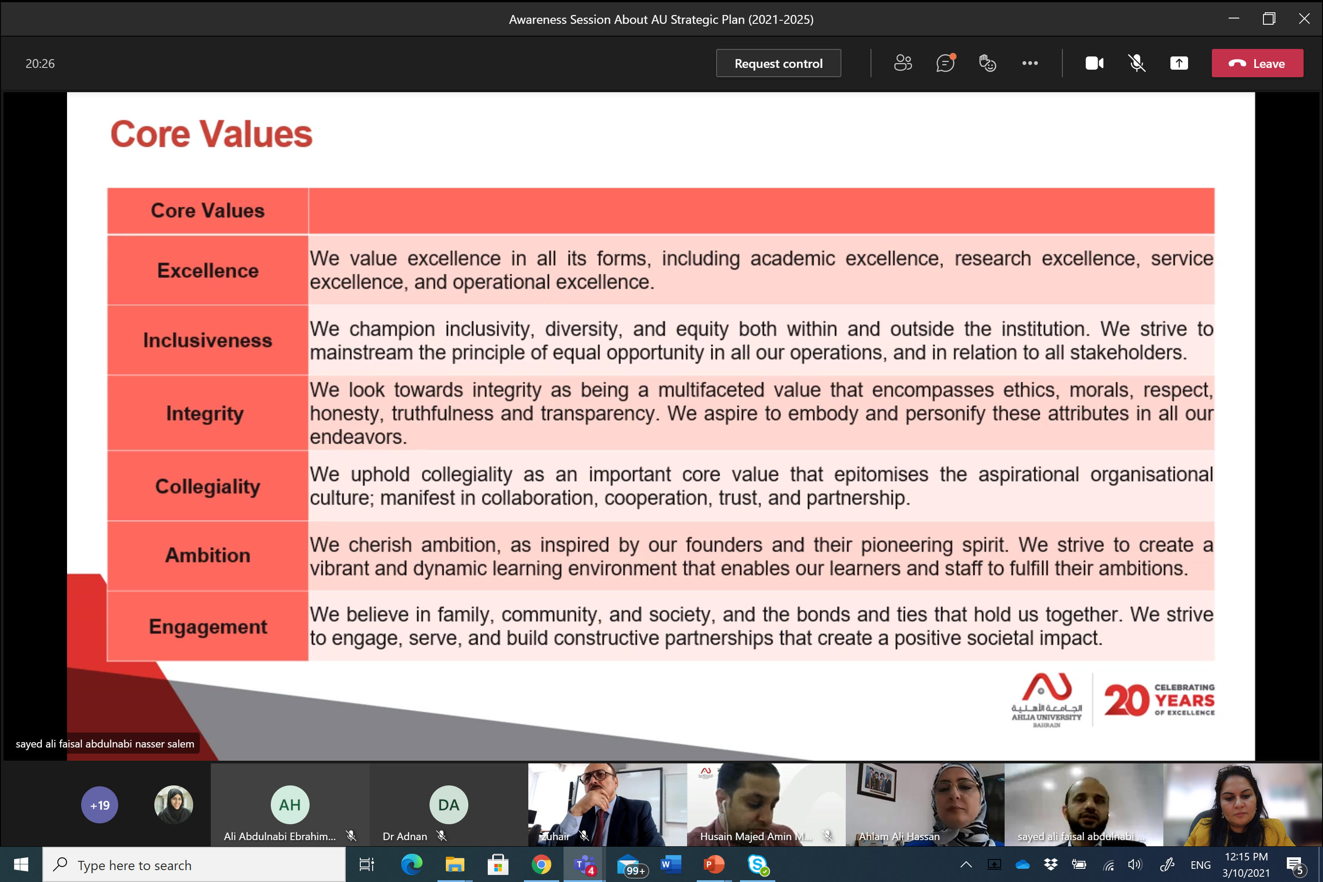
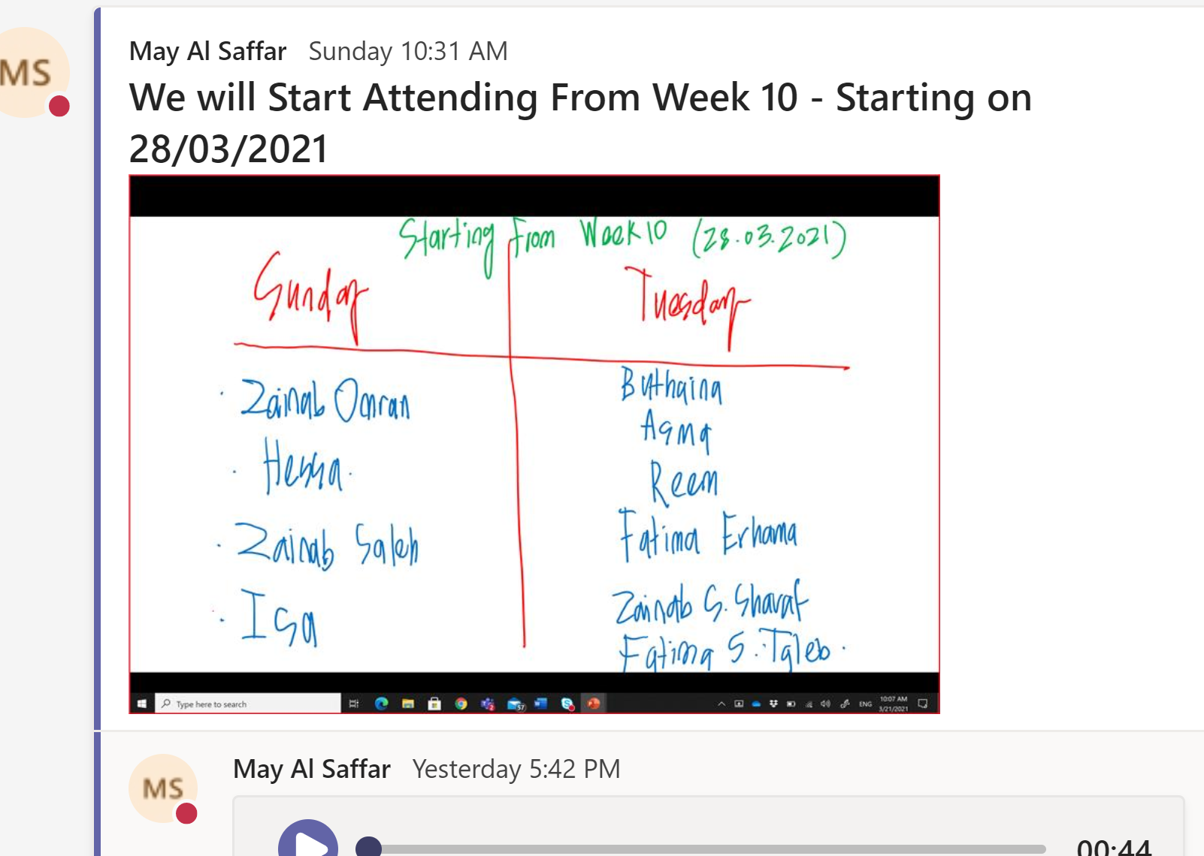
First Step …
AU Strategic Plan
But What Did We Learn?
Way of spreading awareness
(Who is vaccinated?)
We are aligned to the local and international efforts to safe health and survive education.
Response to their requests (addressed in the student satisfaction survey)

Slide 20
Lessons Learned From Covid-19 Crises
Validity: Teaching online is valid now and more trusted, Even for Practical Courses.
Flexibility: Students can attend the live class or recorded classes when needed.
Equal opportunity: All students have equal opportunity and freedom of listening and interacting.
Rapport: Teaching is not presenting slides, if more of social communication
Camera On: Turning on Cameras is not for Attendance, But for facial expression and status.
(social, cognitive and facilitatory)
Notes:
Slide 10
Ultimately these settings are intended to the visitors, and all visitors have their own motivation, Interests, Backgrounds …etc. THESE SETTINGS ARE DESIGNED FOR VISITORS TO EXPERIENCE. IN TURN, VISITORS COME TO SUCH SETTINGS WITH THEIR OWN MOTIVATION, INTERESTS, CULTURAL BACKGROUNDS AND OTHER VARIABLES. This is a suggestions but not must to take
When these variables CHANGE OR EVOLVE, they may have a different impact which lead to the following two inquires.

Slide 21
Still, we have many steps to go …
WE Want to do more than survive
(social, cognitive and facilitatory)

Slide 22
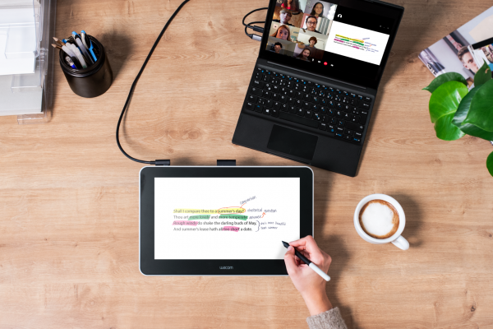
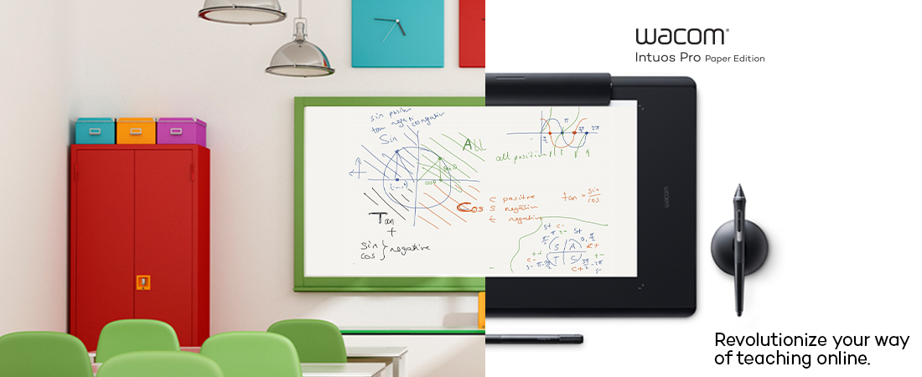
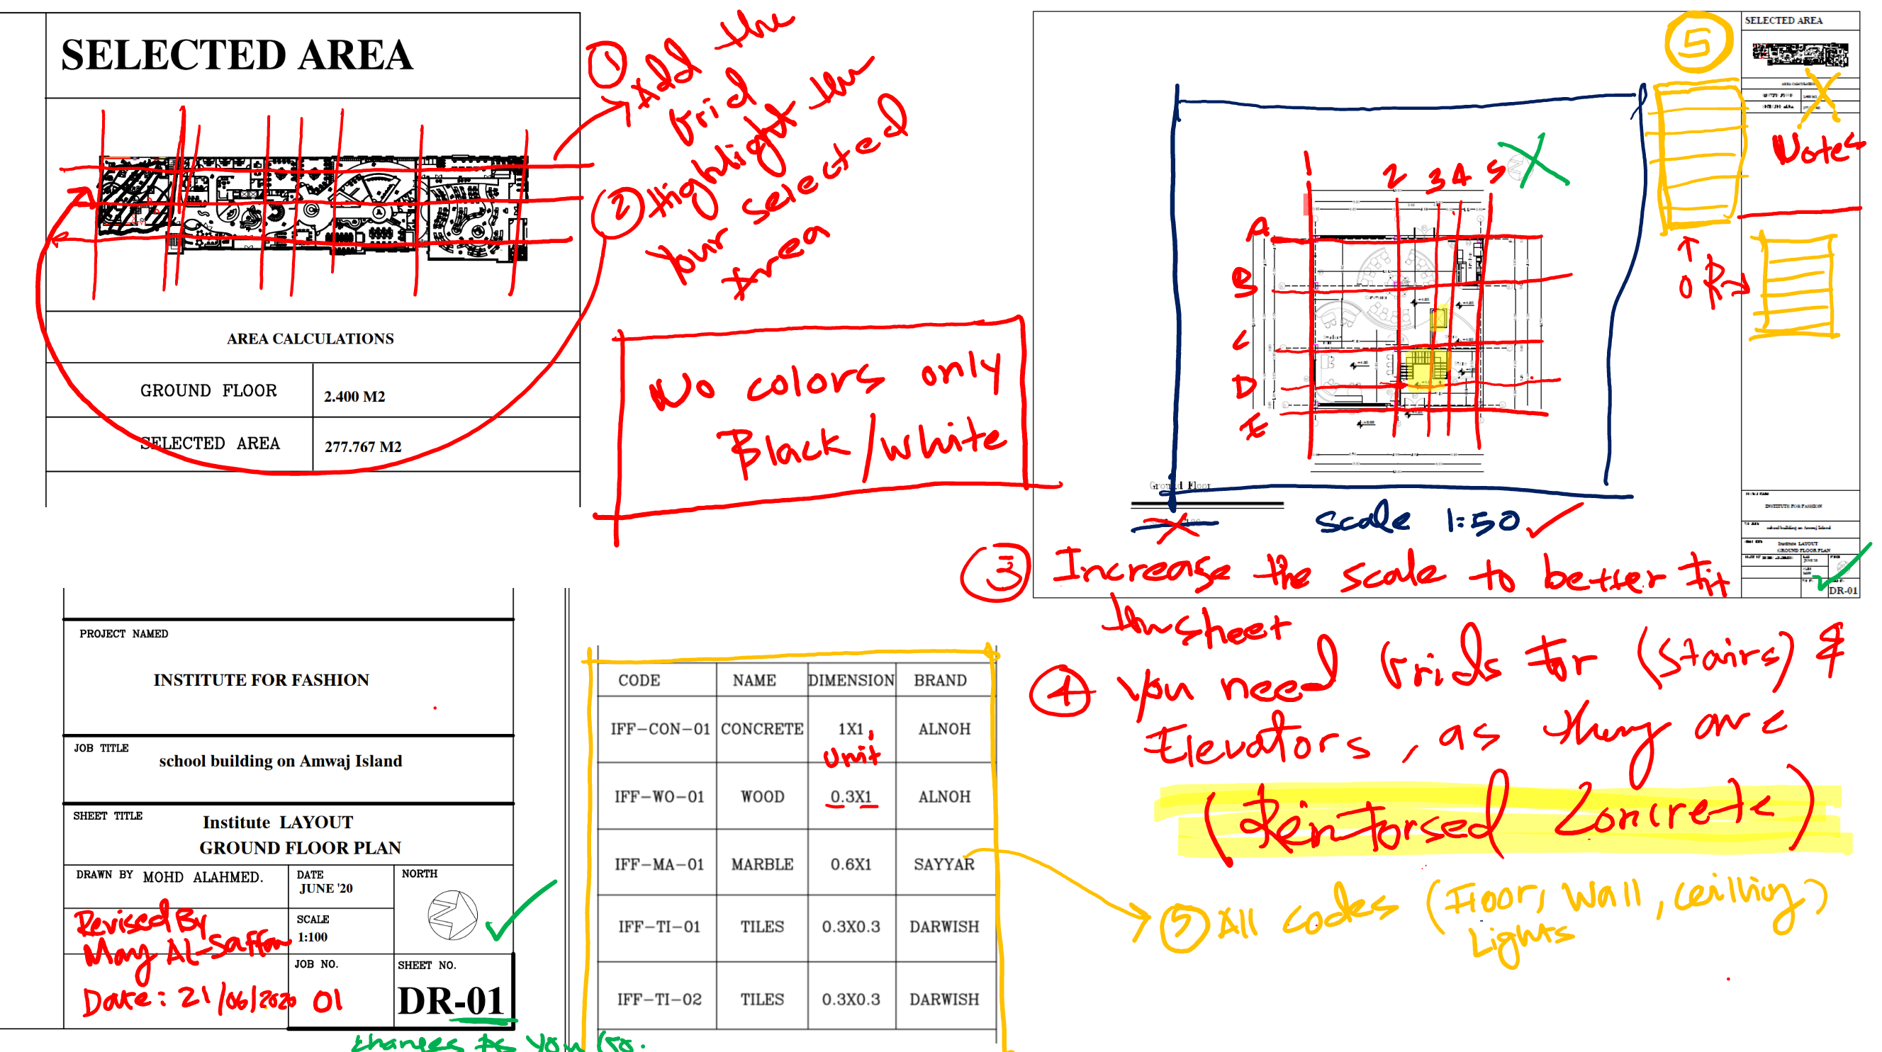
Recommended Meaning-Making Approach
Wacom : Advanced Digital, Art and Design
OR Pen Supported Laptops

Slide 23
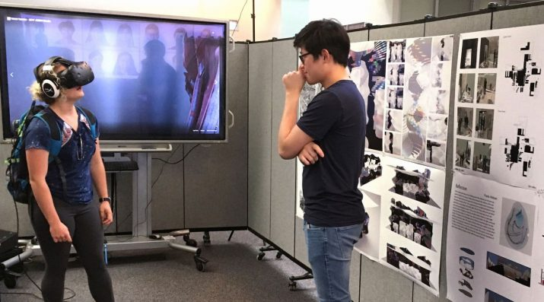
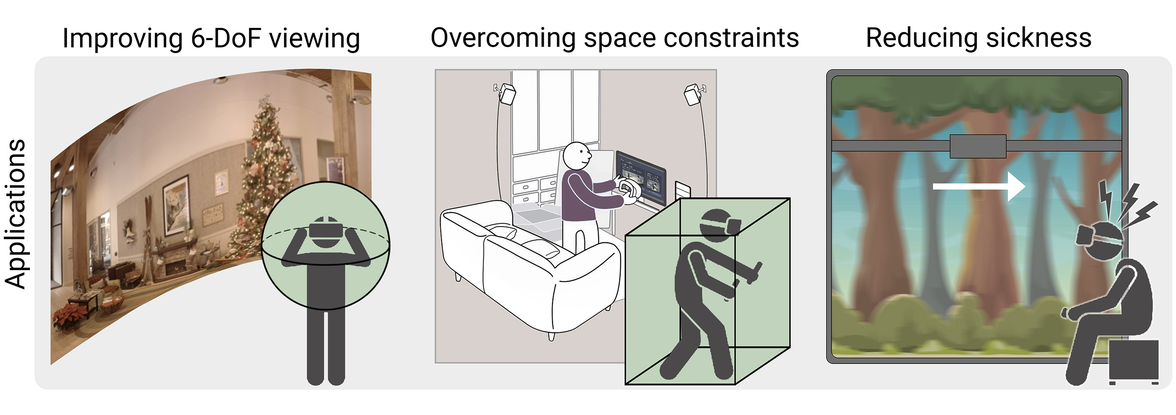
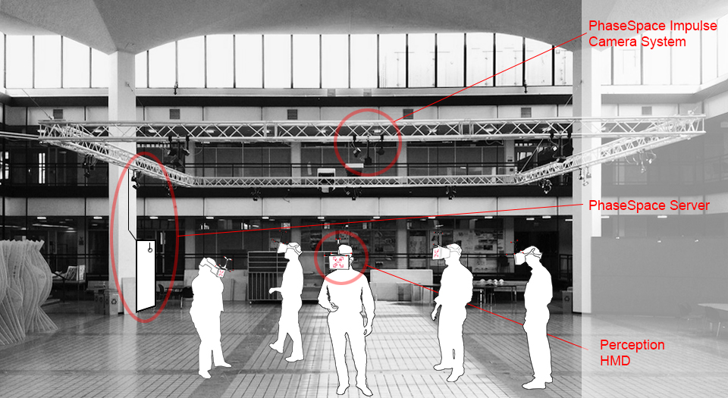
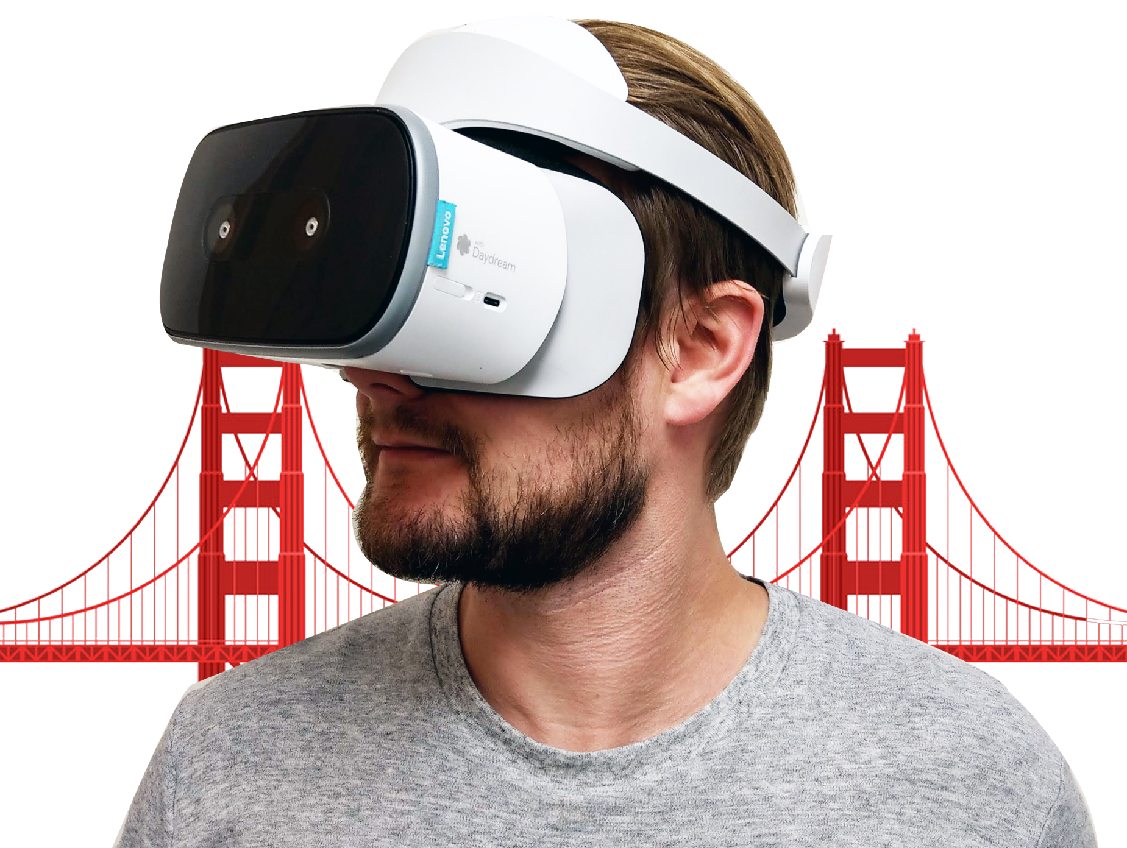
Recommended Meaning-Making Approach (cont.)
History & Theory Classes
Virtual Reality
Virtual Reality (VR) systems increase immersion by reproducing users’ movements in the real world.

Slide 24

Thank you!

