Slide 1

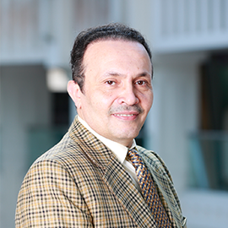
THE EIGHTH ANNUAL RESEARCH FORUM
DR. IMAD ASSALI
Associate Professor & Chairperson of Interior Design Department
23-24th March 2021
Evaluation of the Online Teaching of Interior Design Courses

Slide 2

Contents
INTRODUCTION
RESEARCH QUESTION
INTERIOR DESIGN DEPARTMENT AT AHLIA UNIVERSITY
RESULTS
CONCLUSION

Slide 3

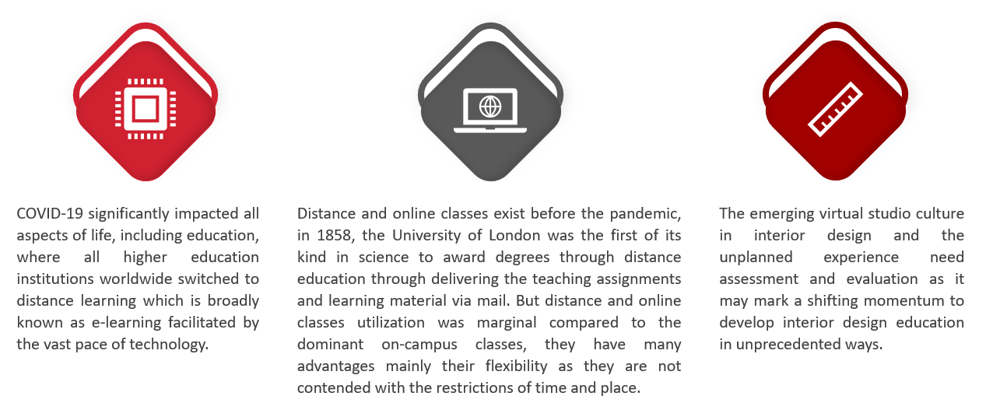
INTRODUCTION

Slide 4
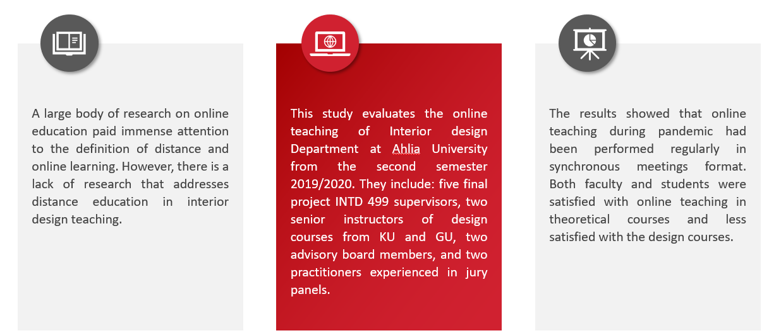

Slide 5
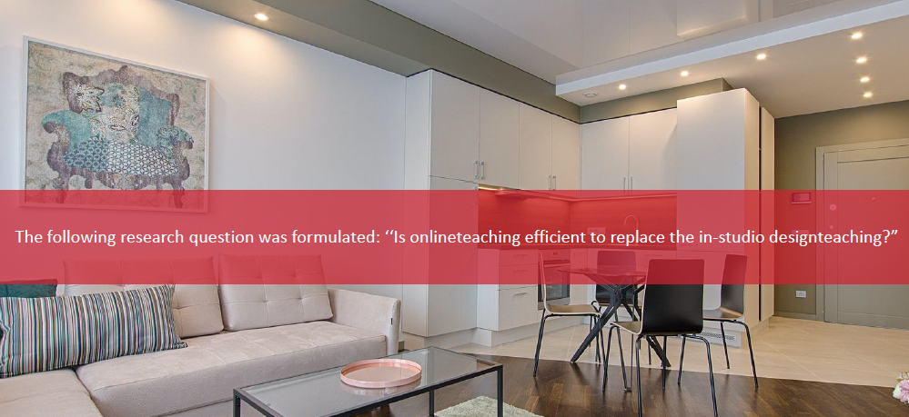
RESEARCH QUESTION

Slide 6

INTERIOR DESIGN DEPARTMENT AT AHLIA UNIVERSITY

Slide 7
RESULTS

Slide 8
RESULTS

Slide 9
RESULTS

Slide 10
RESULTS

Slide 11
CONCLUSION

Slide 12
Thank you!

