Slide 1

Customer Experiences Using Online Food Ordering and Delivery Platforms (OFODPs): An S-O-R Perspective
Dr. Maryam Almahdi
Dr. Noor Alsayed

Slide 2
Content
Introduction and purpose
Conceptual Framework
Methods
Results
Discussion
Conclusion

Slide 3
Introduction
OFODPs have witnessed a notable growth in recent years
Statista (2020): Global revenues of the online delivery market reached $107.4 billion in 2019 and are expected to climb to $182.3 billion by 2024.
The spread of the COVID-19 pandemic contributed even more demand for OFODPs with users in the US growing by 25.2% to 45.6 million
OFODPs are used by the customers to order meals and beverages which are then delivered to them.
This service offers customers convenience, transparency, and timesaving
More research on user’s behaviors and experiences using OFODPs, with the aim of informing the marketing perspective, is needed

Slide 4
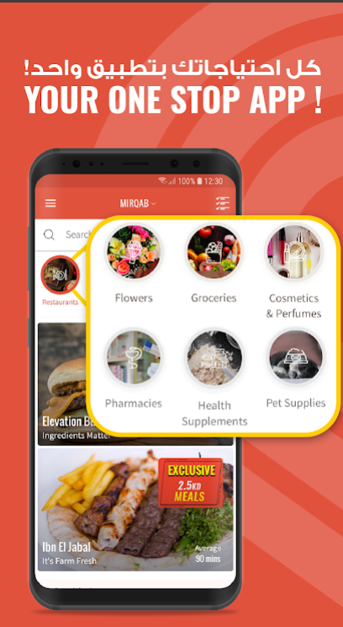
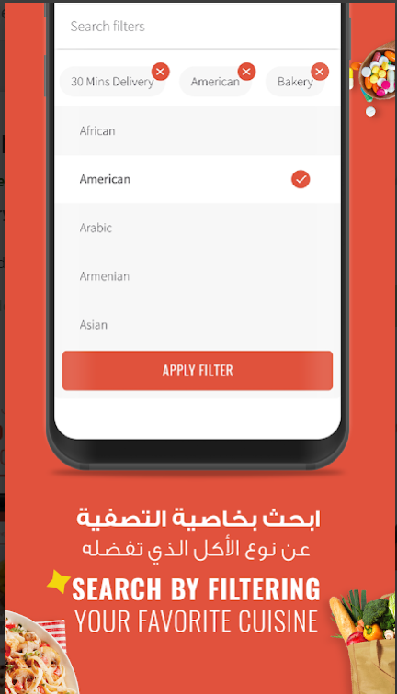
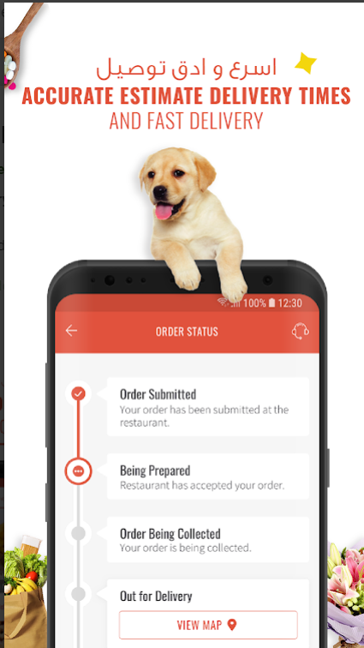
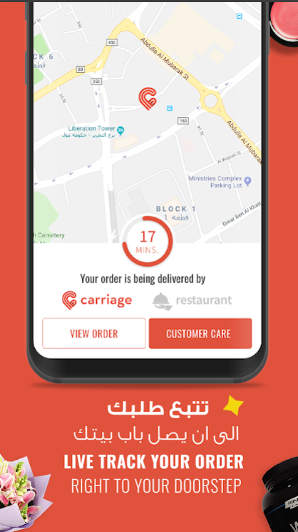
Online Food Ordering and Delivery Platforms (OFODPs)

Slide 5
Conceptual Model
Stimulus
Organism
Response
Usefulness
H1b
H1a
H1b
Content Quality
H2a
Satisfaction
Loyalty Toward App
Visual appeal
H3a
H3b
H4a
Social Presence
H4b

Slide 6
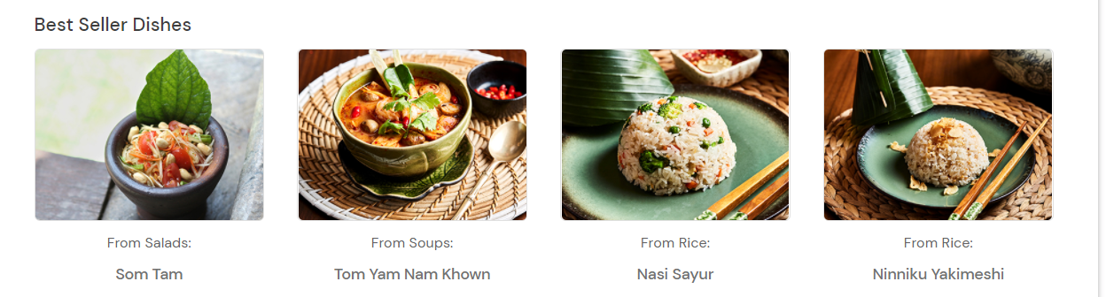
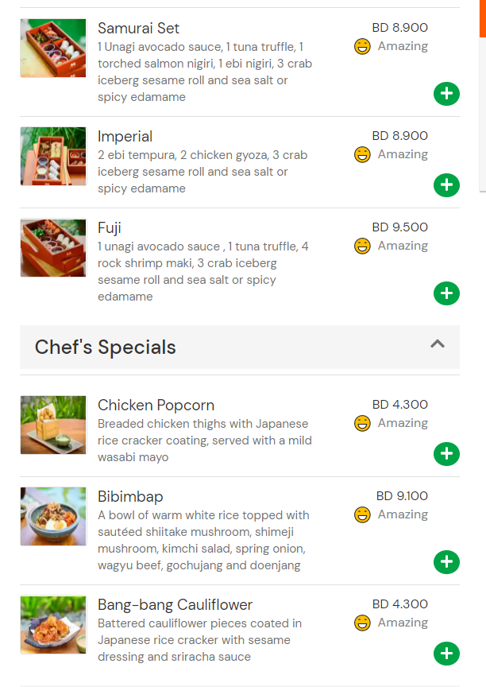
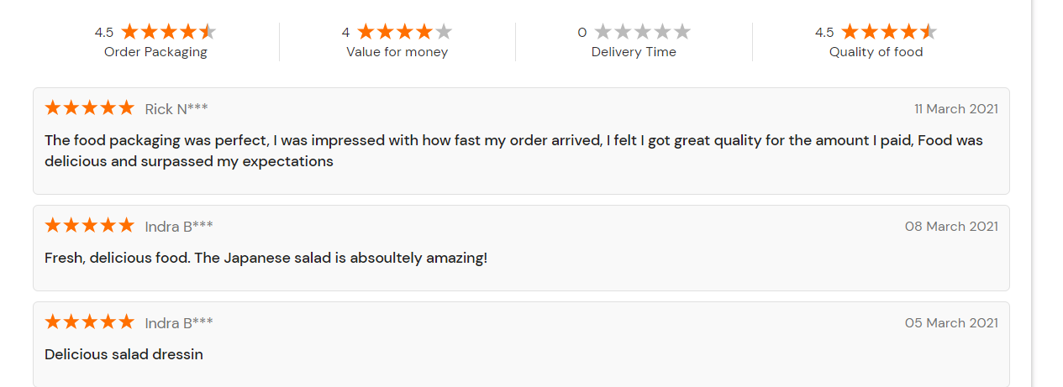
Content Quality
Visual Appeal
Social Presence

Slide 7
Methods
389 participants (55.5% female and 44.5% male) acquired through convenience sampling took part in this study.
Undergraduate students between the ages of 18-25 years were admitted to the study upon positively answering the question: ‘Do you use online food ordering and delivery apps?’
To test the hypotheses, an online questionnaire was created by adapting several measurements to reflect the model’s variables, using 5-point Likert scales
Notes:
Indeed, it was found that 80 percent of customers rarely leave a platform to a competitor’s, once they have signed up to it (ibid, 2016). This necessitates continued to research to uncover how to create the best OFODP-specific customer experiences that contribute to achieving customer satisfaction (Cho et al., 2019).

Slide 8
Survey Questions
Visual Appeal
  The app is visually pleasing
  The app is visually cheerful
  The app is visually interesting
  The app is visually appealing
Usefulness
  I find Talabat useful.
  Talabat saves me time.
  Talabat makes my life easier
Loyalty
  I prefer Talabat to other food ordering apps available.
  I’m going to order food using Talabat in my next purchase.
  I recommend Talabat to others (e.g., friends, family).
  I’m going to purchase more on Talabat than on other food ordering apps available
Content Quality
  The information regarding the meals that Talabat provides is accurate.
  Talabat provides the information that I need.
  Talabat provides quite professional information.
Social Presence
  A. There is a sense of human contact on the app.
  There is a sense of sociability on the app.
  There is a sense of human warmth on the app.
  There is a sense of human sensitivity on the app.
Satisfaction
  I am satisfied with my experience on Talabat.
  Talabat is exactly what I need.
  My experience on Talabat is not working out as well as I thought it would.

Slide 9
Results
Table 1: Mediation models
* significant at the 0.05 level
The results from reveal that all of the independent variables positively influence satisfaction and loyalty.
Results also show that satisfaction mediated the relationship between usefulness, content quality, visual appeal, and social presence and loyalty.
Model no. | Loyalty toward app (Dependent) | Loyalty toward app (Dependent)
 |  | co-ef | T | p-value
Mediation Model 1 | Perceived Usefulness (Independent) | 0.42 | 8.07 | 0.00*
 | Satisfaction (Mediator) | 0.31 | 5.75 | 0.00*
Mediation Model 2 | Content Quality (Independent) | 0.24 | 4.60 | 0.00*
 | Satisfaction (Mediator) | 0.47 | 9.11 | 0.00*
Mediation Model 3 | Visual Appeal (Independent) | 0.29 | 5.67 | 0.00*
 | Satisfaction (Mediator) | 0.45 | 8.98 | 0.00*
Mediation Model 4 | Perceived Social Presence (Independent) | 0.15 | 4.46 | 0.00*
 | Satisfaction (Mediator) | 0.53 | 11.20 | 0.00*
Notes:
Mediation analysis was conducted to test the mediating effect of satisfaction on the relationship between loyalty toward OFODP and each of the independent variables as shown in Table 1.

Slide 10
Results
An interesting finding of this research is the important role of social presence in achieving satisfaction and loyalty in the context of OFODPs, since the social side of such platforms is rarely addressed in research
Indeed, almost no prior research on online food ordering addressed the role of the customers’ social experiences

Slide 11
Discussion
The results show that the different elements of the customer experience on such platforms are equally important, whether the customer is reacting to the performance of the platform, its visuals, its information, or even the existence of others on the platform.
The findings are in line with the literature investigating customer experiences in a variety of online platforms.

Slide 12
Conclusion
The study reflect the importance of understanding the customers’ multifaceted experiences on OFODPs
Our findings are useful to marketers of OFODPs, enriching their understanding of what aspects customers find useful when experiencing these platforms
Our findings serve the restaurant managers and marketers, as they shed light on the importance of including complete and accurate information and attractive pictures on their presences on OFODPs

Slide 13
Conclusion
Future research can approach the same subject using experiments, comparing different prototypes of OFODPs to show how different features can lead to different responses from customer
Another future research suggestion is to address the role and effects of interactivity within OFODPs, especially as customers’ perceptions of interactivity keep changing with time

Slide 14
Questions?

