Slide 1

Machine Learning Algorithms for Odor Classifications
Presented in
The Eighth Annual RESEARCH FORUM
Ahlia University
Yousif Albastaki
23-24 March 2021

Slide 2

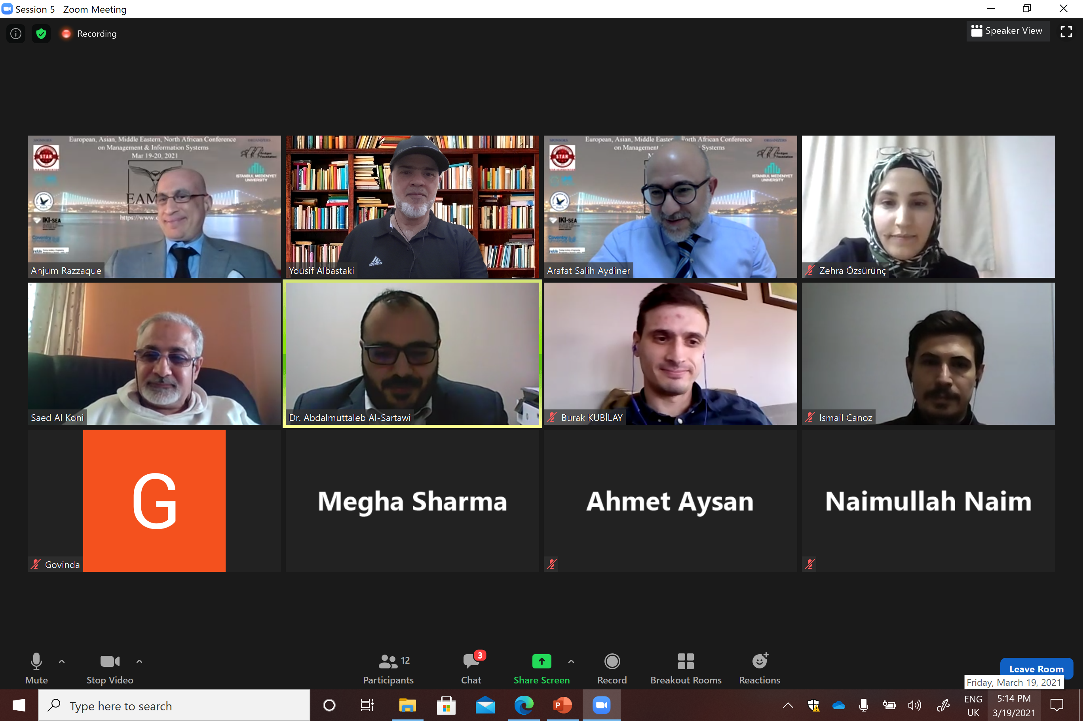
Contents
Human Olfaction System
ANN-Based E-nose Concept
ML-Based E-nose Concept
Experiment Process and Data Collection
R as an Analytical Tool
K-Means Clustering Algorithm
Results of the Experiment

Slide 3

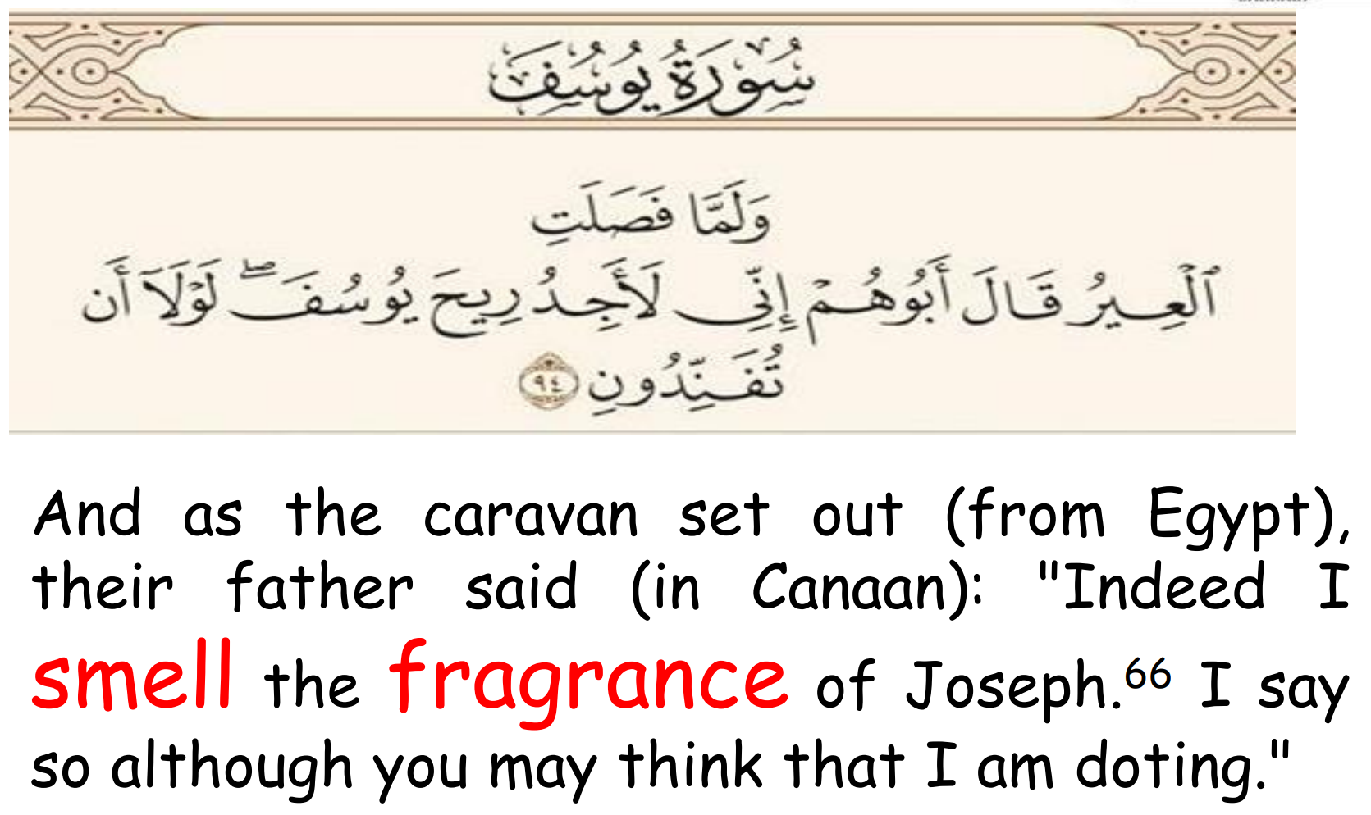

Slide 4
?
Can we transmit Smell?

Slide 5
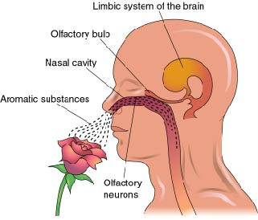
Human Olfaction System
Odor Database
The olfactory bulb is one of the structures of the limbic system and a very ancient part of the brain.
The information captured by the sense of smell goes from the olfactory bulb to other structures of the limbic system
    Detect odors
    Identifies the specific components of an odor
    Analyzes its chemical makeup to identify it

Slide 6

Human Olfaction System
Odor Database
    Detect odors
    Identifies the specific components of an odor
    Analyzes its chemical makeup to identify it

Slide 7
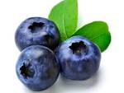
Human Olfaction System
Odor Database
    Detect odors
    Identifies the specific components of an odor
    Analyzes its chemical makeup to identify it

Slide 8
Human Olfaction System
Odor Database
    Detect odors
    Identifies the specific components of an odor
    Analyzes its chemical makeup to identify it

Slide 9

Human Olfaction System
Odor Database
    Detect odors
    Identifies the specific components of an odor
    Analyzes its chemical makeup to identify it

Slide 10
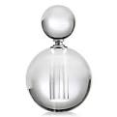
Human Olfaction System
Odor Database
    Detect odors
    Identifies the specific components of an odor
    Analyzes its chemical makeup to identify it

Slide 11
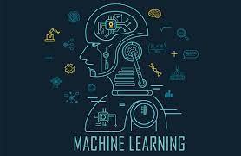
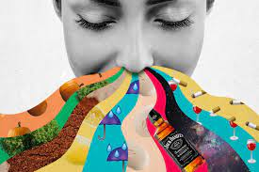

Aim to use Machine Learning Algorithms in odor Classification
+
=

Slide 12

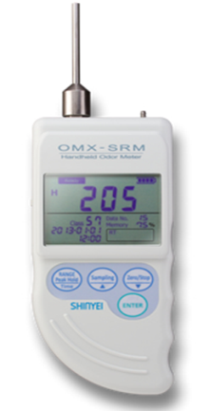

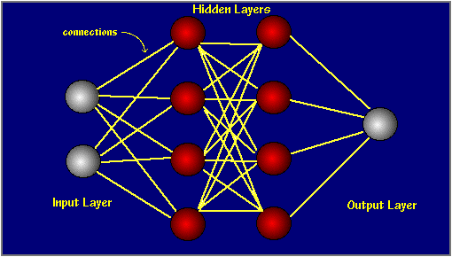


ANN-Based E-nose Concept
Odor
Sensor Array
Neural Network

Slide 13
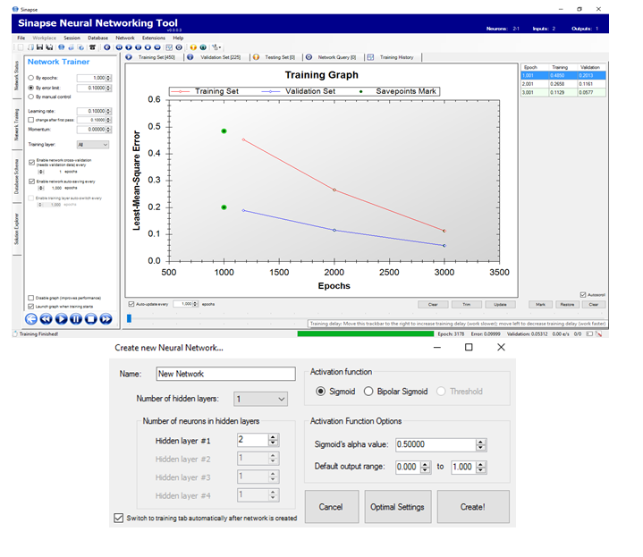
ANN-Based E-nose Concept

Slide 14
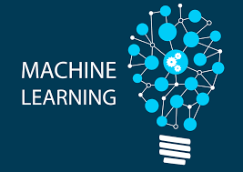
ML-Based E-nose Concept
Odor
Sensor Array
Machine Learning

Slide 15
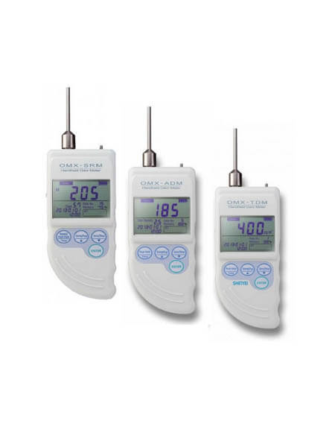
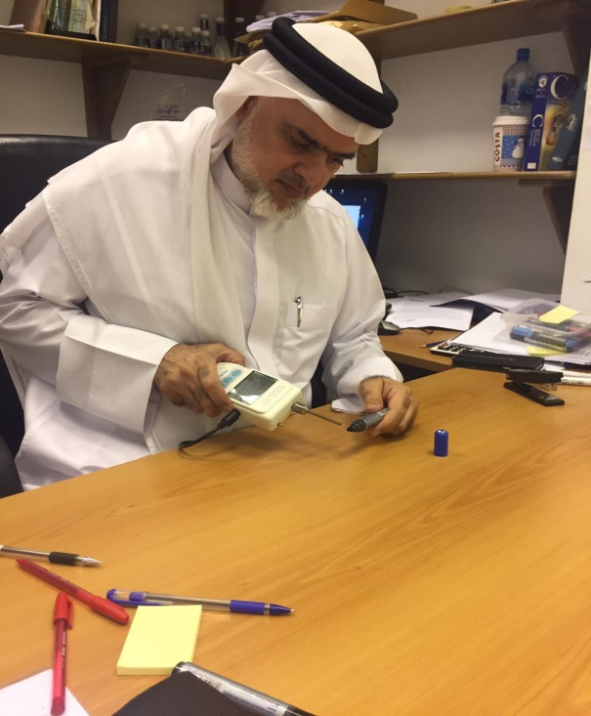

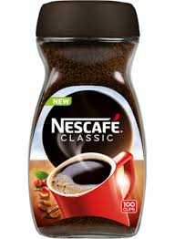
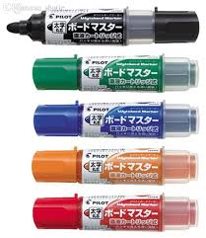
Experiment Process and Data Collection

Slide 16
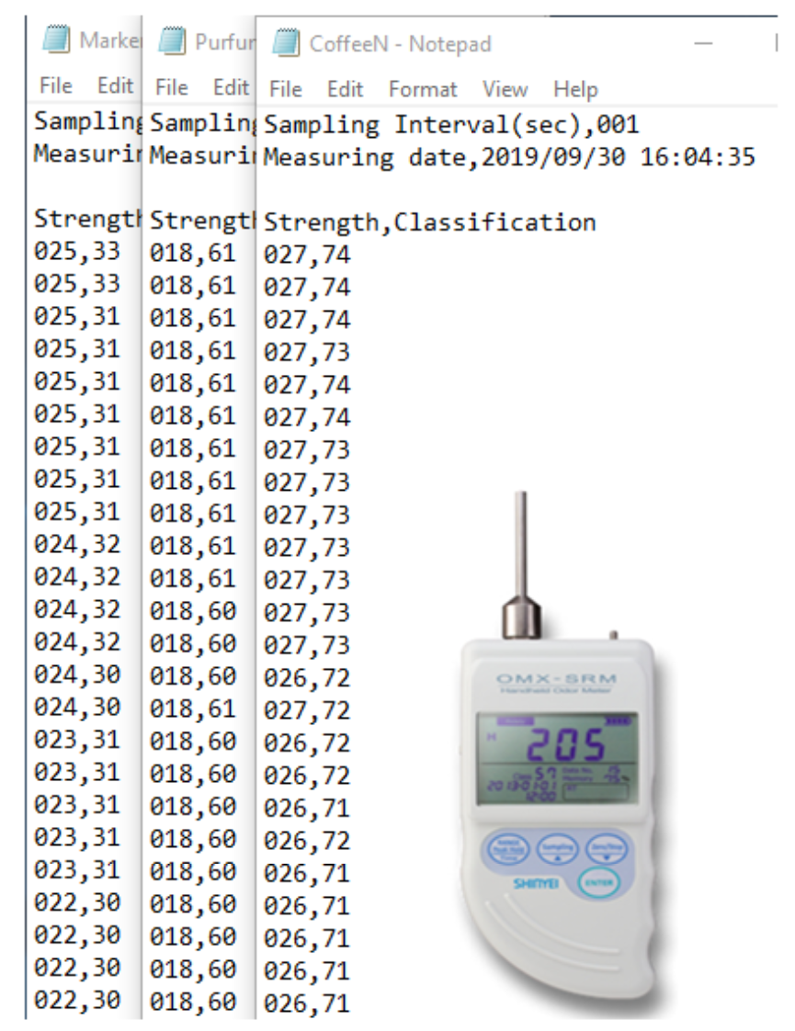
Experiment Process and Data Collection

Slide 17
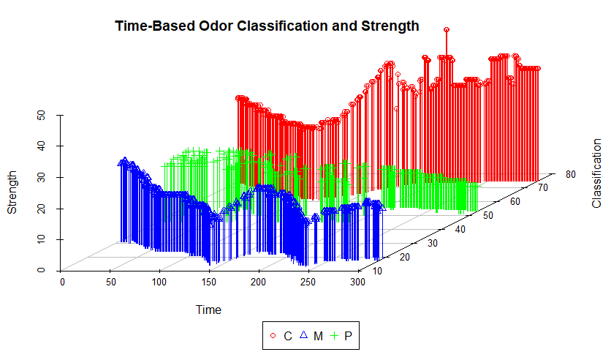
R as an Analytical Tool

Slide 18
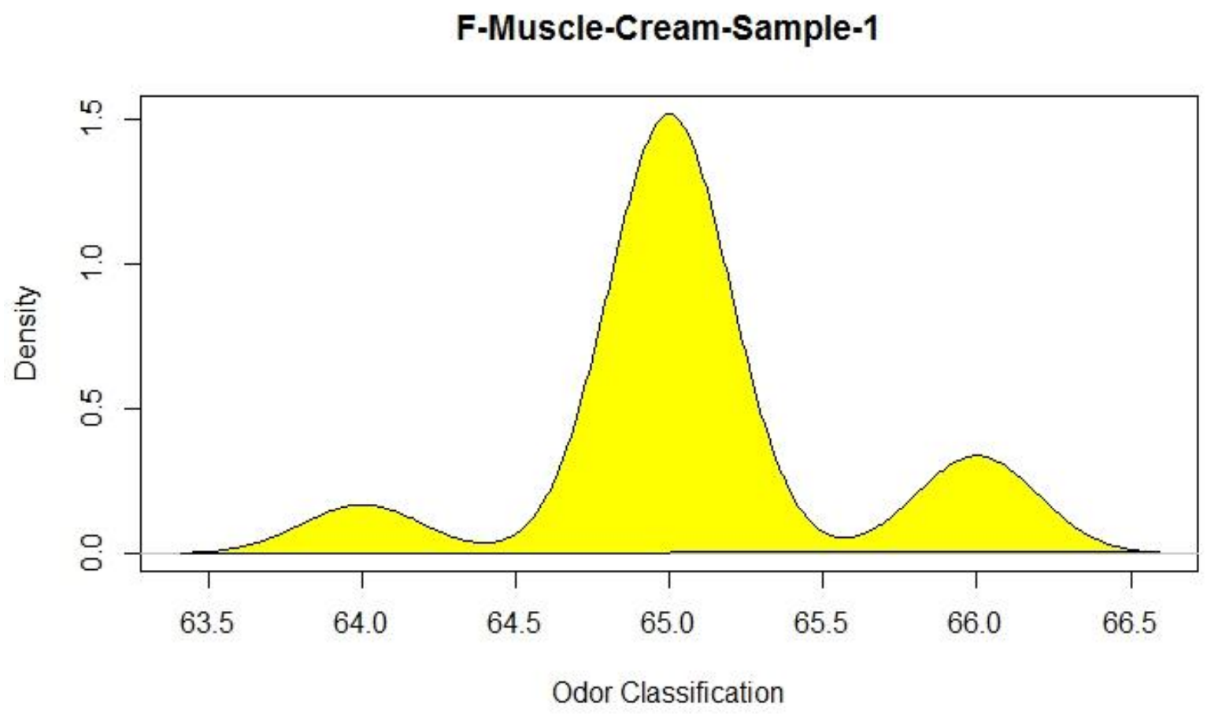
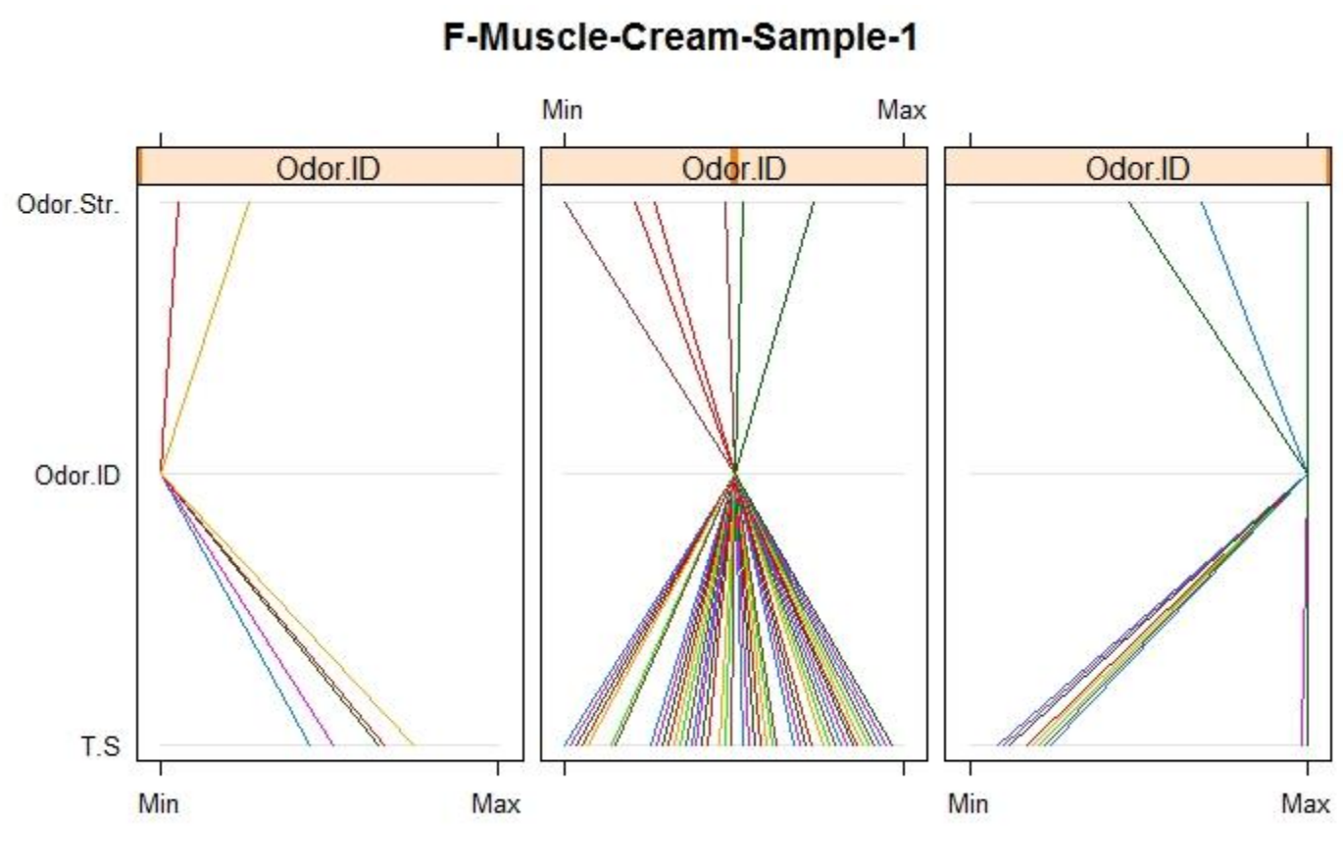
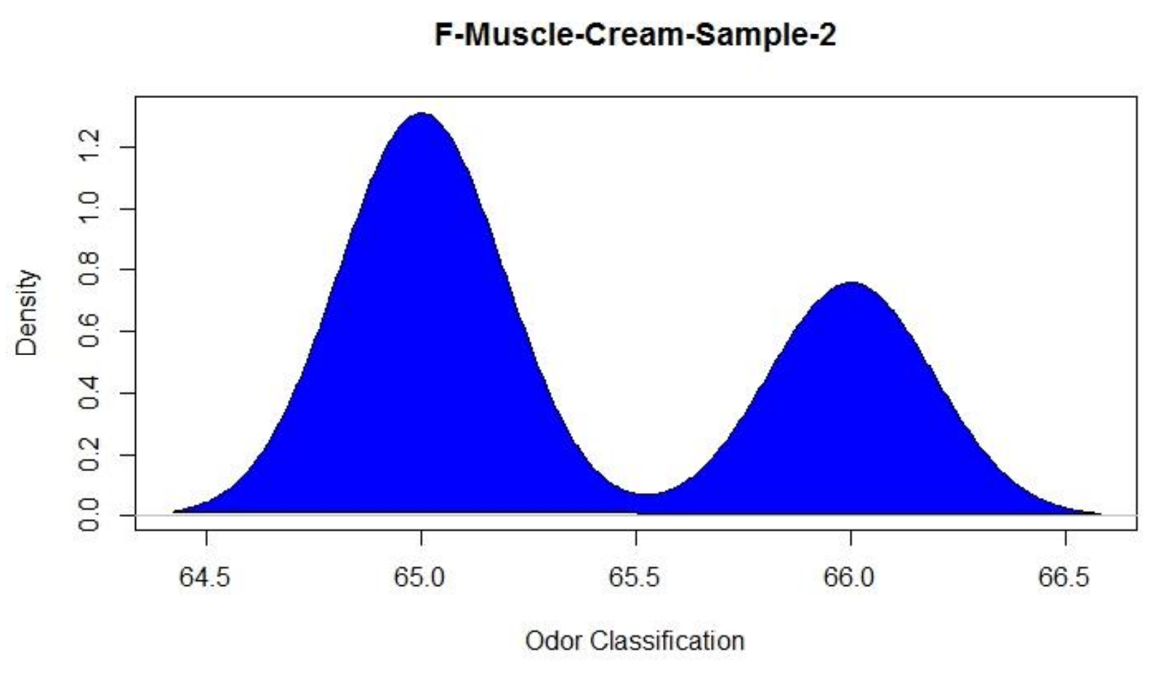
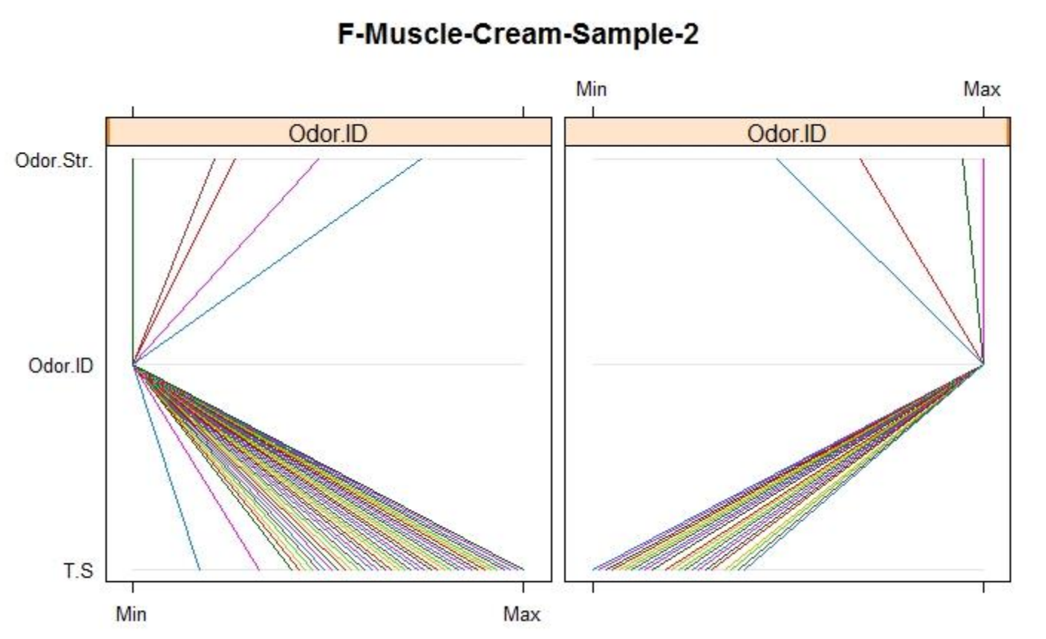


R as an Analytical Tool

Slide 19
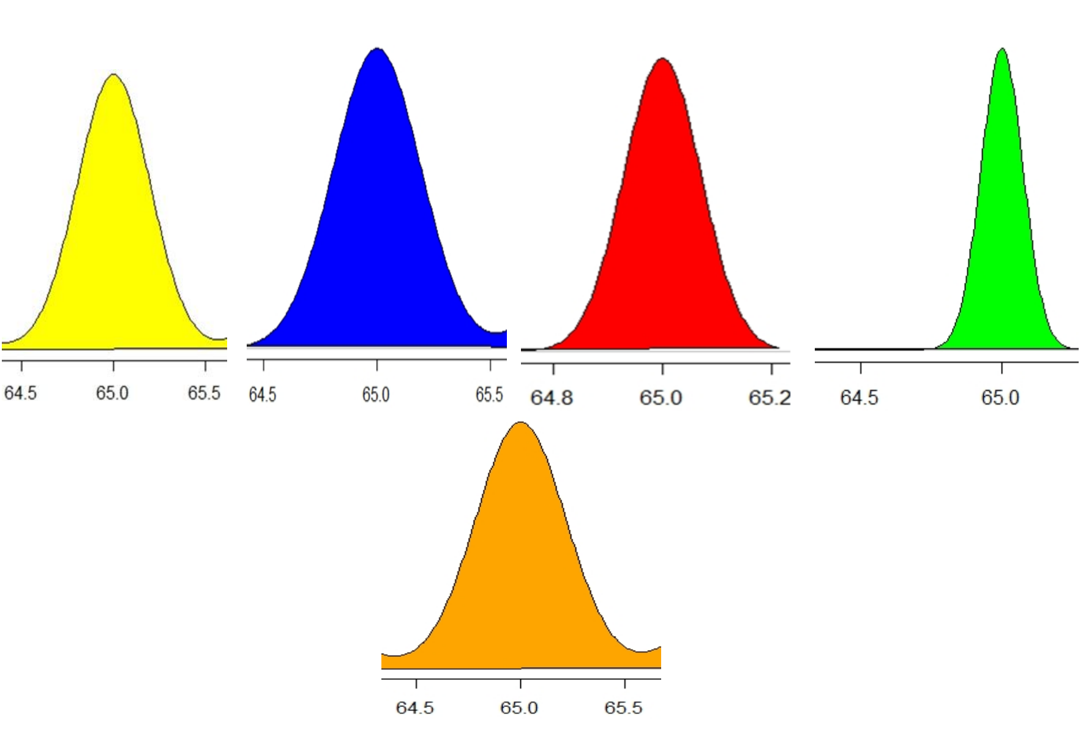
Data Purifications and Normalization

Slide 20
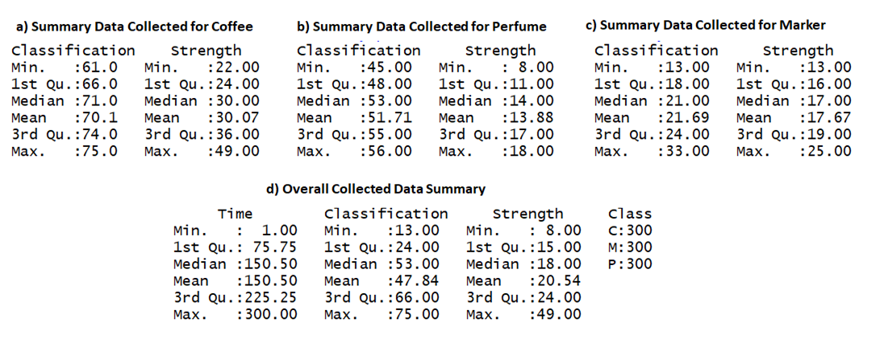
Results of the Experiment

Slide 21
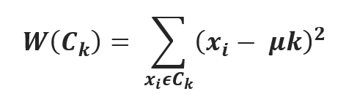
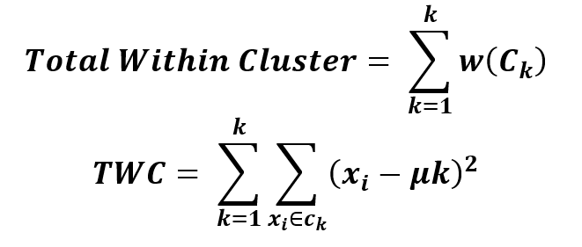
K-Means Clustering Algorithm

Slide 22
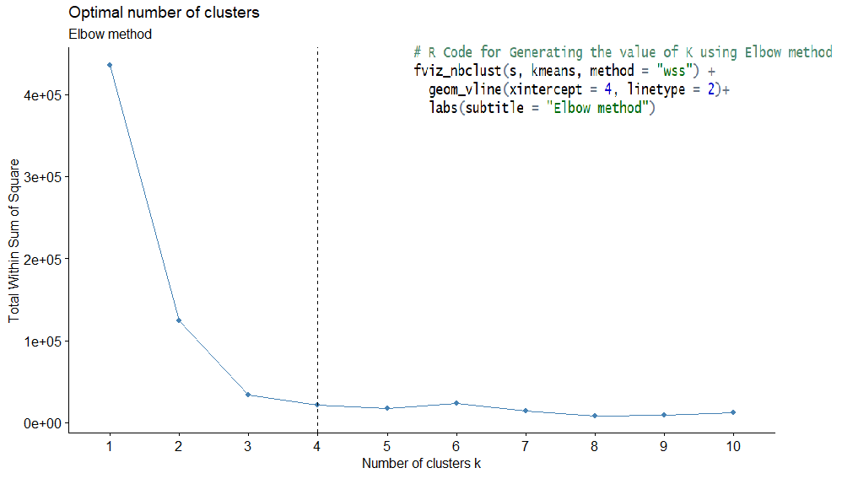
Selecting the Value of k using Elbow Method Algorithm

Slide 23
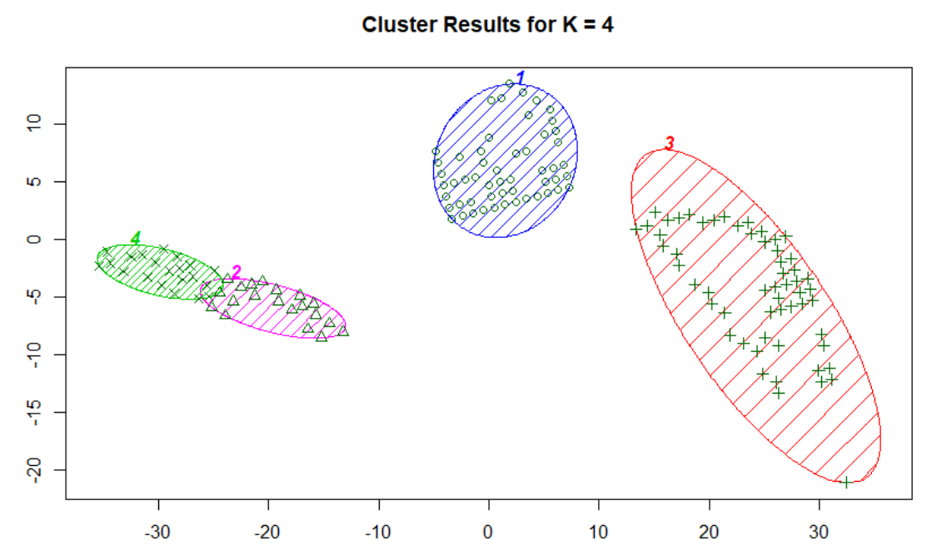
Results of the Experiment
Selecting the Value of k using Elbow Method Algorithm

Slide 24
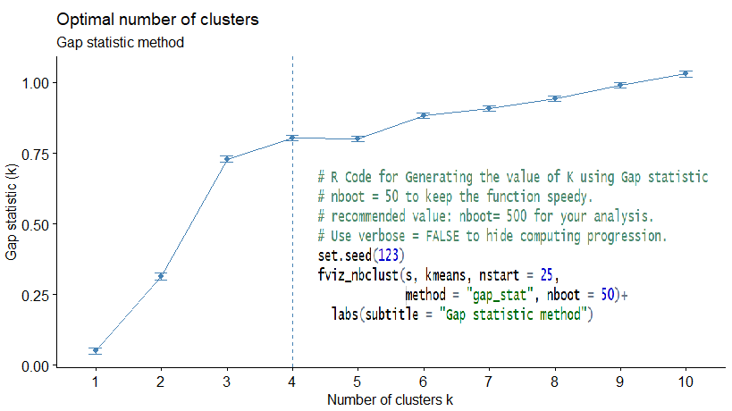
Selecting the Value of k using the Gap Statistic Algorithm

Slide 25
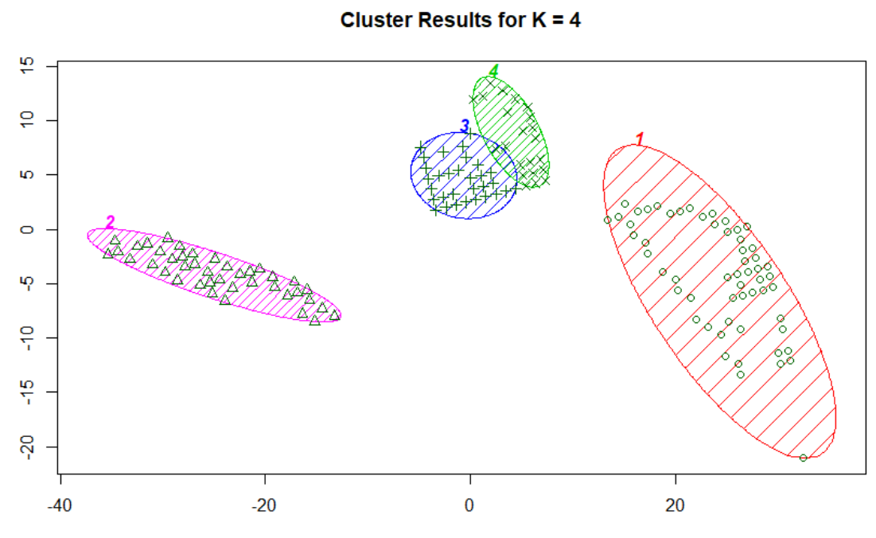
Results of the Experiment
Selecting the Value of k using the Gap Statistic Algorithm

Slide 26
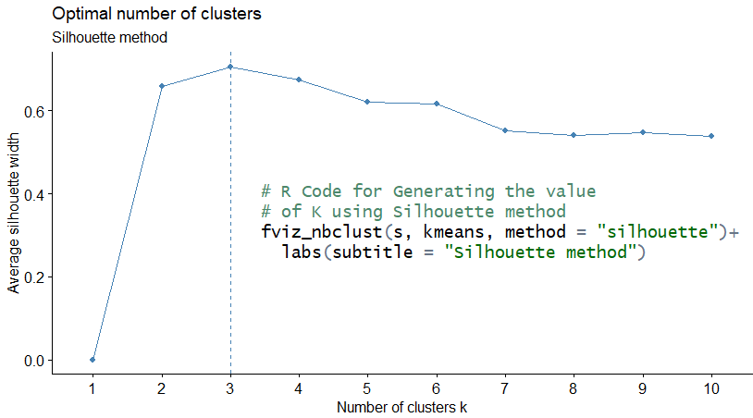
Selecting the Value of k using Silhouette Method

Slide 27
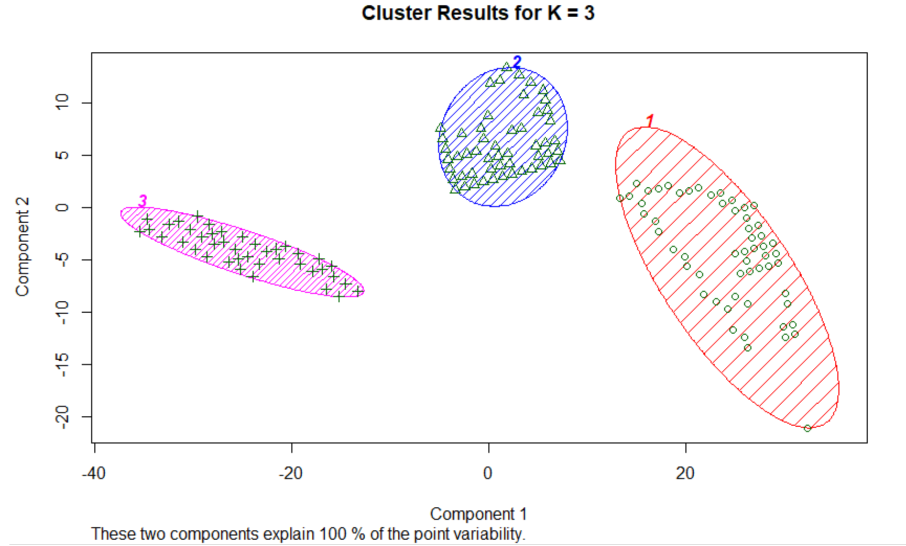
Results of the Experiment
Selecting the Value of k using the Silhouette Method

Slide 28
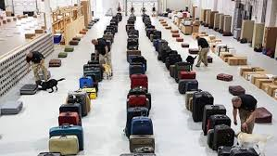
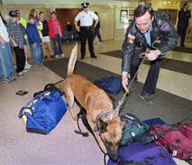
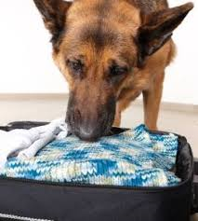
Applications …..1
Police Dog Drug Training - K-9 cops can sniff out drugs

Slide 29
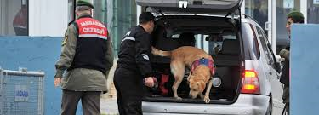
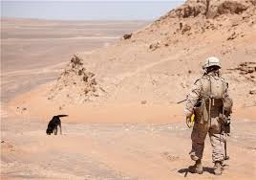
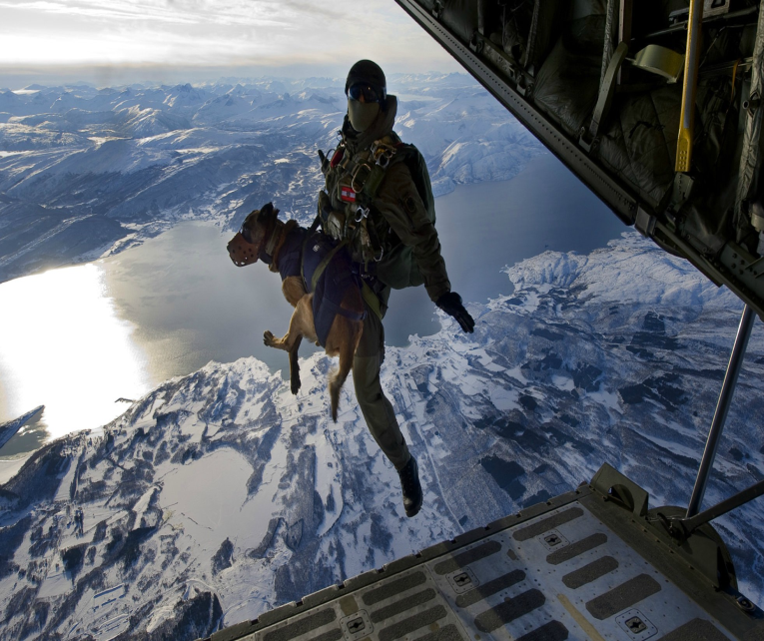

Applications …..2
Police Dog explosive and bombs Training - K-9 cops can sniff out explosive and bombs
The Dogs can Sniff Out Land Mines

Slide 30
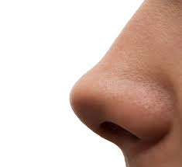
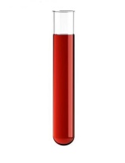
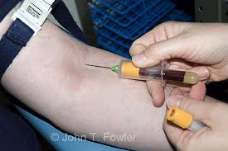
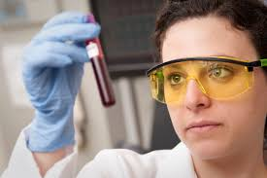
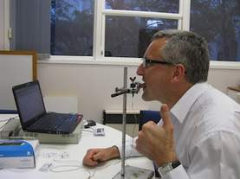
Applications …..3
In the middle ages if you were sick doctors usually:
Smell it
Take blood sample
Look at it
Even taste it
Doctors used their own senses to diagnose the diseases

Slide 31
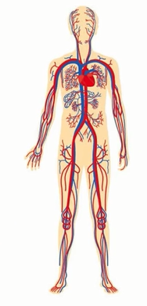
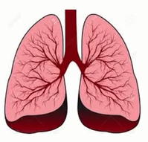
Applications …..3
The blood usually takes oxygen and food to all your living cells in your body
It also takes back all the litters and garbage that comes off the cells back
The blood has a good interaction with the lung
The lung takes oxygen from the air and the blood takes this oxygen to the cells in our body and takes back CO₂ and other waste gases back to the lung.
Any disease or illness you have will affect your organs and cells in your body and those cells will produce toxins in form of gases
In fact, if your blood smells then your breath will smell

Slide 32
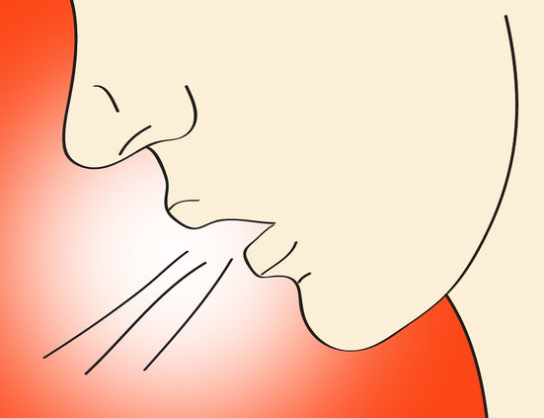
Applications …..3
Resent Research demonstrated 2500 different chemicals in our breath

Slide 33


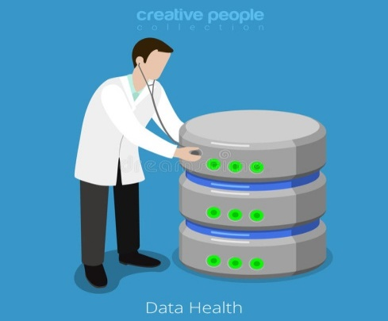
Applications …..3
National Breath Samples Database
Collection of Breath Samples

Slide 34
Thank you!

