Slide 1
Building Capabilities for Economic Diversification in the Gulf Region
Amer Al-Roubaie
Ahlia University

Slide 2
Productive Capacity: Defined
“Productive capacities are the productive resources, entrepreneurial capabilities and production linkages which together determine the capacity of a country to produce goods and services and enable it to grow and develop”
UNCTAD Least Developed Countries 2006
“as a set of different types of productive, organizational, technological and innovation capabilities embedded in organizations, institutions and infrastructures whose integration determine the capacity of a country to produce goods and services in a competitive global market”
UNCTAD: Building and Utilizing Productive Capacities in African and Least Developed Countries, 2020

Slide 3
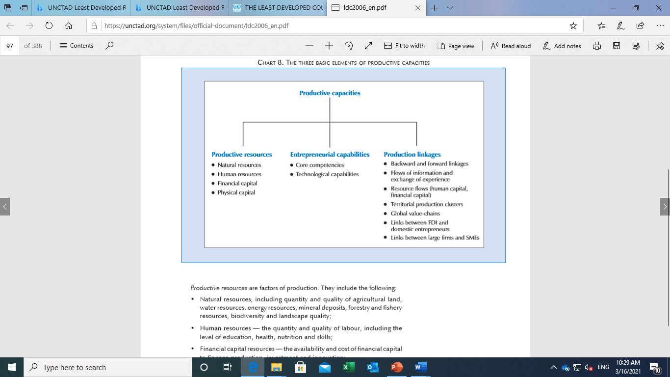
Productive capacities
(UNCTAD, 2006)

Slide 4
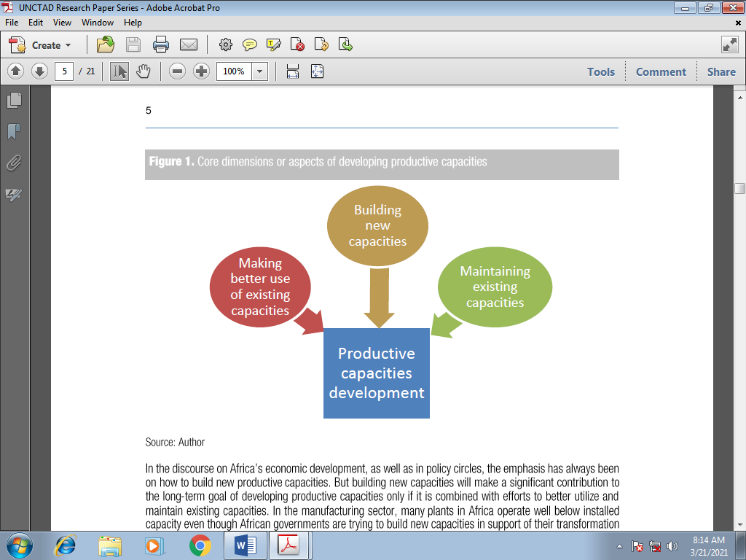

Slide 5
Economic Diversification defined
“as the shift toward a more varied structure of domestic production and trade with a view to increasing productivity, creating jobs and providing the base for sustained poverty-reduced growth. Domestic production diversification results from the shift of domestic output across sectors, industries, and firms. It captures the dynamic of structural transformation, because successful diversification of domestic production entails resource allocation across and/or within industries from low productivity activities to those with higher productivity.”
(p. 142 https://www.wto.org/english/res_e/booksp_e/aid4trade19_chap5_e.pdf)

Slide 6
Objectives of Economic Diversification
Economic empowerment
Inclusive development
Poverty alleviation
Income distribution
Gender equity
FDI flows
Employment generation
Improve the economy performance to achieve Sustainable development
Economic stabilization
Reduce the economy dependence on using a single source of income

Slide 7
Country | ECI (2017) | Concentration index | Diversification index | Productive capacities Index
Japan | 2.31 | 0.142 | 0.393 | 45.29
Germany | 2.08 | 0.092 | 0.302 | 47.38
U.S.A | 1.76 | 0.101 | 0.227 | 50.51
UK | 1.53 | 0.105 | 0.307 | 46.18
Canada | 1.08 | 0.151 | 0.379 | 42.30
Malaysia | 0.97 | 0.218 | 0.436 | 34.94
Saudi Arabia | 0.75 | 0.590 | 0.766 | 34.73
Qatar | 0.40 | 0.484 | 0.794 | 40.81
Turkey | 0.18 | 0.072 | 0.409 | 34.29
UAE | 0.18 | 0.204 | 0.556 | 42.30-
Kuwait | 0.12 | 0.669 | 0.795 | 33.90
Jordan | -0.15 | 0.169 | 0.620 | 31.01
Tunisia | -0.29 | 0.141 | 0.526 | 33.28
Egypt | -0.32 | 0.142 | 0.585 | 29.39
Indonesia | -0.32 | 0.127 | 0.565 | 29.94
Syria | -0.74 | 0.223 | 0.447 | 24.67
Algeria | -0.81 | 0.421 | 0.817 | 27.76
Pakistan | -0.81 | 0.207 | 0.766 | 25.17
Morocco | -0.88 | 0.181 | 0.655 | 30.51
Libya | -0.97 | 0.780 | 0.832 | 24.16
Yemen | -0,97 | 0.422 | 0.776 | 23.28
Sudan | -1.48 | 0.397 | 0.847 | 22.01
Nigeria | -1.90 | 0.792 | 0.875 | 21.65

Slide 8
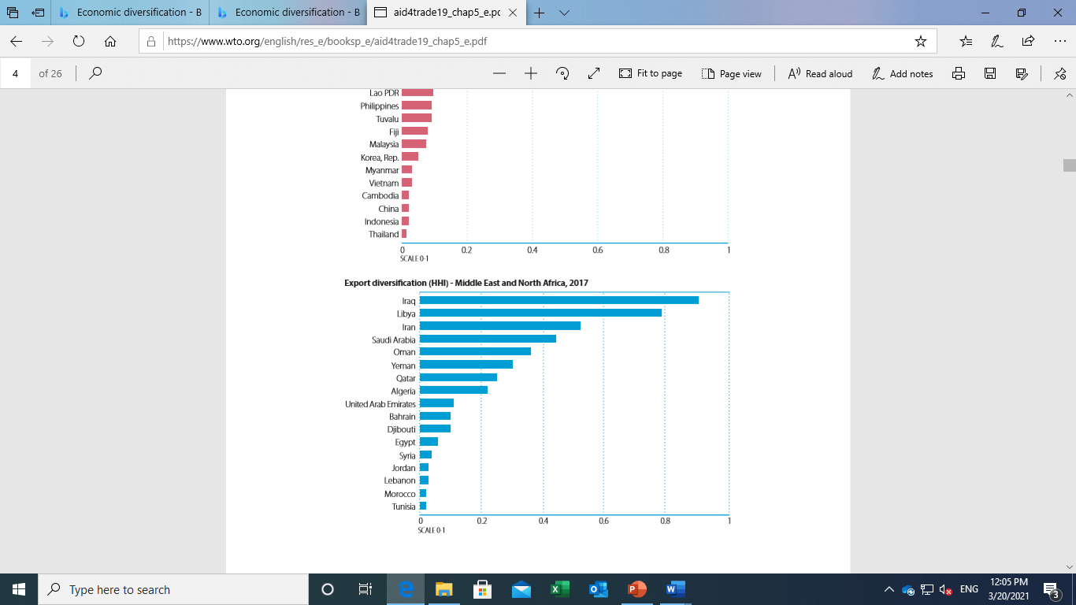
Export Diversification –Middle East
(WTO-https://www.oecd.org/dac/aft/aid-for-trade-at-a-glance-22234411.htm)

Slide 9
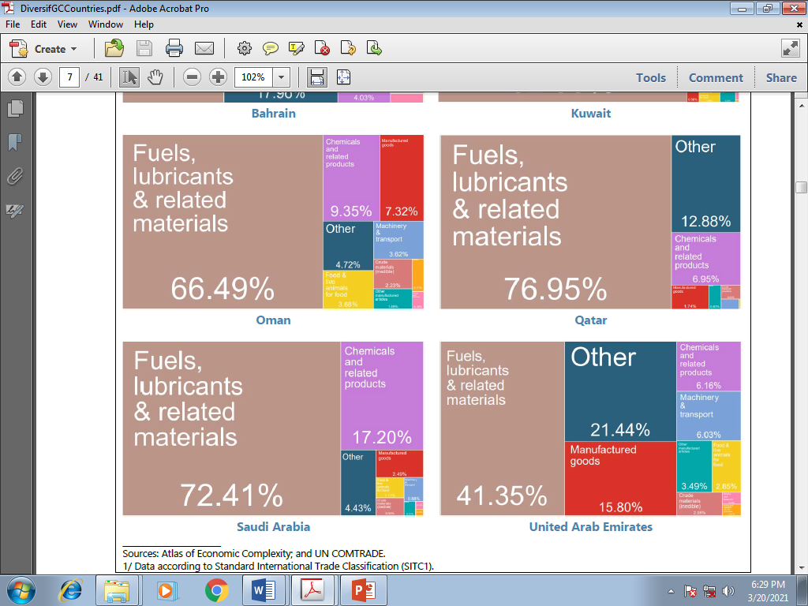
Share of Fuels in Total Export –Saudi Arabia
(IMF- https://www.imf.org/en/Publications/Policy-Papers/Issues/2018/12/04/pp120618gcc-trade-and-foreign-investment)

Slide 10
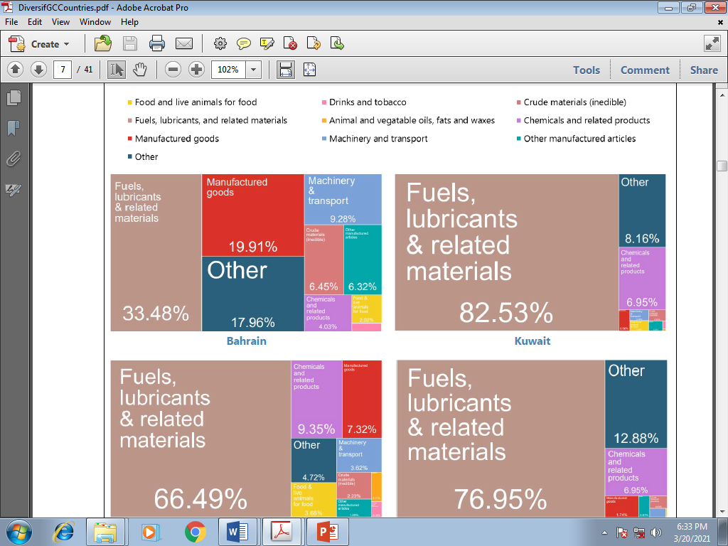

Slide 11
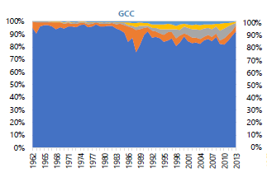
Product Complexity of Exports –GCC Countries (IMF –Trade and FDI)

Slide 12
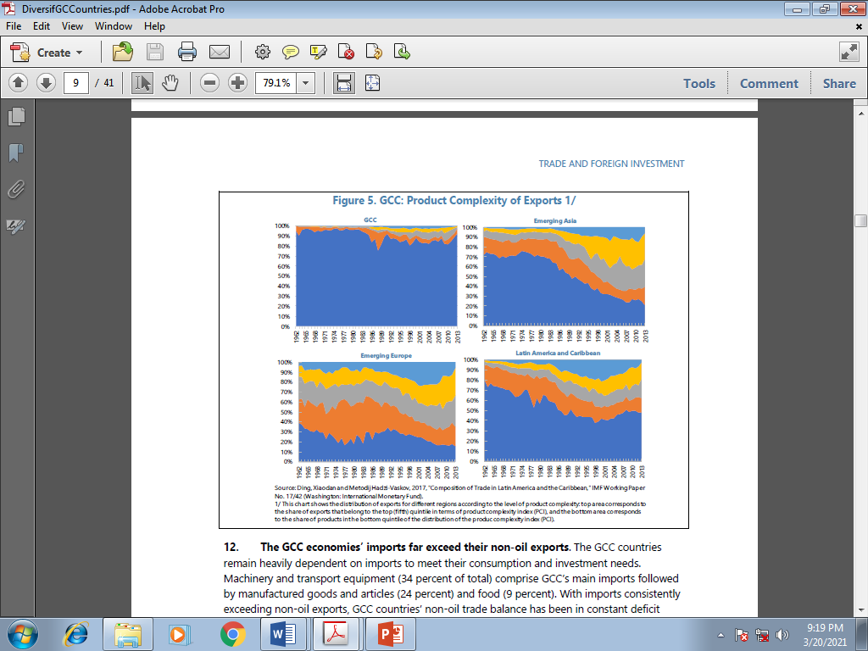

Slide 13
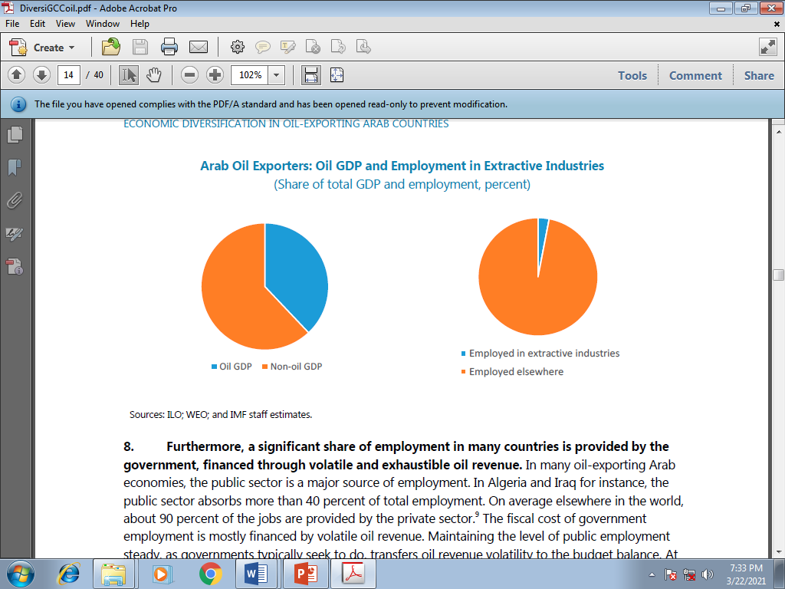
Share of GDP and Employment
(IMF-Economic Diversification in Oil-exporting Arab Countries)

