Slide 1
Celebrating 20 Years
of Excellence
Crystal-Melt Interfacial Free Energy of Binary Hard Spheres from Capillary Fluctuations
23rd March 2021

Slide 2
Contents
Abstract
Definition
Crystal Orientations and FCC Lattice
The importance of interfacial free energy
The importance of interfacial free energy
Why performing simulation
Why Using Hardsphere
Fluctuation Method
Equations of stiffness and interfacial free energy
Determine stiffness from simulation
Results
Conclusion

Slide 3
Abstract
Using the analysis of equilibrium capillary fluctuations in molecular dynamics simulations, we compute the magnitude and anisotropy of the interfacial free energy gamma of the crystal-melt interface for the binary hard-sphere system with alpha= 0.9 at the azeotrope. We are comparing the anisotropy of the interfacial free energy of this experiment with the ones not at azeotrope as well as single hard spheres. The result of this experiment was consistent with the previous results not at azeotrope as.

Slide 4
Definition
Interfacial free energy(γ): the reversible work required to form a unit area of interface
between a crystal and its melt.

Slide 5
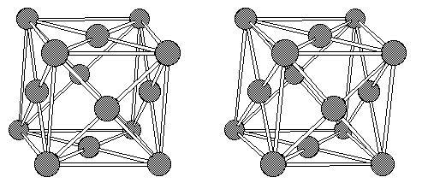
Crystal Orientations and FCC Lattice

Slide 6
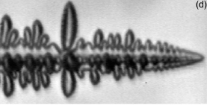
The importance of interfacial free energy
In metallurgical processes the formation of dendrites plays a vital role in the final product, such as cast iron.
The dendrite (tree like branching) growth morphology depends on the anisotropy
(orientation dependency) of the crystal-melt. Interfacial free energy γ
The nucleation rate of crystals depends on the magnitude of interfacial free energy, γ.
ammonium- bromide¹
a) γ along (100)
b) γ along (110)
6
Y. Couder et. al, Phys. Rev. E. 71, 031602 (2005)
W.J. Boettinger et. al. Ann. Rev. Mater. Res. 32, 163 (2002)

Slide 7
Why Performing Simulation
The crystal-melt interface lies between two condensed phases, direct experimental measurements of the interfacial free energy(γ) is difficult.

Slide 8
Why Using Hardsphere
hard-sphere system is the simplest model
Works pretty well for many systems, such as
Simple liquids
Glasses
Colloids
Hard spheres freeze into a face centered cubic (fcc) lattice
It can mimic fcc metals
It gives 90% accuracy for γ of fcc metals
The contribution of the attractive potential energy to γ of
metals is about 10% (perturbed part).
Hard spheres can be considered a reference for the fcc metals.

Slide 9
Hard-spheres Potential and Coexisting Density
σ₁₂
σ₁₂ = (σ₁ + σ₂)/2
0
σ₁₂
r
η= Volume(H.S.)/Volume(container)
Coexisting η (1)
η^{f} = 0.5076
η^{c} = 0.5457
We have used (2) η^{f} = 0.5076, η^{c} = 0.5457 to maintain the stability of
the interface as well as guarantee the strain-free bulk crystal.
[1] W. G. Hoover and F. H. Ree, J. Chem. Phys. 49, 3609 (1968)
[2] R.L. Davidchack’s thesis

Slide 10
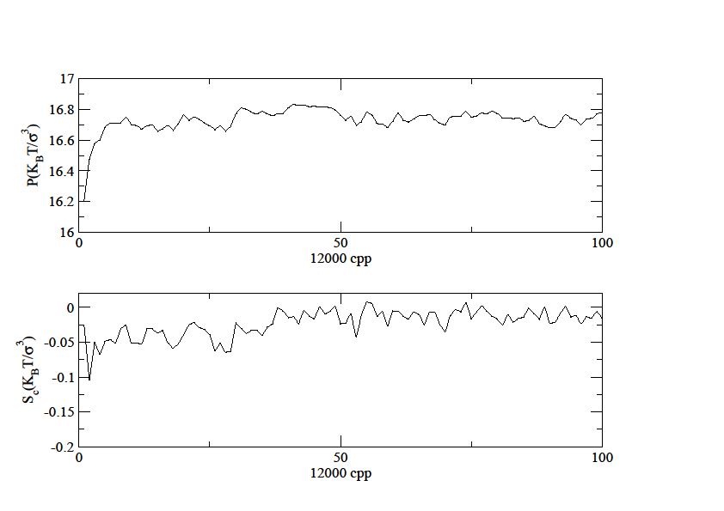
Pressure of the interface and stress in crystal

Slide 11
Pressure of the interface and stress in crystal

Slide 12
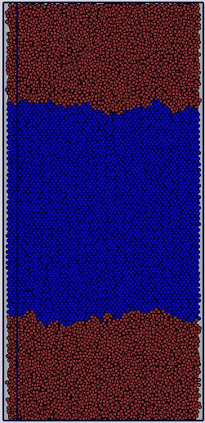
Fluctuation Method
The fluctuation in interfacial position h(y) is monitored. The Fourier transform of the h(y) is used, which is, related to the stiffness, as follows
melt
h(y)
crystal
melt
b
K_{B}T: thermal energy
bw: interfacial area
q: wave number
: interfacial stiffness
w

Slide 13
Fluctuation method continue
By expanding dl and γ and solving for work
where
Apply Fourier Transform
h(y) = Σ_{j} (q_{j}) exp(iq_{j}y)
yields,
γdl
θ
γ₀dy

Slide 14
Fluctuation method continue
melt
h(y)
The interface normal ∼ 2 w for the interfaces not to interact.
Width w > 10 b to get small wave number, q ~1/w,
or to increase the range of q
crystal
The thickness, b, (short direction): 3-5 unit-cells to get
more fluctuations at the interface, reduce the number
of particles, and make the system quasi two dimensional
and use one-dimensional Fourier Transform
melt
b
w
orientation size(σ₂)
(100)[010] 4.3 x 57.9 x 125.8 6.1 x 55.0 x 95.3 (110)[001] 49.1 x 7.2 x 90.9 5.1 x 56.7 x 108.5
σ₂ : the diameter of the larger sphere (unit length)
(ijk) and [lmn] are the orientation and short direction,
respectively.

Slide 15
Determination of the order parameter
Example:
For any vector r connecting near neighbors
in a perfect fcc lattice. We chose N_{q} = 8.
Z is the neighbors found within r_{c}, chosen
to be between the first and second neighbor
shells. The order parameter for perfect fcc lattice
will equal to one , and less than one otherwise.
[1] J. R. Morris Phys. Rev. B. 66, 144104 (2002)

Slide 16
Free energy using cubic harmonic expansion(1)
Since our system is cubic, we use cubic harmonic
expansion for interfacial free energy.
Use stiffness(2) to determine the γ₀, ε₁, ε₂, from which to calculate γ
[1] W.R. Fehlner and S.H. Vosco Can. J. Phys. 54, 2159(1976)
[2] M. Asta, J. J. Hoyt and A. Karma, Phys. Rev. B 66, 100101(2002)

Slide 17
Equations of stiffness and interfacial free energy
Equations of stiffness derived from
the interfacial free energy equations for
different orientations
Equations of free energy for different orientations
We use least square method to determine
the parameters γ₀, ε₁, ε₂, from which
to find γ
[1] J. R. Morris, J. Chem. Phys. 119, 3920(2003)
[2] Y. Mu, A. Houk and X. Song (preprint)

Slide 18
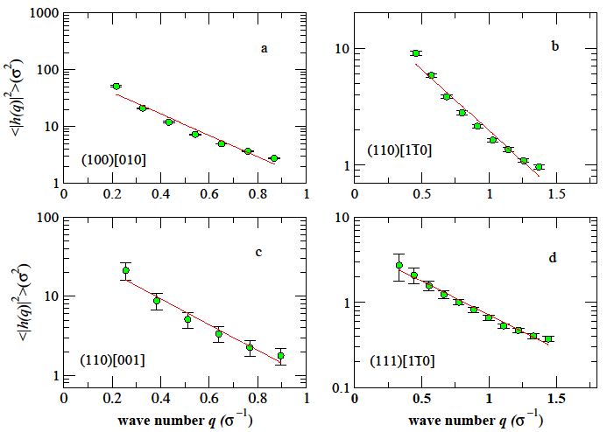
Determine the stiffness from simulation
The stiffness is obtained by fitting
the above equation.

Slide 19
Binary (two-component) hard-sphere system
Hard spheres with two different diameters (σ₁, σ₂)
The larger diameter (σ₂) is the unit length
The diameter ratio (α = 0.9)
Identical masses.
Simulate two binary systems at azeotrope
Reason: to mimic real systems, such as fcc metallic alloys (entropic dominance)
The equations to calculate the interfacial free energy for the binary hard-sphere
system are the same as used for single hard-sphere system.

Slide 20
Pressure versus concentration for single and
binary hard-sphere system at coexistence
x = N₂ /N
W.G.T. Kranendon and D. Frenkel, J. Phys. Condens. Matter 1 7735 (1989)

Slide 21
The reduced pressure (P⁰), fluid and crystal packing fraction (η_{f} ,η_{c}),
fluid and crystal mole fraction (χ_{f} , χ_{c}) from the simulation
System P*(K_{B}T/σ³) η_{f} η_{c} χ_{f} χ_{c}
P₀ 11.57 0.491 0.543 1.0 1.0 P₁ 12.23 0.4963 0.548 0.98 0.947 P₂ 13.13 0.4998 0.5498 0.75 0.865 P₃ 14.70 0.502 0.552 0.54 0.71 P₄ 16.19 0.510 0.549 0.38 0.47 P₅ 16.75 0.507 0.5457 0.22 0.22
The result for the interfacial stiffness
Pressure | stiffness
P(K_{B}T/σ₂³ | $\tilde{γ} ( K_{B}T/$σ₂²)
11.57 | 0.44(5) | 0.458(12) | 0.72(3) | 0.76(3)
12.23 | 0.450(7) | 0.447(11) | 0.72(4) | 0.849(13)
13.13 | 0.468(12) | 0.494(12) | 0.79(3) | 0.806(17)
14.7 | 0.49(3) | 0.467(17) | 0.84(6) | 0.87(3)
16.19 | 0.413(13) | 0.43(4) | 0.928(7) | 0.926(0)
16.75 | 0.43(6) | 0.43(4) | 0.830(17 | 0.84(4)

Slide 22
The calculated orientationally averaged interfacial free energy (γ₀) , anisotropy parameters (ε₁,ε₂), and interfacial free energy for different orientations (γ₁₀₀ , γ_{110 ,} γ₁₁₁)
P(K_{B}T/σ³) γ₀ (KBT/σ²) ε₁ ε₂ γ₁₀₀ γ₁₁₀ γ₁₁₁
11.57 0.591(17) 0.075(12) -0.0036(13) 0.61(2) 0.59(2) 0.55(2) 12.23 0.617(9) 0.078(6) -0.0062(8) 0.63(1) 0.62(1) 0.57(1) 13.13 0.633(9) 0.077(5) -0.0030(7) 0.65(1) 0.63(1) 0.59(1) 14.70 0.663(18) 0.085(10) -0.0048(13) 0.68(2) 0.66(2) 0.61(2) 15.75 0.61(2) 0.049(13) 0.0014(7) 0.62(2) 0.60(2) 0.58(2) 16.19 0.667(11) 0.117(5) -0.0047(12) 0.70(1) 0.66(1) 0.59(1) 16.75) 0.63(3) 0.10(2) -0.005(2) 0.65(3) 0.62(3) 0.57(2)
The calculated anisotropy differences for the binary
hard sphere system for a variety of pressures
P(K_{B}T/σ³)
11.57 0.032(6) 0.102(8) 12.23 0.030(3) 0.107(4) 13.13 0.034(3) 0.104(3) 14.70 0.035(5) 0.115(7) 15.75 0.027(6) 0.064(9) 16.19 0.051(3) 0.158(3) 16.75 0.021(5) 0.07(10)
M. Amini, B. B. Laird, Phys. Rev. B. 78, 144112 (2008)

Slide 23
Results of Ni and Cu-Ni
parameters | Ni Cu-Ni | unit
γ₀ ε₁ ε₂ T | 310 (7) 287 (7) 9.0 (6) 7.2 (8) -1.1(1) -0.7(1) 1820(6) 1750(?) | mJ/m² --- --- K
1. Potential: Embedded atom method (EAM)
2. Performed at the same pressure, but different
temperature.
M. Asta, J.J. Hoyt, and A. Karma, Phys. Rev. B. 66, 100101® (2002)

Slide 24
Conclusion
The interfacial free energy along 100 orientation is the largest, along 110 orientation is the second largest and along 111 orientation is the smallest, where the crystal growth is the fastest. Our results are in accordance with the literature.
24

Slide 25
Thank you!

