Slide 1
On the Prospect of Fossil Fuel on Mars
Shawqi Al Dallal
Ahlia University, BAHRAIN

Slide 2
Is there Fossil Fuel on Mars?
- Determine the environment in Early Earth giving rise to the formation of fossil fuel.
- Identify a possible signature or indicator for the formation of fossil fuel.
- Study the environment on Mars in the past and search for an indicator of the formation of fossil fuel.

Slide 3
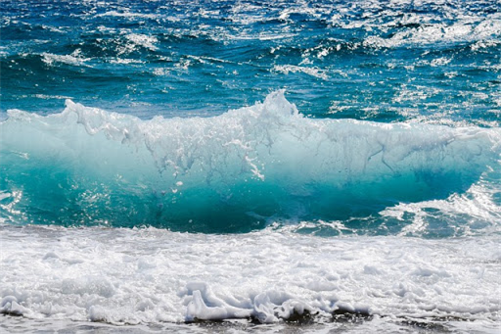


Ingredients of Fossil Fuel
Aqueous Environment
Complex Chemistry
Lifeforms

Slide 4
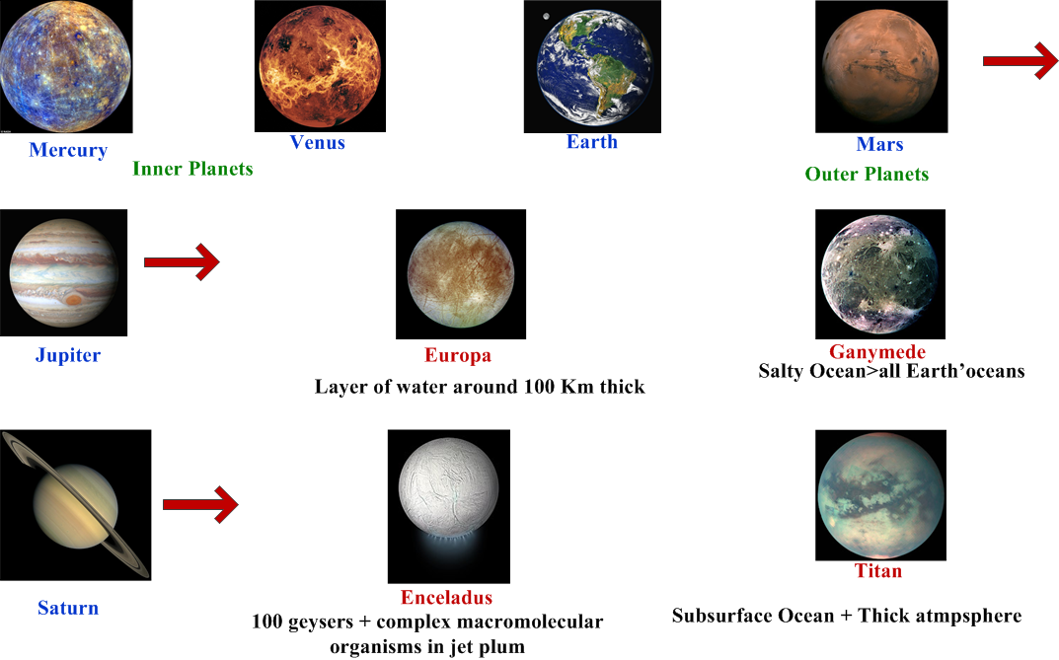
Water in the Solar System

Slide 5
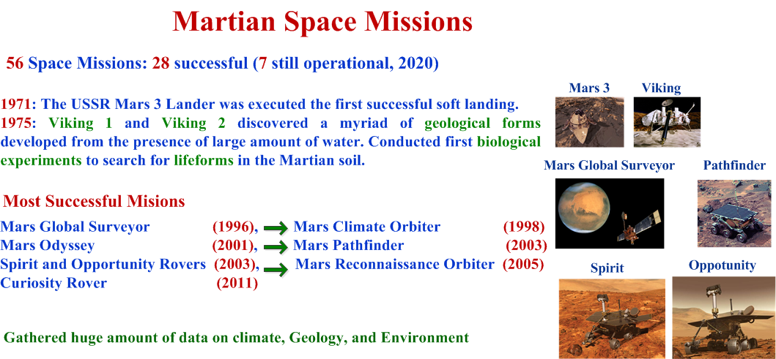

Slide 6
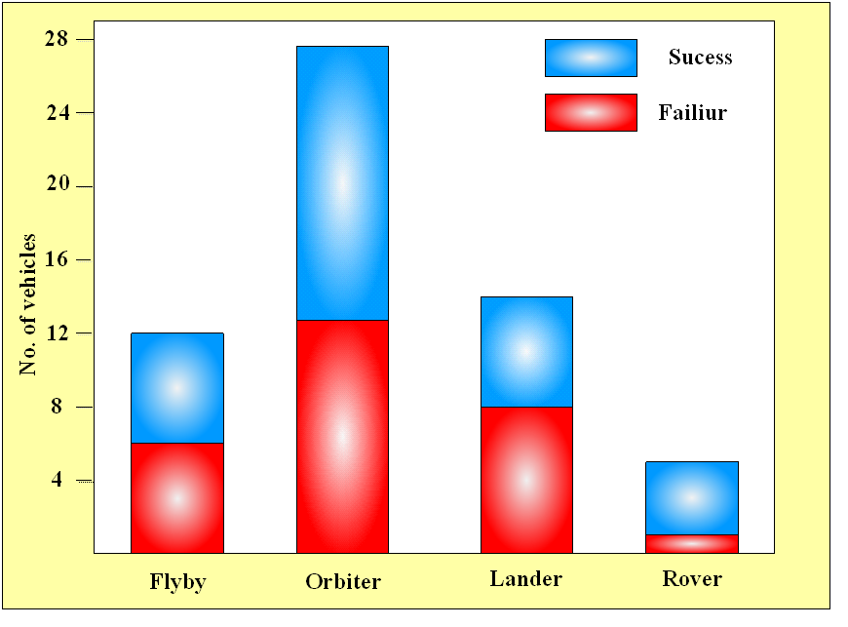
The distribution of various spacecrafts sent to Mars. Among the 56 missions, only 28 are successful.

Slide 7
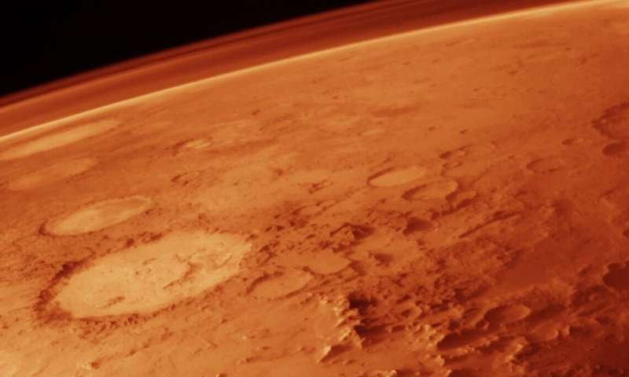
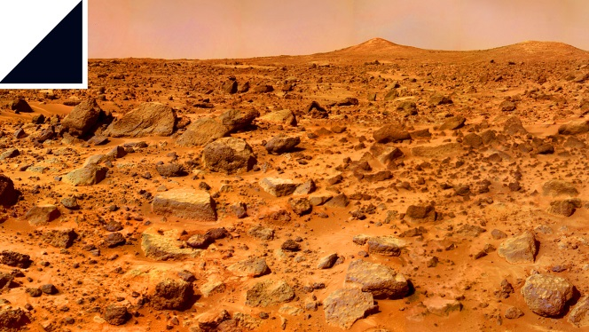
Present Mars
Cold, dry, and bathed in ultraviolet radiation
Hostile to any kind of lifeforms on its surface.
Atmospheric Composition
95.32% CO2
2.6% N2
1.9% Ar
Burning of fossil fuel on Mars will not adversely impact the atmospheric environment.

Slide 8
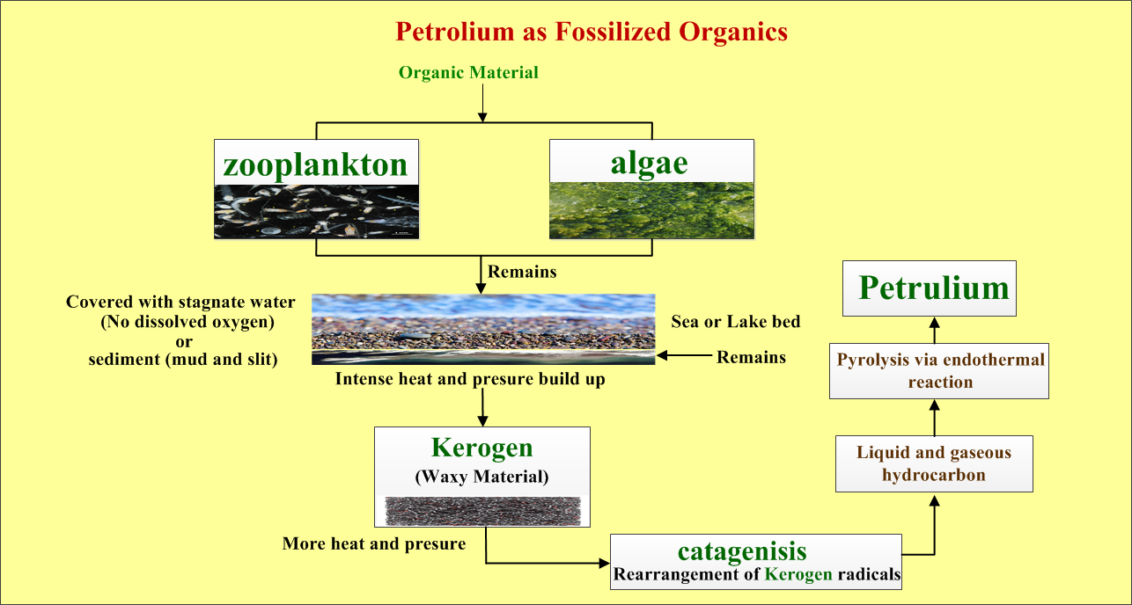

Slide 9
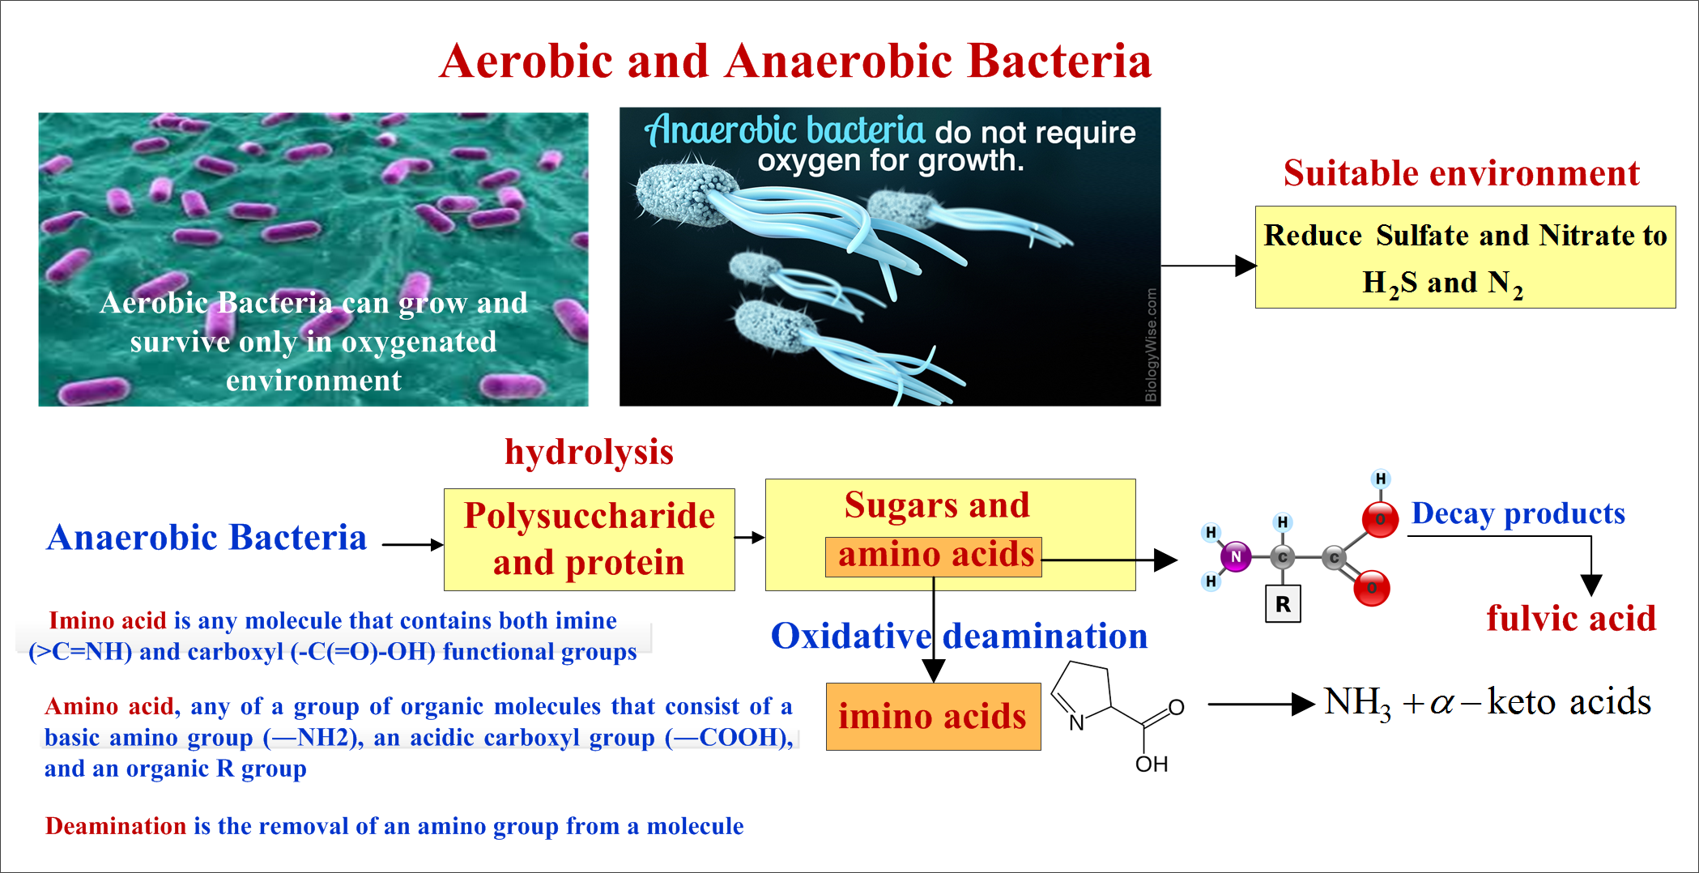

Slide 10
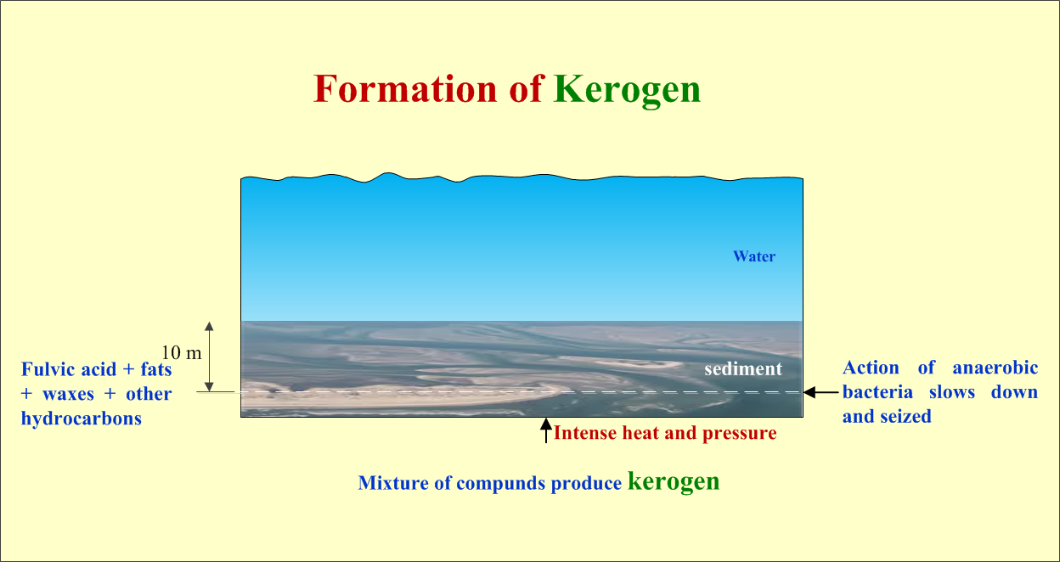

Slide 11

From Kerogen to Fossil Fuel
- When Kerogen exposed to oxygen; it is oxidized and thus lost.
CATAGENESIS:
Kerogen Fossil Fuel: mostly radical rearrangement of Kerogen.
- The process takes thousands of years in the absence of external reactants.
- Source of Heat triggering catagenesis came from decomposition of radioactive minerals of the
crust, mainly:
- Kerogen reacted towards two classes of products:
Carbon rich with low H/C ratio
Hydrogen rich with high H/C ratio
- Three main types of Kerogen: Type I (algae, oil prone), Type II (Plankton, H-rich, O-poor),
Type III (Land plant, O-rich, H-poor).

Slide 12
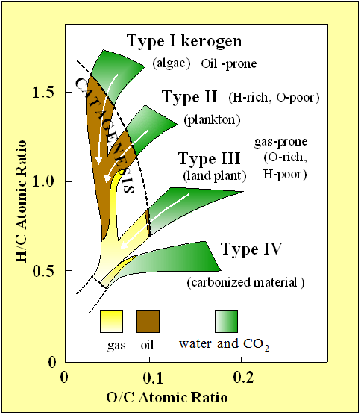
Types of Kerogen
Van Krevelen diagram: Classification of kerogen by (H/C) and (O/C) atomic ratios.

Slide 13
Preliminary Conclusion
Aqueous environment on Earth at its early history has been hospitable to the initiation of chemical and biological processes leading to the formation of kerogen and ultimately to fossil fuel.
Kerogen is a viable signature of the existence of fossil fuel on Mars

Slide 14
Martian Water World Today
Water on Martian surface at Present:
- Bulk Volume of water is in the form of ice
- North pole ice cap
- Beneath carbon dioxide planets south pole.
- 21 million km square of ice.
2016: NASA large amount of underground water equivalent to the
volume of water in Lake Superior
2018: Subglacial lake at about 1.5 km below the southern pole ice cap extending 20 km
sideways

Slide 15
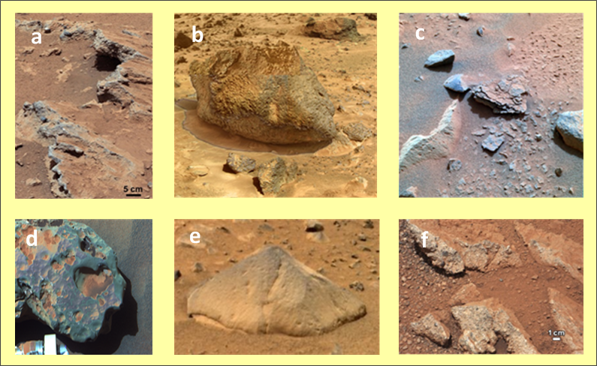
Water and Aqueous Minerals
Reliable indicators of existing type of environment when the minerals formed.
a- Remnant of Ancient Streambed on Mars.
b- Yogi Rock on Mars.
c- Mimi flaky roch
d- Meteorite (opportunity Rov.).
e-Adirondack Rock.
f- Martian rock called link ( Spirit Rov.).

Slide 16
History of Water in Aqueous Minerals
Opportunity examined the amount of water stored in Martian crust
Indicators of the type of minerals:
pH: low pH favors the formation of sulfate mineral jarosite
High to moderate pH favors the formation of phyllosilicates
Eh : Oxidation potential. It is an indication of oxidation state of an aqueous system.
pH and Eh are together indicators of the type of minerals that are most likely to form.
Therefore, past environment conditions on Mars can be inferred by analyzing the type of minerals present in the rocks.

Slide 17
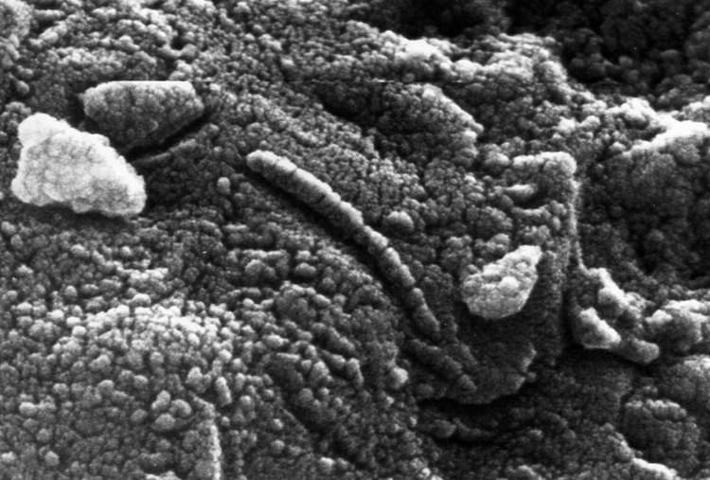
Martian Meteorites
Over 60 Martian meteorites
- Basaltic shergottite exposed to water before being ejected into space.
- Nakhlite suffused with liquid water around 620 million years, and ejected from Mars 10.75 million years ago.
- Highest percentage of water discovered in NWA 7034. It exceeds by one order most other meteorites.
Allen Hills 8400
Organic matter of terrestrial origin

Slide 18
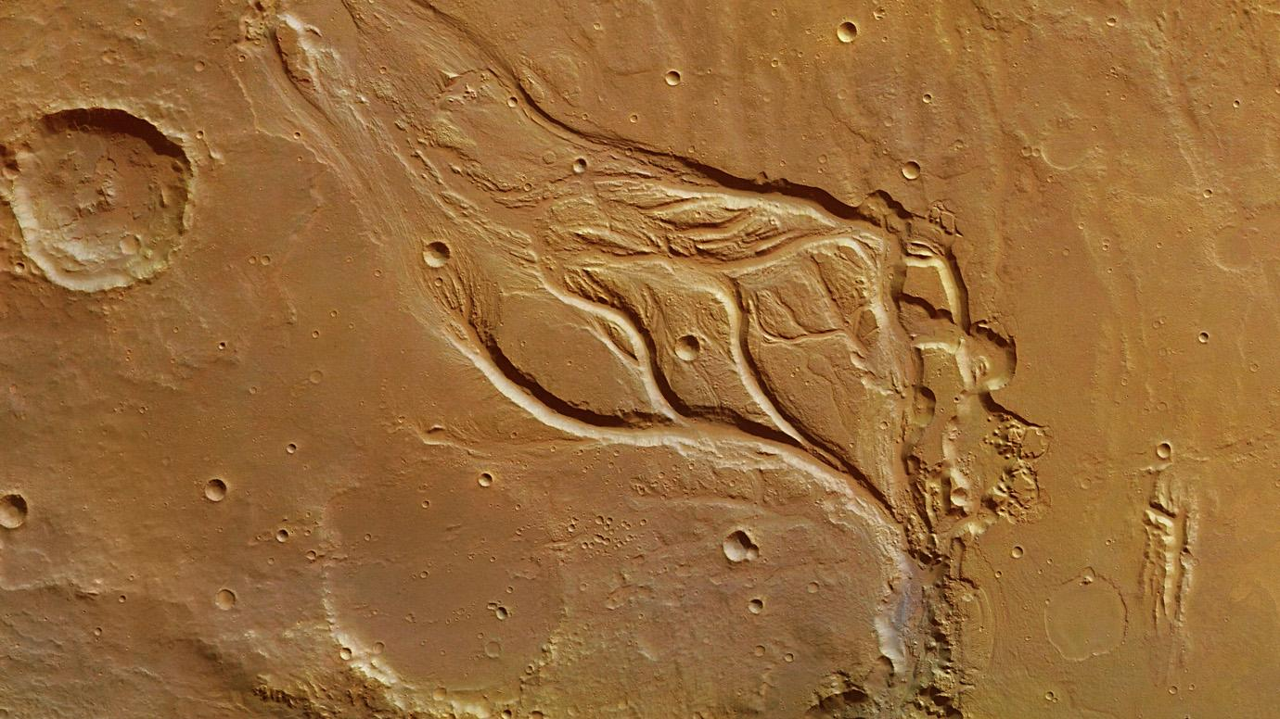
Rivers, Lakes and Ocean on Mars
-Mariner 9 (1971)
Branching rivers in Osuga Valles on Mars caused by overland flooding. )Credit: ESA/DLR/FU Berlin).
Analysis of data published in June 2010 revealed 40000 river valleys on Mars.

Slide 19
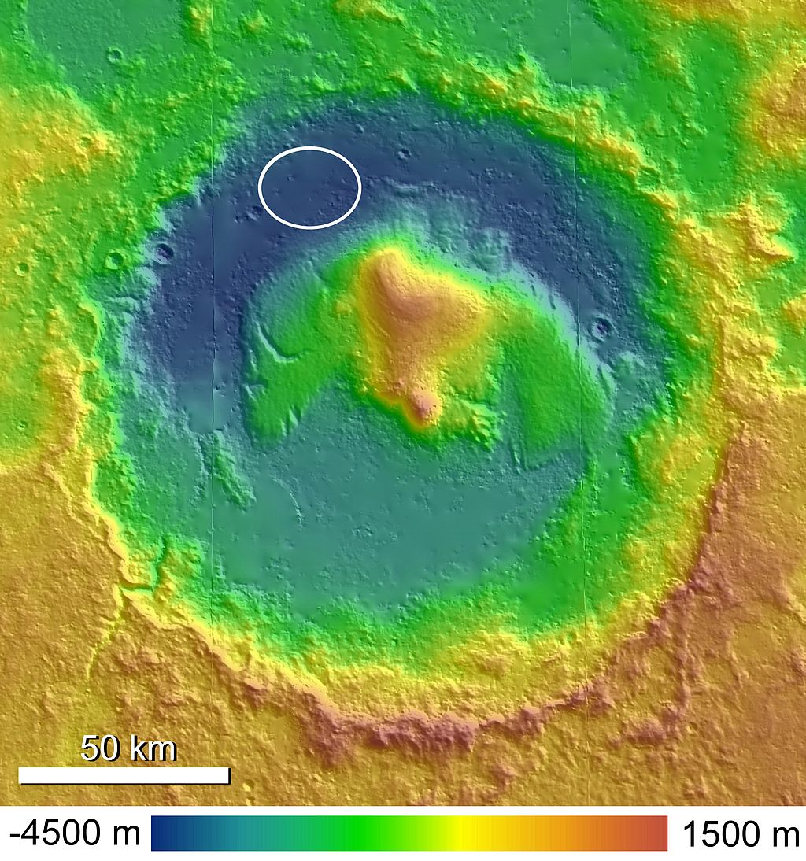
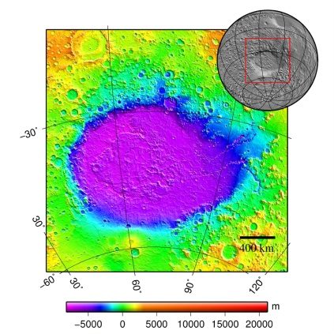
Lake Basins
- Many forms of lake basins have been discovered on Mars.
- Some basins are as large as the Caspian Sea or Black Sea on Earth
- Lakes were fed by river valleys networks.
- Some lakes are probably formed by precipitation
- Others are formed my ground water
- Lakes are found in: Argyre basin, Hellas basin, and Valle Marineries
- Several channels were discovered to connect lake basins
Gale crater: NASA detailing the mounting evidence that Gale crater once contained a large lake.
Hellas Basin Area topography. Crater depth is 7152 m

Slide 20
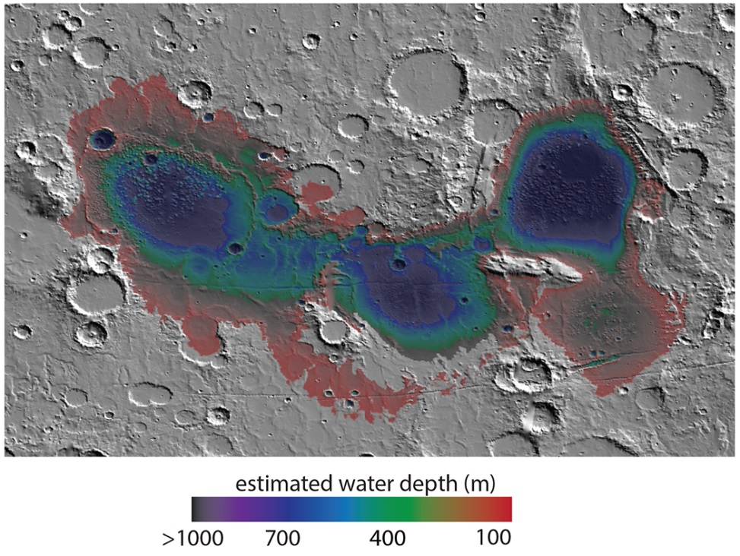
Eridania Lake/Sea
- Ancient lake occupying an area of 1.1 milliom km2.
- Deepest point 2400 m.
- Total volume: 562000 Km cube.
- It contains more water than all Martian lakes together.
- It holds 9 times more water than all of North American’s
great lakes, and even larger than the Caspian sea.
- A valley Network surrounded the lake.
Map showing estimated water depth in different parts of Eridania Sea. This map is about 850 km across. (Credit: Jim Secosky and NASA)

Slide 21
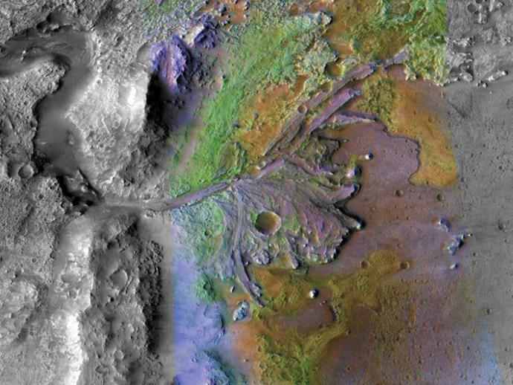
Martian Deltas
- Research work indicated that deltas have been
formed in certain Martian lakes.
- Deltas are usually formed in stable water to keep
sediment from washing away.
Grooved channels of an ancient river delta drift through Jezero crater on Mars.
(Credit: NASA/JPL-Caltech/MSSS/JHUAPL).

Slide 22
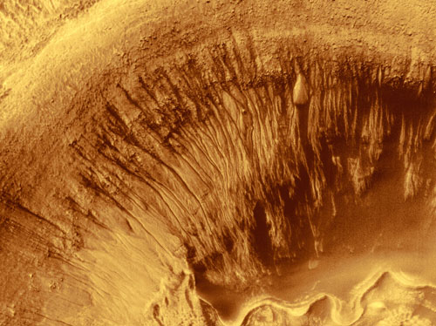
Groundwater
- European scientists demonstrated geological evidence
of an ancient planet-wide groundwater system.
connected to a putative Vast ocean.
- In 2019 Insight Lander received a mysterious magnetic
pulse, a magnetic oscillations consistent with a planet-
wide reservoir of deep underground water.
In mid 2000 NASA's Mars Global Surveyor spacecraft reported what looked like evidence of underground water seeping up to the surface relatively recently. (Credit: NASA/MGS)

Slide 23
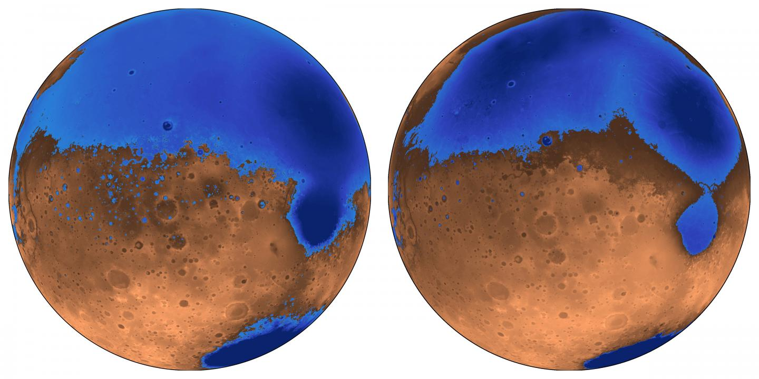
Mars Ocean Hypothesis
- Vastitas Borealis basin was once the location
of an ocean of liquid water.
- In 1999 Mars Orbiter Laser Altimeter
found that an ocean would have
covered 75% of the Planet.
- The existence of liquid water requires
warmer climate and dense atmosphere.
- Primordial ocean on Mars remains
controversial. The conjectured 2-billion
years old shoreline does not follow a line of constant gravitational potential. It could be due to a change in distribution of Mars mass, probably resulting from volcanic eruption or meteor impact.
- In 2015 evidence of ab ancient Martian Ocean in the planets northern hemisphere comparable to the size of Earth’s Arctic ocean.

Slide 24
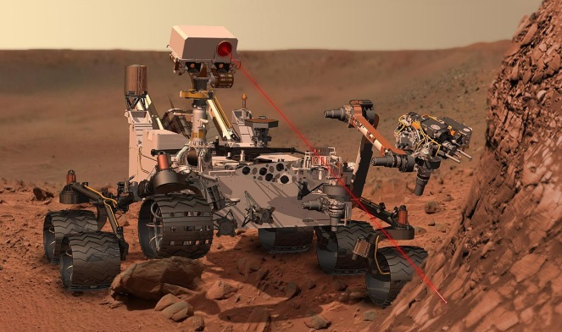
Curiosity Rover, the Search for Biosignature
- Curiosity Rover landed on Mars in 2012.
- In 2018 the Rover sifted a sample of soil and ground-up rock
searching for signs of organic molecules.
-Molecules are unlocked from sample by baking them up in an oven
to temperatures between 600 – 860 centigrade. (To remove all source of contamination).
- Resulting Fume are then fed to a spectrometer to identify molecules by weight.
- The organic signal reflects dozens or hundreds of small carbon molecules (aromatic and aliphatic).
- In addition to sulfur bearing rings known as thiophenes.
- The mass pattern of theses molecules resembles what we obtain on Earth by Kerogen.
- Kerogen, when combined with sulfur compounds can be preserved for billion of years.

Slide 25
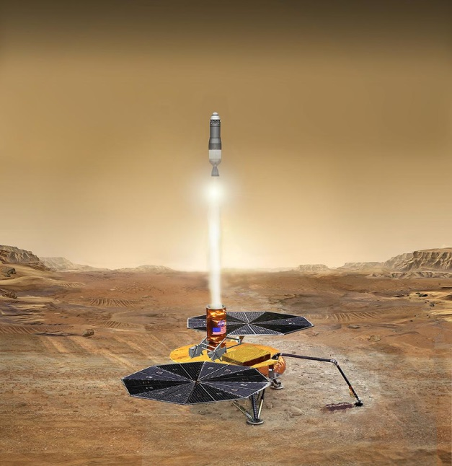
Source of kerogen on Mars
Searching for a Biosignature
- Carbon-rich meteorites containing kerogen-like compounds
- compounds are formed by reaction driven by ancient volcanos.
- Nondestructive testing by Curiosity Rover involves using cups that free organic compound bonded in rocks, and thus avoiding the need to breaking apart and destroy them at high temperatures. Technical problems prevented the Rover from achieving this task.
- The finding of Curiosity Rover are worth pursuing by future Martian missions.
Possible answer may be provided by Perseverance Rover and Europe’ Rosalind Franklin Rover.
-Mars Sample Return mission (MSR) will impact our approach.
- There are three proposals of MSR missions: NASA-ESA, Russian, and Chinese.

Slide 26
CONCLUSION
- In the first part of this paper, it was determined that the aqueous environment played a crucial role in the formation of fossil fuel in the early history of Earth.
- Kerogen emerges as a possible biosignature utile in identifying similar processes leading to the formation of fossil fuel on Mars.
- Aqueous environment in the early history of Mars supported a biosphere conductive to the ultimate formation of hydrocarbons.
- Martian probes confirm that Mars has been once replete with large reservoirs of water in form of rivers, deltas, lakes and underground channels – not to mention even a possible ocean.
-It was demonstrated that bioforms can be transformed, through chemical and biological processes, to kerogen and, as a final by-product, catagenisis transforms kerogen into liquid and gaseous hydrocarbons.
- Analysis of samples extracted from the Martian subsurface indicates the presence of kerogen in the soil. However, no consensus was obtained as to the origin of the discovered kerogen.
- It is concluded that future Martian missions can elucidate the origin of kerogen on Mars as an important step towards confirming – or refuting -- the existence of fossil fuel in the subsurface of the planet

Slide 27
شكرًا
Thank You

