Slide 1
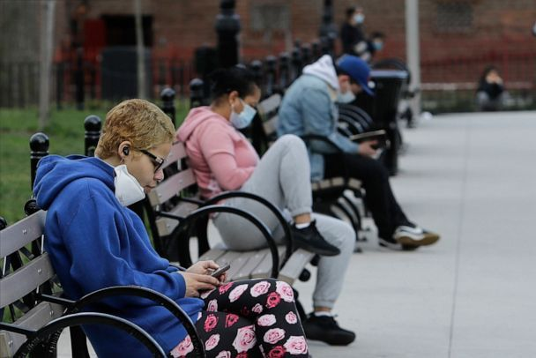
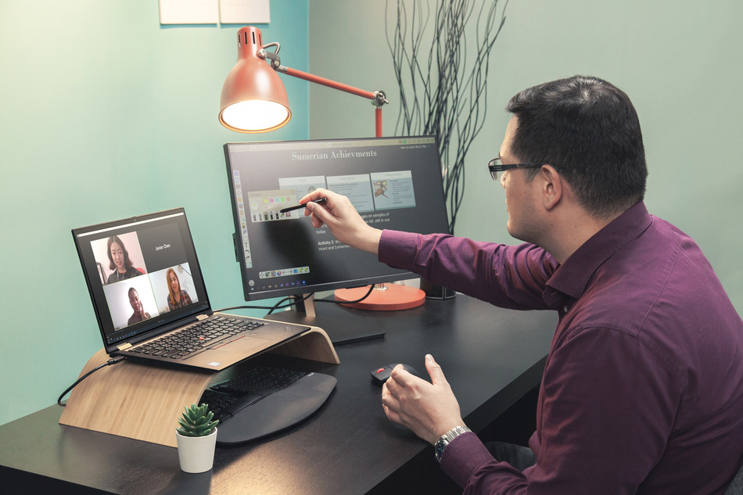
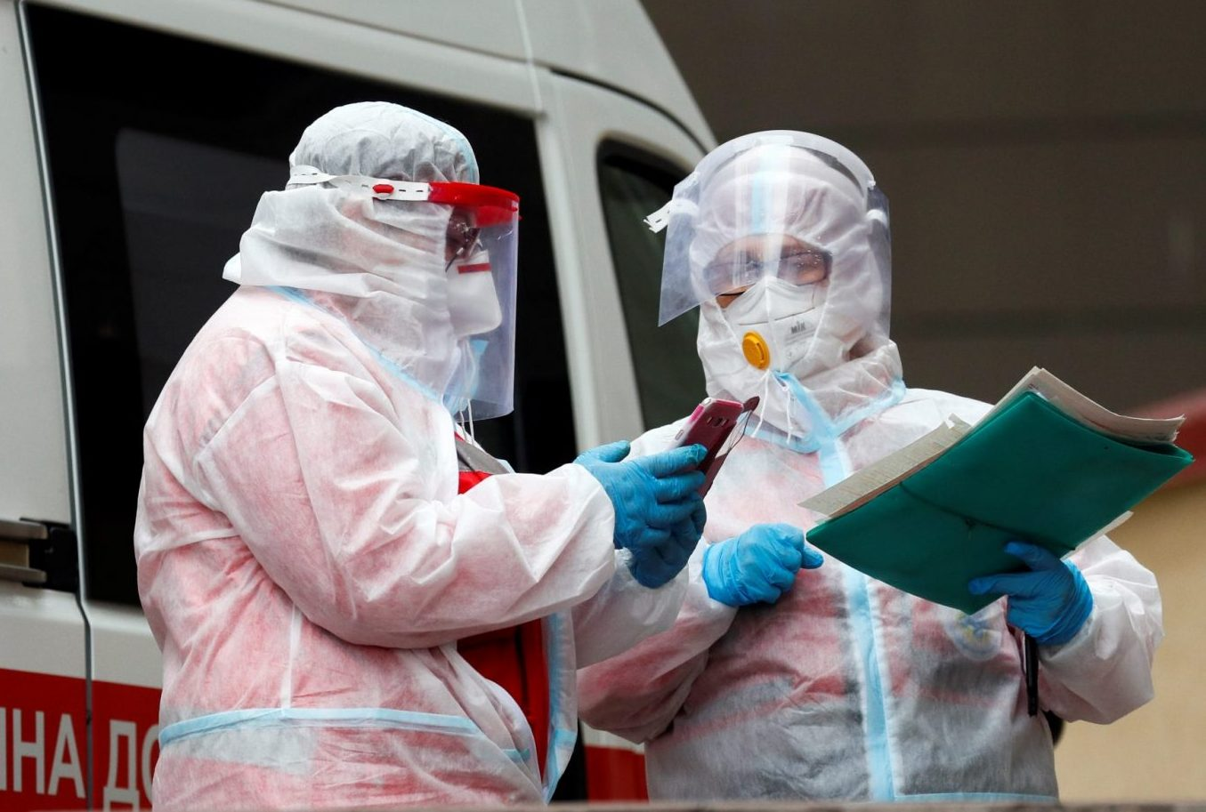
Perception and Impact of Coronavirus (COVID-19) on People’s and lifestyle in Bahrain
Professor Mukhtar AL-Hashimi
Vice president for Academic Affairs
March 23, 2021

Slide 2
Can you define crisis?
One can define a crisis as an occurrence that is either natural or human-instigated disasters that affects the normal operation of organizations, business, people and government as well as people lifestyles.
In short,
a crisis can lead to turbulence in normal business transactions, economic status, people lifestyles and the political wellness of a country.

Slide 3
What are the types of emergencies we be planning for?
Routine emergencies
Crisis emergencies
Emergent Crises

Slide 4
Emergent Crises
Pose Special challenges in term of recognizing novelty because they are unusual characterizes.
We Never planned and expected it

Slide 5
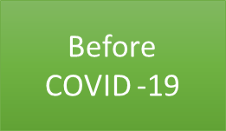
Reflection on the organization and well-being Before COVID-19
Everyone of us busy with their work, life, and career
Travelling and enjoying our times.
Freedom of movements and travels.
Seeking more family time and work-life balance.
Attending social, conferences workshops in physical while socializing.
Relax and focusing on the future without anxiety.
Changes are anticipated and planned for based on sound parameters.
Learning is schools, university, and educational responsibility.
Working at Workplace and management closely monitoring the productivities.
Healthcare facilities accessible to all and operating in normal
Everyone enjoying social engagement – from conferences, wedding, eating, cinema and sports
Job security and stable financial well-being of families and organizations – relative Stability in our life.
In short, “we never imagined and anticipated that a public health crisis would tragically …..”
No Mask

Slide 6
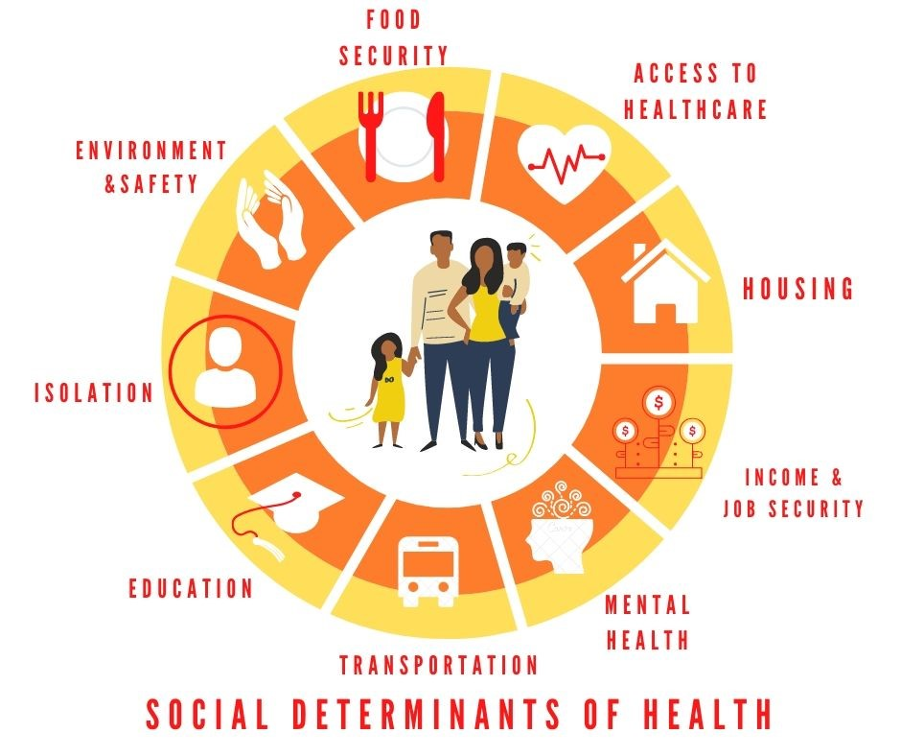
Reflection on the organization and well-being During COVID-19
During
COVID -19
Wearing Mask is a habit
Top issues on people minds during the COVID-19 crisis include:
Job security
Personal health
Childcare and home schooling
Personal finances
Remote work
Visibility of their employer
Stress and mental health
Work life balance
Family health
Productivity
Social isolation
Managing schedule
Stay physically safe from the virus
Government Role

Slide 7
Reflection on the organization and well-being Interim COVID-19
People still have anxiety and fear of losing love ones.
Fear of not meeting business or personal financial obligation
Worried from another wave of COVID-19
Weak purchasing power and weak economy performance
Worried from recession especially U recession.
Uncontrollable domino effect
Unable to shift your mind set from COVID-19 Implication and getting caught in the situation..
Interim
COVID -19

Slide 8
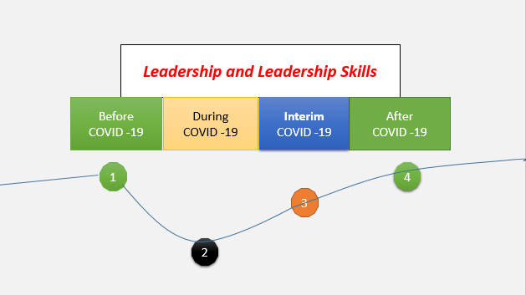
The Question here is ….
What is the perception and lifestyle toward COVID-19?

Slide 9
Government trust, perceptions of COVID-19 and behaviour change: cohort surveys, Singapore
Lim, V.W., Lim, R.L., Tan, Y.R., Soh, A.S., Tan, M.X., Othman, N.B., Dickens, S.B., Thein, T., Lwin, M.O., Ong, R.T., Leo, Y., Lee, V.J. & Chen, M.I.C. 2021, "Government trust, perceptions of COVID-19 and behaviour change: cohort surveys, Singapore", World Health Organization.Bulletin of the World Health Organization, vol. 99, no. 2, pp. 92-101.
Objective To evaluate how public perceptions and trust in government communications affected the adoption of protective behaviour in Singapore during the coronavirus disease 2019 (COVID-19) pandemic
Most participants agreed or strongly agreed that information from official government sources and Singapore-based news agencies was trustworthy.
Perception Toward Quarantine for COVID-19 Among Adult Residents of Selected Towns in Southwest Ethiopia
Mamo, Y., Asefa, A., Qanche, Q., Dhuguma, T., Wolde, A. & Nigussie, T. 2020, "Perception Toward Quarantine for COVID-19 Among Adult Residents of Selected Towns in Southwest Ethiopia", International Journal of General Medicine, vol. 13, pp. 991-1001.
The aim of this study was to assess public perceptions toward quarantine for COVID-19 and associated factors among adult residents of selected towns in Southwest Ethiopia, 2020.
Factors were significantly associated with a positive perception toward quarantine were educational status of secondary and above, being a merchant, knowledge of COVID-19 and knowledge of quarantine were significantly associated with a positive perception toward quarantine.

Slide 10
Public Perception Regarding COVID-19, Nature of the Disease, Susceptibility to Complications, and Relationship to Influenza: A Study from Jordan Using Google Forms
Khabour, O.F., Alomari, M.A., Alzoubi, K.H. & Alfaqih, M.A. 2020, "Public Perception Regarding COVID-19, Nature of the Disease, Susceptibility to Complications, and Relationship to Influenza: A Study from Jordan Using Google Forms", Journal of Multidisciplinary Healthcare, vol. 13, pp. 1937-1945.
Objective: study, perception regarding the nature of the COVID-19 disease, susceptibility to its complications, and its relationship to seasonal influenza was investigated among the Jordanian population
The majority of Jordanians have a good perception about the nature, cause and symptoms of COVID-19 disease.
Factors such as age, gender, and education were found to modulate some of the perceptions of Jordanians regarding different aspects of COVID-19 disease
Perceptions and experiences of the public regarding the COVID-19 pandemic in Nepal: a qualitative study using phenomenological analysis
Bhatt, N., Bhatt, B., Gurung, S., Dahal, S., Jaishi, A.R., Neupane, B. & Shyam, S.B. 2020, "Perceptions and experiences of the public regarding the COVID-19 pandemic in Nepal: a qualitative study using phenomenological analysis", BMJ Open, vol. 10, no. 12.
Perceptions of people regarding COVID-19 influences their health behaviour in terms of seeking public health services
There was a good general understanding among respondents about COVID-19, personal preventive measures and population-level strategies.
The respondents acknowledged the vital role of media in increasing awareness.
The lack of social interaction, isolation and loss of income were raised as pertinent issues by the participants as potentially leading to psychological consequences

Slide 11
The knowledge and perception of COVID-19 and its Preventive measures, in public of Pakistan.
(Taaha, et al) Pak Armed Forces Med J 2020; 70 (2): 338-45
.
Objective: To study the perception of COVID-19 and its prevention in the general public.
Most of the participants thought that use of face mask (91%), washing hands (99.4%), avoiding close contact with sick people (97.8%) and not touching the face with unwashed hands (98.7%) should be used as a preventive measure.
The participants were also strongly in support of all the preventive measures at government level suggested in the questionnaire to reduce the transmission of COVID-19;
The participants also had mixed views regarding whether they thought that this pandemic was a bioweapon developed by a government or a terrorist organization. 55.3% of the people felt that it was likely.
Understanding of General People about COVID-19: A Cross-Sectional Online Survey and Qualitative Presentation
Rabby, I.I., Hossain, F., Akhi, I.J., Amin, S.A.M.S. & Khan, A. 2020, "Understanding of General People about COVID-19: A Cross-Sectional Online Survey and Qualitative Presentation: Turkiye Klinkeri Journal of Medical Sciences", Türkiye Klinikleri.Tip Bilimleri Dergisi, vol. 40, no. 2, pp. 203-219.
Objective: To identify general people’s actual knowledge, awareness, and perception about COVID-19 and to facilitate healthcare organizations, responsible authority, and general people.
it is necessary to identify and improve the actual knowledge, awareness, and perception to control its spread

Slide 12
Public Perception on COVID-19 in India (Prakash et al).
(International Journal of Pharmaceutical Research | Jan - Mar 2021 | Vol 13 | Issue 1
.
Aimed on the understanding of disease nature, causal organism, their spread, containment measures and the contribution of government in controlling the disease measured by 463 people were collected and presented.
Usage of mask in preventing the disease is acknowledged by maximum number of respondents.
The respondents are also supporting traditional system of medicine than any other type of medicinal system in containment of virus.
Maximum number of people appreciate the measures taken by the Government in containment of virus and supports the Government to bring a bill for clearance of virus
Towards the knowledge related to the spread of COVID-19 is concerned, nearly 95% of the respondents answered that the disease spread worldwide.
Perception of COVID-19 During the 2020 Pandemic in Russia
Pervichko E.I., Mitina O.V., Stepanova O.B., et al. Perception of COVID-19 During the 2020 Pandemic in Russia. Klinicheskaia i spetsial'naia psikhologiia=Clinical Psychology and Special Education, 2020. Vol. 9, no. 2, pp. 119–146.
Objective: To identify general people’s Perception of COVID-19 During the 2020 Pandemic in Russia
Significant differences were found in experiencing stress, anxiety, and perceptions of the pandemic by gender, while anxiety and stress were found to be related to income.

Slide 13
Analysis of Results
Data Collection
April 2020 for three Weeks Period
Perception and Impact of Coronavirus (COVID-19) on People’s and lifestyle in Bahrain

Slide 14
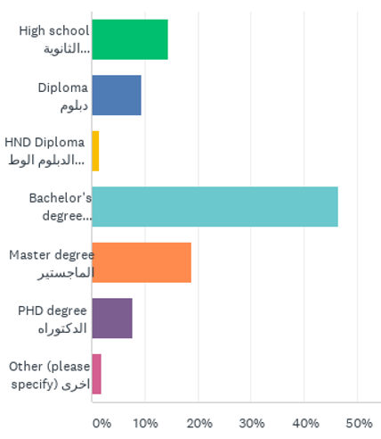
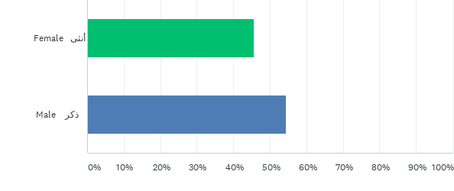
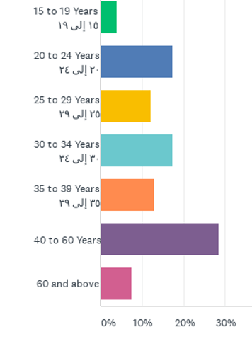
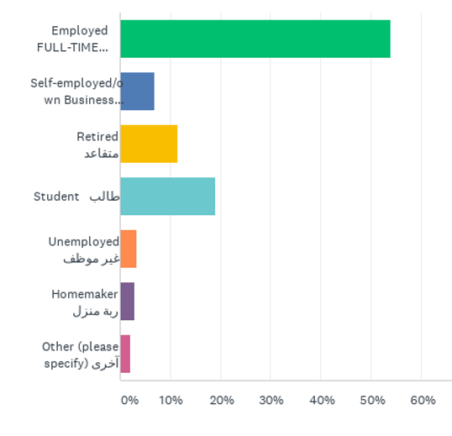
Participants Demographic
613 Total Responses
Qualification
Gender
Age in Years
Employment status

Slide 15
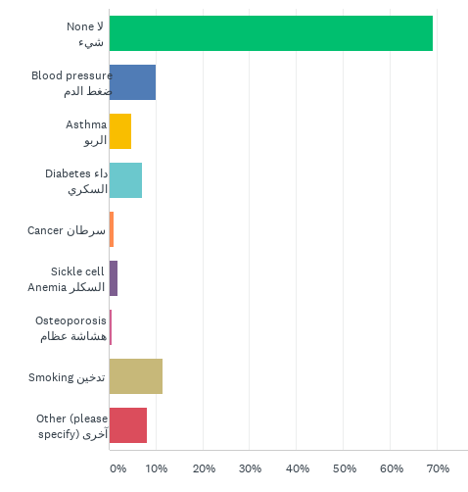
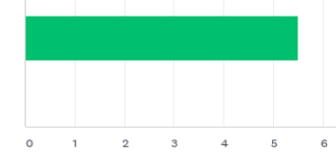
Participants Demographic
613 Total Responses
How many people live in your household?
Any chronic or hereditary diseases or medical history

Slide 16
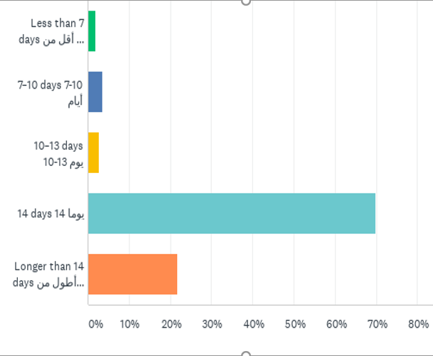
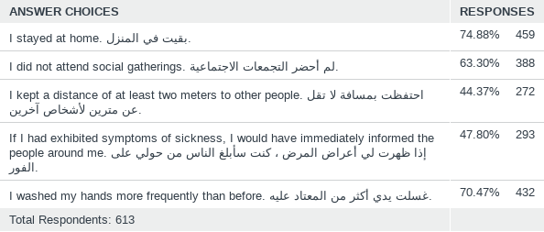
Knowledge of COVID-19
613 Total Responses
Describe your behavior for the past week?
How long is the quarantine or self-imposed isolation period?

Slide 17
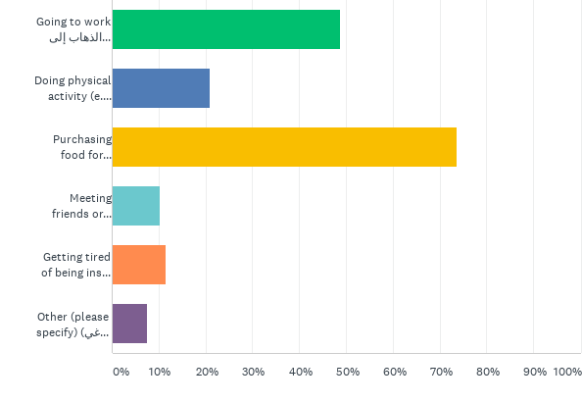
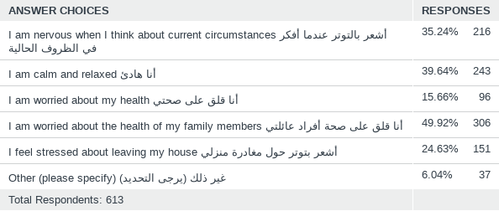
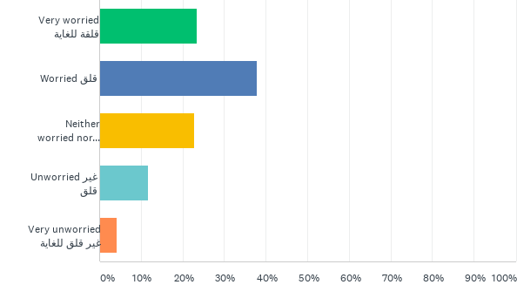
Psychological effects of COVID-19 on People
613 Total Responses
To which extent do the following statements apply to you right now?
What are the reasons for you to leave your home ?
How worried are you about the effects of coronavirus on your household’s economic situation?

Slide 18
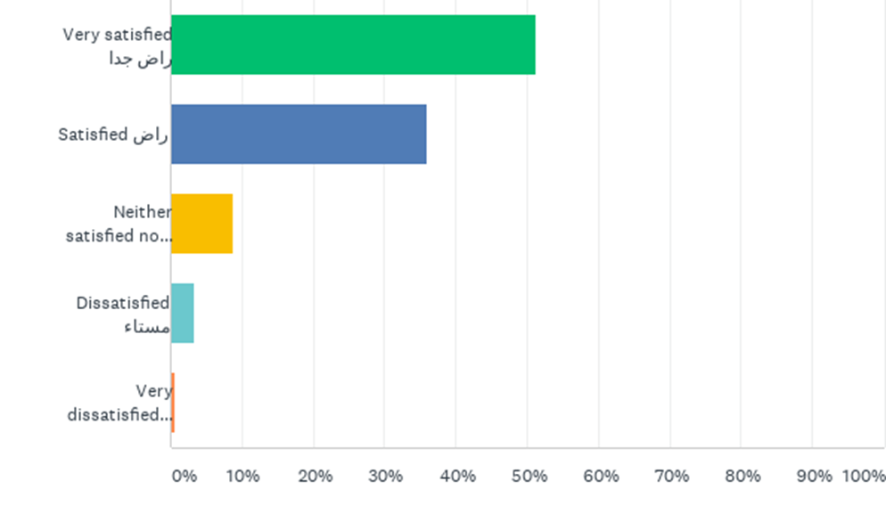
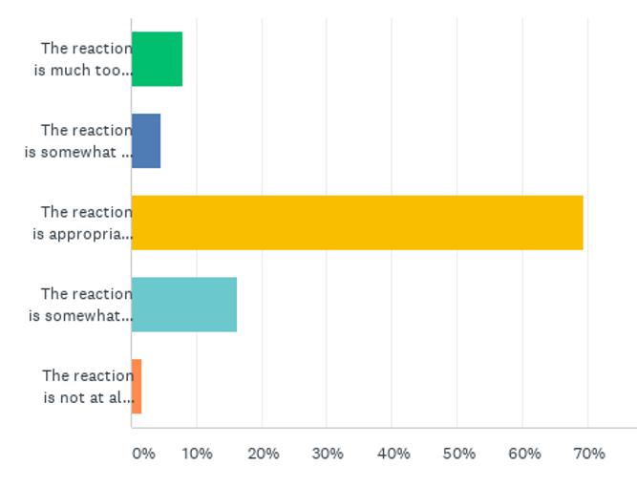
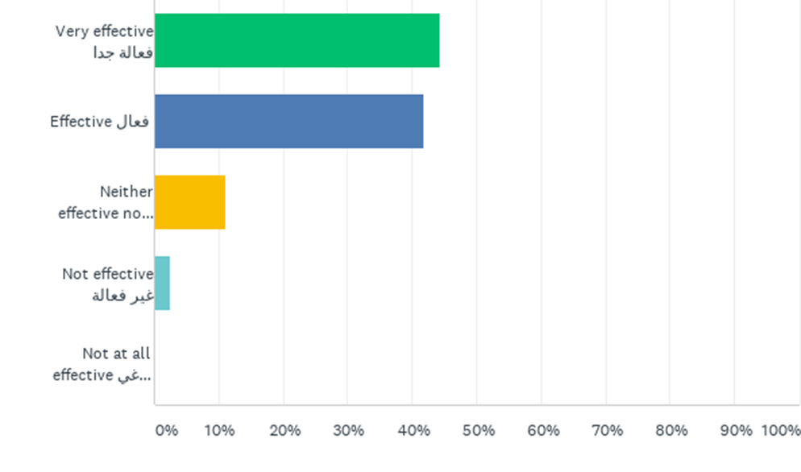
Perception of Governmental Measures
613 Total Responses
Reaction of your country’s government to the current coronavirus outbreak
How satisfied are you with the government's economic and financial support program. Such as government supporting salaries, electricity, and stopping bank loans on the citizen of your country?
How effective are social distancing measures (e.g., through a general curfew) to slow down the spread of the coronavirus?

Slide 19
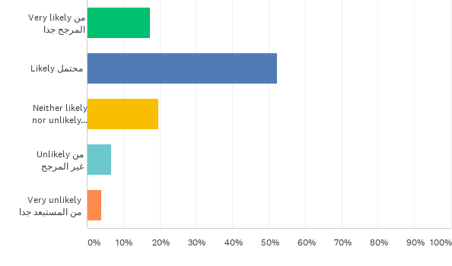
Beliefs about COVID-19
613 Total Responses
Do you think coronavirus is part of an international conspiracy ?
How likely do you think that coronavirus will come back again?

Slide 20
Lessons learned from the coronavirus crisis
613 Total Responses
Criteria | Responses
Health/hygiene related knowledge
Awareness (وعي)
Importance of being Prepared/planning
Strengthening Family Relations
Social Distancing
Following goverment procedures.
Self Dependence/Self Discipline
Unity of society to support each other.
Stronger relations to god/understanding the power or strength of God.
Change in lifestyle
Anything is possible
Patience
Importance of healthcare and health workers
Prevention is better than cure
Life goes on
High Appreciation to government Leadership and Medical Professionals citizen
Able to Spend More Time with Family

Slide 21
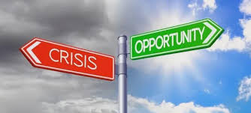
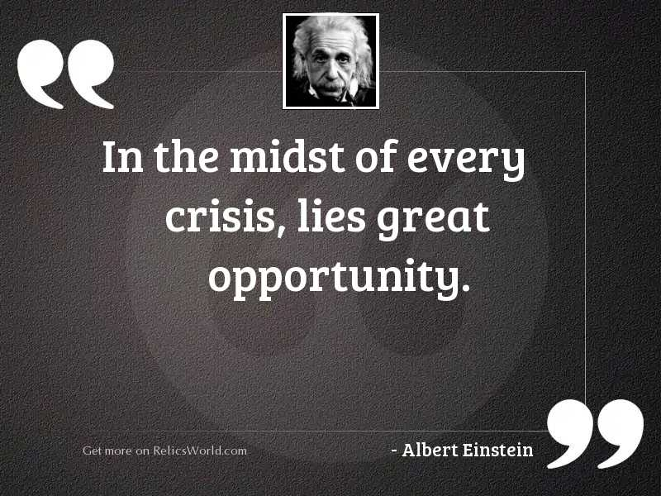
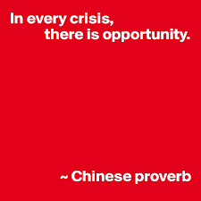
Remember with every problem comes numerous opportunities to grab.
Effective Leader faces the challenges effectively and sport and execute the opportunities.

Slide 22
Reflection on the organization and well-being After COVID-19
Life will never be the same as it was before COVID-19
COVID-19 Vaccinee passport highly feasible.
Working from home and blended working scheme (working from home is reality for work life balance)
Acceptance of some new practice introduced during the COVID-19 – Online Learning and Work.
Increase in Adoption of Telehealth, E-health, E-consultation, Digital health Apps options will accelerate
Necessary for merger and alliance to sustain our organization.
Different Lifestyle, Masks and Sanitizer products
Increase in the number of mental health such as anxiety and depression.
Government will continue investing in healthcare sectors especially public healthcare and research.
Restriction and Lockdowns will be acceptable.
After
COVID -19

Slide 23
Thank you!

