Slide 1
Using Data Mining Techniques to Predict Diabetes and Heart Diseases
Dr. Ammar Aldallal
Amina Almoosa
Ahlia University- Bahrain
Department of Computer Engineering

Slide 2
Outlines
Introduction
Data mining techniques
NCD prediction application
Results
Conclusion

Slide 3
Introduction
The figures of World Health Organization (WHO) show that globally non-communicable diseases (NCD) are responsible for 68% of fatalities, where the major fatal NCDs’ are diabetes, cancer and heart diseases
Medical diagnosis is an important task that is needed to execute predictions accurately and efficiently.
Unfortunately, doctors are not always experts in every specialization, and there is a shortage of specialized personnel at many places.
Hence, any system that would predict or forecast diagnostics will bring a lot of relief and help to doctors and practitioners.

Slide 4
Importance of the proposed system
According to WHO fact sheet (2014):
Cardiovascular diseases (type of heart disease) caused 26% of deaths in Bahrain.
Probability that 13% deaths within the age range 30-70 years will be caused by four NCDs.
Physicians must monitor risk factor of cardiovascular diseases to prevent reasons that cause heart attacks or strokes by getting the right system for storing the medical record and analyzing the data.

Slide 5
Data Mining Techniques
Data mining is concept used for retrieving information from a large set of data.
Mining means using available data and processing it in such a way that it is useful for decision-making.
Two types:
Predictive data-mining model predicts the future outcomes based on past records retrieved from database.
Descriptive model is used to discover patterns in the data and understand the relationships between the data attributes.

Slide 6
Prediction System
The objective of this application is to predict whether the patient is at risk of getting a non-communicable disease or not by analyzing the patients’ data obtained.
The attributes collected from the database are the following:
Age
Sex
Chest Pain (CP)
Test bps (Resting blood pressure )
Cholesterol
Fasting Blood Sugar (FBS )
Rest ECG (Electronic Cardio Graphic)
Diet (Yes, No)
Smoking and Alcohol

Slide 7
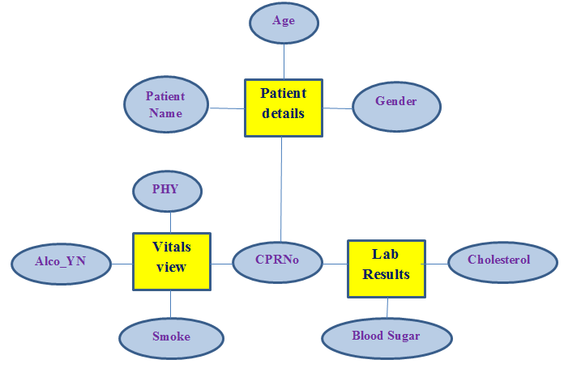
ER-Diagram

Slide 8
Attributes and values collected from the data set (1)
No. | Attr. | Description | Cut-off Value | Type
1 | Age | Age of the patients in years | Age <=40 40 < Age <=60 Age >60 | Young Age Middle Age Old Age
2 | Sex | Gender | 1 0 | Male Female
3 | CP | Chest Pain Type | Value1 Value2 Value3 Value4 | Stable Angina No-Stable Angina Non-Angina Pain Asymptomatic
4 | Test bps | Resting blood pressure (in mmHg) | BP<80 BP<90 BP>90 | Normal Normal to High High

Slide 9
Attributes and values collected from the data set (2)
No. | Attr. | Description | Cut-off Value | Type
5 | Chol | Serum Cholesterol (mmg/dl) | Chol < 5.2 5.2 < Chol < 6.2 Chol >=6.2 | Normal High Severe
6 | FBS | Fasting blood Sugar | 1 0 | True False
7 | Rest ECG | Resting electro cardio graphic results | Val=0 Val=1 Val-2 | Normal Abnormal Probable
8 | Diet | On healthy diet | 0 1 | True False
9 | Smoking | Smoker patient | 0 1 | True False
10 | Alcohol | Alcohol drinker | 0 1 | True False

Slide 10
Process of data mining
The data mining task can be shown in Data Mining Query Language DMQL as follow:
Use Patient_DB
Mine comparison as “Patient_NCD_Risk_Level”
In relevant to Age, Sex, CP, Test bps, Chol, FBS, Rest ECG, Diet, Smoking, Alcohol
For “Vitals_View” and “Lab_Results’
Versus “if_condition_rule”
Analyze sum
Display as “risk level”

Slide 11
Sample of classification process
The cholesterol grouped as
0 if the value is less than 5.2.
1 if the value is greater than or equal 5.2 and less than 6.2.
2 if the value is greater than or equal 6.2.
If cholesterol value < 5.2 then
group = 0
Else if 5.2 < cholesterol value < 6.2
group = 1
Else
group = 2

Slide 12
Results
Prediction of Risk level
BP | Heart Rate | Chol. | Chest Pain | Age | Risk Result
0 | 0 | 0 | 0 | 0 | No Risk
0 | 1 | 0 | 1 | 0 | No Risk
0 | 2 | 0 | 1 | 0 | No Risk
1 | 1 | 1 | 1 | 1 | Low Risk
1 | 2 | 0 | 1 | 0 | No Risk
1 | 2 | 0 | 1 | 1 | No Risk
1 | 2 | 0 | 1 | 2 | Low Risk
1 | 2 | 0 | 2 | 2 | Medium
1 | 2 | 1 | 1 | 1 | Low risk
1 | 2 | 1 | 2 | 1 | Medium
2 | 2 | 1 | 1 | 1 | Low Risk
2 | 2 | 1 | 1 | 2 | Medium
2 | 2 | 1 | 2 or 3 | 2 | High Risk
2 | 2 | 2 | 1 | 1 | Medium
2 | 2 | 2 | 2 or 3 | 2 | High Risk

Slide 13
Sample output

Slide 14
Conclusion
The results obtained are approved by a number of practitioners of Bahrain Defense Force Hospital.
The huge amount of data available in the DB of health center can be utilized in developing such application.
This study confirms that health centers need to have a system or a software application that predicts NCDs.
This application would be a tremendous asset for doctors so that they can ensure that their diagnosis or inferences are correct and professional.

