Slide 1
Behaviour equilibrium exchange rate and misalignment:
Empirical Case from Kuwaiti Dinars
Researchers:
Zainab Alhayki (Ahlia University)
Ahmed Alhayky (Skyline University)

Slide 2
Outline of Presentation
Introduction
Aim, Motivation and Contribution
Literature Review
Econometric Methodology and Data
Processing the Results
Conclusions

Slide 3
Introduction
Exchange rate plays a significant role to achieve both internal and external balance.
Exchange rate fluctuation affect macroeconomics variables:
  Level of GDP
  Trade
  Interest rate
  Unemployment
  Inflation

Slide 4
Importance of RER Misalignments
  Could be used to predict future shifts of the exchange rate (Aguirre, Calderon, (2005)).
  A likely prelude to financial crisis (Krugman (1979), Kaminsky and Reinhart (1999));
  May underline the need to adjust the exchange rate;
  May affect economic growth (Edwards (1989));
  May boost the economic growth, as was the case of Japan and Germany and more recently, China (Dooley et al. (2003)).

Slide 5
Aim and Motivation
Aim:
  Choosing the variables that determine the behavior of the real equilibrium exchange rate (REER)
  Estimating the equilibrium exchange rate (the BEER model)
  Calculating the real exchange misalignments (RERM)

Slide 6
Literature Review
The relationship between real exchange rates and economic fundamentals (trade openness, productivity as well as terms of trade) was the scope of a study done by Yehoue and Dufrenot in 2005. Their sample includes 64 developing countries. They found that exchange rate dynamics of low-income countries are more likely to be explained by economic fundamentals than they are for middle-income countries.
In 2007, Ghana’s behavioral equilibrium exchange rate (BEER) was assessed by Iossifov and Loukoianova. They found that Ghana's main export commodities real world prices, real GDP growth as well as real interest rate differentials (both relative to trading-partner countries) can explain REER's long-run behavior. Based on that, they found that in 2006 REER was close to its estimated equilibrium level and that within two to three years the deviations from the equilibrium path will be eliminated.
Sallenave (2010) measured the growth impact of REER misalignments for the G20 countries. He found that developed countries converge slowly towards its estimated equilibrium exchange rate while size of misalignment for the emerging countries is higher than industrialized ones. Moreover, he found that economic growth is negatively influenced by misalignments.
.

Slide 7
Methodology and Data
Unit Root Test
Co-integration Tests
ARDL Model
To check stationary problems
To examine the long run co-integration relationship among variables
To estimate the long run equilibrium level of the REER

Slide 8
Methodology and Data
Variables
  Oil Price (OIL)
  Monetary Policy Proxy (MP)
  Relative productivity (PROD)
  Net Capital Flow (NKF)
  Degree of Openness (OPN)
  Government Expenditures (GOV)
  Reserve to GDP (RES)
  Data source
  Bloomberg
  Sample
  from1985Q1 to 2013Q4

Slide 9
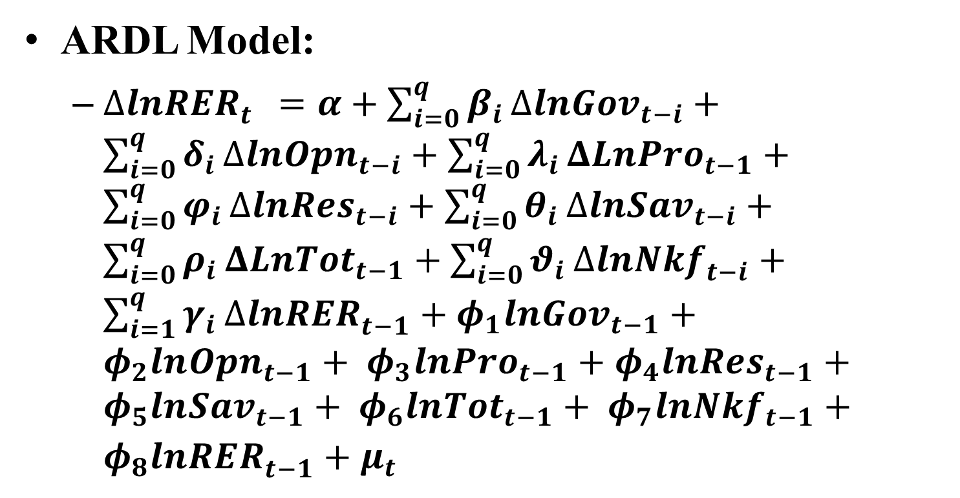
Methodology and Data

Slide 10
Unit Root Test: (Level)
 | ADF- Test |  |  |  | Phillips-Perron Test
Variables | None | Constant | Constant & Trend | Decision | None | Constant | Constant & Trend | Decision
LRER | 0.84 | -0.99 | -1.61 | I(1) | 0.82 | -0.86 | -1.52 | I(1)
LGOV | -0.44 | -1.67 | -1.96 | I(1) | -0.80 | -2.34 | -2.19 | I(1)
LMP | -0.24 | -1.74 | -2.86 | I(1) | -0.41 | -2.82*** | -3.03 | I(1)
LOIL | 0.03 | -2.02 | -2.38 | I(1) | -0.01 | -1.41 | -1.98 | I(1)
LOPN | -1.6*** | -3.76* | -4.15* | I(0) | -2.25** | -3.82** | -3.93** | I(0)
LPRO | -0.74 | -1.94 | -2.69 | I(1) | -0.84 | -2.16 | -2.50 | I(1)
LRES | 0.84 | -0.99 | -1.61 | I(1) | 0.82 | -0.86 | -1.52 | I(1)
NKF | -1.8*** | -3.33** | -3.84** | I(0) | -2.07** | -3.16** | -3.53** | I(0)

Slide 11
Unit Root Test: (1st Difference)
 | ADF- Test |  |  |  | Phillips-Perron Test
Variables | None | Constant | Constant & Trend | Decision | None | Constant | Constant & Trend | Decision
DLRER | -7.63* | -7.67* | -7.69* | I(0) | -7.57* | -7.60* | -7.70* | I(0)
DLGOV | -5.25* | -5.22* | -5.46* | I(0) | -3.55** | -3.35* | -3.51** | I(0)
DLMP | -5.94* | -5.90* | -6.43* | I(0) | -4.48* | -4.46* | -4.52* | I(0)
DLOIL | -7.64* | -7.60* | -6.18* | I(0) | -7.02* | -6.96* | -6.80* | I(0)
DLOPN | -10.45* | -10.41* | -10.36* | I(0) | -13.11* | -13.67* | -13.10* | I(0)
DLPRO | -5.69* | -5.50* | -5.69* | I(0) | -5.53* | -5.56* | -5.69* | I(0)
DLRES | -4.40* | -4.38* | -4.37* | I(0) | -10.12* | -10.06* | -10.21* | I(0)
DNKF | -8.45* | -8.42* | -8.50* | I(0) | -6.79* | -6.73* | -11.75* | I(0)

Slide 12
  Co-integration test results:
Table 4.2: Results of Co-integration test associated with Diagnostic statistics
* The asymptotic upper bound critical value for F-statistics at 1% level of significance is 4.43.
F-statistic* | ECM (-1) | T-Statistic | Serial Correlation | Functional Form | Heteroscedasticity
6.641 | -0.1135 | -3.875 | 12.481 | 1.23 | 2.181

Slide 13
  Results of Long- and short-run analysis:
Table 4.3: Results of Estimated long-run and short-run Coefficients
Estimated Long-run |  |  | Estimated Short-run Coefficients
Variables | Coefficients |  | Variables | 0 |  | 1 |  | 2 |  | 3
LGOV | 0.38 | (2.32)** | DLRER |  |  | 0.45 | (4.88)* | 0.16 | (1.72)*** | -0.20 | (-3.00)*
LMP | 0.57 | (2.59)** | DLGOV | 0.00 | (-0.07) | 0.01 | (-0.18) | -0.05 | (-1.53)
LOIL | 0.26 | (3.85)* | DLMP | 0.14 | (-1.65) | -0.32 | (-1.61) | 0.32 | (3.52)*
LOPN | -0.45 | (-2.41)** | DLOIL | 0.00 | (0.00) | -0.02 | (-1.34) | 0.02 | (1.90)***
LPRO | 1.41 | (4.16)* | DLOPN | -0.02 | (-1.29) | -0.01 | (-0.64) | -0.02 | (-1.80)*** | -0.03 | (-2.14)**
LRES | 0.03 | (0.77) | DLPRO | -0.67 | (-11.93)* | 0.32 | (2.10)** | 0.17 | (2.08)**
C | 11.83 | (6.30) | DLRES | 0.00 | (0.70)
Note: *, ** and *** denote significance at the 1%, 5% and 10% levels, respectively. Parentheses are t-statistics.

Slide 14
  Behavioral Equilibrium Exchange Rate and Misalignment
Figure 4.1: Interaction between LRER, BEER, PEER Figure 4.2: RER Misalignment

Slide 15
Conclusion
The independent variables play a significant role in determining REER both in long and short run.
The degree of misalignment ranged between -1.382 to 2.184 percent with zero reversion mean.
The overvaluation periods were during (1986- 90, 1996-98, 2002, 2005-08 and 2012-13) and the undervaluation periods were during (1991-95, 1999-01, 2003-04 and 2009-011).
The misalignment getting smaller and smaller.

