Slide 1
Algo trading in a limit order book prediction using Machine Learning Algorithm
Ahlia University 7th Annual
Research Forum
Dr. Suresh Subramanian
College of Information Technology

Slide 2
Agenda
Introduction
Literature review
Problem statement
Objectives
Proposed System Design
Proposed System
Sample Data Representation
Conclusion

Slide 3
Introduction
Financial Exchanges
Exchanges are organized marketplaces where securities (like stocks), commodities and derivatives (among other financial instruments) are traded
Investors need to agree upon a price before exchanging an asset, and this needs to be done centrally so the transactions can be monitored
Exchanges use what is called a Limit Order Book to achieve this coordination

Slide 4
Introduction
Limit Order Book (LOB)
The Limit Order Book is a transparent trading system that matches customer orders (bids and asks) using a “price first time second” priority basis
When an order is submitted it contains 3 attributes:
› Whether it is an ask (sell) or bid (buy) order
› The price limit p(t)
› The size of the order v(t)
The order book has two sides, the bid side, containing buy orders, and the ask side, containing sell orders

Slide 5
Literature Review
[1] Huang, B., Huan, Y., Xu, L. D., Zheng, L., & Zou, Z. (2019). Automated trading systems statistical and machine learning methods and hardware implementation: a survey. Enterprise Information Systems, 13(1), 132-144.
[2] Tsantekidis, A., Passalis, N., Tefas, A., Kanniainen, J., Gabbouj, M., & Iosifidis, A. (2018). Using Deep Learning for price prediction by exploiting stationary limit order book features. arXiv preprint arXiv:1810.09965.
[3] Chen, S., & He, H. (2018, October). Stock Prediction Using Convolutional Neural Network. In IOP Conference Series: Materials Science and Engineering (Vol. 435, No. 1, p. 012026). IOP Publishing.
[4] Tsantekidis, A., Passalis, N., Tefas, A., Kanniainen, J., Gabbouj, M., & Iosifidis, A. (2017, July). Forecasting stock prices from the limit order book using convolutional neural networks. In 2017 IEEE 19th Conference on Business Informatics (CBI) (Vol. 1, pp. 7-12). IEEE.
[5] Box, G. E., Jenkins, G. M., Reinsel, G. C., & Ljung, G. M. (2015). Time series analysis: forecasting and control. John Wiley & Sons.
[6] Cartea, Á., & Penalva, J. (2012). Where is the value in high frequency trading?. The Quarterly Journal of Finance, 2(03), 1250014.
[7] Avellaneda, M. (2011). Algorithmic and High-frequency trading: an overview. In New York University & Finance Concepts LLC Quant Congress USA 2011.

Slide 6
Problem Statement
Propose a machine learning framework to capture the dynamics of high frequency limit order books in financial equity markets and automate real-time prediction of metrics such as mid-price movement and price spread crossing.
Why Algo Bahrain?
http://algobahrain.com/#WhyALGOBahrain?
Algorithmic trading is the concept has introduced in Bahrain in 2017 to interconnect the banks through FinTech technology
Four out of ten customers in the GCC are ready to switch to a digital-first relationship
(http://www.bizbahrain.com/algo-bahrain-worlds-first-fintech-consortium-islamic-banks/).

Slide 7
Objectives
To accomplish the prediction of price movements based on current and past changes occurring in the limit order books
To propose a machine learning framework to capture the dynamics of high frequency limit order books in financial equity markets and automate real-time prediction of metrics such as mid-price movement.
To analyse and evaluate the accuracy of the proposed system using deep learning techniques.
To benchmark with other standard techniques such as Support Vector Machine (SVM) and Regression analysis.

Slide 8
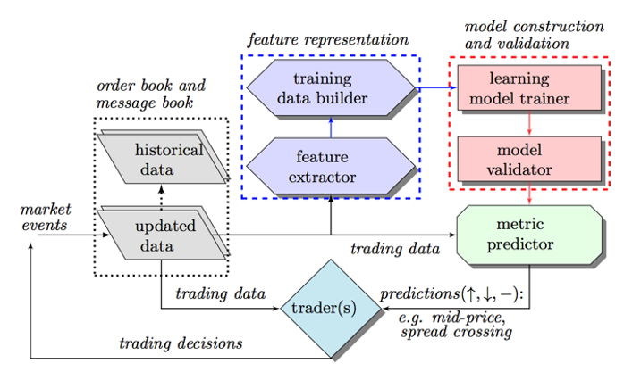
Proposed System Design

Slide 9
Proposed system
Proposed system has the following steps
Get the Data
Open Dataset
First publicly available datasets that contain representations and annotations for a limit order book (LOB) in the High Frequency Trading universe.
Benchmark Dataset for Mid-Price Forecasting of Limit Order Book Data with Machine Learning Methods.
Paid Dataset
NASDAQ datasets
Generate Features
Auto Regressive Integrated Moving Average (ARIMA) model is proposed – which is the most popular in time series analysis [4]
Statistical checks
Ensuring that the data has good quality is very important for our models.
Proposed techniques are Conditional Heteroskedasticity, serial correlation

Slide 10
Proposed system
Generate Model
Deep Learning techniques are identified
Convolutional Neural Networks (CNN) [3]
Recurrent Neural Network (RNN) [2][5]
Train the model
Test the model
Predict the Accuracy – Benchmarking with standard model
Implementation
Python V 3.6
TensorFlow

Slide 11
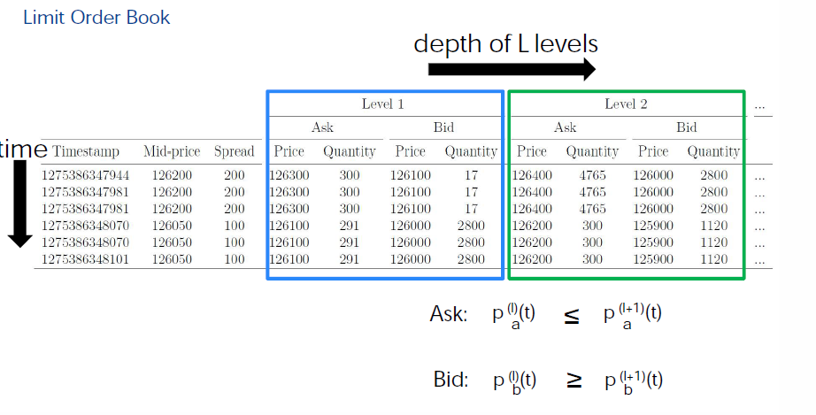
Data Representation
Sample data of Limit Order Book
Adopted from [4]

Slide 12
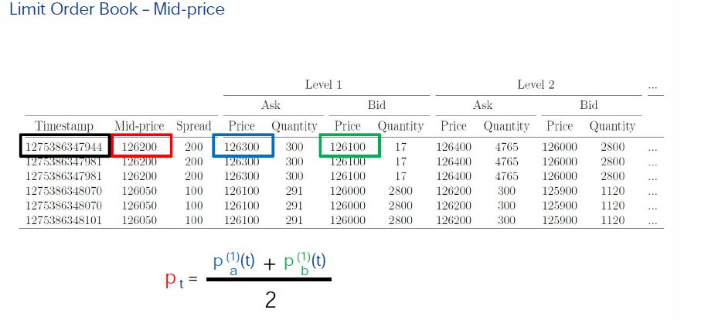
Data Representation
Adopted from [4]

Slide 13
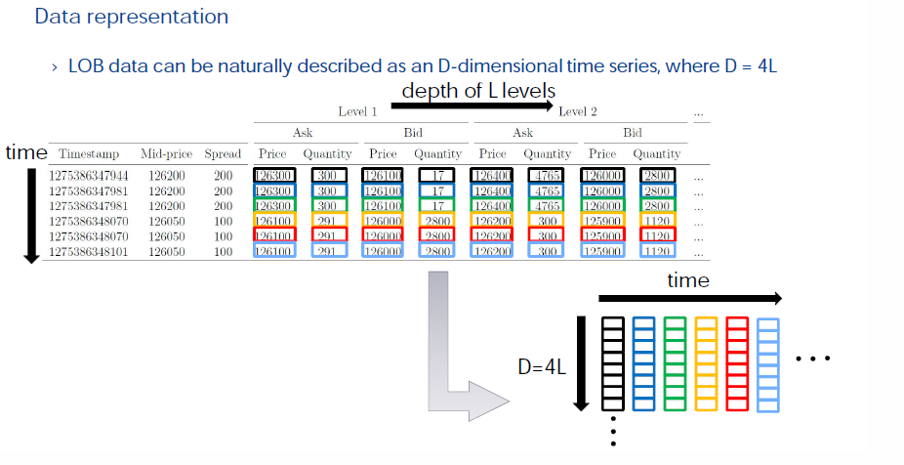
Data Representation
Adopted from [4]

Slide 14
Data Representation
Adopted from [4]

Slide 15
Conclusion
Proposed work is the Inter-disciplinary work which includes IT and Finance
Suggestions from QS Maple presentation at Ahlia University by Mr. Ashwin
Why Algo Bahrain?
Proposed work is submitted to –
Ahlia University - Academic Research Intellectual Contribution Committee (ARICC)
Application for funding to conduct a research project (Submitted the application to ARICC)
Primary Investigator : Dr. Suresh Subramanian
Co-Investigator: Dr. Gagan Kukreja
Received the positive feedback from reviewers and comments are addressed in this presentation

Slide 16
Conclusion
Thank You
Any Questions Please ?

