Slide 1



Research Topic at Wireless Networks and Communications Centre (WNCC)
H.S. Al-Raweshidy
Director of Wireless Networks and Communications Centre (WNCC),
Director of Post Graduate studies (ECE)
Department of Electronic and Computer Engineering,
Brunel University London,
Hamed.Al-Raweshidy@brunel.ac.uk
http://www.brunel.ac.uk/cedps/electronic-computer-engineering/research-activities/wncc

Slide 2
List of Contents
1- Research Topics
  Why, What and How
2- MSc Wireless Communication Networks
  Modules, Aim and Contents

Slide 3
WHY Are We Carrying Research in Such Area

Slide 4
Global Mobile Data Traffic, 2016 to 2021
Overall mobile data traffic is expected to grow to 49 exabytes per month by 2021, a sevenfold increase over 2016. Mobile data traffic will grow at a CAGR of 47 percent from 2016 to 2021
Source: Cisco VNI Mobile, 2017

Slide 5
Global Mobile Devices and Connections Growth
By 2021, Three – quarter of all devices connected to the mobile network will be “smart” device.
Note: Figures in parentheses refer to 2016, 2021 device share.
Source: Cisco VNI Mobile, 2017

Slide 6
Mobile Video Traffic by 2021
Mobile Video Will Generate More Than Three-Quarters of Mobile Data Traffic by 2021
Note: Figures in parentheses refer to 2016, 2021 device share.
Source: Cisco VNI Mobile, 2017

Slide 7



We’re communicating more than sleeping
8hrs 41m
The average UK adult is now spending more time using media than they are sleeping. 8h 41m communicating versus 8h 21m sleeping
Source Ofcom August 2014

Slide 8
What Are The Research Area

Slide 9
Research Topics
1- Beyond 5G and 6G
H-CRAN, Beam Forming, MMIMO, CDI, AI, MM WAVE 200-400 GHz, RoF, QoS, QoE
2- IoT
IIoT, I-IoT, Solar Energy Technology, Cloudification with SDN, Big Data, Sensor Networks, M2M, Autonomous Vehicle, Security, Protocols

Slide 10
How Are We Carrying Research ?

Slide 11
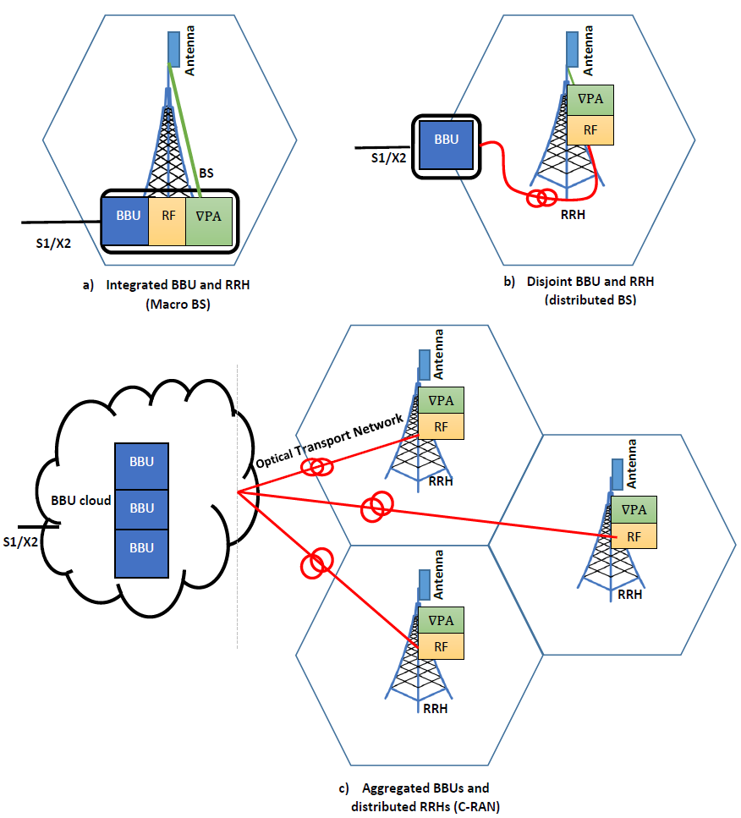
Base Station Evolution
Notes:
In a traditional architecture, the two main components, i.e., the BBU and RRH are integrated within a single centralised BS housed securely in an outdoor shelter. Radio Frequency (RF) signals are generated inside the integrated unit and fed to the antenna module over coaxial cables. The X2 and S1 interfaces are defined for BSs which connects a BS to its neighbouring BSs and the mobile network core, respectively.
The architecture was widely used for 1G and 2G mobile network deployments.
Disjoint BBU and RRH: Due to space limitations and a high cost of deployment operations, traditional integrated BS implementation is not possible everywhere. In this architecture, the BS is physically split into two components, i.e., the BBU and RRH. The RRH can be mounted near the antenna on the tower due to its small size and volume while the BBU can be located in a suitable space that is conveniently accessible and cost efficient in terms of site rental and maintenance.
In C-RAN, the BBUs of BSs are aggregated in a centralised location called the BBU pool/farm/cloud, while the RRHs are left on the cell sites, The RRHs are coonected to the BBU pool via an optical transport links with high bandwidth and low latency. The letter C in acronym C-RAN have different meanings. It not only stands for a ’Centralised-RAN’ or ’Cloud-RAN’ due to its cloud like infrastructure but is also interpreted as ’Collaborative,
Cooperative Radio or Clean (Green) RAN’ due to its flexible architecture.

Slide 12
Challenge in Mobile Networks
BS cell site is the major source of power consumption.
Power Consumption of Base Station
Notes:
The power consumption gets a dramatic rise as the operators constantly increase the number of base stations to offer broadband wireless services. However, doubling the number of (BS) to provide better network coverage and capacity, will significantly doubled the total power consumption as well. The majority of power consumption is going (BS) in the radio access network. Inside the BS, only half of the power is used by the RAN equipment; while the other half is consumed by air condition and other facilitate equipment as shown in the Pie chart.
In order to save energy and decrease carbon-dioxide emissions is by decreasing the number of (BS). However, this will result in worse network coverage and lower capacity in traditional RAN. Therefore, new technologies are needed to reduce energy consumption without reducing the network coverage and capacity.
Nowadays, many technologies solution that helps to reduce (BS) power consumption, such as the software solutions which save power through turning off selected carriers on idle hours like midnight, the green energy solutions which offer solar, wind and other renewable energy for base station's power supply according to local natural conditions, and the energy-saving air conditioning technology which combined with the local climate and environment characteristics, reduce the energy consumption of the air conditioning equipment, etc.

Slide 13
Why the need for new architecture
2G
3G
LTE
Increased Construction Cost leads to increased Inter-cell Interference

Slide 14
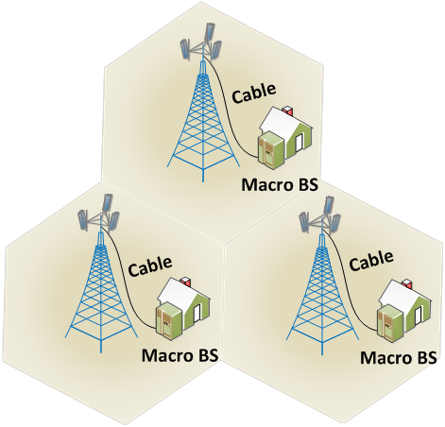
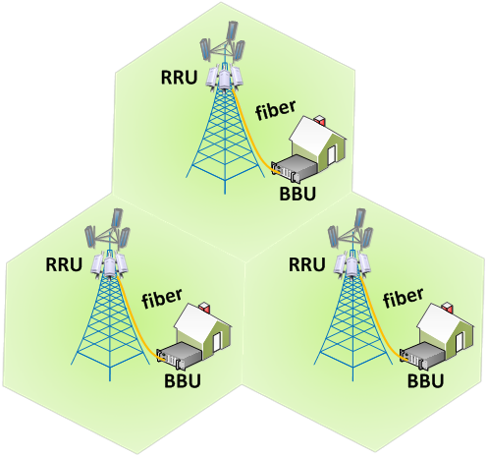
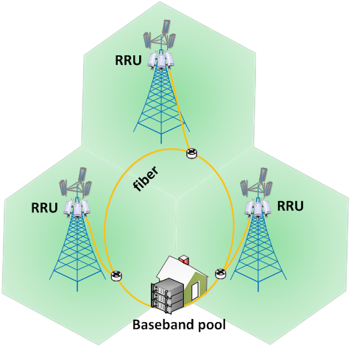
Centralized baseband pool
Traditional macro base-stations
Distributed
base-stations
C-RAN Centralized
baseband pool
Notes:
Traditional Base Station :
In the 1G and 2G networks, most base station were using the all-in-one design, which mean having the analog, digital and power functions in one cabinet. Usually the base station cabinet is placed in a dedicated equipment room with all necessary site supporting facilitates like power, backup battery, air condition, backhaul transmission equipment etc. The RF signal from the base station RF unit goes through pairs of RF cable to the antennas on the top of base station tower.
Distributed Base Station:
The distributed base station design in 3G network used where the radio function unit also referred to as the remote radio head (RRH), is separated from the digital function unit, also referred to as the baseband unit (BBU). The RRH can be installed on the top of tower, close to the antenna. This reduces the cable loss compared to the traditional base station where the RF signal has to travel through a long cable from the base station cabinet to the antenna at the top of power.
C-RAN/Cloud-RAN:
C-RAN can consider as an evolution based on the above distributed base station design. It applies recent Data Centre Network technology to allow a low cost, high reliability, low latency and high bandwidth interconnect network in the BBU pool. It utilizes open platform and real-time virtualization technology rooted in cloud computing to achieve dynamic shared resource allocation in BBU pool.

Slide 15
C-RAN Solutions
Virtual BS Pool
Centralized baseband pool
Cloud computing
Collaborative radio
Optical
Network
Clean system target
RRU
RRU
RRU
RRU
RRU
RRU
RRU
Notes:
The C-RAN design has the advantages of easy upgrading and network capacity expansion; it also has better capability for supporting multi-standard operation, maximum resource sharing, and it is more convenient towards support of multi-cell collaborative signal processing. Its major disadvantage is the high bandwidth requirement between the BBU and to carry the baseband signal.
The operator only needs to install new RRHs and connect them to the BBU pool to expand the network coverage or split the cell to improve capacity. If the network load grows, the operator only needs to upgrade the BBU pool to accommodate the increased processing capacity.
Different from traditional distributed BS architecture, C-RAN breaks up the static relationship between RRHs and BBUs. Each RRH does not belong to any specific physical BBU. The radio signals from /to a particular RRH can be processed by a virtual BS, which is part of the processing capacity allocated from the physical BBU pool by the real-time virtualization technology. The adoption of virtualization technology will maximize the flexibility in the C-RAN system.

Slide 16

Cloud Radio Access Network Architecture
C-RAN breaks down Several traditional base stations into centralized BBUs and multiple RRHs distributed over a geographical area
BBUs will not be placed on the cell site anymore; in fact the BBUs will be located to a centralized point/central office
C-RAN is a cost efficient and power efficient way for spatial Densification
‘C’ can stand for Collaborative, Cloud and Clean
RRH
……..
RRH
BBU 1
BBU n
RRH
BBU Cloud
Notes:
Spatial Densification is a term used which refers to
Increasing the number of Antennas per node (User Equipment & Base station)
Increasing the density of base stations (Heterogeneous Networks, Microcells, Pico cells etc.)
However Spatial densification comes at the expense of increased CAPEX and OPEX

Slide 17
Clean System Target
Construction cost per site
reduced by 1/3
Power consumption
reduced by at most 71%
Notes:
While comparing with traditional radio access network, the cooperative multi-point (CoMP) accessing procedure can be more easily
accomplished within the BS cluster with advantage that all transmission and receiving procedures are processing by virtual BS pool.
As power of the BSs in a BS cluster are supplied by a power system uniformly, more energy can be saved because the number of
air conditioner and other equipment can be greatly reduced by this architecture as aforementioned.
Better energy efficiency (EE) performance can be achieved because the energy consumption of C-RAN is greatly deduced comparing with traditional architecture, where each BS equipped with one machine room. And while the number of UEs growing, the EE trend to flat, that is because of the total maximum UEs’ number restrict of one cluster. BBU can effectively manage underutilized RRHs by dynamically turning them on/off, by interference mitigation through cooperative transmission.

Slide 18
Vision of C-RAN
The future RAN should provide mobile broadband Internet access to wireless customers with high spectral and energy efficiency.
Reduced cost (CAPEX and OPEX)
Lower energy consumption
High spectral efficiency
Based on open platform, support multiple standards, and smooth evolution
Provide a platform for additional revenue generating services
Notes:
THE CONCEPT OF C-RAN
C-RAN system centralizes different baseband processing resources together to form a pool so that resources could be managed and dynamically allocated on demand on a pool level. The C-RAN architecture, which consists of three main parts:-
Remote Radio Head (RRH): Distributed radio units located at remote sites, with most baseband processing capabilities moved to the BBU,
except for radio frequency (RF) amplifier and electronic-optical conversion. High RRH (H-RRH) acts as macro BS and low RRH (L-RRH) as femto BS.
Base Band Unit (BBU): A cloud-based platform where signals are processed by real-time virtualized computing resources. Note that
C-RAN is not simply moving the proprietary BS hardware to BBU, instead it forms a logically centralized baseband pool in which all available information of RRHs could be jointly processed.
Optical fibbers: The optical medium through which radio signal between RRHs and the BBU will be carried. It can be deployed in practice
as a passive optical network (PON) for cost-effectiveness and ease deployment. Two industry consortiums have been established to standardize the optical interface, namely, common public radio interface (CPRI) and open base station architecture initiative (OBASI).

Slide 19
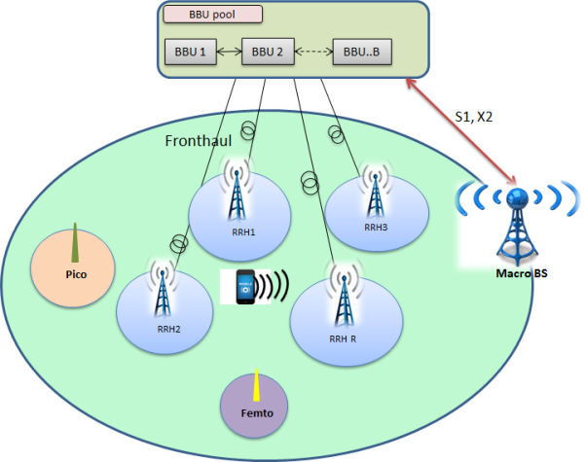
H-CRAN Architecture
Taking the full advantages of both HetNets and C-RAN
Macro BSs -BBU pool coordination and cooperation
Alleviation the front haul constraints by shifting the functionalities of RRHs to Macro BS
H-CRAN Architecture
Notes:
1- Het-Net increases the throughput and C-RAN decreases the CAPEX and OPEX
2- Macro BSs are interfaced with the BBU pool by the means of S1 and X2 protocols for the data and control plane respectively to coordinate the inter-tier interference between the Macro BS and the RRHs.
3- Moreover, the fronthaul constraint in C-RAN is alleviated by incorporating with Macro BS, i.e., shifting the control functionality of the RRHs to the Macro BS.

Slide 20





Dynamic BBU-RRH Configuratio
C-RAN has the ability to dynamically change the BBU-RRH mapping.
A single BBU can serve multiple RRHs.
Dynamically remapping the BBU-RRH configuration, significant resource utilisation and power savings can be achieved
BBU Cloud
BBU Cloud
……….
……….
RRH a
RRH c
RRH e
RRH a
RRH c
RRH e
RRH b
RRH f
RRH b
RRH f
RRH d
RRH d
Notes:
C-RAN relieves the base stations (BSs) from maintaining 24/7 services by aggregating the BBUs in a remote data center/BBU pool. BBUs can now be turned to low power mode or even shut down selectively depending on the traffic environment. By dynamically remapping the BBU-RRH configuration, significant resource utilisation and power savings can be achieved. C-RAN requires fewer BBUs to serve a geographical area compared to traditional RAN thus saving operational and management cost to a great extent.
C-RAN greatly reduces the number of equipment rooms at sites needed to cover a given geographical area. Thus, the power consumed by air conditioning and other site support equipment can be reduced significantly. Moreover, the connections between BBUs and RRHs are changed dynamically while allowing one BBU to connect to one or more RRHs. By allocating BBUs to RRHs according to traffic load, cost reductions can be achieved due to the reduction in the number of BBUs and the effective utilization of baseband resources.

Slide 21
Finding proper BBU-RRH Configuration for maximum network Quality of Service
  Artificial Intelligence (AI) techniques
Genetic Algorithms
Swarm Intelligence
Artificial Neural Networks
Standard Genetic Algorithms
Discrete Particle Swarm Optimisation
K-Mean Clustering Algorithm
(Supervised Learning)
Choosing Key Performance Indicators (KPIs) for Network QoS function (Objective function)
Key Performance Indicator for Blocked Users:
    The number of users deprived of network services due to hard-capacity is considered as blocked users.
    $$Blocked Users= \sum_{s}{max\left[\left(\left(\sum_{i}{U_{i}R_{is}^{t+1}}\right)−{HC}_{s}\right),0\right]}$$

Slide 22
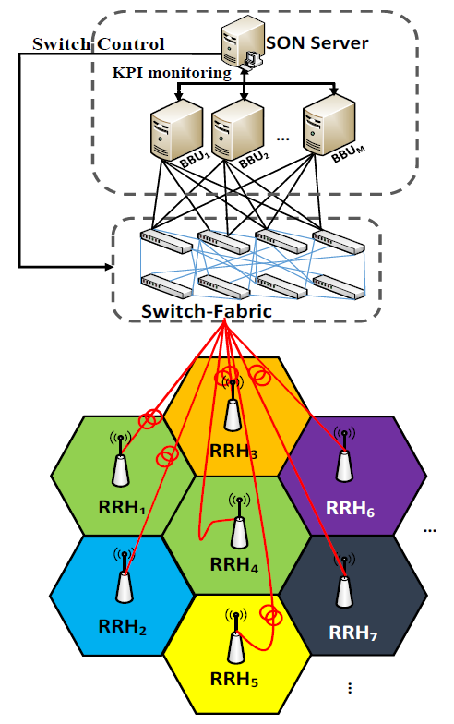
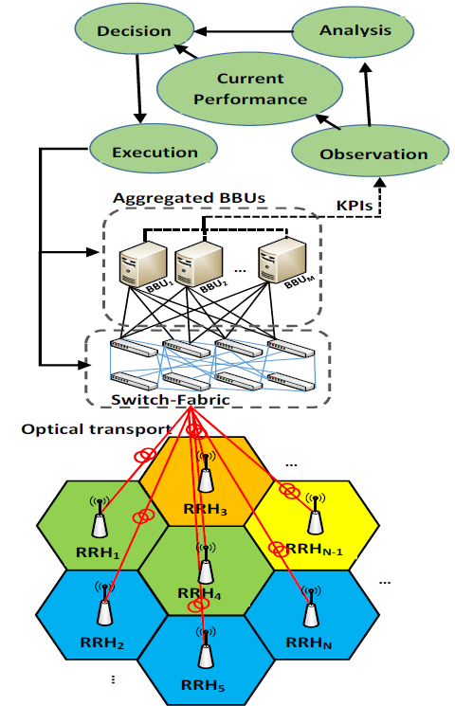
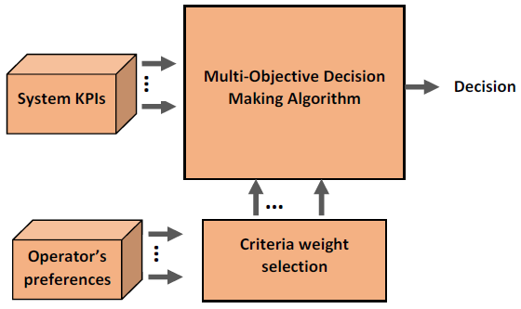
Block diagram of multi-objective decision making logic for SON server
Structure of a Cloud Radio Access Network represented as SON
Generic concept of a Self organisation in C-RAN
Notes:
A generic concept of a self-organisation in C-RAN. The RRHs are connected to the aggregated BBU pool via optical transport network (often termed as front-haul) which may consist of a switch fabric (including a network of switches, optical splitters, multiplexers) and low latency, high bandwidth fibre optic links. Note that, there are various possibilities of front-haul deployment in C-RAN architecture. The RRHs are equipped with omnidirectional antennas and rests at the centre of small virtual-cells (micro-cells). The self-organisation concept is explained in phases as shown in Figure. where the observation and analysis phases are utilised to detect
the performance of current network deployment (BBU-RRH configuration), and then an optimal implementation is identified for performance comparison. KPIs are used to monitor network status for current and optimal deployment settings. Based on the chosen KPIs, an algorithm decides the best system configuration, and finally, the new topology (BBU-RRH setting) is enforced in the execution phase (if necessary).

Slide 23
An Example
RRH1 RRH2 RRH3 RRH4 RRH5 RRH6 Initial Configuration = { 3, 1, 1, 3, 2, 2 } Hard Capacity of each sector = 20 Blocked calls in this configuration = 11
BBU1 = Sector 1
11
RRH6
11
RRH6
BBU2 = Sector 2
BBU2 = Sector 3
15
RRH3
15
RRH3
5
RRH1
10
RRH5
5
RRH1
10
RRH5
15
RRH2
15
RRH2
5
RRH4
5
RRH4
RRH1 RRH2 RRH3 RRH4 RRH5 RRH6
Best Configuration by GA = { 1, 3, 1, 3, 2, 2 }
Blocked calls in this configuration = 1
Notes:
Where the binary variable $R_{is}^{t+1}$ = 1, if${ RRH}_{i}$belongs to Sector_{s}. $U_{i}$ is the number of active users served by ${ RRH}_{i}$ and ${HC}_{s}$ is the hard capacity of sector_{s}
Varying the binary variable$R_{s}^{t+1}$to find the new BBU-RRH configuration makes the search space$2^{NS}$.Where N is the number of RRHs and S is the number of sectors.

Slide 24


5G and Beyond
NET 1
1- Local Servers (DHCP, NTP, DNS ... etc.)
2- Application Services (Load balance, Firewall, Discovery, IP flat …etc.)
3- Management Services for orchestra controllers
NET 2
Orchestra SDN controllers
(VMs Pool)
SDN Controllers +BBU Pool
VMs Pool
(S-GW,
P-GW)
Open flow gateway
…
Open flow
Switches
Macro Cells
Internet
Aggregation Links
mm-wave
RoF
mm-wave
…
Cell Differentiation
RRH
RRH
…
RRH
RAU
RRH
RRH
RRH

Slide 25
Towards Extreme Network Densification
Network Densification → Key mechanism for wireless evolution.
The “Big Three” 5G Technologies:
    Ultra-densification
    mm Wave radios
    massive MIMO
Adding more small cell sites to increase the amount of available capacity.
    Extended coverage at cell edges
    Cell split
The base-station-to-terminal distances will be shorter with a corresponding improvement in achievable data rates.
Notes:
Definition for network densification is “adding more cell sites to increase the amount of available capacity.” Cell sites placed in capacity-strained areas add more capacity where it is most needed and also help offload traffic from surrounding sites. Urban areas and large public venues are candidates for network densification because of the high concentration of mobile users.
A major component of 5G, which is still not standardized or defined, will be ultra-dense network configurations.
Densification can either be increasing the number of base stations in a given geographical area or increasing the number of antennas on the base station, collectively they are termed as spatial densification.
5G network – will require a densification of the radio access network or the deployment of additional network nodes. By increasing the number of cells, the traffic per square-meter can be increased, and by deploying small cells , the base-station-to-terminal distances will be shorter with a corresponding improvement in achievable data rates.
Early cell densification was achieved by deploying more macro BSs (i.e., macro cellular densification). The goal was to increase user capacity and achieve wider coverage. This process was later expanded to include the use of smaller size stations with reduced coverage footprint. Small cells (Micro, pico etc) utilizing low transmission power and supporting a smaller number of users are easier to install and provide improved cost efficiency.
Small cells are widely deployed to provide
• Extended coverage at cell edges: To service offices or apartment buildings at the cell edge.
• cell split: Uneven and peaky demands on capacity are cost-effectively addressed using a combination of outdoor and indoor plus different sizes of small cells.

Slide 26
Small Cell deployment Challenges
Increased power consumption and cost of deployment
Deployment strategy
  A significant effect on interference and power consumption in the network.
Handover and mobility management.
  Smaller coverage areas, handovers for mobile UEs are much more frequent.
  Variety of coverage footprints (HetNets) → Cell specific handover parameters rather than homogeneous network parameters.
  Unnecessary Handovers (due to inappropriate Tx powers)
Notes:
While network densification is seen as an effective method of increasing system capacity and coverage, such gain comes at the expense of increased power consumption.
The deployment strategy of small cells has a significant effect on interference and power consumption in the network. Small cells are deployed in 1) an open access fashion in which any nearby user is allowed to connect the small cell BS; 2) a closed access fashion in which only subscribed users are allowed to connect to their designated small cell BS.
The handover process in cellular networks enables a UE that is already connected to a serving cell to transfer its connection to a neighbouring cell while maintaining quality of service at an acceptable level.
Due to the variety of coverage footprints of HetNets, a mobile UE cannot use the same set of handover parameters as those used in a homogenous network. Instead, a mobile UE must use cell specific handover parameters
Another factor aggravating the problem occurs when handover decisions are based solely on the received signal strength at the mobile UE (downlink). Since downlink transmission powers for macro and small cells are disproportionate, handovers might be unnecessary performed. Hence, it is required to simultaneously consider both downlink and uplink which could be challenging.
In an ideal load balancing setting, a user of moderate or high mobility on entering a small cell association area should be offloaded from its original cell and back when it is no more near the small cell. However, it is known that handovers involve relatively complicated procedures as well as costly overhead. In the case of a short sojourn time in small cell, it may be preferable from a system-level view to temporarily tolerate a suboptimal BS association versus initiating a handover into and out of this cell.
While the introduction of HetNets as a solution helped improve coverage and capacity, there remains significant room for improvements in the concept of network densification.

Slide 27
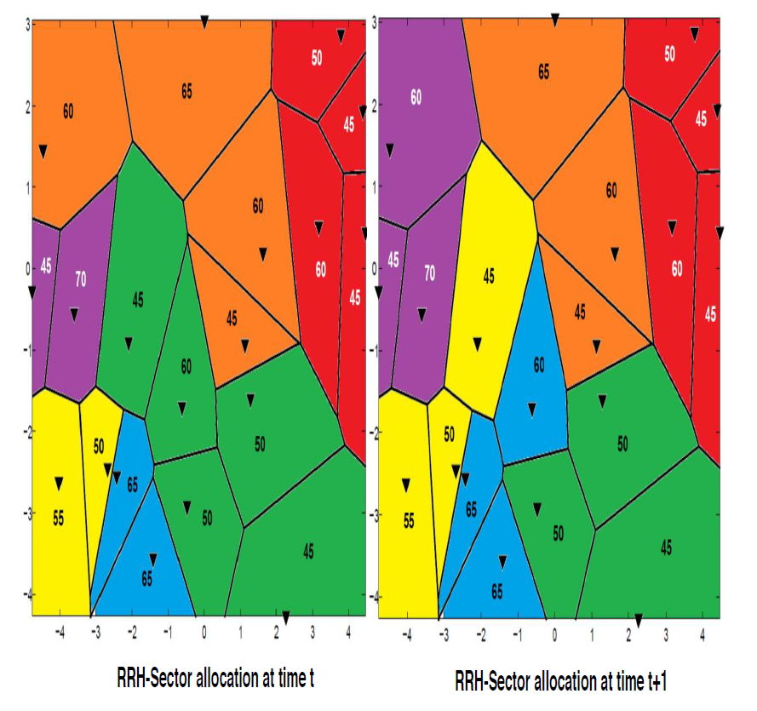

Benchmark problem $P_{1}$
[2018] Muhammad khan, Zainab Fakhri and Hamed Al-Raweshidy, "Semi-Static Cell Differentiation And Integration With Dynamic BBU-RRH Mapping In Cloud Radio Access Network", IEEE Transactions on Network and Service Management, vol. 15, no. 1, pp. 289-303, March 2018, DOI:10.1109/TNSE.2017.2771622.

Slide 28
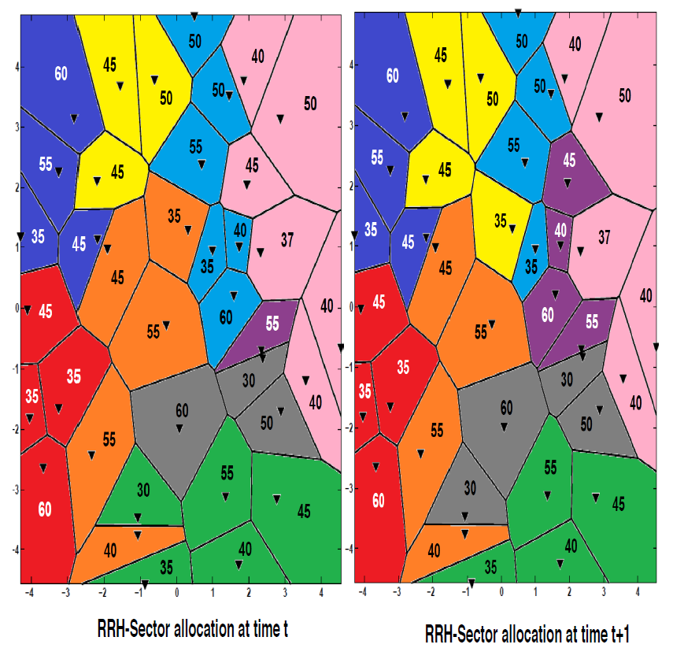

Benchmark problem $P_{2}$
Notes:
Note that, all 30 initial configurations are improper RRH-sector allocations and each improper configuration generates 80, 177, and 128 blocked users for
P1, P2, and P3, respectively.

Slide 29
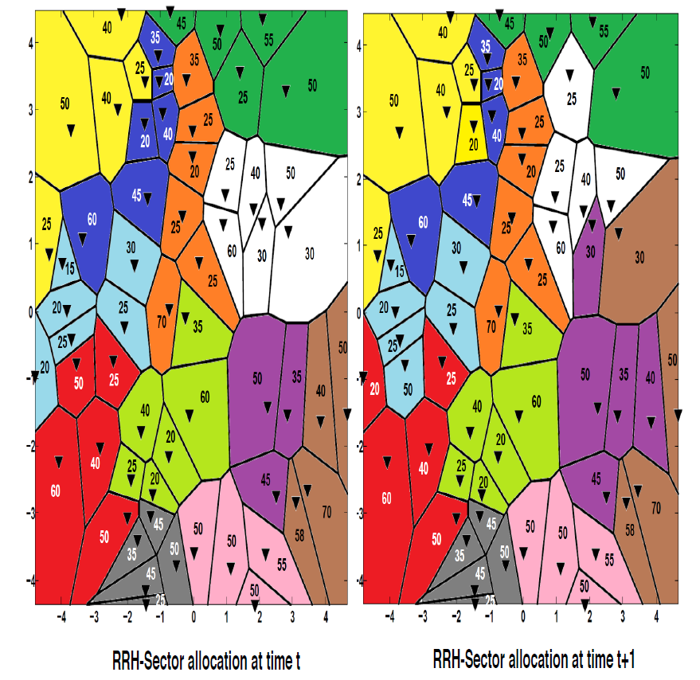

Benchmark problem $P_{3}$

Slide 30
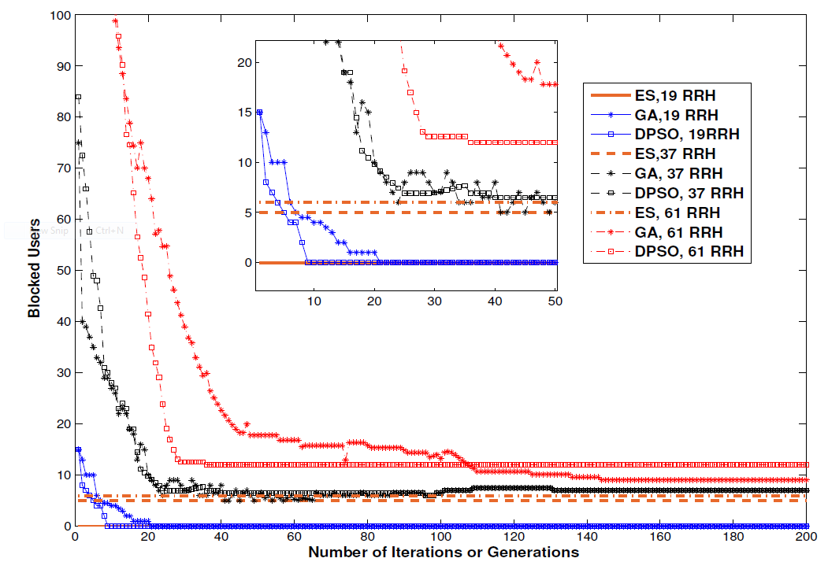

Slide 31
CDI For Self-Orgnised New Radio C-RAN
Aim: Realizing the 5G vision of providing "Gbit/s anywhere“ by suggesting an energy efficient self optimised cellular network, which will dynamically adapt to the varying capacity demand to utilise network resources efficiently.
Motivations:
A Self-Organising Cloud Radio Access Network (C-RAN) is proposed to dynamically adapt to varying capacity demands of cellular networks.
A new millimetre wave heterogeneous C-RAN is proposed to tackle both issues of capacity deficiency and interference in future cellular networks by exploiting the millimetre wave band properties.
5G in its early deployment is expected to work in a non stand alone operation which means working along with LTE-A.

Slide 32
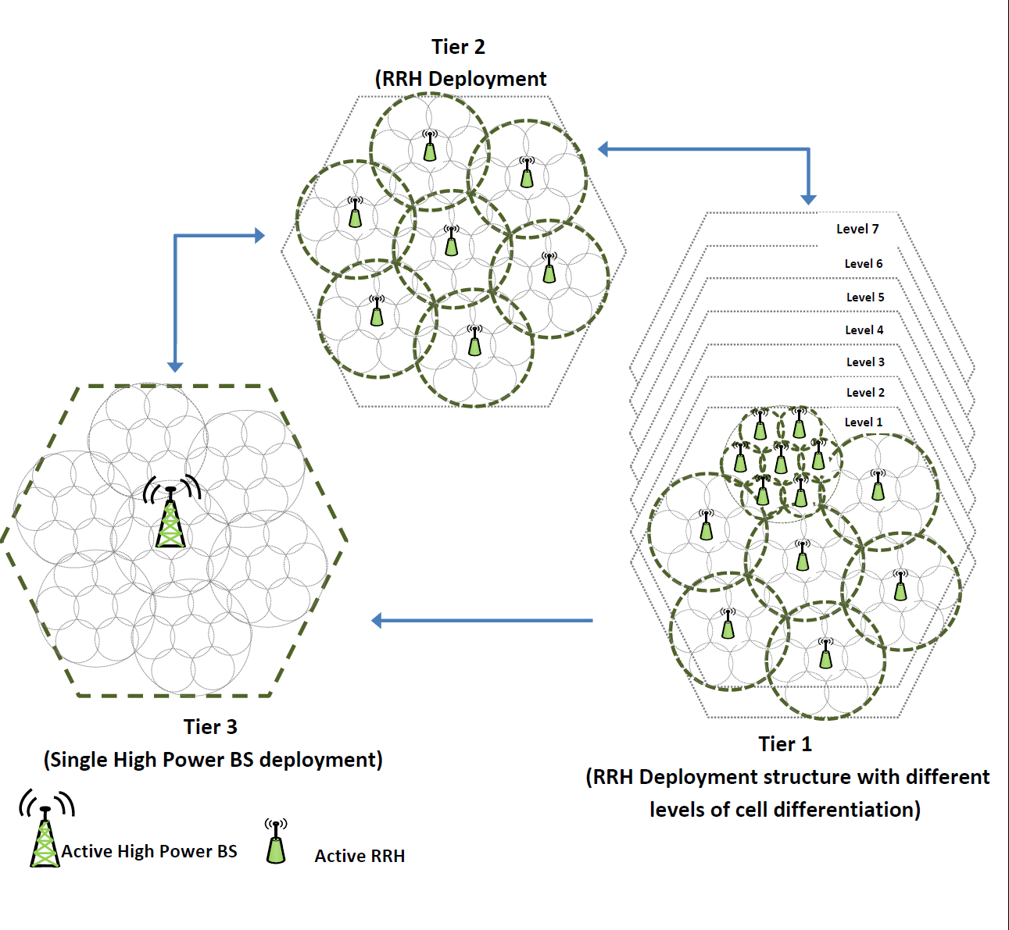
System diagram

Slide 33
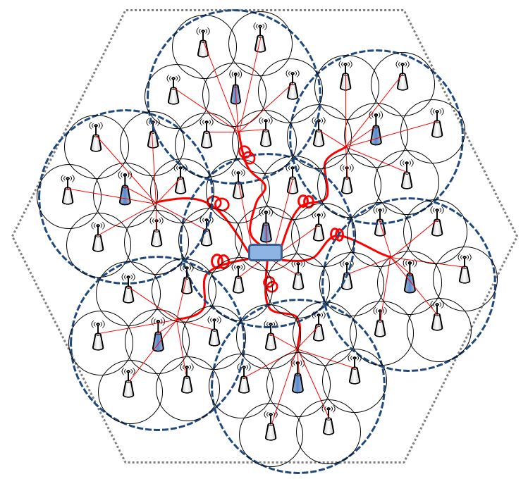
Concept of Cell Differentiation and Integration
$$SON controller$$
$$KPIs$$
$$Aggregated BBUs$$
…
BBU₁
BBU₂
BBU_{M}
$$Switch−Fabric$$
Notes:
The BBUs are decoupled from the RRH and migrated to a centralised BBU-pool, whereas the RRHs with simple RF transmission functions are left on the cell sites. A SON controller inside the BBU cloud monitors the BBU-pool resource utilisation as well as controls the front-haul. Each RRH is connected to the BBU pool via optical transport network (front-haul).
In contrast, the same geographical area is served by a single high-power base station at extreme low load traffic conditions. As the traffic load reaches the resource limitation of the high-power base station, the geographical area differentiates into C equally sized small cells by activating the RRHs deployed. Furthermore, each of the C cells can further differentiate into c more small cells by activating the RRHs deployed within the cell to accommodate capacity demands.
Moreover, each RRH can be served by only one BBU at a given time instance. The actual number of RRHs required in the network is determined by the coverage area, users density, and other environment-related factors, however, in this work, both C and c are considered to be seven as a reasonable example.

Slide 34
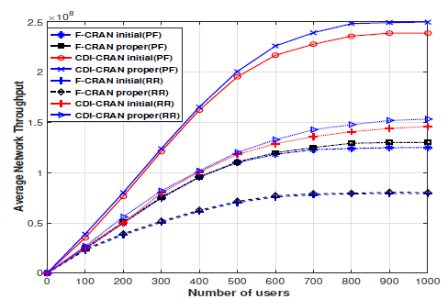
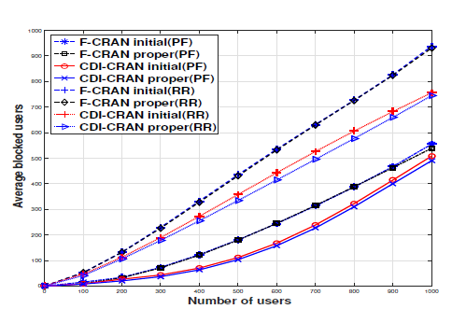
Results:
[2017] Khan, M., Fakhri, Z., Sabir, F. and Al-Raweshidy, H. 'A Resource Allocation Mechanism for Cloud Radio Access Network Based on Cell Differentiation and Integration Concept'. IEEE Transactions on Network Science and Engineering, vol. PP, no. 99 pp. 1-1, DOI: 10.1109/TNSE.2017.2754101, 2017.
Notes:
From the results shown in the first figure above, it is observed that the average network throughput increases by 45.53% in the cell differentiation and integration C-RAN (CDI-CRAN) compared to fixed C-RAN (F-CRAN), both enabled with proportional fair PF schedulers. Whereas with Round Robin RR schedulers, an increase of 42.102% is observed. Moreover, the average throughput difference between initial and optimum BBU-RRH mapping in a CDI-enabled C-RAN, with PF and RR scheduling is 4.0219% and 4.126%, respectively. This indicates efficient resource utilisation during cell differentiation and integration, ensuring minimum blocked users until a proper BBU-RRH setting is identified.
About 23.149% reduction in the average number of blocked users with PF scheduler and 20.903% with RR is observed in the figure shown above. Moreover, the average resource shortage drastically decreases in the CDI-CRAN, compared to fixed C-RAN

Slide 35
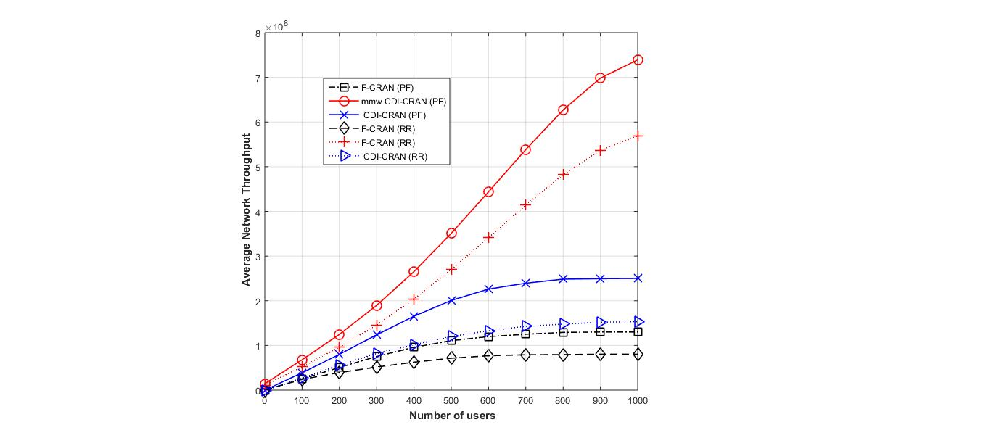
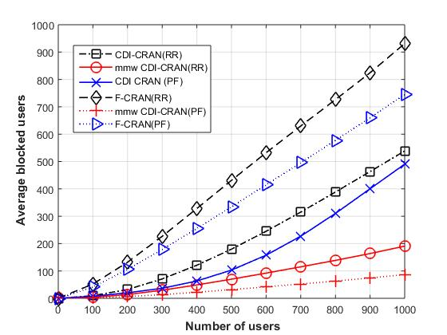
Results: after using NR FR2
Notes:
There is a clear increase in network capacity when using new radio frequency range 2 (FR2) (mmw band 27500 MHz – 28350 MHz) for the differentiated cells.
It also clear from the second figure above that there is a clear reduction in

Slide 36
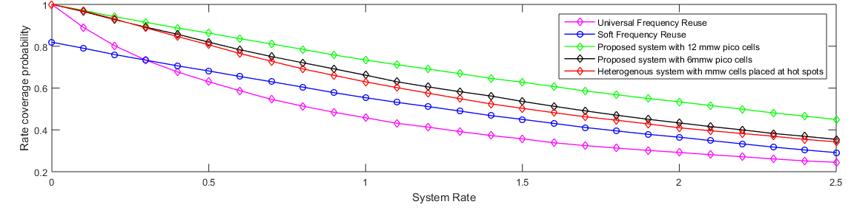
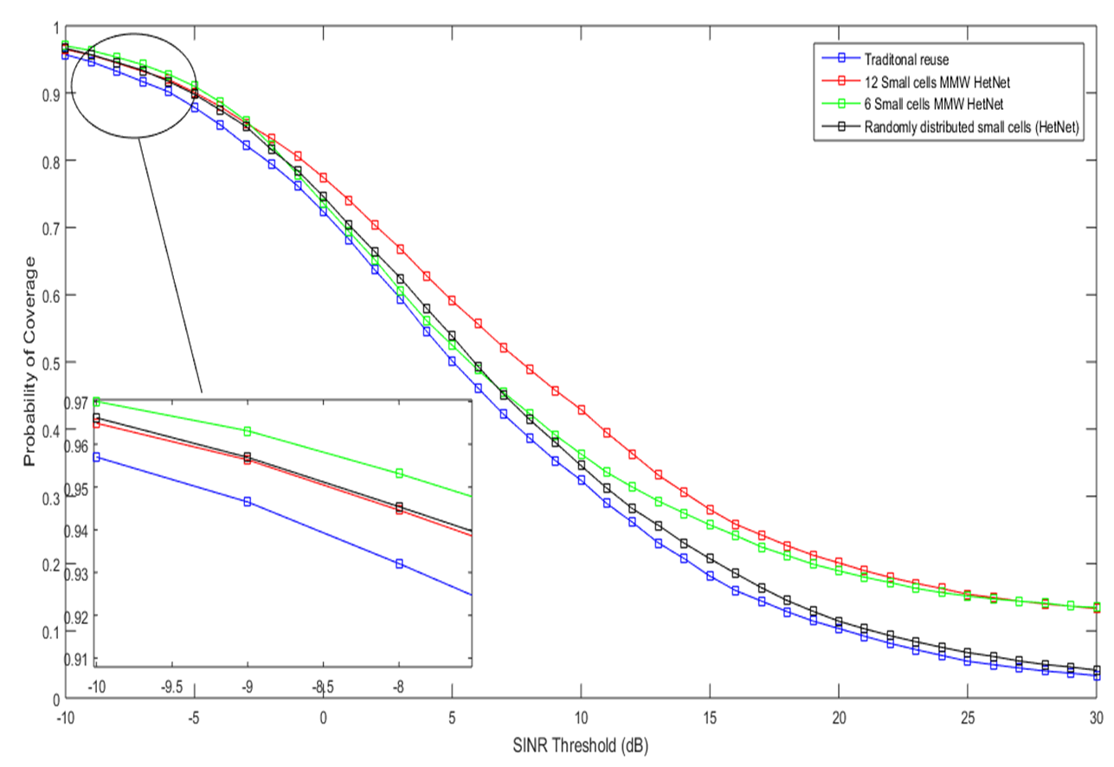
Results:
Notes:
The figure above shows a comparison of different cellular scenarios to validate the suggested architecture. There is a clear improvement in the overall system rate compared to SFR technique, HetNet with mmw pico cells located at hot spots and the traditional universal frequency reuse. A 35.7% average improvement in system rate compared to SFR.
There is also a noticeable enhancement in coverage compared to different systems scenarios. A 15% increase in average coverage probability after implementing the proposed architecture of serving cell edge area by mmw band compared to Het Net with mmw pico-cells located at hot spots only.

Slide 37
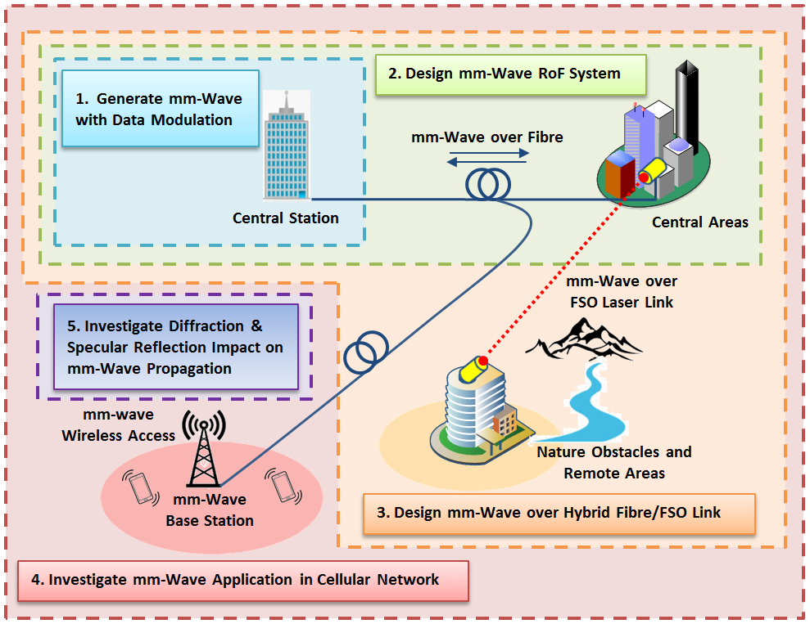
MM-Wave generation with RoF for Beyond 5G
[2017] R. K. Al-Dabbagh, and Al-Raweshidy, H. “64-GHz millimeter-wave photonic generation with a feasible radio over fiber system,” Optical Engineering, 56(2), pp. 026117(1)-026117(10), 2017.

Slide 38
MM Wave with Massive MIMO AND Beam Forming with AI for 6G Networks

Slide 39
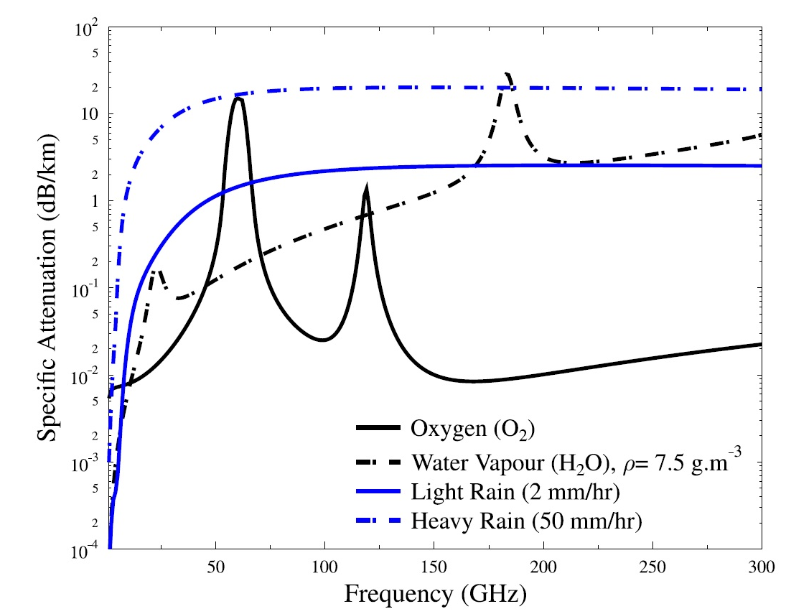
Notes:
The mmWave spectrum band is essential if mobile networks aiming to reach its full potential regarding both capacity and speed.
The graph shows O2,H2O water vapour, light rain and heavy rain absorption in dB/km against frequency in GHz

Slide 40
Notes:
The mmWave band between 200 - 300GHz is highly interested because of its relatively flat and low absorption attenuation, however the most challenge is how to overcome the high path loss in multipath environment as well as.

Slide 41
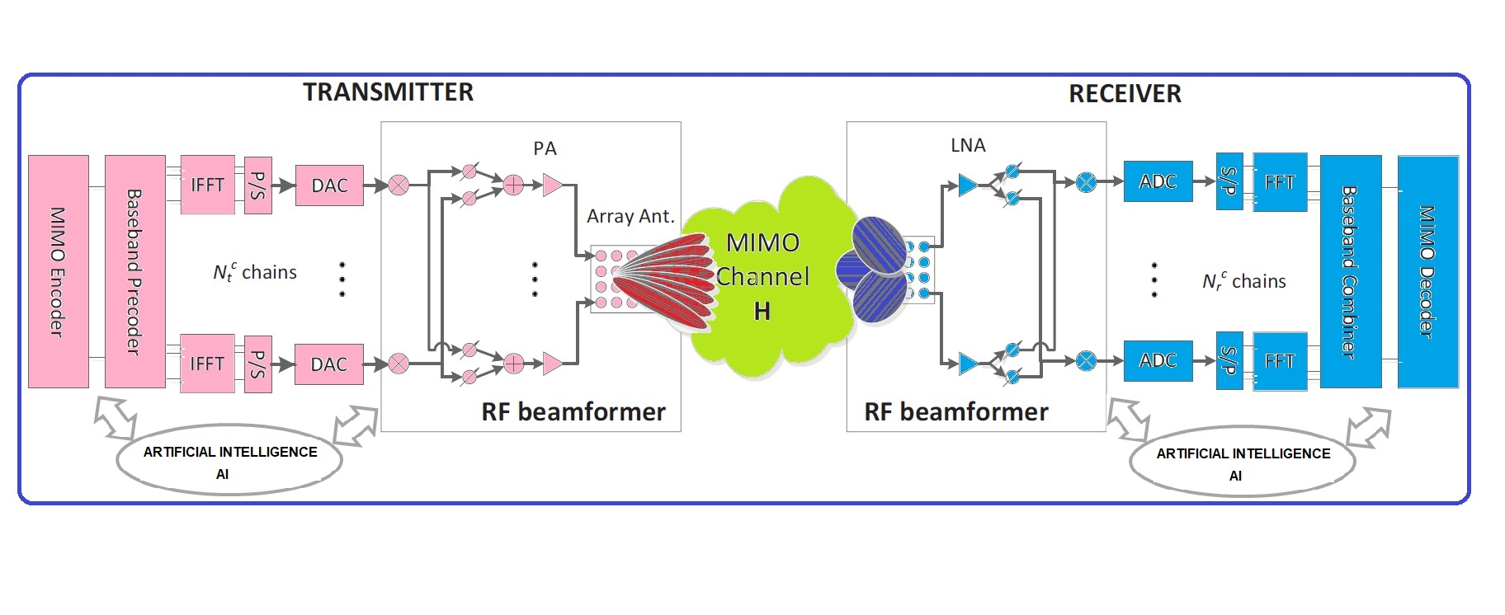
Notes:
To tackle several issues in mmWave communication system such as high propagation path loss, narrow beam width requires a bound of relevant techniques such as mmWave massive Multi Input Multi Output (MIMO), highly directive antennas or various beamforming techniques, since many multipath components may be excluded by the narrow beam, the mmWave radio channel (consisting of the transmit antenna, the propagation channels, and the receive antenna) strongly depends on the beamwidth, orientation, and shape of the narrow beam, an example of hybrid beam forming is highly recommended. And last not the least a touch of Artificial Intelligent (AI) technique which is present for all machine learning systems including mobile network systems.

Slide 42
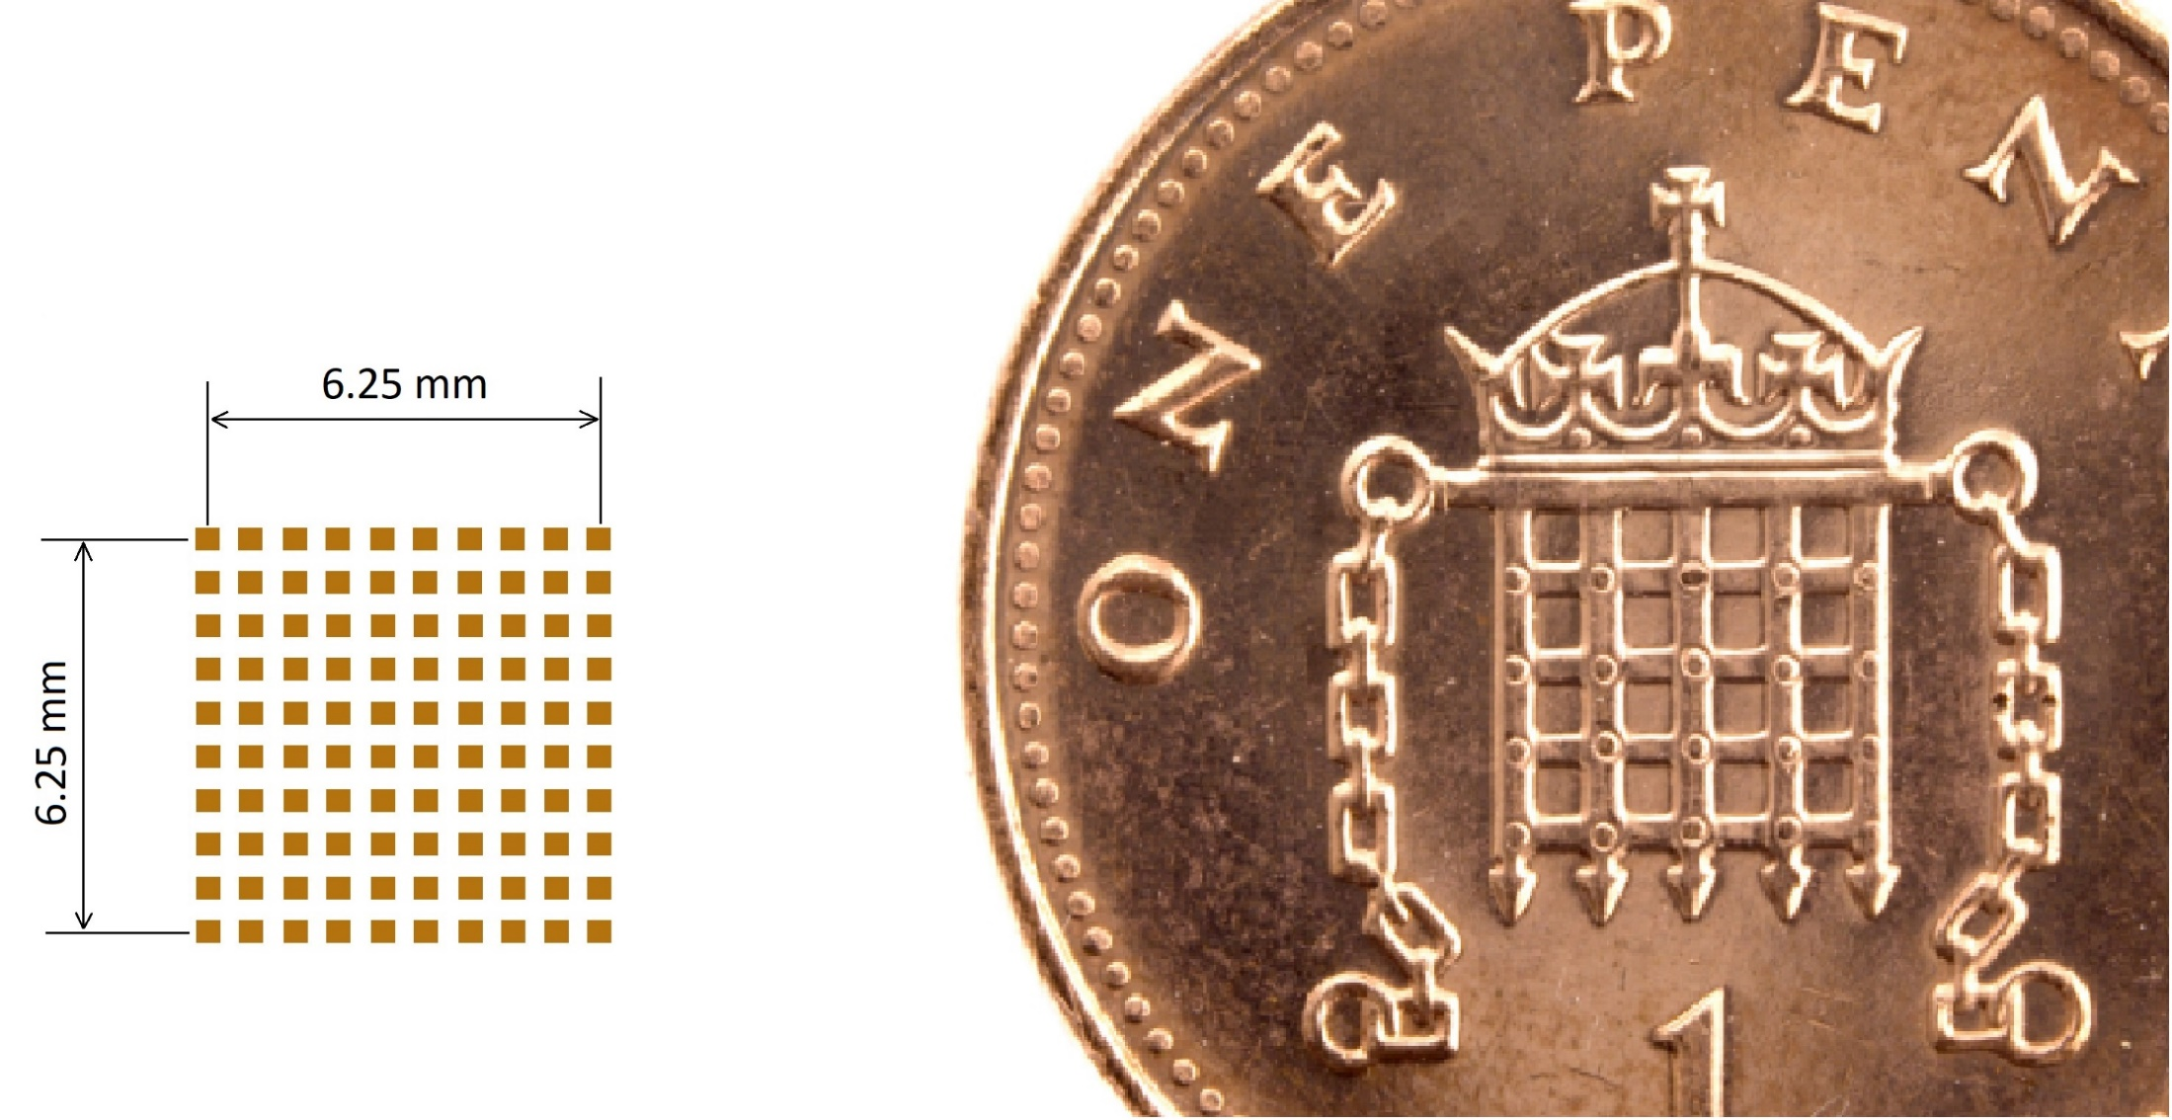
Notes:
One of the benefits of mmWave characteristic is small wavelength, for example in 240GHz frequency the half wavelength is = 0.625mm, so a 10x10 antenna array would be in about a size of portcullis of penny.

Slide 43
Testbed for Virtualisation for SDN and NFV in the Cloud
[2018] Alasadi, E. and Al-Raweshidy, H. 'SSED: Servers under Software-Defined Network Architectures to Eliminate Discovery Messages'. IEEE/ACM Transactions on Networking, vol. 26, no. 1, pp. 104-117, 2018.

Slide 44
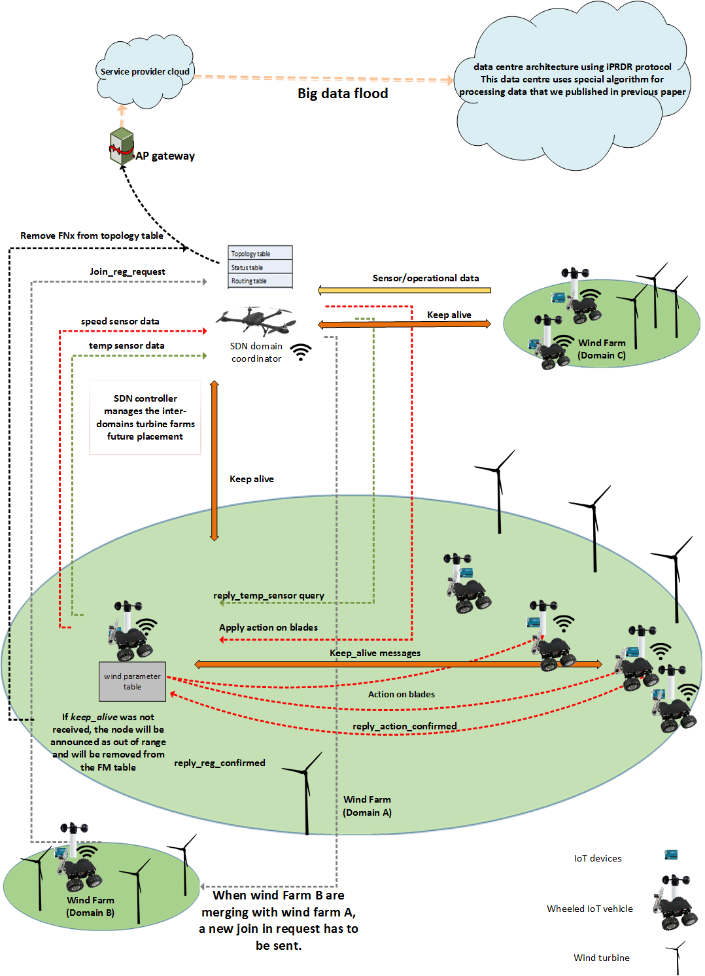
Industrial Internet of Things (IIoT)

Slide 45
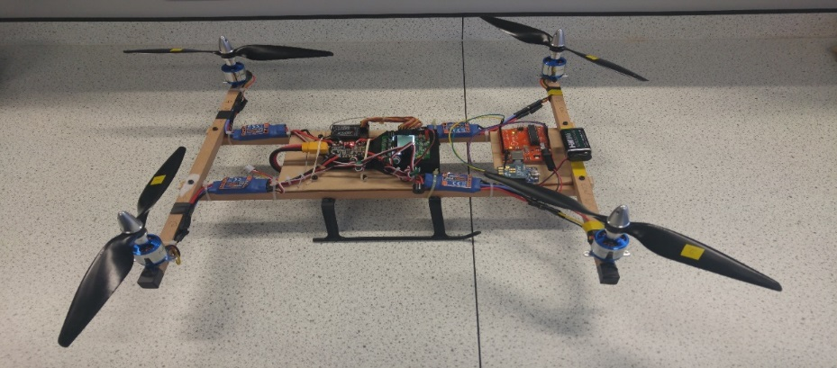
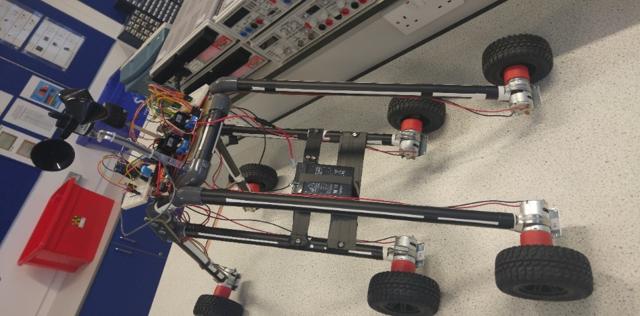
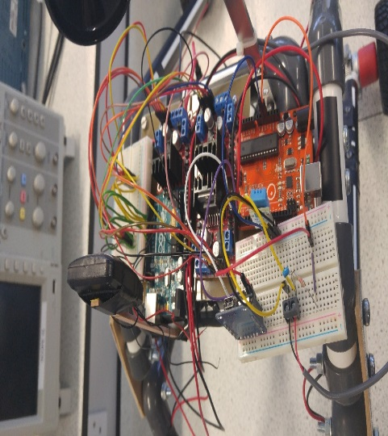

[2018] A. Al Mhdawi and H. S. Al-Raweshidy, "SDQ-6WI: Software Defined Quadcopter-Six Wheeled IoT Sensor Architecture for Future Wind Turbine Placement", IEEE Access Journal, Access-2018-14039, 2018.

Slide 46










Tactile Internet
Response (e.g. force)
Bi-Directional Haptic Control
Command (e.g. velocity)
Serving Gateway
Router
Packet Gateway
Tactile Support Elgin
Operator(s) with tactile human-system interface (possibly distributed)
Internet, transmitting audio-visual and tactile information
Telecommunications Core and Radio Access Network, and an intelligent Tactile Support Engine
Tactile edge composed of e.g. remotely controlled robots
Master Domain
Network Domain
Controlled Domain

Slide 47

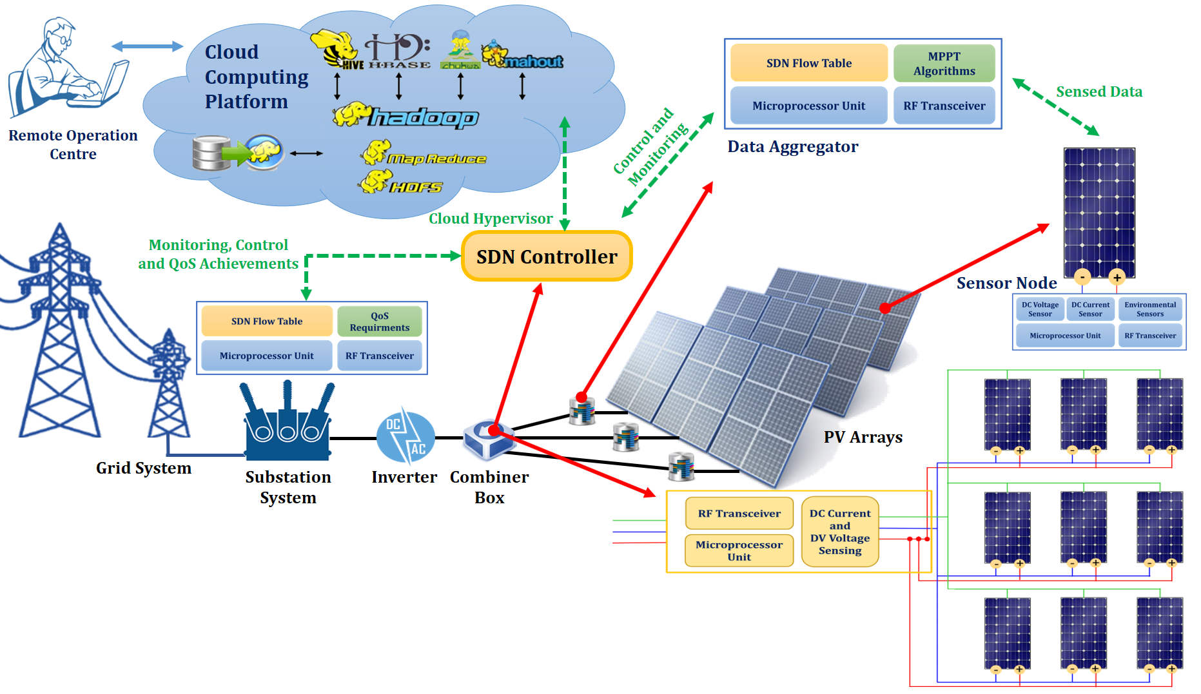
Proposed Technical Description
[2018] Ali Khalil and H.S. Al-Raweshidy” Optimisation of computing and networking resources of a Hadoop cluster based on software defined network“ IEEE Access Journal, DOI 10.1109/ACCESS2018.2876385, 2018.

Slide 48
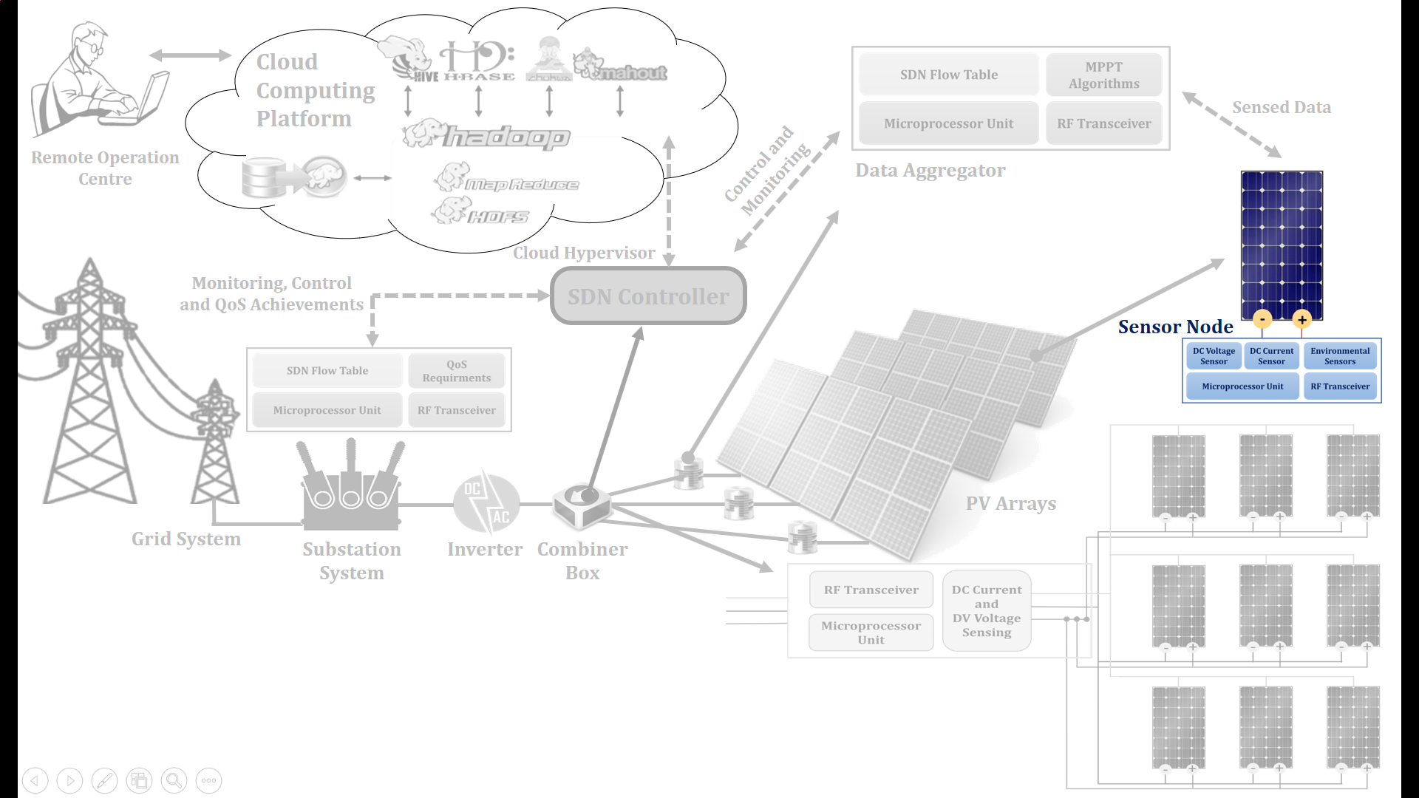
Design of M2 M Sensor node
This will focus on designing the M2M sensor node based on open source hardware platforms and the available software libraries.
[2018] Thair. Al-Janabi and H. S. Al-Raweshidy, “A Centralised Routing Protocol with a Scheduled Mobile Sink-Based AI for Large Scale I-IoT”, IEEE Sensors Journal, Number 23733-2018.

Slide 49
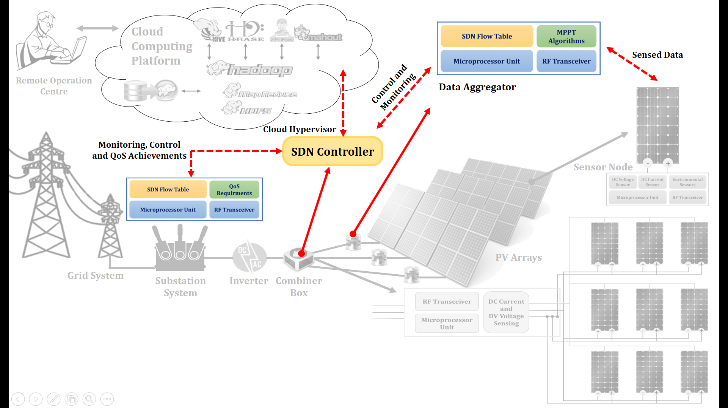
Enabling SDN and Cloud Computing in M2M Gateway
This work will propose a novel solution to overcome the consequences of delay restrictions and algorithm processing. The diagram shows relationship between SDN and cloud computing with the Wi-Fi M2M network, it is clear that each technology abstracts certain function from different network resources, the benefits obtained from each of them are similar in terms of traffic agility, cost-effective, reduction in consumed energy and scalability.

Slide 50
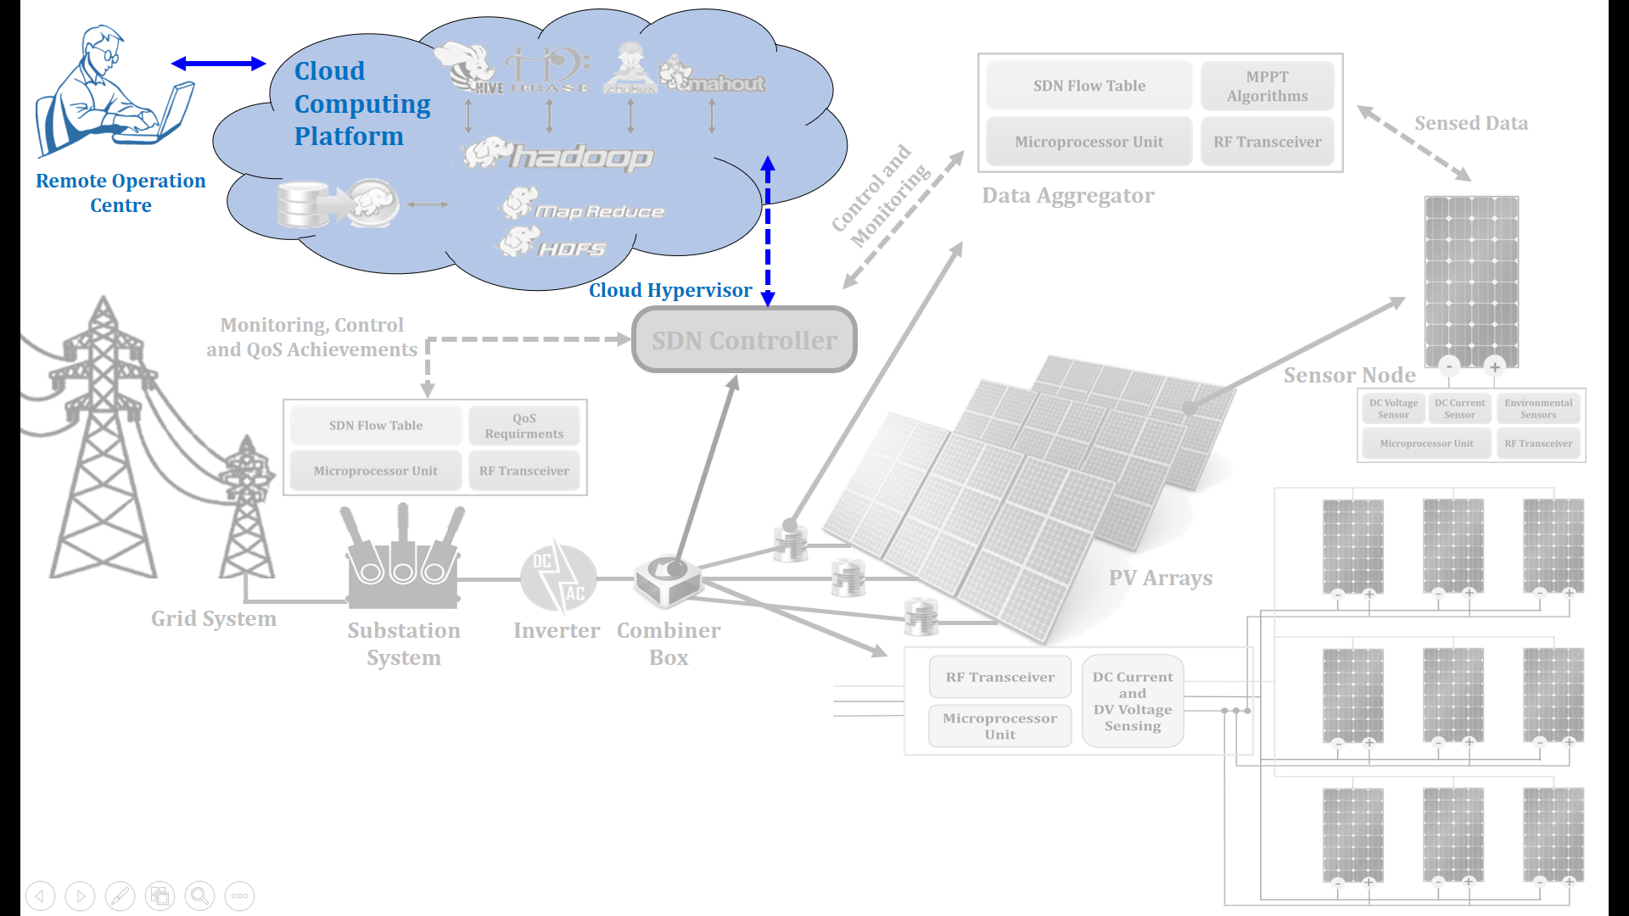
Energy-Efficient Open Cloud Infrastructure
The designing of energy – efficient cognitive open cloud (COC) infrastructure framework. This system can be inculcated into any resource manager of the cloud. Its major objective is to ensure energy – efficiency management of resources by ensuring the switching off of idle or unused resources such as computing, networking and storage and also to predict and aggregate reservations of such resources in an end – to – end enterprise network architecture.

Slide 51
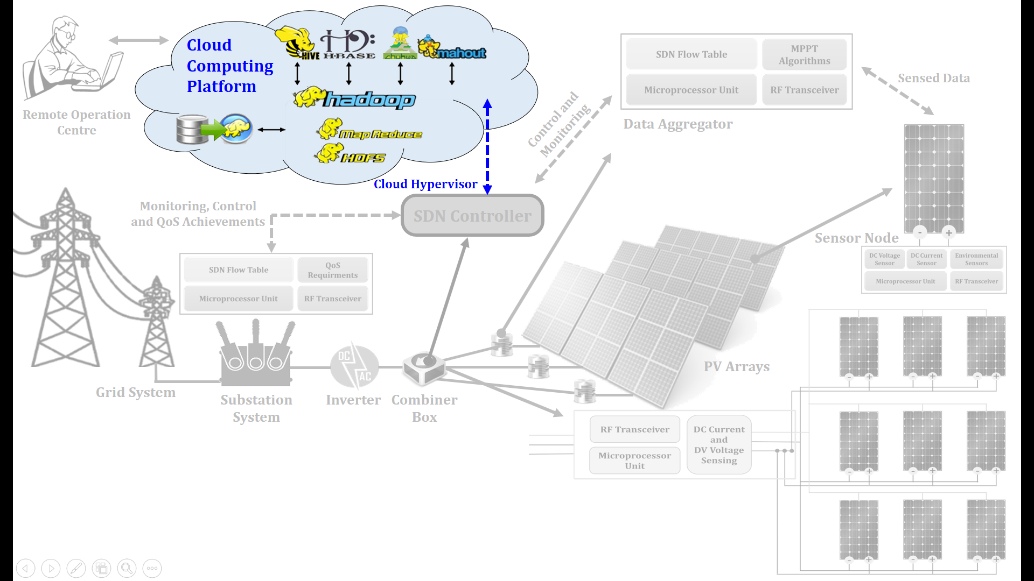
Big Data Analytics Infrastructure
Hadoop Cluster can be used to store, process and analyse the huge data generated from Solar PV panels. This cluster will be setup on Cloud Computing that provide compute power (e.g., storage and processing) as a utility and deploying and maintaining the needed IT infrastructure, e.g., recruiting engineers, maintenance, hardware, and software purchase.

Slide 52
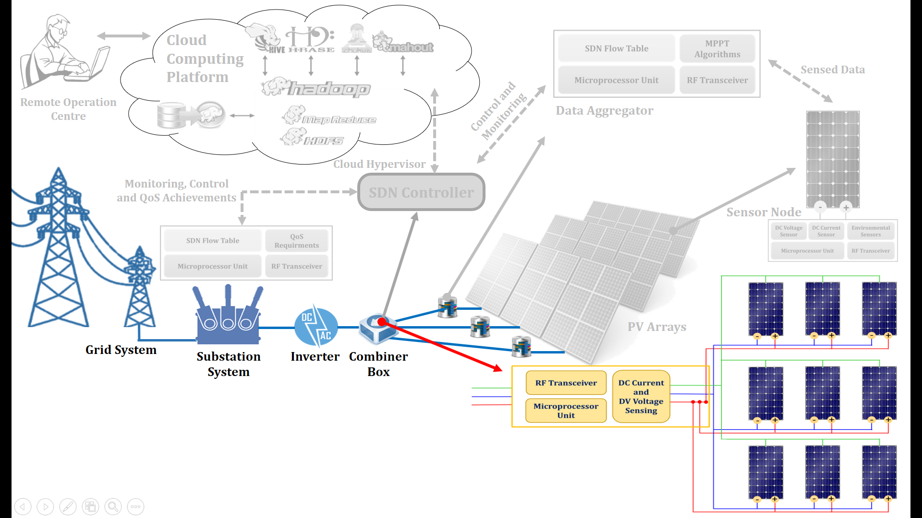
Smart Monitoring and Control Algorithim
This will deal with design smart IoT system for monitoring and control a large solar power plant based on SDN. The first objective of this work is the realization of a WSN that allows monitoring at panel level to provide data useful to investigate on causes of efficiency losses and to detect inertial events such as fault. Leveraging SDN technology to centralize control architecture and install a new algorithm of maximum power tracking MPPT as well as choose a suitable control way to work with wireless control system.

Slide 53
QoS Assurance and Provision
This is specifically aimed to support the QoS of proposed network infrastructure. The communication network transports the traffic of real-time application, high-quality services and delay-sensitive data. In turn network must provide predictable, measurable, and guaranteed QoS by controlling bandwidth, delay, jitter and loss parameters on the network.

Slide 54

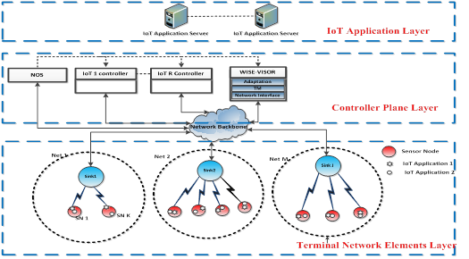
Network Performance of M2M with Self Organising Cluster Head to Sink Mapping
[2017] Wasan Twayej, M. Khan and Al-Raweshidy, H. 'Network Performance Evaluation of M2M with Self Organising Cluster Head to Sink Mapping'. IEEE Sensors Journal, vol. 17, no. 15, pp. 4962-4974, 2017.
Notes:
Contributions (1)
Network Model and Cluster Generation Algorithm
Here the hierarchical network is considered in which a sensor field is logically divided into quarters, with levels of CHs. Each cluster has a sink and a cluster head (CH), and the remaining components are the ordinary sensor nodes. It is assumed that (n), a sensor node in an N*N sensing field, is used with a homogeneous distribution, as shown in Fig above
The proposed network model contains the following elements:
The nodes: Distributed randomly.
Two stationary sinks: One sink is located in the middle of the left side (${[1}/{4] N}$,${[1}/{2] N}$) and the other one is in the middle of the right side (${[3}/{4] N}$,${[1}/2] N$).
Four quarters of the sensing field: Each quarter is divided into three levels horizontally. At each level, there is a maximum transmission range (TR), which is the diagonal length of the level as shown in Fig. 1. Nodes that are beyond this are unable to connect with the CHs, whereas those within this range use this to transmit their parameters so that they might themselves become the new CH, and once chosen, the others will send data to it.
We proposed a model through M2M to be as a part of the IoT system as shown in figure .1. The proposed protocol of the Multilevel Clustering with Multiple Sink algorithm (MLCMS) through 6LoWPAN, which is an improved routing protocol to enhance the lifetime of the network by using three levels of cluster heads with two sinks in fixed and useful positions ,which represented as a specific structure network strategy. As well as there is a special technique in election and rotation of cluster heads. All of these should be put the transmission rage in the consideration before sending any data. The objective of this contribution is to improve network performance by applying a load balancing technique for M2M networks with the aim being to achieve a high average residual energy amongst the nodes. In order to meet the N.P. requirements of M2M, we introduce an optimal reconfiguration of the network solution that involves a traffic-aware load balancing mechanism, thereby improving energy efficiency. The main contribution of this paper is to present an efficient model for proper CH to sinks mapping as an approach to achieve an optimal network structure to solve a load balancing and residual energy problem, which in turn maximises the Network Performance (N.P.). In addition, an MLCMS protocol is presented to control CH-Sink and Node-CH transmission techniques so as to enhance network lifetime.
Contributions (2)
The transmission between the CHs and sinks is dynamically adjusted by proper CH assignment to sinks via an intelligent algorithm. Enhancement of the N.P. in terms of reliability and lifetime can be achieved by the CH selecting a sink through applying an optimisation algorithm rather than the nearest sink to communicate. CH-sink allocation is achieved by formulating a linear integer-based optimisation problem with constraints. Two evolutionary algorithms, i.e. GA and DPSO, are considered for solving the optimisation problem.
Network performance can be measured by utilising multiple Key Performance Indicators (KPIs). These KPIs help the network to react proactively against events that threaten network performance and services availability. A different set of objectives can be employed to evaluate network performance, which can then be mapped to predefined performance metrics. Note that, a weighted normalised function is required when considering different sets of objectives. This work represent KPIs that define network performance. The medium load balancer (centralised server) is responsible for manipulating the route of the request nodes and allowing the system to scale so as to service more requests by just adding nodes. It continuously checks the load at the CPU of the sinks as it will increase due to the processing of the data coming from the CH sensors. When the CPU workload attains a certain threshold level, an alarm is sent by the aggregator to the server, which triggers the load balance algorithm.
The CHs in the network at a particular time are re-configured optimally for sink transmission, based on the KPIs’ information to achieve a balanced load in the network. If the CH-Sink configuration is known at time t, then finding the optimum CH-Sink configuration at time t+1 is the main challenge. Let N be the number of CHs in the network and M be the number of sinks.
Contributions (3)
A sensing field is logically divided into N sections, depending on the number of sinks, as shown in Figure contribution3. In addition, the SDN-WISE protocol stacks as shown in Figure 5.1 is based on the SDN-WISE architecture proposed in [26], with complete layers related to the proposed architecture. The introduced network model is based on the power model parameter’s definitions and the simulation parameters, which are listed in table 5.1and table 5.2 respectively. The sensing field size is assumed as NxN. In consequence, the proposed network model would contain the following elements:
Sensor Nodes (SNs): The sensors contain the following layers:
IoT Application layer
SDN-WISE layers
Topology Discovery (TD) layer
In-Network Packet Processing (INPP) layer
Forwarding layer (FWD)
MAC layer
Physical layer
Sinks Nodes (SNKs): Is an aggregation point from sensors with short-range interface through to the Internet with a specific network ID is presenting as the gateway between sensor nodes, which are running the data plane and the elements of control plane of the proposed network. It is a bidirectional protocol convertor. It is the same as a sensor node but with unlimited energy. This sink roots the same layers in sensor nodes in addition to extra layers, which are the adaptation layer, as well as TCP/IP protocol with external network interface as Ethernet 802.3. This sink has two ports one deals with 802.15.4 for connecting with WSN (network elements) and the other corresponds to the Ethernet 802.3 for connecting with external network as well as SDN-WISE controller.
WISE-VISOR: Is a controller device, which is a proxy between the SDN-WISE network components and other networks. Moreover, the WISE-VISOR is responsible for creating and managing the SDN-WISE flow table. Furthermore, it has the Adaptation Layer and the Topology Management (TM) layer.
NOS : This layer is runs beyond the application layer.

Slide 55
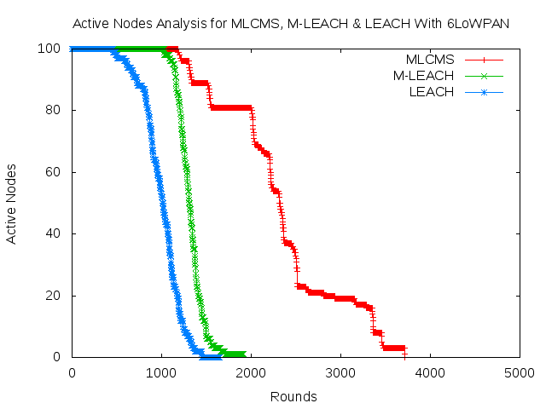
Performance and Evaluation
Notes:
The comparison of M2M Routing protocol MLCMS (Multi-Level Clustering multiple Sink) with the MLEACH (Multi-Hop LEACH ) in number of active nodes and the remaining energy as clear from the graphs how the energy efficiency and the lifetime of system is better in our proposed routing protocol MLCMS
The number of “alive” nodes over the simulation time is illustrated in Figure 4. The life time of the system refers to the period between its first operation and the demise of the last node. It can be seen that MLCMs lasted for 3716 rounds, whilst LEACH and M-LEACH achieved 1500 and 1900 rounds, respectively. This is observed in the shape of the graphs, where a steep decrease in LEACH and M-LEACH shows where energy equalisation is attained. When last node is reached, all nodes are depleted energy resources, leading to this quick decline. On the other hand, MLCMS shows a gradual decrease in the number of alive nodes, which is due to the fact that energy equalization is not coordinated and some nodes run out of battery energy much more quickly than others. We can also observe an early jump for LEACH and M-LEACH in Fig. 4. A jump is seen at the instance when many sensor have depleted their energy resources.
The operation of the MLCMS routing protocol is divided into two phases in each round: the set-up phase and the steady-state phase. The first phase is the selection of CHs in each quarter, which involves the central node or that nearest the centre for each of the three levels in each quarter, initially sending a Hello message to all the nodes at the same level. Only those within transmission range can receive the message, and hence, send information regarding residual energy and their position (x, y). The two nodes with the MAX Z (n) in equation (4) will be selected as the CHs of this level. These CHs are uniformly distributed to prevent them from being too close to each other, as shown in Fig. 2. Then the elected CHs broadcast their election to the rest of the nodes by sending an INVITE message to declare itself the CH, which contains the ID of the CH. The nodes within their transmission range will receive the INVITE message, then will measure the signal strength and join the CH with the largest signal strength. While the node doesn’t receive an invitation message within T(Z) (T(Z)<T(n)), it declares itself the CH, T(Z) is waiting time, and T(n) is for refreshing the distribution of the nodes in the field. Furthermore, the CH’s energy is checked regularly, and if it is less than 25% of its residual energy, it should be changed. The new CHs for each level will be selected by the old CH, sending a request to all related nodes about their residual energy and their (x, y) position to measure their distance from their sink. The one with maximum Z(n) will be assigned the role of new CH for that level. $W\left(n\right)=π_{1}E(n)+π_{2}N\left(n\right)−π_{3}D(n)$

Slide 56
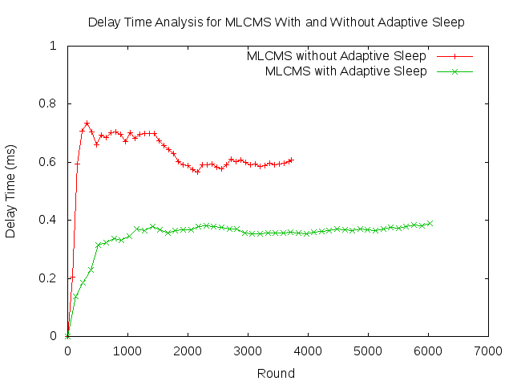
Performance and Evaluation
For MLCMS with Adaptive Sleep Mode
Notes:
we plot the expected end-to-end delay associated with round. As seen, the end-to-end delay decreases as the traffic load of the system is minimising, by considering the sleep mode periods for CHs and its nodes in adaptive way based on the residual energy of its and achieve the overlapping between CHs to keep the performance of the multi-level clustering. The delay is lineary proportional to traffic load. Indeed, as the traffic between source and destination of consecutive forwarders increases, the times that a data packet will be forwarded increases and hence the end-to-end delay increases. It means that, the more conjunction increases, the more end-to-end delay is.

Slide 57
Journal Publications 2017-2018
[2018] Al-Kaseem, BR., Al-Dunainawi, Yousif and Al-Raweshidy, H., “End-to-End Delay Enhancement in 6LoWPAN Testbed Using Programmable Network Concepts “. IEEE Internet of Things (Accepted) 2018, 'IoT-5423-2018.R1.
[2018] Ammar K. Al Mhdawi and Hamed Al-Raweshidy, “SDQIM: Software-Deﬁned Quadcopter Inter-domain Management Protocol with Decentralized Inductive Power Transfer (DIPT) platform”, IEEE Internet of Things, 10.1109/JIOT.2018.2882897,2018.
[2018] Alaa H. Radhi, Rajagopal Nilavalan, Yi Wang, H.S. Al-Raweshidy, Amira A. Eltokhy, Nur Ab Aziz1,”Mutual coupling reduction with a novel fractal electromagnetic bandgap structure”, ISSN 1751-8725, October 2018 doi: 10.1049/iet-map.2018.5273.
[2018] Emad Alasadi, and Hamed Al-Raweshidy, “OLC: Open-Level Control plane architecture for providing better scalability in an SDN network” IEEE Access Journal, DOI 10.1109/ACCESS.2018.2848638, pp. 1-14, June 2018.
[2018] Raad S. Alhumaima, Yousif Al-Dunainawi and H.S. Al-Raweshidy,” Green Network Costs of 5G and Beyond, Expectations vs Reality” IEEE Access Journal, DOI 10.1109/ACCESS.2018.2875891. November 2018.
[2018] Thair. Al-Janabi and H. S. Al-Raweshidy, “A Centralised Routing Protocol with a Scheduled Mobile Sink-Based AI for Large Scale I-IoT”, IEEE Sensors Journal, Number 23733-2018.
[2018] A. Al Mhdawi and H. S. Al-Raweshidy, "SDQ-6WI: Software Defined Quadcopter-Six Wheeled IoT Sensor Architecture for Future Wind Turbine Placement", IEEE Access Journal, Access-2018-14039, 2018.

Slide 58
[2018] Abdollahi, Seyedreza; Al-Raweshidy, Hamed safa; Owens, Thomas ,”Pipelined photonic analog-to-digital converter” Journal of Optics, JOPT-105195.R1, 2018.
[2018] Raad S. Alhumaima, Riyadh Khalf Ahmed, and H.S. Al-Raweshidy,”Maximising the Energy Efficiency of Virtualised C-RAN Via Optimising the Number of Virtual Machines” IEEE Transactions on Green Communications and Networking, DOI:10.1109/TGCN. 2018. 2859407.
[2018] H. Al-Hmood and H. Al-Raweshidy, “Unified approaches based effective capacity analysis over composite α – η – μ/gamma fading channels” Electronics Letters, March 2018.
[2018] Ali Khalil and H.S. Al-Raweshidy” Optimisation of computing and networking resources of a Hadoop cluster based on software defined network“ IEEE Access Journal, DOI 10.1109/ACCESS2018.2876385, 2018.
[2018] Alaa H. Radhi, R. Nilavalan, Yi Wang, H. S. Al-Raweshidy, Amira A. Eltokhy and Nur Ab Aziz, “Mutual coupling reduction with a wideband planar decoupling structure for UWB– MIMO antennas”, International Journal of Microwave and Wireless Technologies, July 2018.
[2018] Sadeq D. Al-Majidi, Maysam F. Abbod, and Hamed S. Al-Raweshidy, “A Novel Maximum Power Point Tracking Technique Based on Fuzzy Logic for Photovoltaic Systems”, Elsevier, May 2018.
[2018] F. Goudarzi, H. Asgari and H.S. Al-Raweshidy, “Traffic-Aware VANETs Routing for City Environments – A Protocol on Ant Colony Optimization” IEEE Systems Journal, DOI: 10.1109/JSYST.2018.2806996.

Slide 59
[2018] A. Al Mhdawi and H. S. Al-Raweshidy, ”iPRDR: Intelligent Power Reduction Decision Routing Protocol for Big Traffic Flood in Hybrid-SDN Architecture” IEEE Access Journal, vol. 6, pp. 10944--10955, 2018, DOI: 10.1109/ACCESS.2018.2800408, 2018.
[2018] Murtadha Al-Saedy, H. S. Al-Raweshidy, Hussien Al-Hmood, and Fourat Haider, ”Coverage and Effective Capacity in Down Link Multicell Networks with Power Control: Stochastic Geometry Modelling” IEEE Access Journal, vol. 6, pp. 9173-9185, March 2018. DOI:10.1109/ACCESS.2018.2794060.
[2018] B. Al-Shammari, N. Al-Aboody, and H. Al-Raweshidy, “IoT Traffic Management and Integration in the QoS Supported Network,” IEEE Internet of Things Journal, vol. 5, no. 1, pp. 352-370, 2018.
[2018] Muhammad khan, Zainab Fakhri and Hamed Al-Raweshidy, "Semi-Static Cell Differentiation And Integration With Dynamic BBU-RRH Mapping In Cloud Radio Access Network", IEEE Transactions on Network and Service Management, vol. 15, no. 1, pp. 289-303, March 2018, DOI:10.1109/TNSE.2017.2771622.
[2018] Alasadi, E. and Al-Raweshidy, H. 'SSED: Servers under Software-Defined Network Architectures to Eliminate Discovery Messages'. IEEE/ACM Transactions on Networking, vol. 26, no. 1, pp. 104-117, 2018.
[2017] Khan, M., Fakhri, Z., Sabir, F. and Al-Raweshidy, H. 'A Resource Allocation Mechanism for Cloud Radio Access Network Based on Cell Differentiation and Integration Concept'. IEEE Transactions on Network Science and Engineering, vol. PP, no. 99 pp. 1-1, DOI: 10.1109/TNSE.2017.2754101, 2017.

Slide 60
[2017] Al-Kaseem, BR. , Al-Raweshidy, H. , Al-Dunainawi, Y. and Banitsas, K. 'A New Intelligent Approach for Optimising 6LoWPAN MAC Layer Parameters'. IEEE Access Journal, vol. 5, pp. 16229-16240, 2017.
[2017] Khan, M. , Al-Raweshidy, H. and Alhumaima, R. 'QoS-Aware Dynamic RRH Allocation in a Self-Optimised Cloud Radio Access Network with RRH Proximity Constraint'. IEEE Transactions on Network and Service Management, vol. 14, no. 3, pp. 730-744, 2017.
[2017] Murttadha Al-Saedy. , Al-Raweshidy, H. , M. Al-Imari. and M. Al-Shuraifi. 'Joint User Selection and Multi-Mode Scheduling in Multicell MIMO Cellular Networks'. IEEE Transactions on Vehicular Technology, vol 66, no 12, pp. 10962-10972, 2017.
[2017] Wasan Twayej, M. Khan and Al-Raweshidy, H. 'Network Performance Evaluation of M2M with Self Organising Cluster Head to Sink Mapping'. IEEE Sensors Journal, vol. 17, no. 15, pp. 4962-4974, 2017.
[2017] Al-Kaseem, BR. and Al-Raweshidy, HS. 'SD–NFV as an Energy Efficient Approach for M2M Networks Using Cloud–Based 6LoWPAN Testbed'. IEEE Internet of Things Journal, vol. 4, no. 5, pp. 1787-1792, 2017.
[2017] Al-Hmood, H. and Al-Raweshidy, H. 'Unified modeling of composite κ -μ/gamma, η -μ/gamma, and α -μ/gamma fading channels using a mixture gamma distribution with applications to energy detection'. IEEE Antennas and Wireless Propagation Letters, vol, 16, pp. 104 -108, 2017.
[2017] Alhumiama, R. and Al-Raweshidy, H. 'Modelling the Power Consumption and Trade-offs of Virtualised Cloud Radio Access Networks'. IET Communications, vol. 11, no. 7, pp.1158-1164, 2017.

Slide 61
[2017] Al-Hmood, H. and Al-Raweshidy, H. 'Analysis of energy detection with diversity receivers over non-identically distributed κ − μ shadowed fading channels'. Electronics Letters, v. 53, no. 2, pp.83-85, 2017.
[2017] R. K. Al-Dabbagh, and Al-Raweshidy, H. “64-GHz millimeter-wave photonic generation with a feasible radio over fiber system,” Optical Engineering, 56(2), pp. 026117(1)-026117(10), 2017.

Slide 62
MSc Wireless Communication Networks
Modules
Wireless Communication Networks
Research Methods and Professional Development
Radio and Optical Communication Systems
Communication Networks Security
Project and Control Management
DSP for Communications
Network Design and Management
Advanced Digital Communication
Project and Dissertation

Slide 63
Wireless Network Technologies/ EE5515
MAIN AIMS
To provide students with up-to-date knowledge regarding the new technologies for mobile communication systems and connectivity.
To introduce the students with more advanced concepts in mobile communication systems.

Slide 64
Overview of mobile communication systems
UMTS (3G)
4G
5G
Other Communication Technologies
ZIGBEE, UWB, Bluetooth
Ad-hoc and Mesh Networks

Slide 65
Radio and Optical Communication Systems/ EE5550
MAIN AIMS To consider the operation of radio and optical frequency systems and their integration into global systems for effective communications.

Slide 66
INDICATIVE CONTENT:
Overview of RF Systems
Satellite communication Systems
Radio Frequency Identification Systems (RFIDs)
Overview of Optical Fibre Communications
Light Propagation in Optical Fibres
Optical Sources and Photodetectors
WDM and Optical Networks

Slide 67
Project and Dissertation/ EE5500
MAIN AIMS
To provide experience in defining and organising, executing and evaluating a substantial individual in-depth investigation into a topic related to the appropriate MSc Programme Specification and presenting the information in the form of a dissertation.

Slide 68
Research Methods and Professional Development /EE5611
MAIN AIMS
Instil principles of good research practice and enable students to acquire skills to conduct scientifically-robust research with due consideration of engineering quality issues and environmental and health and safety risks.
To develop understanding of how research and development drives innovation in a business context and the mechanisms to protect intellectual property.
To develop student’s ability to plan their own research and learning activities, including for a piece of advanced research (the dissertation).

Slide 69
INDICATIVE CONTENT:
Research Methods: Planning a research project, literature review, experiment design and analysis, presenting written work in the form of reports or thesis and delivering oral presentation.
The range of projects is naturally very wide, often reflecting the research or teaching interests of the supervisor. As a general rule, projects must focus within the contents of the course. The project content must be agreed with the supervisor. The supervisor will not normally approve projects that are not related to the theme of the programme.

Slide 70
CASE STUDY
Multi Tenant Agency
Cloudification
Network Function Virtualisation (NFV)
OPEN FLOW
M2M Mac Layer
Security for IoT
6LowPan
LEACH Protocol
ZigBee
802.11ad
Beamforming for mm-wave
Autonomous Vehicle with AI
Big Data with AI
M2M Network Layer
IoT and IoE using D2D

Slide 71
Communication Networks Security
/EE5612
MAIN AIMS
To introduce the fundamental theory that enables what is achievable through the use of cryptography to be determined.
To explain the operational principles of the practical techniques and algorithms used in telecommunications for secure communication with a wired network over a wireless link and review their security weaknesses.

Slide 72
INDICATIVE CONTENT
CLASSICAL CRYPTOGRAPHY
COMPUTATIONAL FUNDAMENTALS OF CRYPTOSYSTEMS
MODERN SYMMETRIC CRYPTOGRAPHY
PUBLIC KEY CRYPTOGRAPHY
INTRODUCTION TO SECURITY ENGINEERING
INTRODUCTION TO AUTHENTICATION
INTRODUCTION TO AUTHORIZATION
Wi-Fi SECURITY
MOBILE COMMUNICATIONS SECURITY

Slide 73
Project and Control Management
/EE5620
MAIN AIMS OF THE MODULE
The module aims at familiarising the students with the principles of
Project Control and Management. It provides a systematic approach to project
control and management by deploying the tools and transferring the skills for
controlling and managing of projects. It helps to put team work at the core of
any project and ensure that the voice of customers is embedded throughout
the monitoring process and product quality control.

Slide 74
DSP for Communications /EE5555
MAIN AIMS
To develop in-depth knowledge and understanding of real-time signal processing, reconfigurable computing and DSP system architecture.
To comprehensively understand and implement real time algorithms on DSP processors for wireless communication applications.

Slide 75
INDICATIVE CONTENT
Introduction to Real-time DSP
DSP Hardware, Software and Programming
Implementation of DSP Algorithms for communications
Lab exercices for familiarisation with practical aspects of
real-time DSP for communications algorithms.

Slide 76
Network Design and Management/ EE527
MAIN AIM
The aim of this module is to introduce the models and algorithms associated with networks design and management, and to provide a practical understanding of design principles.

Slide 77
INDICATIVE CONTENT:
Introduction
Different types of networks
Information Centric Networking
Software Defined Networks
Different types of protocols
Network performance
Network design principles
User needs and requirements
Characterisation of existing networks
Network architecture design
Network Function Virtualisation

Slide 78
Analytical modelling
Network simulation tools
Network design algorithms
Optimisation algorithms
Quality of Services (QoS)
Resource management
Network management
Regulation and Policies

Slide 79
Advanced Digital Communications
/EE5511
MAIN AIMS
To teach students advanced topics in digital communication systems.
To provide students with up-to-date knowledge of the techniques used in digital communication systems.

Slide 80
INDICATIVE CONTENT
SOURCE CODING AND COMPRESSION
CHANNEL CODING
MODULATION SCHEMES
ROPAGATION AND CHANNEL MODELLING
EQUALISATION and DE-CODING
MULTICARRIER DIGITAL TRANSMISSION AND MULTIPLE ACCESS TECHNIQUES
MIMO SYSTEMS

Slide 81
Thank You

