Slide 1
Welcome to ADREG
(Admission and Registration System)
Workshop

Slide 2
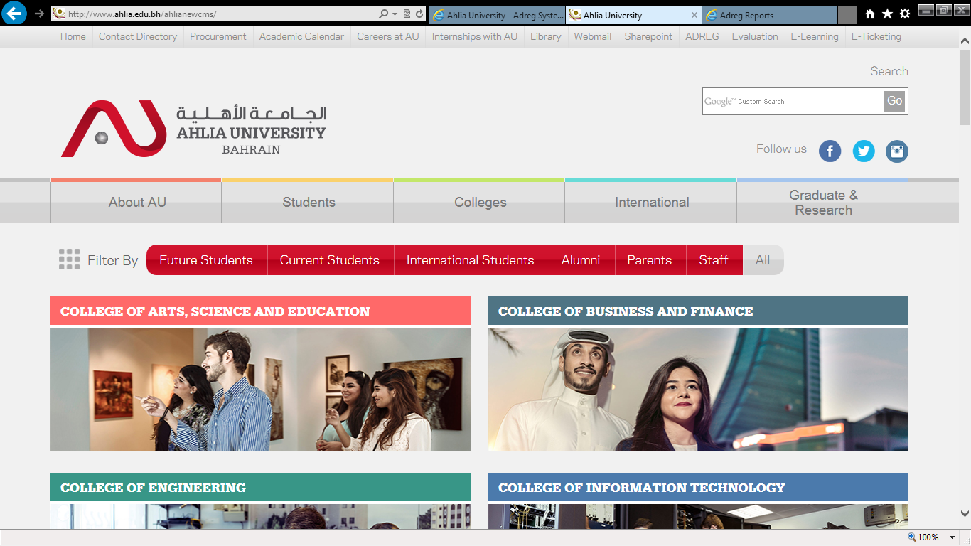
Enter Ahlia web site
Click

Slide 3
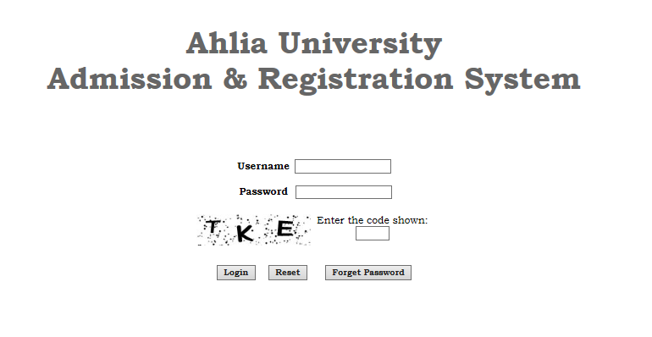
Enter the username & password that you got from the Registration Department and the shown code

Slide 4
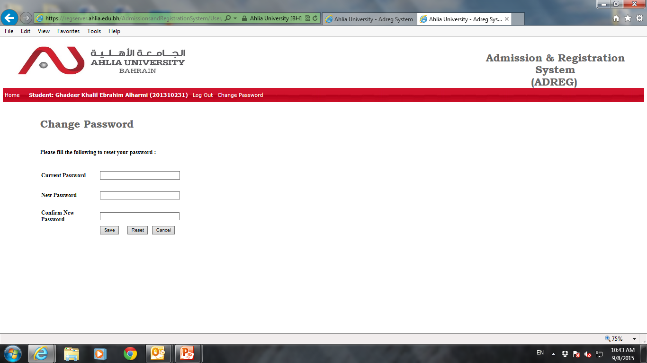
After you login you will be asked to change the password.
Enter the given password
Enter the new password must contain numbers, uppercase & lowercase letters
Repeat the new password

Slide 5
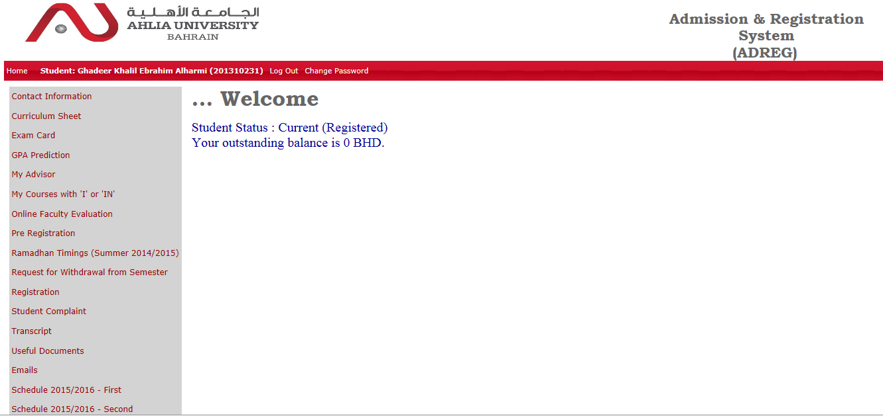
ADREG Home Page

Slide 6
Curriculum Sheet
Student programme plan with grades

Slide 7
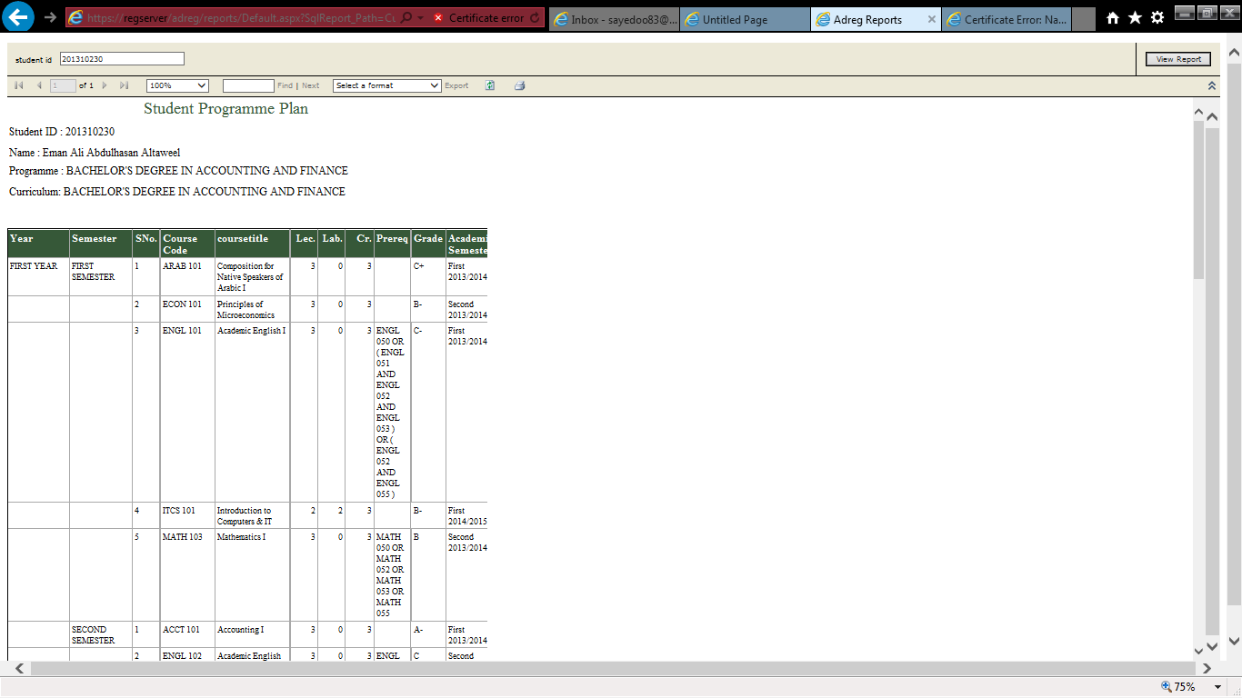
Sample of the curriculum sheet

Slide 8
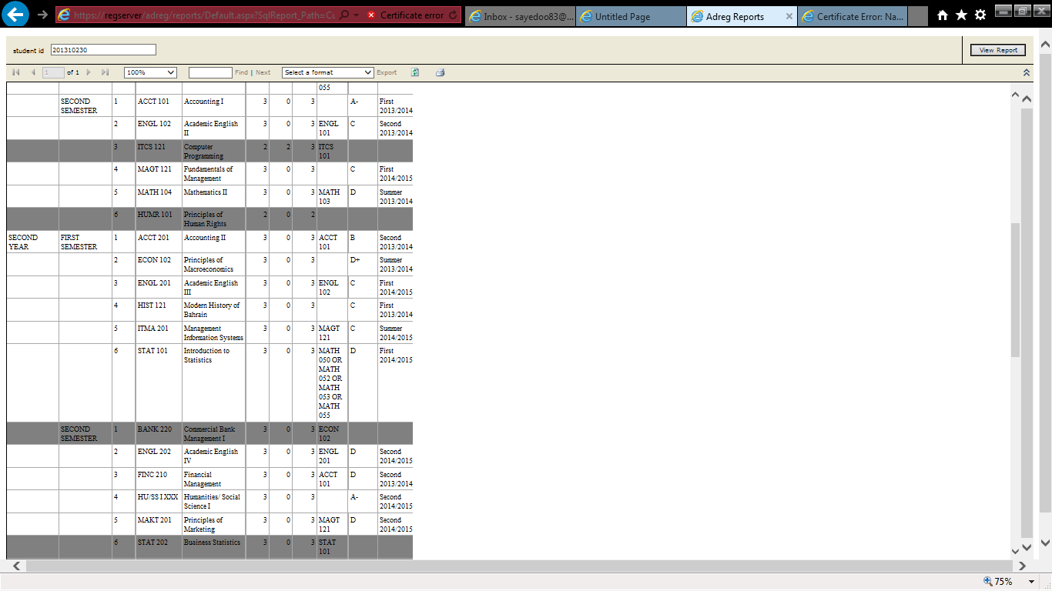

Slide 9
Exam Card
You must print your exam card for attending final exams

Slide 10
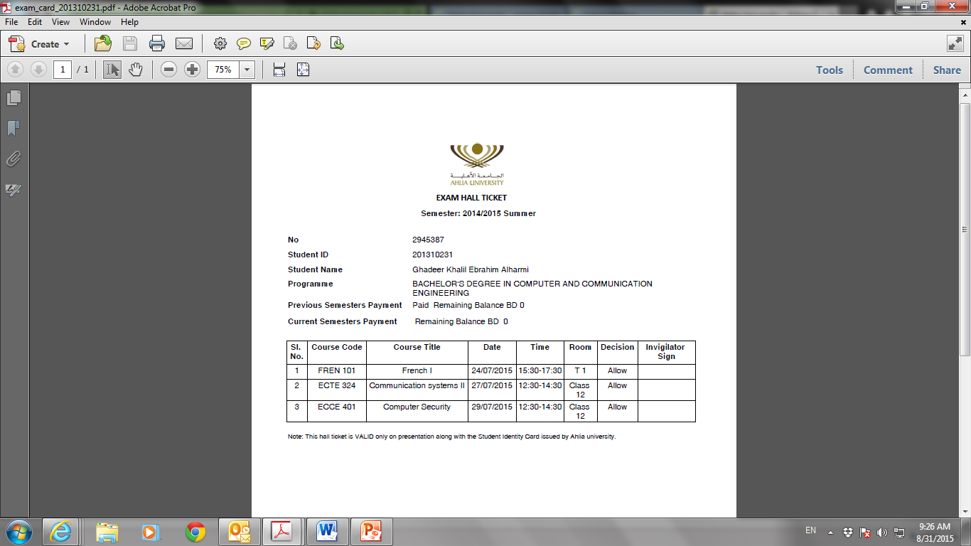
Sample of Exam Card

Slide 11
GPA Prediction
You can predict your grade to evaluate it’s effect on your GPA

Slide 12
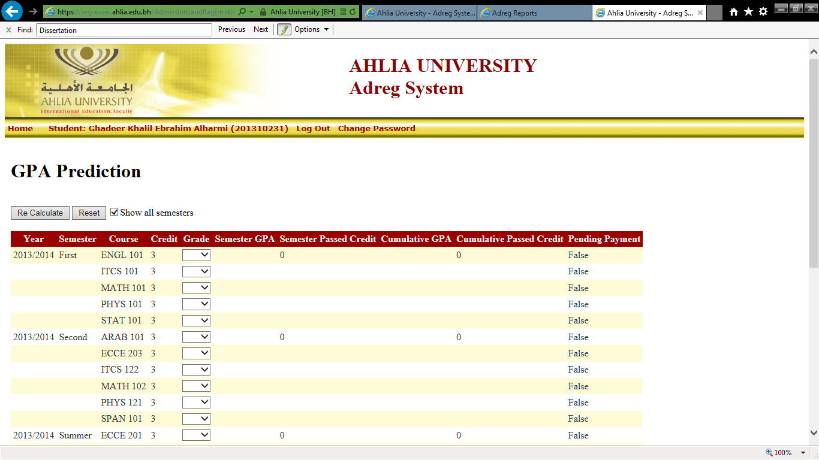
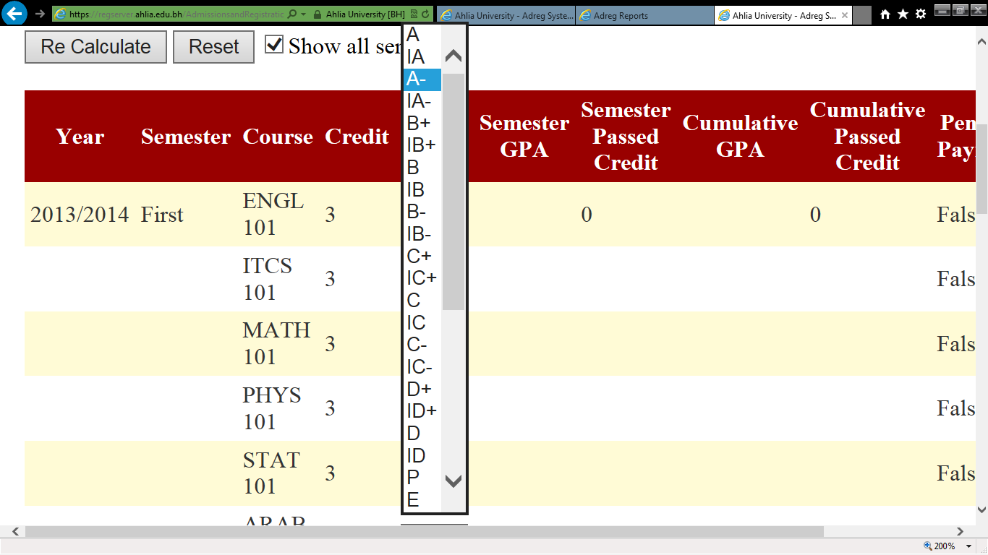
This is a sample of the GPA prediction page
3. Click on Re Calculate
1.By clicking you can chose your predicted grade
2.This is the list that will be shown

Slide 13
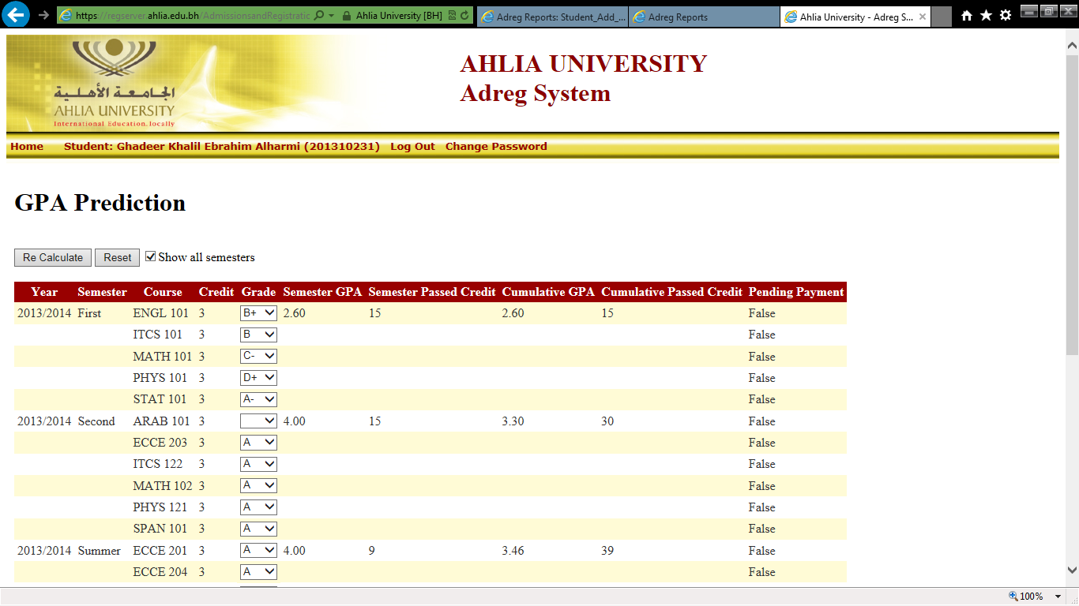
This is a sample of the final page

Slide 14
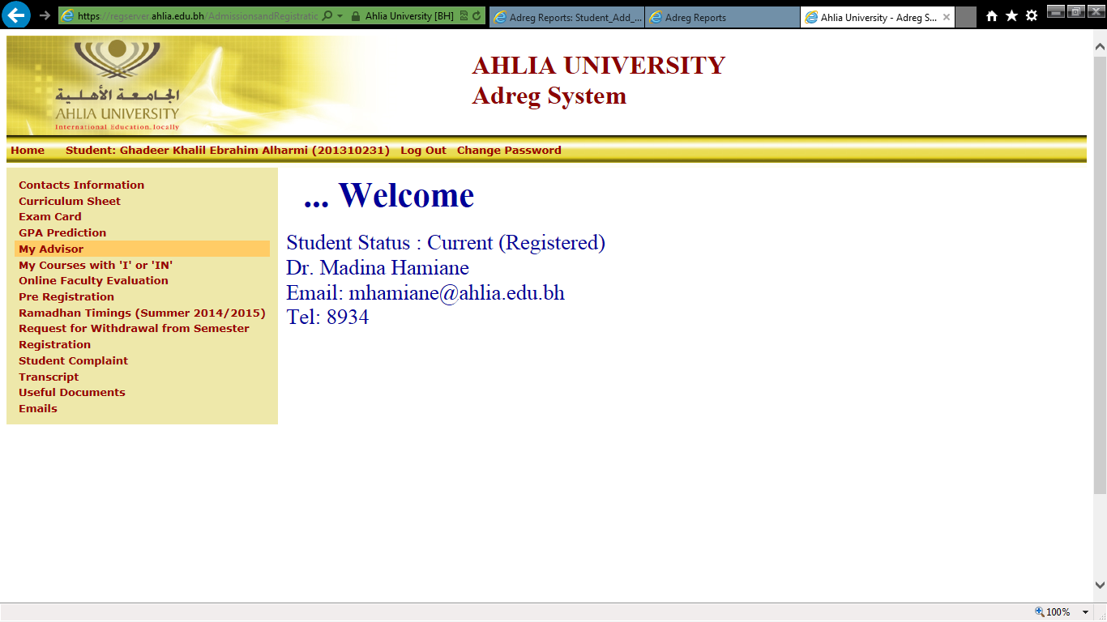
My Advisor
By clicking on “My Advisor” it will show your status & your advisor name with their contact details

Slide 15
My Courses with ‘I’ & ‘IN’
Will give you details of your ‘I’ & ‘IN’ grades

Slide 16
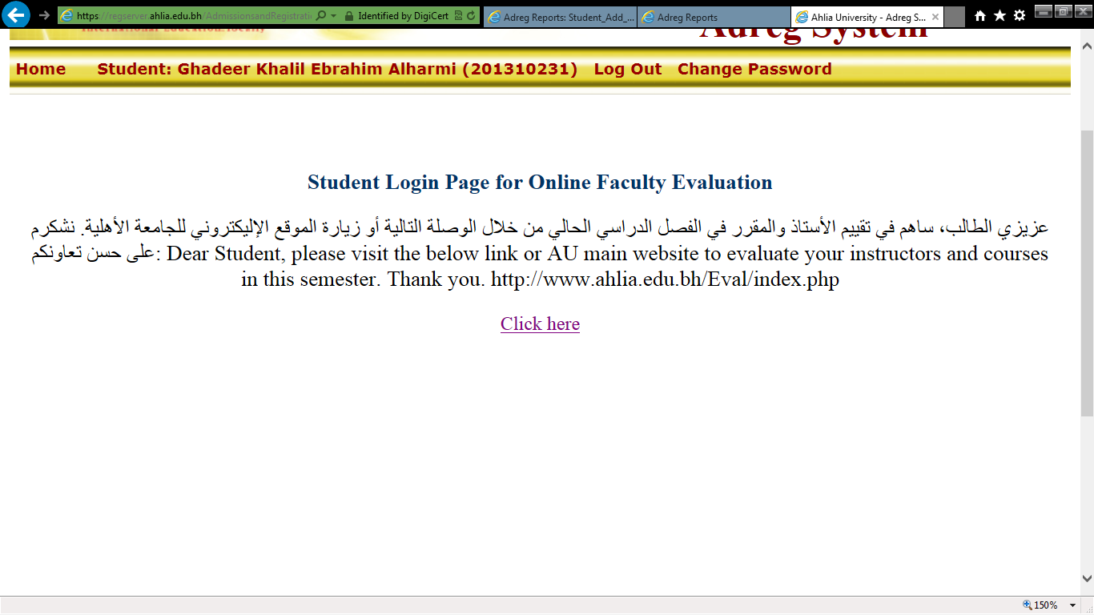
Online Faculty Evaluation
When you click on it you will get this page

Slide 17
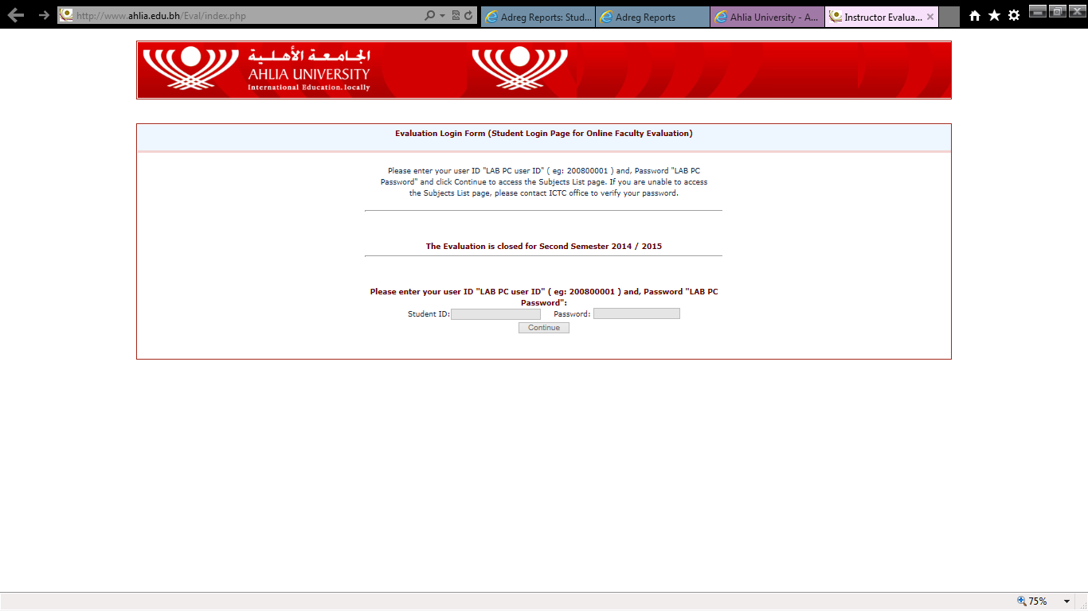
In order to be able to do the evaluation you will need to get the “Lab PC User ID” & “Lab PC Password” from the IT department

Slide 18
Pre Registration
Click

Slide 19
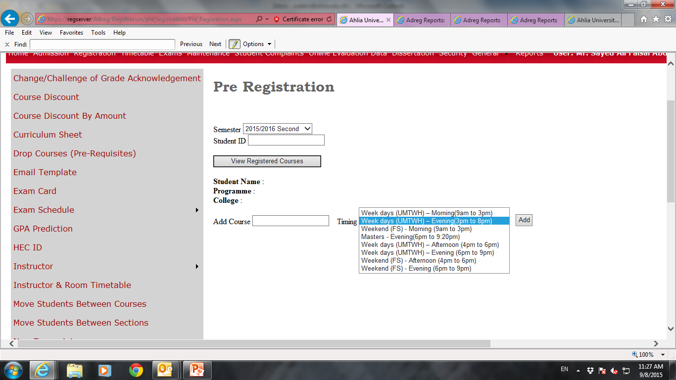

Slide 20
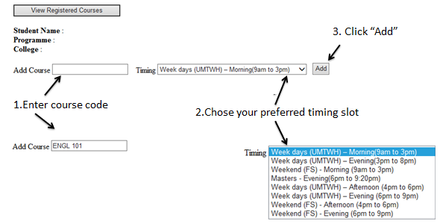
Pre Registration Process

Slide 21
Registration
You can register online in courses in the Add/Drop period

Slide 22
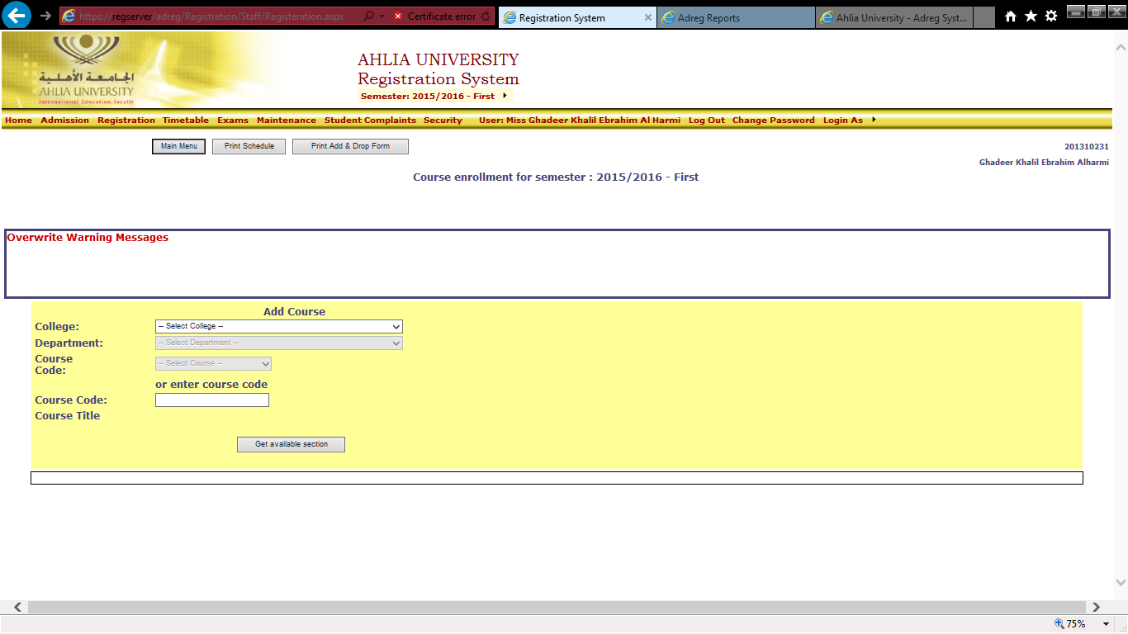
Registration Home Page

Slide 23
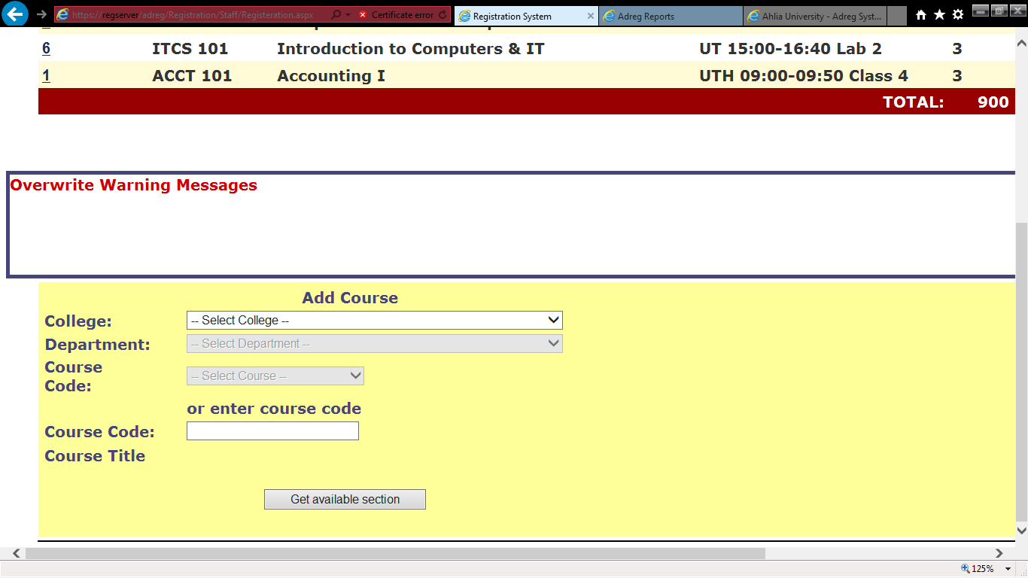
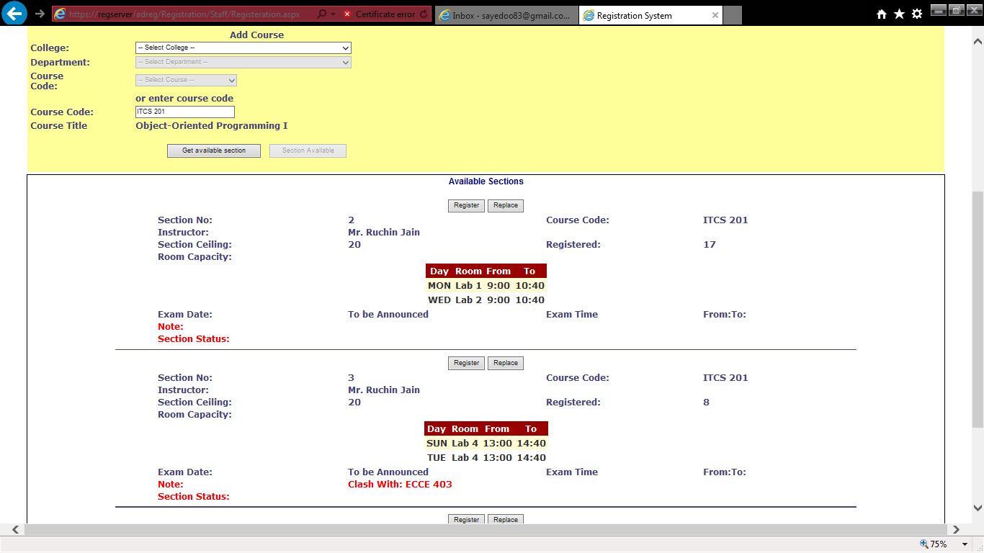
Registration Procces
Enter course code

Slide 24
Click

Slide 25
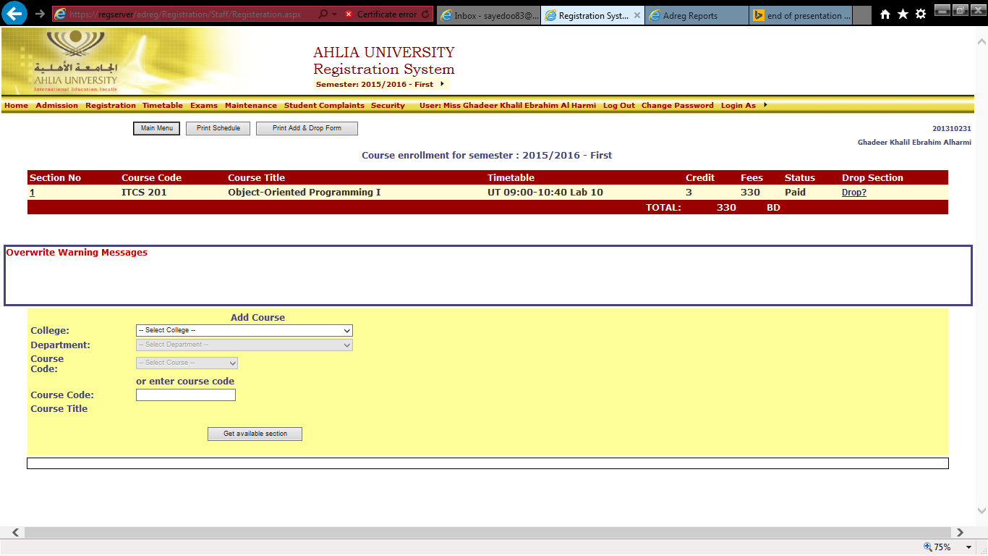

Slide 26
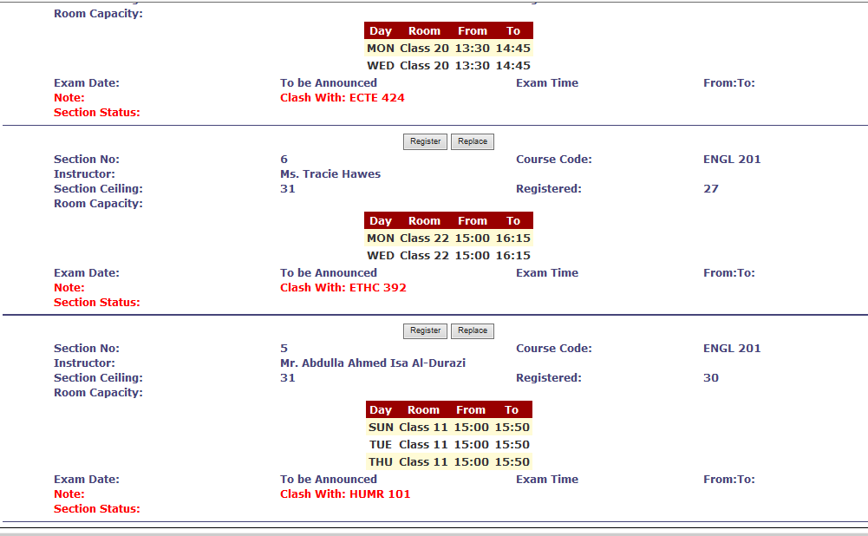
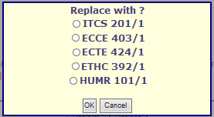
To replace a section/course

Slide 27
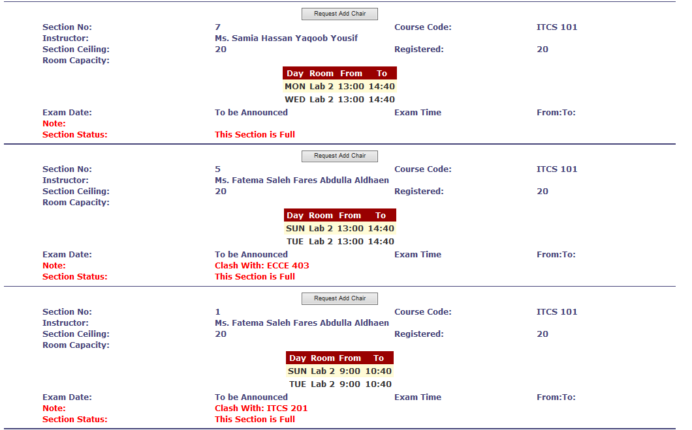
The ADREG is showing timing clash and full section

Slide 28
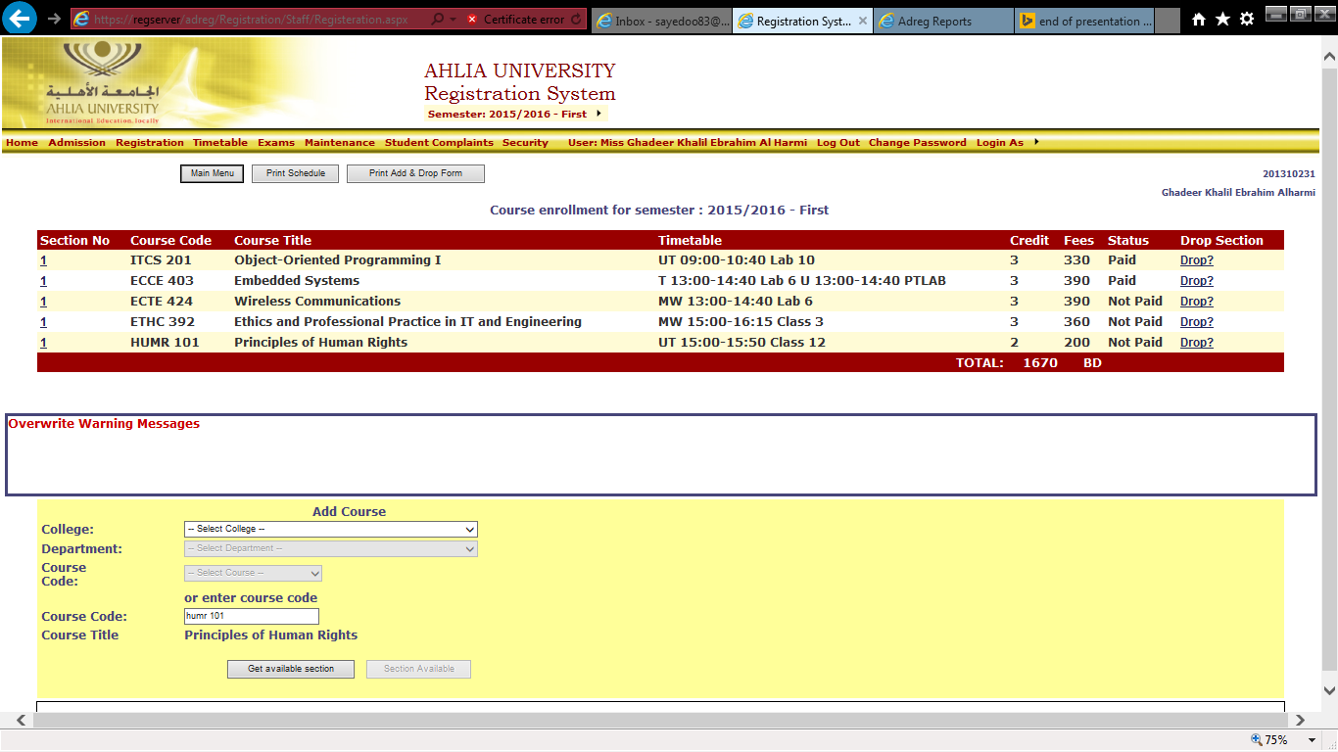

Slide 29
Student Complaint
To submit online complaint form to Dean of Student Affair Office
You can

Slide 30
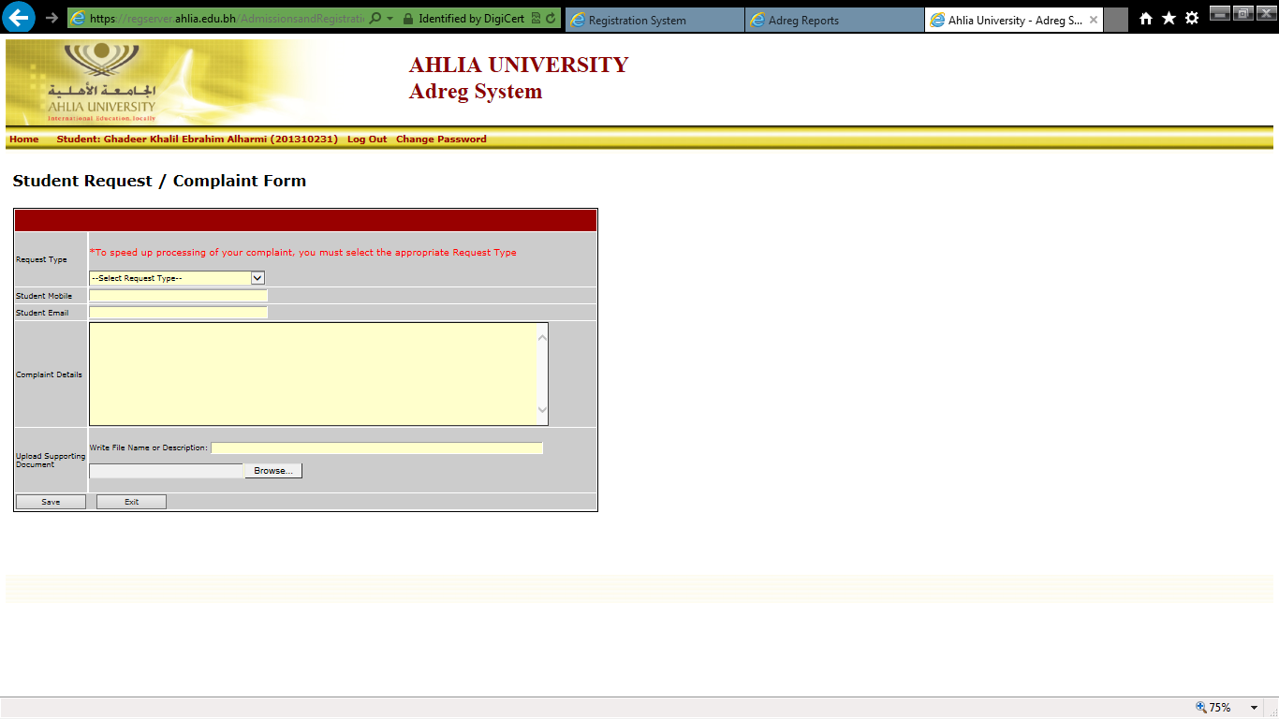
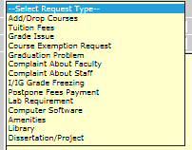
Student Complaint Page

Slide 31
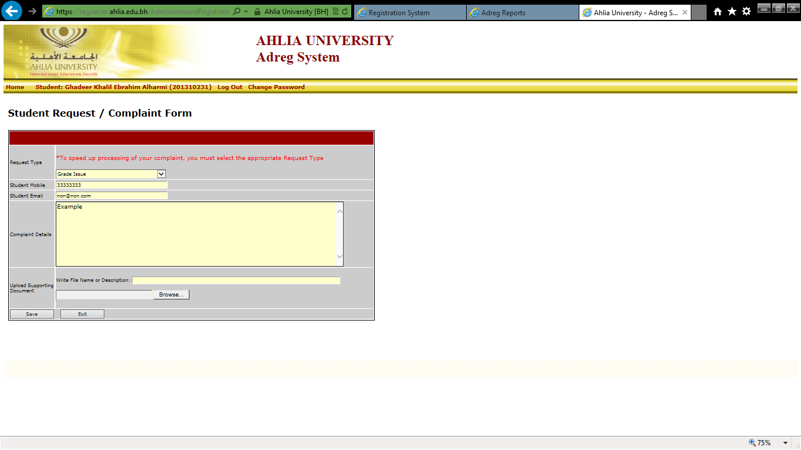
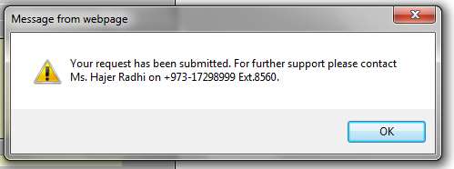

Slide 32
Transcript
You can view your grades by the end of the semester

Slide 33
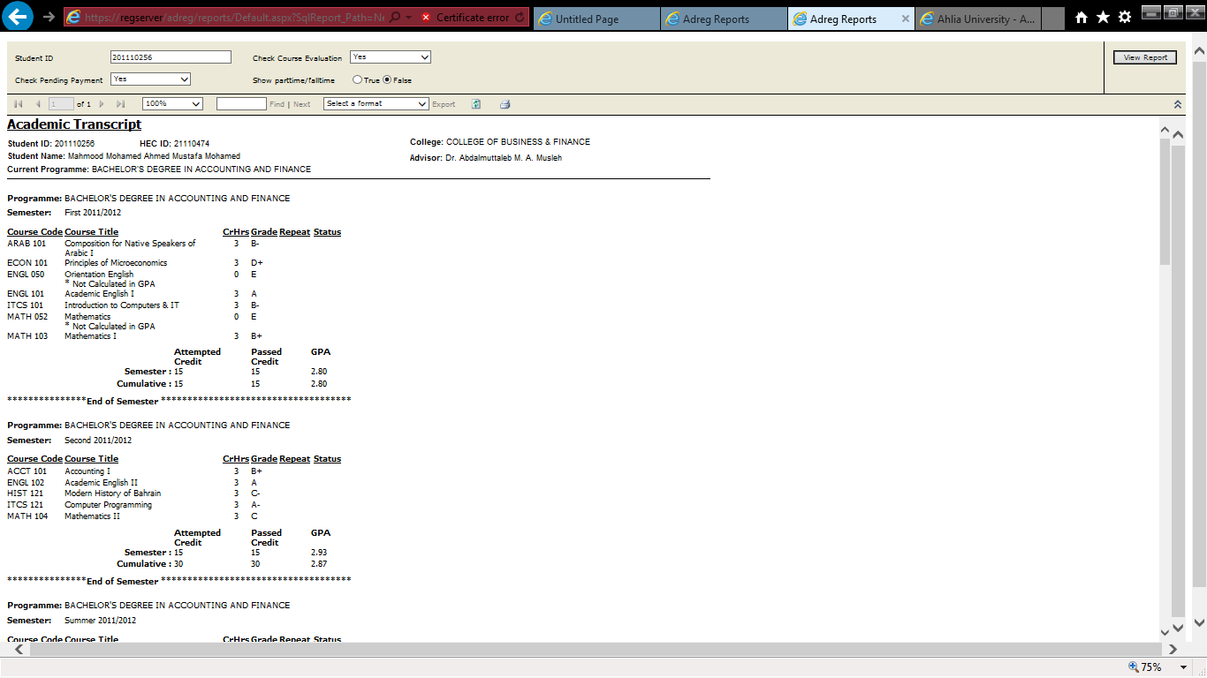
Transcript Sample

Slide 34
You can find some useful documents like withdrawal procedure
You can view email from university

Slide 35
Schedule
To view your schedule

Slide 36
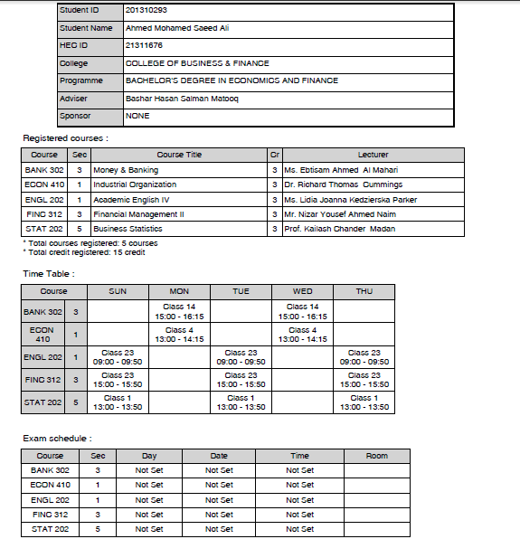

Slide 37
Thank You!
For any enquiry:
T. 17298957 / 17298981
E. ssalem@ahlia.edu.bh / aathar@ahlia.edu.bh

Slide 38
Ahlia University Digital Library
An Overview

Slide 39
INTRODUCTION
At present Ahlia University has a collection of over 10000 hard copies of books in the disciplines of Business, Management, Information Technology, Physiotherapy and Interior Design that cover the syllabi taught in the University. Students and faculty of Ahlia University enjoy access to a wealth of online resources including e-books, e-magazines, e-jounals and e-dissertations.
Ahlia University Library provides access to Electronic Journals and reference materials to 55 databases covering the disciplines of Business, Management, Information Technology, Physiotherapy, Interior Design and Public Relations. In addition to periodical collection, the information centre also provides access to more than 50,000.00 Electronic Books across the disciplines being taught in the University. The library provides access to over Ten of Thousands
e-journals.

Slide 40
CONVENTIONAL HARDCOPIES
OF LITERATURE
Subject Reference
General Reference
Textbooks
Newspapers
Magazines
Dissertations

Slide 41
LIST OF ONLINE
DATABASES
1-EBSCO
2-LEXIS NEXIS
3-INFOTRAC
4-CRC PRESS
5-IGI GLOBAL
6-PROQUEST
7-SAFARI
8-MCGRAW HILL
9-INFORMS ONLINE
10-BRUNEL
11-DOAJ
12-HIGHWIRW
13-OCLC
14-VIRTS INTER PRESS
15-Al MANHAL
Total No. of Databases | 55
No. of E-Journals & Periodicals | More than Ten of Thousands
No. of E-Books | More than 50,000

Slide 42
LIBRARY
FACILITIES
OPAC –COPIERS AND PRINTERS
SPECIAL COLLECTIONS AREA
3.POST GRADUATED- STUDENTS ROOM
READING AREA AND STUDY AREA
5.PHD ROOM
6.STUDY HALL

Slide 43
RULES FOR
TEXTBOOK SALES
Books sold will not be exchanged or refunded.
Make available your schedule to acquire an invoice for textbooks(s).
Payments is only accepted in the cashier desk - Accounts Department.
IN Order to receive the textbooks(so, please verify the payment receipt.
This rules for non sponsored student but sponsored student after collecting the invoice from the circulation desk approval needed from Registration Department.

Slide 44
POLICY FOR BORROWING
CONVENTIONAL BOOKS
STUDENTS
Are allowed to take 3 books for home reading for a period of 10 days. General Books & 1 day for Reference book. Special Collections as dissertation , dictionary etc, .. are not allowed to borrowing out of Library.

Slide 45
LIBRARY
WORKING HOURS
SATURDAY – THURSDAY 8.00 AM – 8.00 PM
FRIDAY 10.00 AM – 3.00 PM

Slide 46
International Students Orientation Day
STUDENT COUNSELING

Slide 47









Slide 48

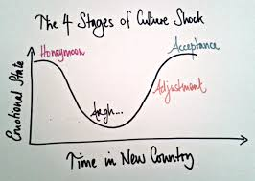

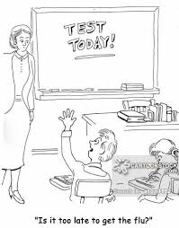
COUNSELING SUPPORT
un soutien psychologique
SOCIAL CONCERNS
(social)
Assimilating to a different culture
EMOTIONAL CONCERNS
(émotif)
Missing home and loved one’s
La France me manque
ACADEMIC CONCERNS(académique)
A different approach to academics- testing format differs (from EPITECH)
CONFIDENTIALITY WILL BE MAINTAINED AT ALL TIMES...CONFIDENTIALITÉ SERA MAINTENUE EN TOUT TEMPS

Slide 49







WELCOME ABOARD
BIENVENUE A BORD

