Slide 1
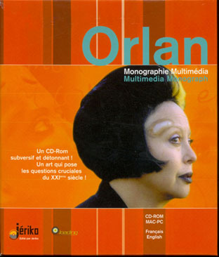
The body in Contemporary Social Science a whirlwind tour Dr Meredith Jones
BRUNEL UNIVERSITY LONDON
AHLIA UNIVERSITY BAHRAIN
EQUAL OPPORTUNITY IN BUSINESS & SOCIETY CONFERENCE

Slide 2
TODAY
THE BODY IN CONTEMPORARY SOCIAL SCIENCE
1
TOMORROW
Body and Self
THE VISUAL TURN
2
TOMORROW
Body and Self
COSMETIC SURGERY
3

Slide 3
The Body? Or Many Bodies?
The Absent Body
The Social Body
The Sensing Body
The Docile Body
The Gendered Body
The Modified Body
The Cyborg Body

Slide 4
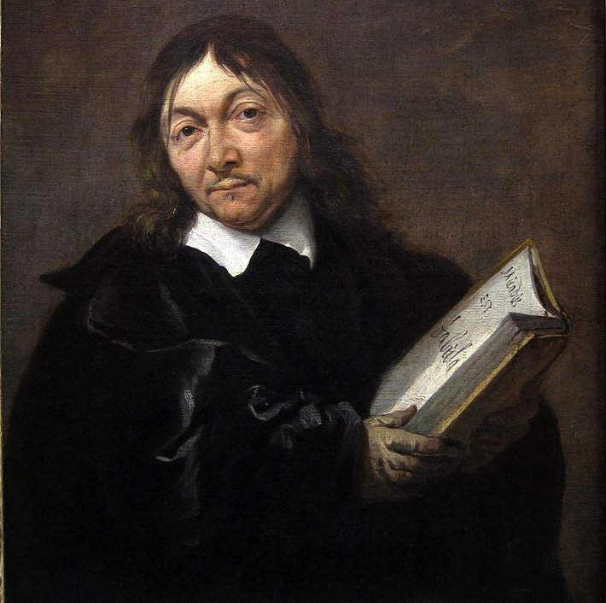
The Absent Body Cogito ergo sum (I think, therefore I am)
Mind/body dualism
Mind and matter (body) are two ontologically separate categories
The body is a machine
Mind = conscious self
Cartesianism (via Descartes)
Truths can only be found through thinking, not through sensation or physical experience
The mind is superior to the body
Mind = human/culture/male/rational
Body = animal/nature/female/irrational
Rene Descartes (1596-1650)
I know now that even bodies are not perceived by the senses or the faculty of imagining, but are perceived only by the mind, and that they are not perceived by being touched or seen but only by being understood, and therefore I know clearly that there is nothing that can be perceived by me more easily or more clearly than my own mind.

Slide 5
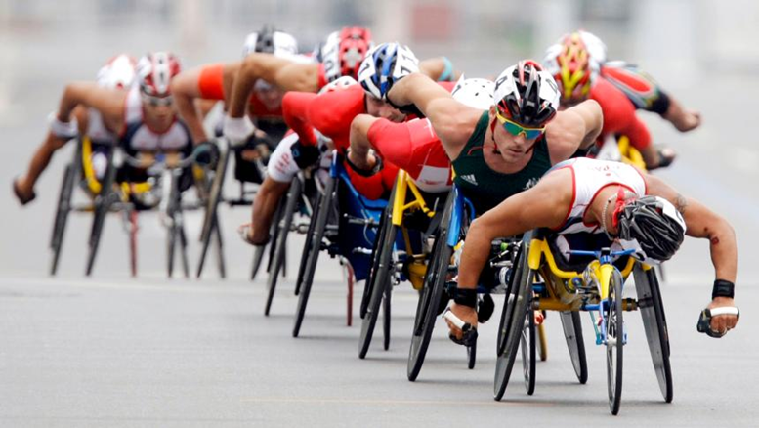
The Social Body
The body is the social world but the social world is the body. Pierre Bourdieu, 1990
Mind and body are inextricably linked.
How we understand our bodies depends on our society and culture.
Bodies are biological but are also social and cultural.
We learn through our bodies
The body is shaped by Institutions, Consumption; Beliefs; Values; Politics; Media; Space; Time… etc
The very possibility of the social world, rooted as it is in interaction, rests upon our embodiment… our bodies are … our very means of experiencing. Nick Crossley, 2001
Notes:
Example:
Impairment = loss of a physiological/anatomical capacity
Disability= repercussions of impairment in a society
Biomedical model of disability sees disability as a physical impairment…
The social model of disability sees the social environment as dis-abling…
Disability is a changeable category that results from interaction between a person’s abilities and their environment
The Tracker, Rolf de Heer, 2002 http://www.youtube.com/watch?v=jSFR17cEfa4
We learn through our bodies
The body is shaped by Institutions; Consumption; Beliefs; Values; Politics; Media; Space; Time… etc

Slide 6
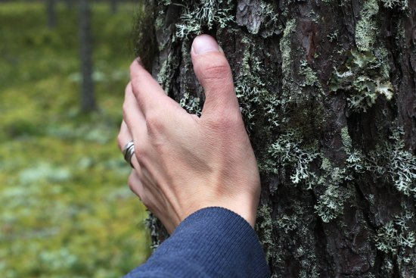
The sensing body (phenomenology)
Bodies are our primary sites of knowing, discovering, understanding the world.
Bodies are intelligent and sense-making.
Bodies are responsive, active, in dialogue with the social and cultural world.
They are always both touching and touched, seeing and seen, sensing and being sensed.
Inside and outside are inseparable. The world is wholly inside and I am wholly outside myself.
Maurice Merleau-Ponty, The Phenomonolgy of Perception, 1945
Notes:
According to Merleau-Ponty, there is a paradoxical condition of all human subjectivity in that we are both a part of the world and coextensive with it, we constitute the world but are also constituted by it. Human and human environment are one.

Slide 7
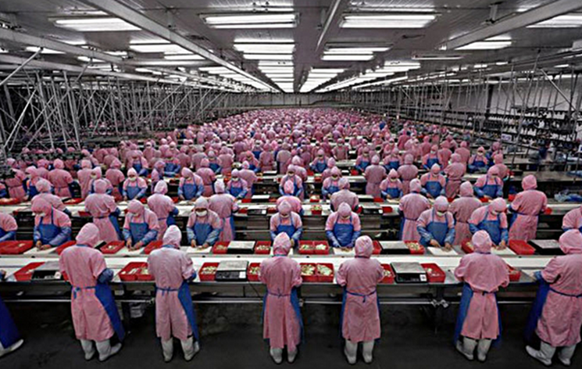
The Docile
Body
Discipline is achieved through surveillance of bodies rather than physical force
Enacted via various institutions and their discourses: schools, prisons, governments, factories
Self-monitoring of bodies, self-surveillance, is a ‘productive form’ of power
He who is subjected to a field of visibility, and who knows it, assumes responsibility for the constraints of power; he makes them play spontaneously upon himself; he inscribes in himself the power relation in which he simultaneously plays both roles; he becomes the principle of his own subjection. Michel Foucault, Discipline and Punish: The Birth of the Prison, 1977
Notes:
Foucault opens Discipline and Punish with a contrast—capital punishment (hung, drawn quartered) vs a simple timetable for a correctional centre.
Foucault is interested in how external structures (like institutions of power) produce subjects
He describes a modern regime of social control; that is, how power controls bodies.
Three technologies enable the production of docile bodies: hierarchical observation, normalizing judgment, and examination.

Slide 8
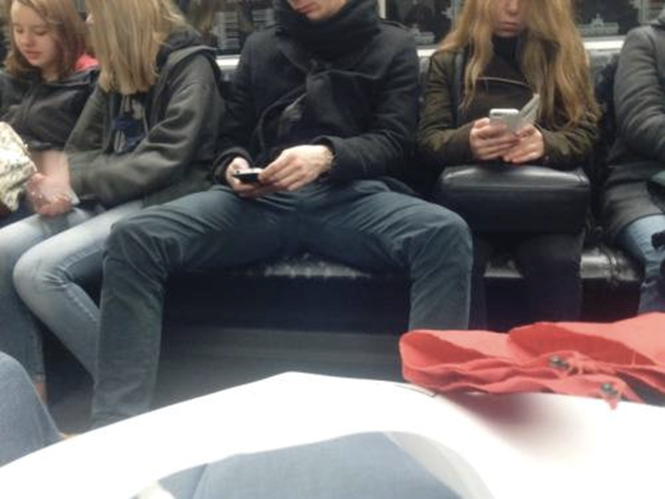
The Gendered Body
Society teaches us how to ‘do’ gender.
It is ‘performed’ but still always ‘constrained by available historical conventions.’
We are usually unconscious of performing our gender.
Many body modifications are connected to gender performativity.
There can be severe ramifications for not performing gender ‘correctly’.
We are always under duress to give the gendered performance expected from us. Performative acts which construct gender may appear ostensibly as a personal choice, but always work within the existing framework of cultural sanctions and proscriptions, of a “shared social structure.
Judith Butler, Gender Trouble: Feminism and the Subversion of Identity, 1990
Notes:
Gender is an identity repeatedly constructed through time, it is always constructed through the body.
We do not have gender first and then choose to perform it; rather, gender is created through our performances.
Any act which deviates from its socially intended gender is subject to punishment.
While actors know that they are acting, we take our gender as natural/normal, and forget that it is learned and then naturalised.

Slide 9
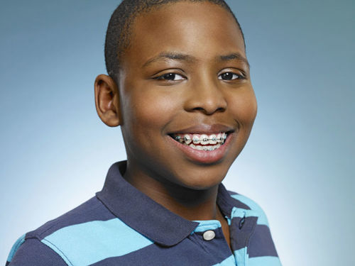
The modified or marked body
Bodies as expressive; bodies as cultural signs
Clothing, Tattooing, Makeup, Piercing, Hairdressing, hair removal, Cosmetic surgery, Dental work, Dieting, Obesity, Gymwork, Bodybuilding
Why are some body modifications acceptable (even mandatory) while others are considered ugly or unnatural?
What are the cultural/historical/social significances of various body modifications?
What can body modifications tell us about the values, morals & beliefs of the cultures we inhabit & create?
The marked body signals the fact that bodies are eminently cultural signs…
The cultural ideals of Western beauty are symbolized by the technological manipulation of the human body.
Anne Balsamo, Forms of Technological Embodiment: Reading the Body in Contemporary Culture 1995

Slide 10
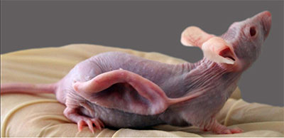
The cyborg body
CYBORGS mix organic and non organic elements. They can be used to think about:
Nature/culture relations
Human/technology relations
Human/animal relations
By the late twentieth century, our time, a mythic time, we are all chimeras, theorized and fabricated hybrids of machine and organism; in short, we are cyborgs.
Donna Haraway, A Cyborg Manifesto: Science, Technology, and Socialist-Feminism in the Late Twentieth Century, 1984
Notes:
the concept of the cyborg is a rejection of rigid boundaries, notably those separating "human" from "animal" and "human" from "machine.“
three boundary breakdowns since the 20th Century that have allowed for her hybrid, cyborg myth: the breakdown of boundaries between human and animal, animal-human and machine, and physical and non-physical. Evolution has blurred the lines between human and animal; 20th Century machines have made ambiguous the lines between natural and artificial; and microelectronics and the political invisibility of cyborgs have confused the lines of physicality
"A Cyborg Manifesto: Science, Technology, and Socialist-Feminism in the Late Twentieth Century". Simians, Cyborgs and Women: The Reinvention of Nature. Routledge

Slide 11
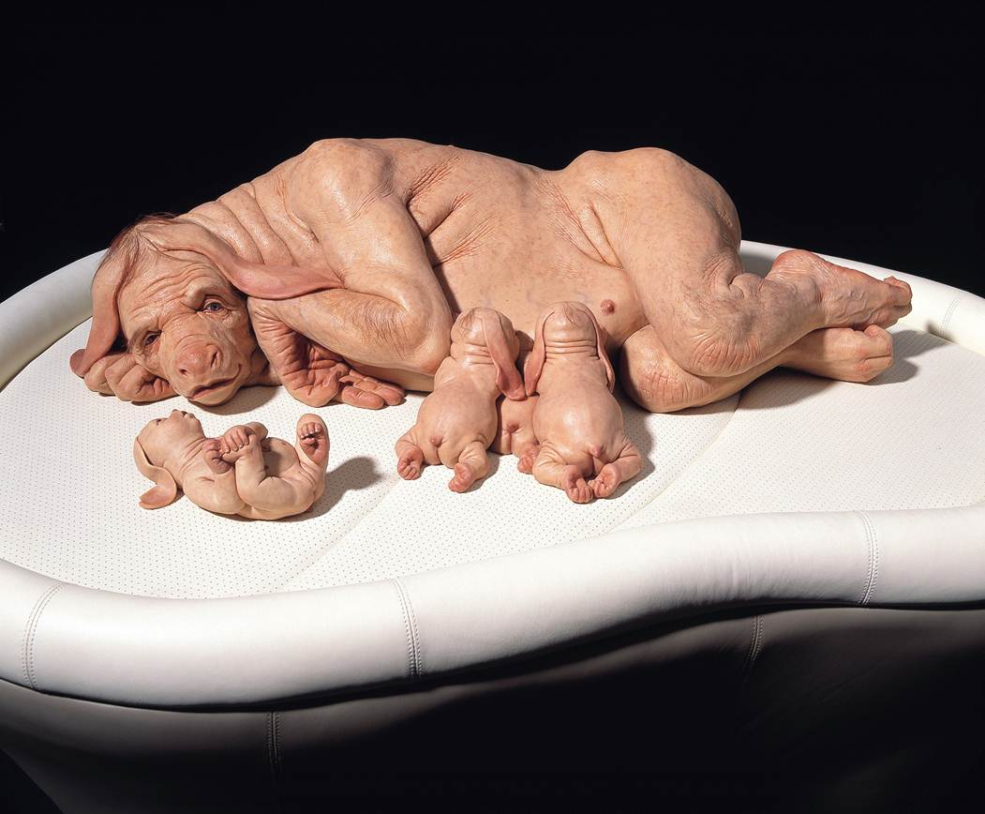
Patricia Piccinini, The Young Family, 2002, silicone, acrylic, human hair, leather, timber, 80.0 x 150.0 x 110.0 cm, Photograph by Graham Baring

Slide 12
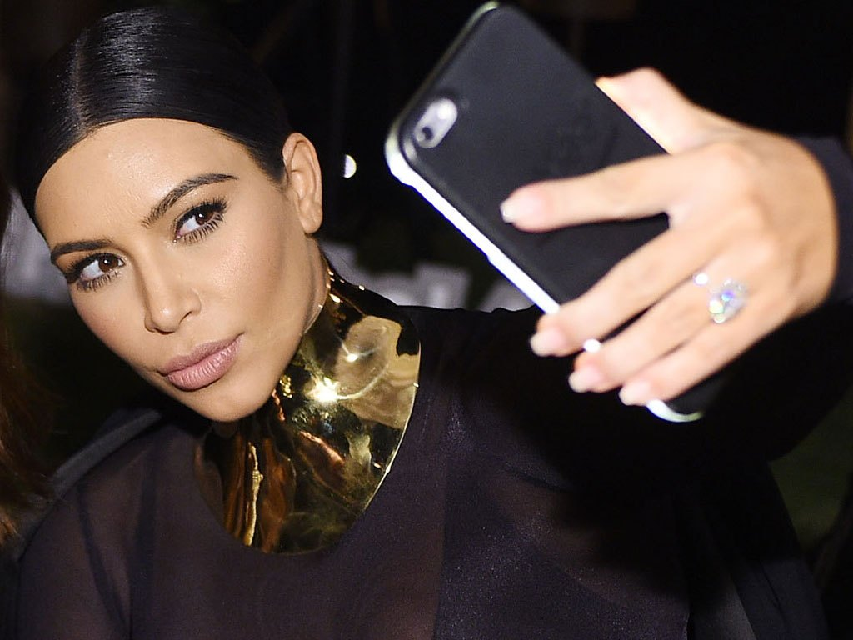
TOMORROW: The mediated body (media-bodies)
WE CREATE MEDIA BUT THEY ALSO CREATE US
We will explore how bodies are mediated via:
Visual Cultures
Cosmetic Surgery
Notes:
McQuire, S. 2003. From glass architecture to Big Brother: Scenes from a cultural history of transparency.
Cultural Studies Review 9, no. 1: 103–23.

