Slide 1
Determinants of Board gender Diversity in firms listed in Bahrain Bourse
Reem Khamis Hamdan

Slide 2
Agenda
Background
Literature Review and Theoretical background
Methodology
Results
Future Research

Slide 3
Background
Women representation on the board of directors has been a hot topic on the strategic agendas of many governments and corporations (Norway, France, Spain, UAE, Malaysia)
Beside the ethical part of board gender diversity, there is the business case of it.

Slide 4
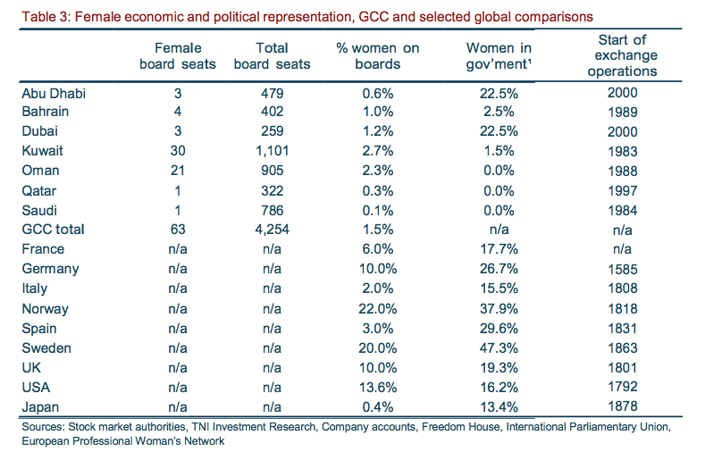

Slide 5
Literature Review And Theoretical Background
Board gender diversity is not only an ethical issue of rights and equality, however, a growing empirical evidence has shown that presence of females in boardrooms has a significant effect on board performance and corporate performance as well. This effect may be as a result of various elements that females may bring to the boardroom dynamics which eventually enhance performance. (Abdullah etal. 2016)

Slide 6
Theoretical Background
Agency Theory
Resource Dependence Theory
Tokenism
Critical Mass Theory
Stakeholders Theory

Slide 7
Methodology
The study was conducted in Bahrain Bourse which contains 39 listed companies. Data was collected for the period of 5 years (2011 to 2015). Data was collected manually from companies’ financial reports and Bahrain Bourse database

Slide 8
Measurement of variables

Slide 9
Descriptive Statistics
No. of women (0.59)
Percentage of women 6%

Slide 10
Regression Analysis
Negative statistically significant effect between (Presence of women and Tobin’s Q)
Board size affect the presence of women
Ownership concentration ,institutional ownership, has positive effect on the presence of women

Slide 11
Limitation and Future Research
Generalizability
Considering country level factors such as (economic and socio-political factors.

Slide 12
THANK YOU

