Slide 1
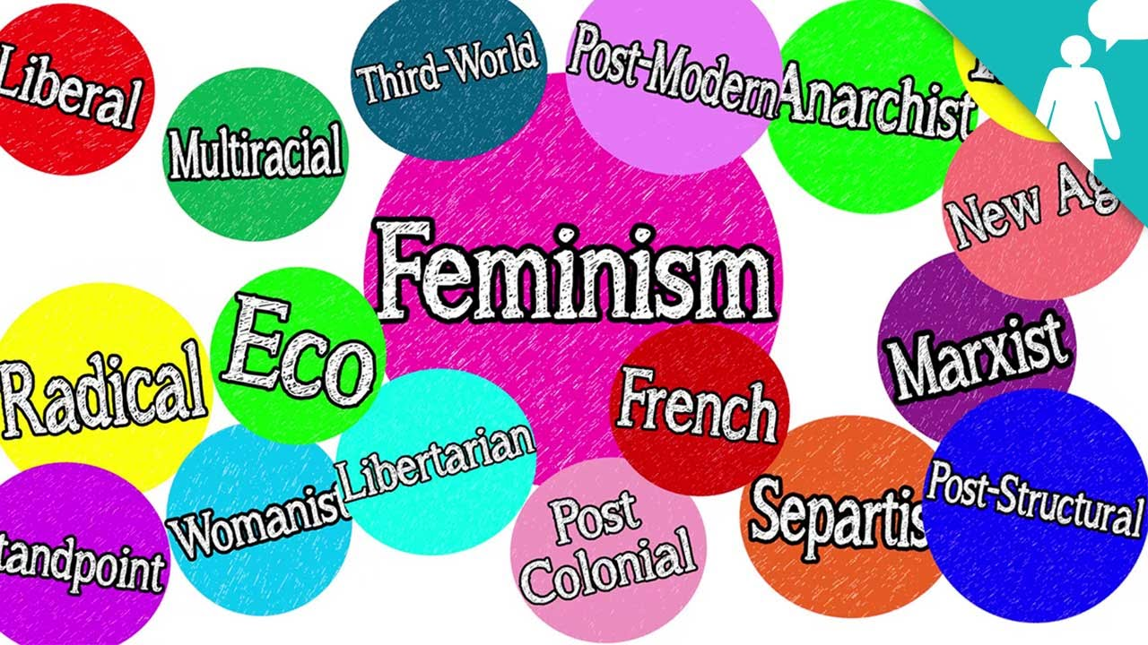
KNOWLEDGE AND POWER – FEMINISM(S) AND RESEARCH Dr Adrienne Barnett Brunel University London Adrienne.Barnett@brunel.ac.uk

Slide 2
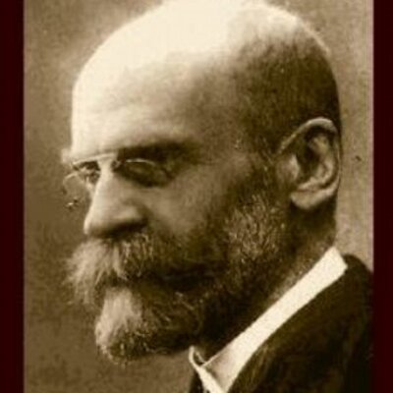
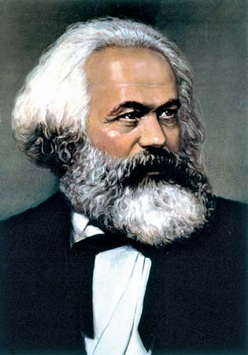
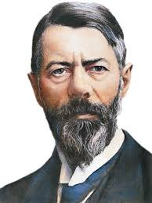
FEMINIST CRITIQUES OF CLASSICAL SOCIAL THEORY
Strategic absence of women, while men had ‘absent presence’
Masculine ontology
Objectivity, neutrality
Privileging of the (non-gendered) male subject
Enlightenment dualisms – minds (men)/bodies (women);
public (men)/private (women)
Modernity as a masculinist project

Slide 3
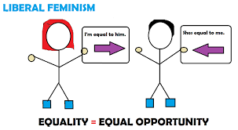
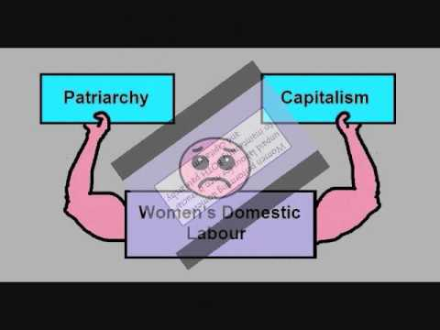
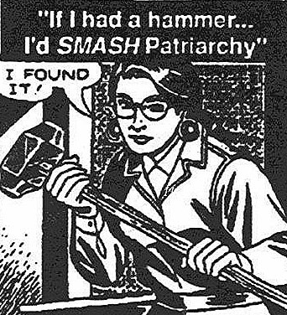
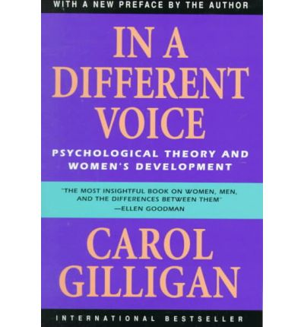
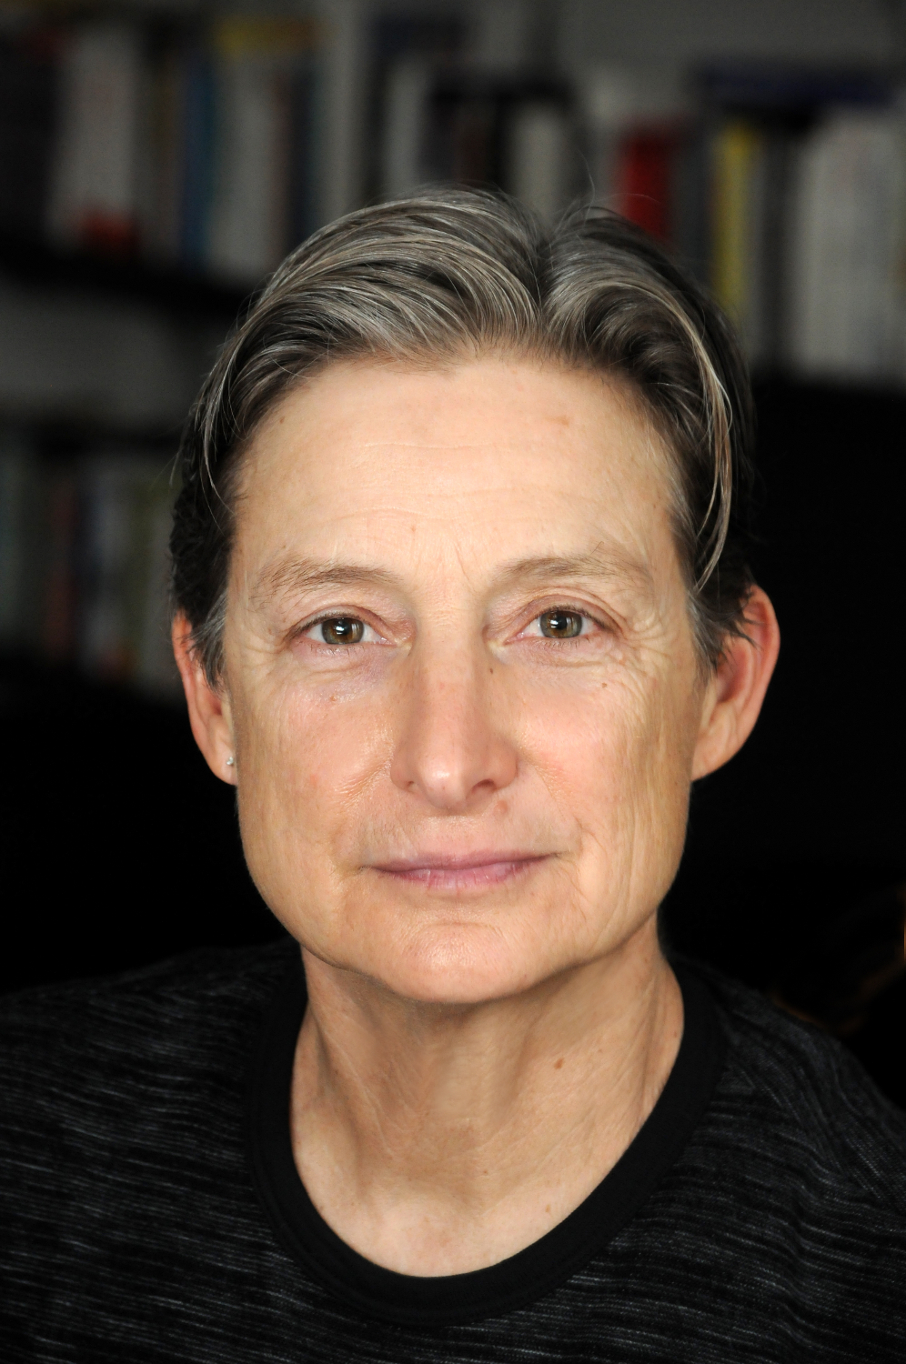
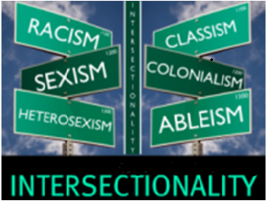
FEMINISMS
Liberal/equality feminists Marxist/socialist feminists Radical feminists
Difference feminists Standpoint feminists Postmodern feminists

Slide 4
ALL FEMINISTS DO NOT THINK ALIKE!
So how can we do feminist research when women speak with many voices?
Common distinctive elements/assumptions shared by feminists in doing research and scholarship:
Women and their contributions to social and cultural life have been marginalised and this is reflected in research practice
The norms of science perpetuate and disguise the myth of the superiority of men over women
Gender as a significant social category has been absent from our understandings and explanations of social phenomena in favour of categories such as social class
Women’s experiences, ideas and needs should be valued
The conditions that oppress women should be recognised
Desire to change conditions through research

Slide 5
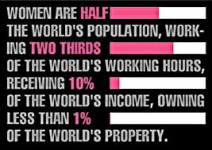
CONNECTION BETWEEN SCHOLARSHIP AND POLITICAL ACTION
Feminist research is political in nature – it seeks to change society, not just understand it
Emancipatory and liberatory goals - feminist research can serve as a vehicle for women’s empowerment
Knowledge production must be useful to women and be instrumental in improving women’s lives
Knowledge is productive of power A dual responsibility – to contribute to knowledge and the interests of women
‘The role of the researcher is thus to produce useful knowledge which contributes to global gender justice, to changing women’s subordination and to stopping all forms of social inequalities’ (Jane Wambui)

Slide 6
CRITIQUES OF POSTIVISM/EMPIRICISM
Positivism = an objective epistemology
Reality/facts exist independently of our interpretations so task of research is to find reality/discover objective, verifiable truths
Researcher must be objective, detached, value-free
Empiricism – ‘the facts speak for themselves’
Feminist critiques of positivism/empiricism
Science is based on male norms (not value-free universal criteria) and in particular the Enlightenment mythical separation of reason (men) and emotion (women)
‘Universal’, ‘objective’ knowledge is masculine knowledge which overlooks or excludes women
Positivist epistemologies exclude women as knowers – a silencing process
So disengagement and aloof detachment of researcher is undesirable
and impossible – ‘objectivity is simply a form of male subjectivity’ (Pat Caplan)
‘The personal is political’
‘Objectivity’ ignores social context

Slide 7
CONSTRUCTIVIST APPROACHES
Constructivism
social reality is constructed rather than rooted in objective fact
meaning is constructed, not discovered, so data are created, not collected
Poststructuralism
Knowledge is the discursive product of relations of power that arise within specific historical, social and material conditions, with ideological effects
The task of research is to examine historically how knowledge in society is produced, to deconstruct the processes by which that knowledge is formed, to make visible the relations of power that give rise to discursive claims to truth, and to articulate subjugated knowledges (May, 1993)
Subjectivity is an ideological effect of discourse that is always historically specific
Postmodernism
Knowledge is local and contingent; there are no universal or foundational standards against which science may judge its truth or falsity; emphasises multiplicity, ambiguity, fragmentation
Attacks the historical agenda of modernity, rejecting notions of social emancipation and the ‘legitimating myths of the modern age’ (grand narratives) (Lyotard)
Research focuses on how the social world becomes represented in texts, how meanings are produced

Slide 8
POSTSTRUCTURALIST FEMINISM
Critiques liberal, difference, standpoint etc feminists for their essentialism and for failing to disrupt binary dualistic thought
Recognises ‘the constructed, partial and politicised nature of these binaries between masculinity and femininity, and between public and private spheres’ (Vanessa Munro)
Shows that concepts of rationality, impartiality and objectivity are historically specific and contingent generalisations embodying dominant (masculinist) values which, in the process, devalue those attributes associated with ‘the feminine’ such as emotions
Illuminates the process of constituting historically specific gendered subjectivity/ies
Makes visible the gendered relations of power that give rise to discursive knowledge, how oppression works, and the way in which ‘most women are still excluded from the production of forms of thought, images and symbols in which their experience and social relations are expressed and ordered’ (Reinharz, 1991)
‘Silence has meaning’ - examines how and why knowledge is obliterated and not produced; resurrects feminist ‘subjugated’ knowledges as part of the process of regaining a feminine subject with a valid voice and knowledge
Notes:
Binary thought – masculine/feminine; subject/object; public/private

Slide 9
POSTSTRUCTURALIST FEMINISM – FEMINISM’S EMANCIPATORY AIMS?
Does the emphasis on multiple interpretations of social reality mean that women lose the capacity for effective social change by depriving women as a category of a valid, speaking voice and thus of political leverage?
While the power of discourse can have exclusionary, repressive and disciplinary effects, ‘language is not monolithic. Dominant meanings can be contested, alternative meanings affirmed’ (Chris Weedon, 1987)
By deconstruction, we can create the space for oppositional meanings to emerge and for the ‘shifting of subjectivities’ which ‘can, at certain junctures, be as crucial and as difficult as shifting economic structures’ (Susan Boyd, 1991)
Feminist critique as a discursive practice with the power to open up the possibilities for resistance to and transformation of patriarchal power relations
What about research aimed at law reform?
Does promoting law reform mask and reinforce law’s gendering role?
While relying on law to achieve social change ‘remains a high risk strategy…it would be riskier still to abandon it to those who are unconcerned with, or opposed to, the goal of gender equality’ (Vanessa Munro, 2007)
Notes:
Rather than obstructing or erasing a feminist voice, a poststructural perspective can allow us ‘to move towards a more empowering vision of the complexities of male-female relations’ (Vanessa Munro

Slide 10
10 TENETS OF FEMINIST RESEARCH (Reinharz 1992)
1. Feminism is a perspective, not a research method.
2. Feminists use a multiplicity of research methods.
3. Feminist research involves an ongoing criticism of nonfeminist scholarship.
4. Feminist research is guided by feminist theory.
5. Feminist research may be transdisciplinary.
6. Feminist research aims to create social change.
7. Feminist research strives to represent human diversity.
8. Feminist research frequently includes the researcher as a research subject
and tool.
9. Feminist research frequently attempts to develop special relations with the
people studied
10. Feminist research frequently defines a special relation with the reader.

Slide 11
FURTHER READING
Heckman, S, Gender and Knowledge: Elements of a Post-Modern Feminism (Cambridge: Polity Press, 1990)
Hesse-Biber, Nagy and Leavy, Feminist Research Practice (Thousand Oakes, CA and London: Sage, 2007)
Hill Collins, P, Black Feminist Thought (Boston: Unwin Hyman,1990)
May, T, Social Research (Buckingham: Open University Press, 1993)
Maynard M and Purvis J (eds), Researching Women’s Lives from Feminist Perspective (London: Taylor and Frances, 1994)
McNay, L, Foucault and Feminism: Power, Gender and the Self (Cambridge: Polity Press, 1992)
Munro, V, Law and Politics at the Perimeter: Re-Evaluating Key Debates in Feminist Theory (Oxford: Hart, 2007)
Reinharz, S, Feminist Methods in Social Research (Oxford: Oxford University Press, 1992)
Smart, C, Feminism and the Power of Law (London: Routledge, 1989)
Weedon, C, Feminist Practice and Poststructuralist Theory (Oxford: Blackwell, 1987)

