Slide 1
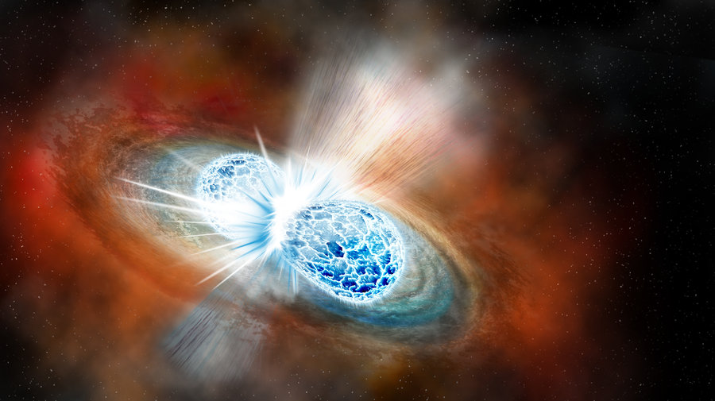
Colliding Neutron Stars
A New Era in Multi-messengers Astronomy
Shawqi Al Dallal
Ahlia University

Slide 2
COMPACT OBJECTS
Compact objects are dying stars after exhausting their fuel (Hydrogen, Helium, …)
- White Dwarfs (Mass < 1.44 solar mass)
- Neutron Stars (Mass > 1.44 and up to 2.5 solar mass)
- Black Holes (Mass > 2.5 solar mass and up to billions of solar masses)

Slide 3
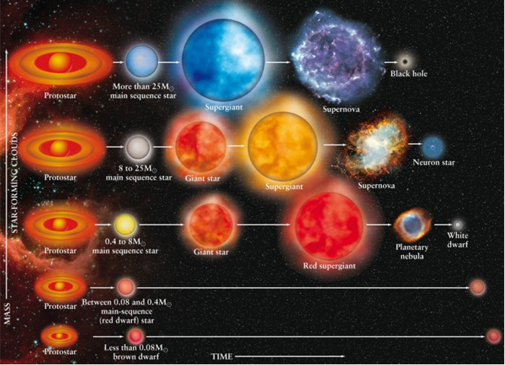

Slide 4
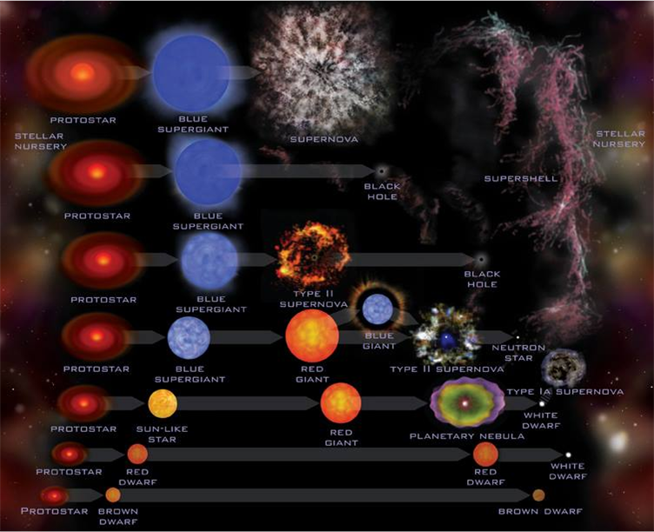
Evolutionary Pathways of Compact Objects

Slide 5
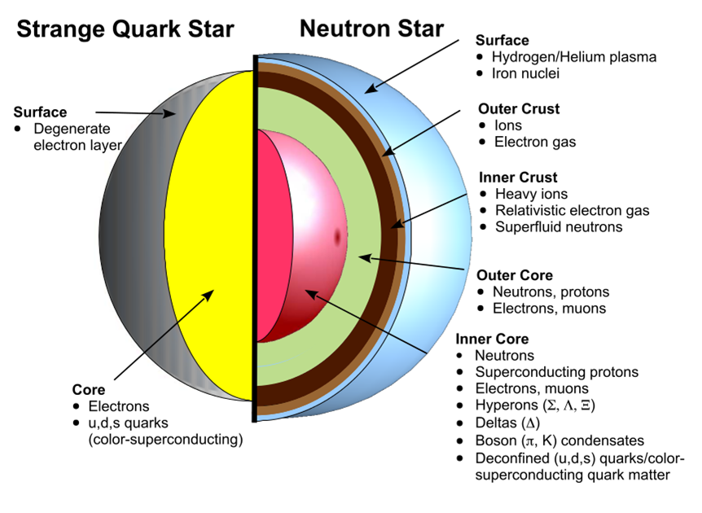

Slide 6
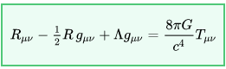
General Theory of Relativity
Einstein Field Equation (1916)
Where
R_{μν} is the Ricci curvature tensor,
R is the scalar curvature,
g_{μν} is the metric tensor,
Λ is the cosmological constant,
G is Newton's gravitational constant,
c is the speed of light in vacuum, and
T_{μν} is the stress–energy tensor.

Slide 7
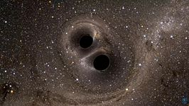
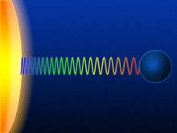
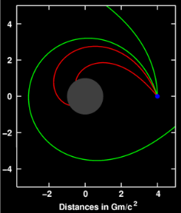
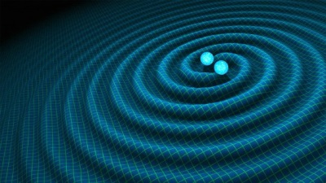
Predictions of General Relativity
- The Universe was created 13.8 billions years ago (big Bang).
- The Universe is Expanding.
Gravitational redshift of a light wave escaping from the surface
of a massive body.
Massive Bodies Curves spacetime around them
Gravitational lensing
- How planets orbit the sun.
- The Existence of GRAVITATIONAL WAVES

Slide 8
First Detection of Compact Binary Objects in a Shrinking Orbit
1974
Russel Hulse and Joseph Taylor observed the binary pulsars Shrinking Period Matcher Prediction of General Relativity
Merger will take place in about 300 million years from now
Nobel Prize was awarded in 1993
PSR 1913+16

Slide 9
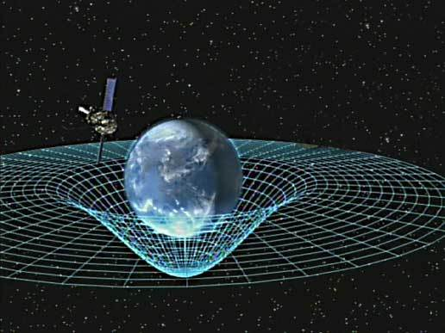
The Elastic Property of Spacetime
Spacetime around a Massive Body

Slide 10
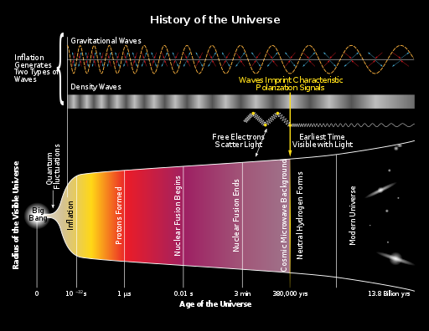
The First Gravitational Wave

Slide 11
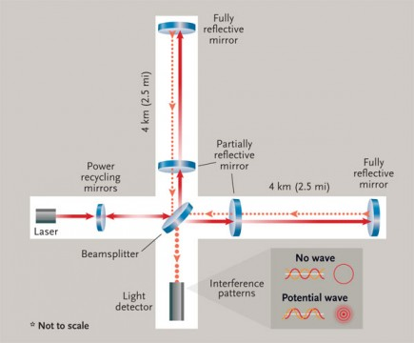
How to Detect a Gravitational Wave

Slide 12


Slide 13
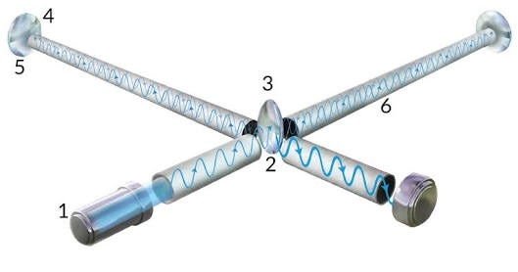
Gravitational Wave Interferometer

Slide 14
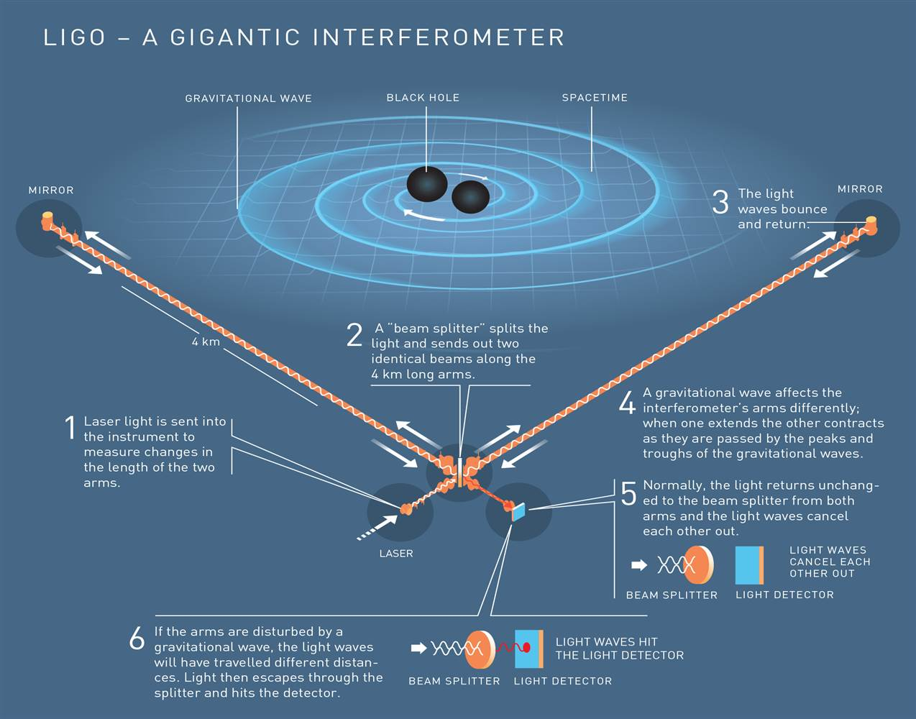

Slide 15
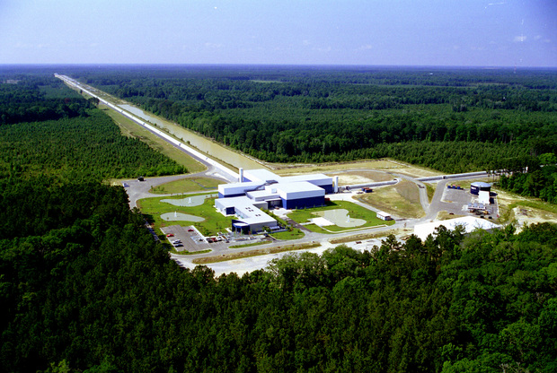
LIGO Livingston
The LIGO Laboratory operates two detector sites, one near Hanford in eastern Washington, and another near Livingston, Louisiana. This photo shows the Livingston detector site.

Slide 16
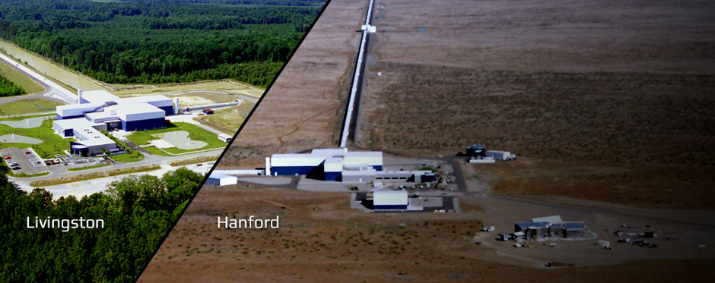

Slide 17
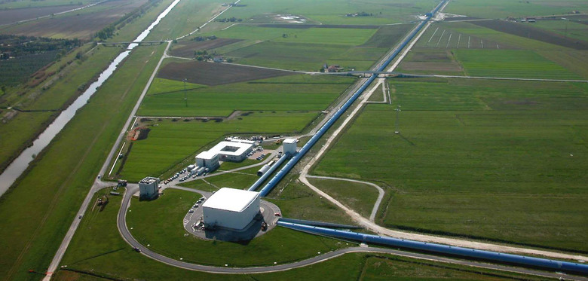
Virgo

Slide 18
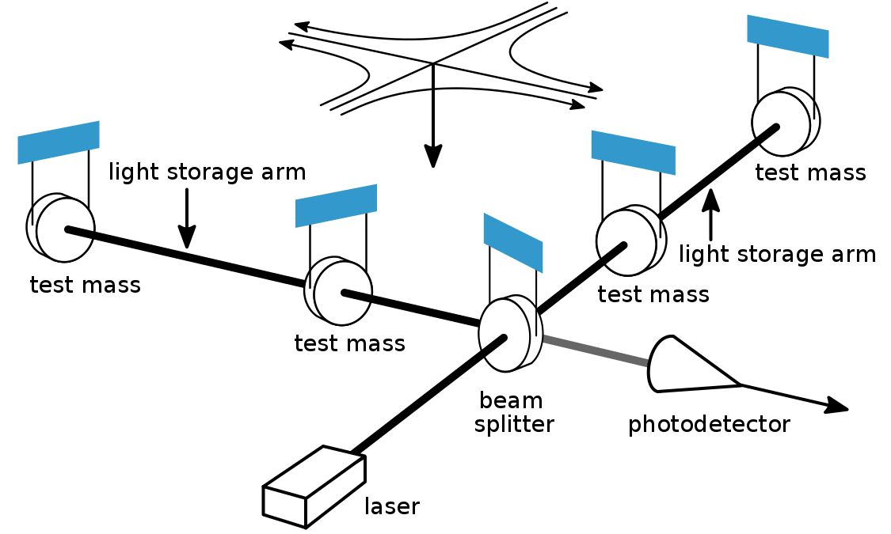

Slide 19
Observation of the First Gravitational Wave from binary Black Hole Merger
14 September 2015
Frequency: 35 to 250 Hz with Peak strain 1.0 x 10⁻²¹
Masses of the black holes: 36 and 29 solar masses
Mass of the Final Black hole after Merger: 62 solar Masses
3 Solar Masses are radiated as Gravitational Wave
Distance: 1.34 Billion Light Years.

Slide 20

Interacting binary Black Holes

Slide 21
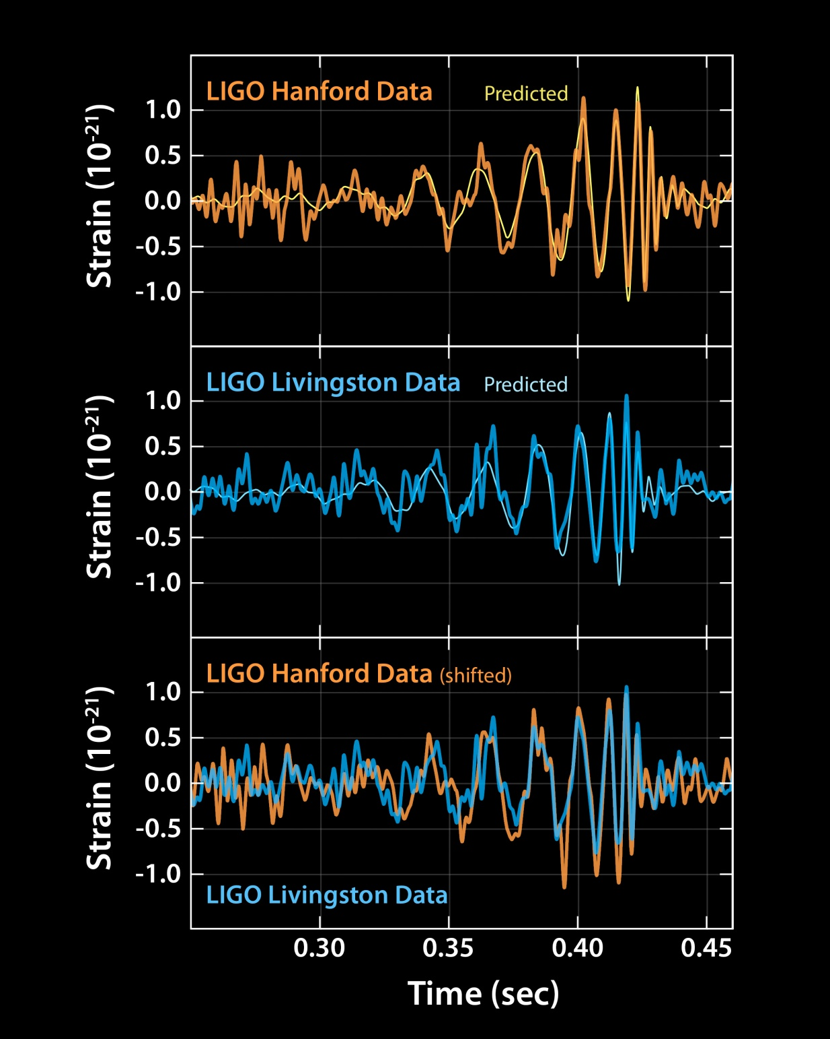

Slide 22
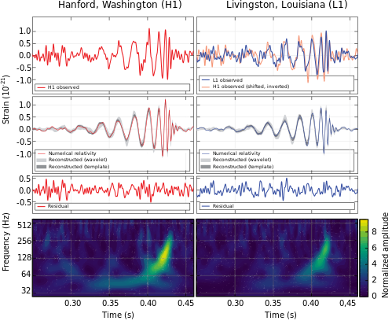

Slide 23
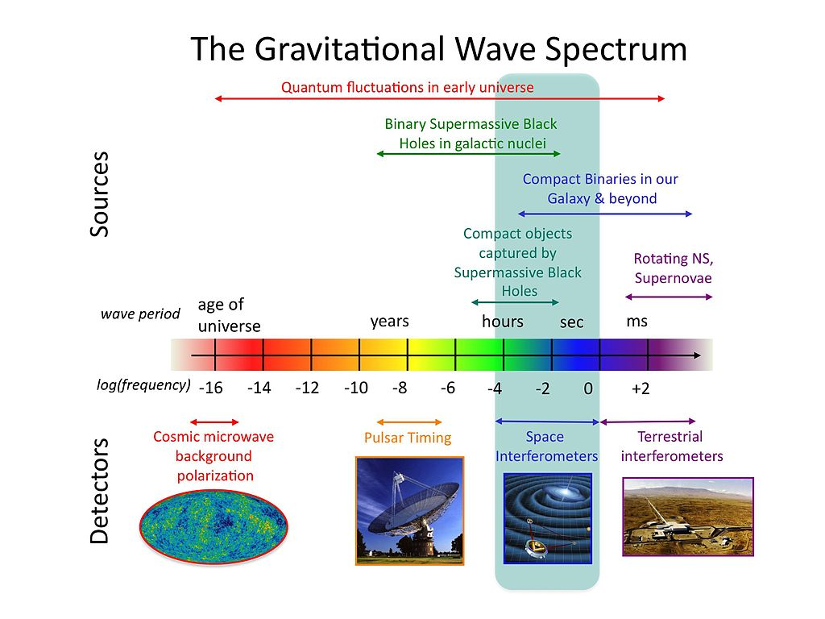

Slide 24
Last Observed Merger of Black Holes
6th Observation: 2:01:16 , 8 June 2017
GW170608
Merger of Two Black Holes of masses;
7 and 12 Solar Masses producing 18 solar mass black hole
And 1 Solar mass is radiated as GRAVITATIONAL WAVE

Slide 25
MERGER OF BINARY NEUTRON STARS
17 August 2017 : Detection of Gravitational Signal
16 of October: Confirmation of Binary Neutron Stars Merger. Spacetime ripple duration: 100s
Frequency: few tens of Hertz to > 600 Hz
Masses: 1.2 and 1.6 solar masses
Galaxy: NGC 4993
Distance:130 Million light years

Slide 26


Slide 27
Merger of Binary Neutron Stars

Slide 28
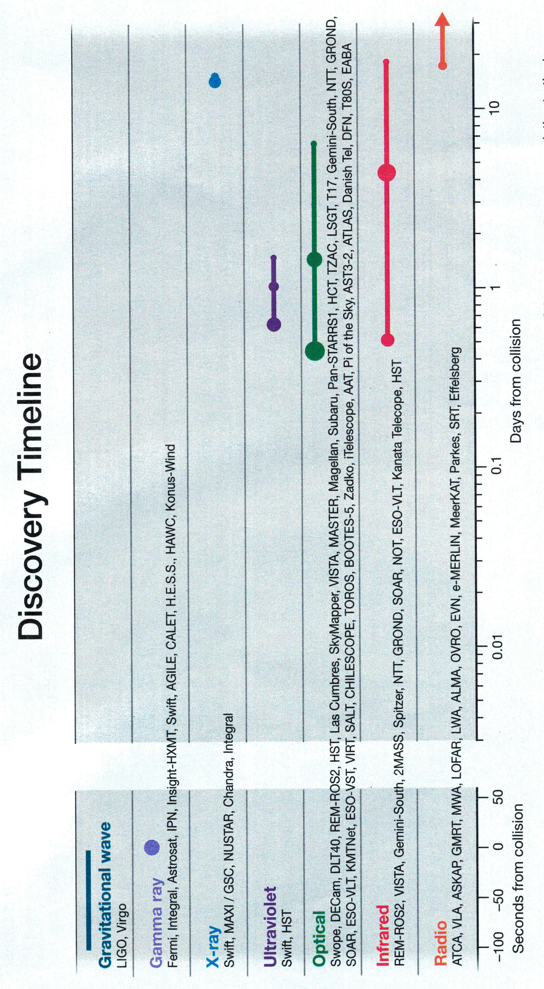

Slide 29
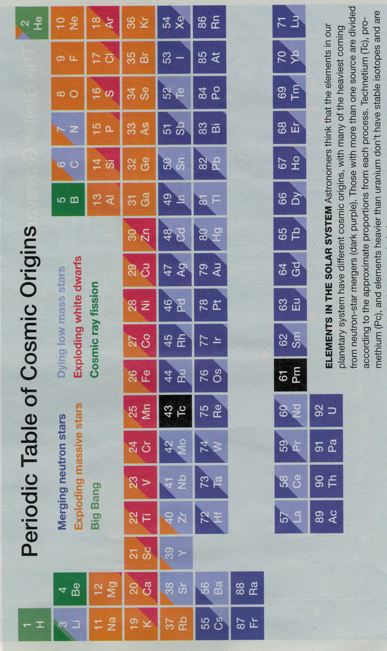
Where the elements consisting our bodies come from?

Slide 30
The Lost 1.74 Seconds
At 12:41:06 UT NASA’s Fermi Gamma Ray Telescope detected a 2 sec gamma ray burst.
No neutrinos from ICE CUBE in Antarectica
Kilonova
Neutrons and protons combined to form heavy nuclei

Slide 31
GOLD
Berger (Harvard) calculated that merger might produce 10 times of mass of the Moon in pure gold.
Gijs Neleman (Netherland) : At least few Earth Masses of Gold.
Metzger: The optical light curve of the Kilonova produce many Earth masses of gold.
Milky Way
16 neutron stars binaries (discovered so far)
1 NS merger every 50000 years
Over the age of the Milky Way few hundred thousands of Earth mass of gold are generated

Slide 32
CONCLUSION
The discovery of Gravitational waves opens the horizon of a new field of astrophysics that enables scientists to probe deeply the nature of our Universe.

Slide 33
شكرًا

