Slide 1
The Wealth of Nations: Human Capital for Sustainable Future
Amer Al-Roubaie
Ahlia University

Slide 2
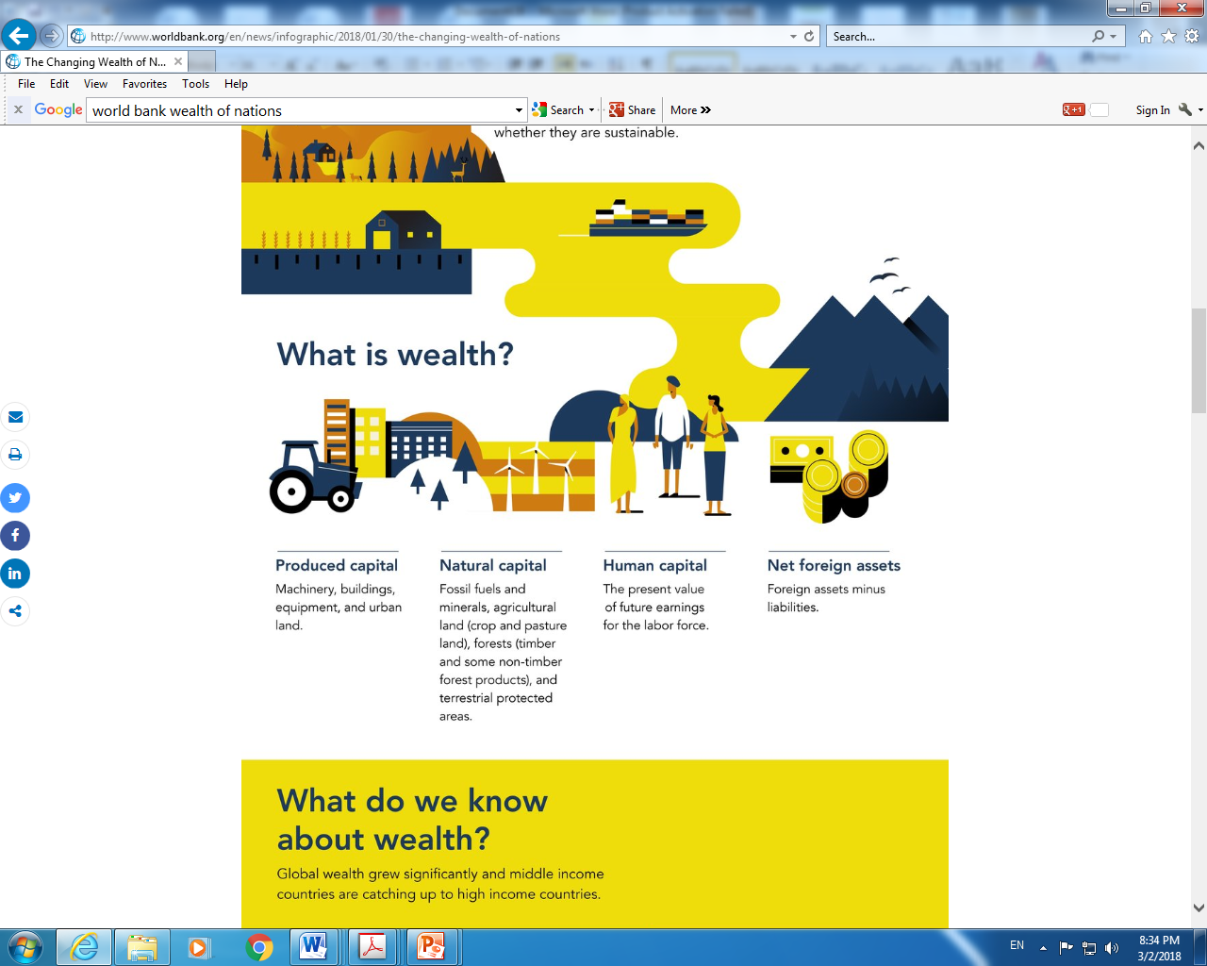

Slide 3
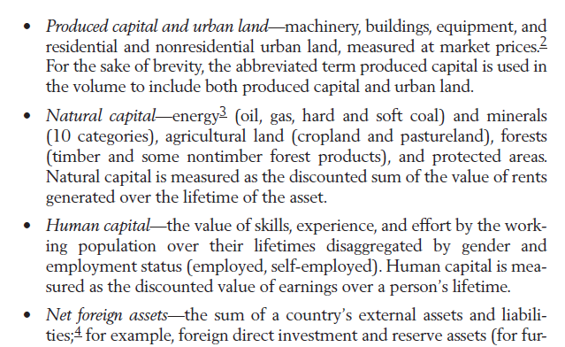
The Wealth Account (World Bank, 2018)

Slide 4
What is Human Capital?
Human Capital is a measure of the skills, education, capacity and attributes of labour which influence their productive capacity and earning potential.
According to the OECD, human capital is defined as:
“the knowledge, skills, competencies and other attributes embodied in individuals or groups of individuals acquired during their life and used to produce goods, services or ideas in market circumstances”.
Individual human capital – the skills and abilities of individual workers
Human capital of the economy – The aggregate human capital of an economy, which will be determined by national educational standards
(https://www.economicshelp.org/blog/26076/economics/human-capital-definition-and-importance)

Slide 5
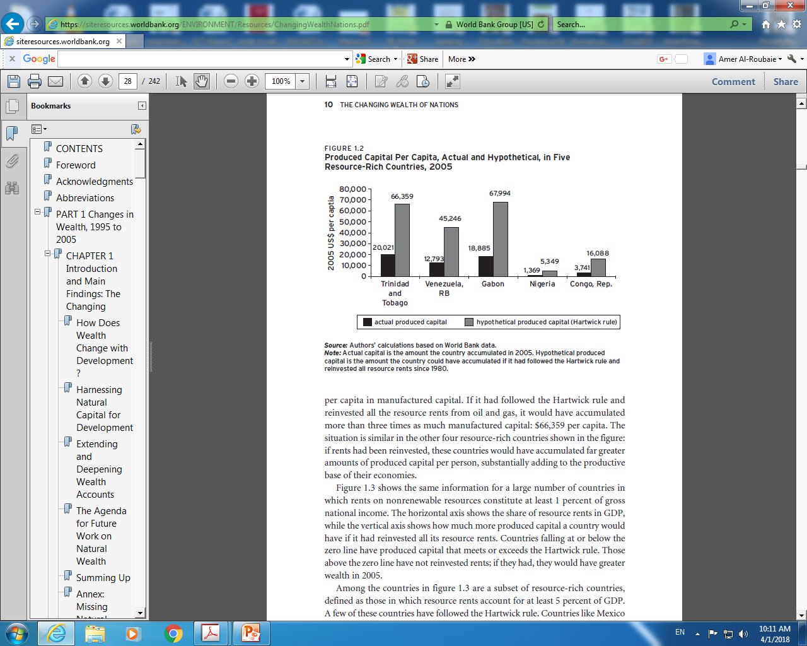

Slide 6
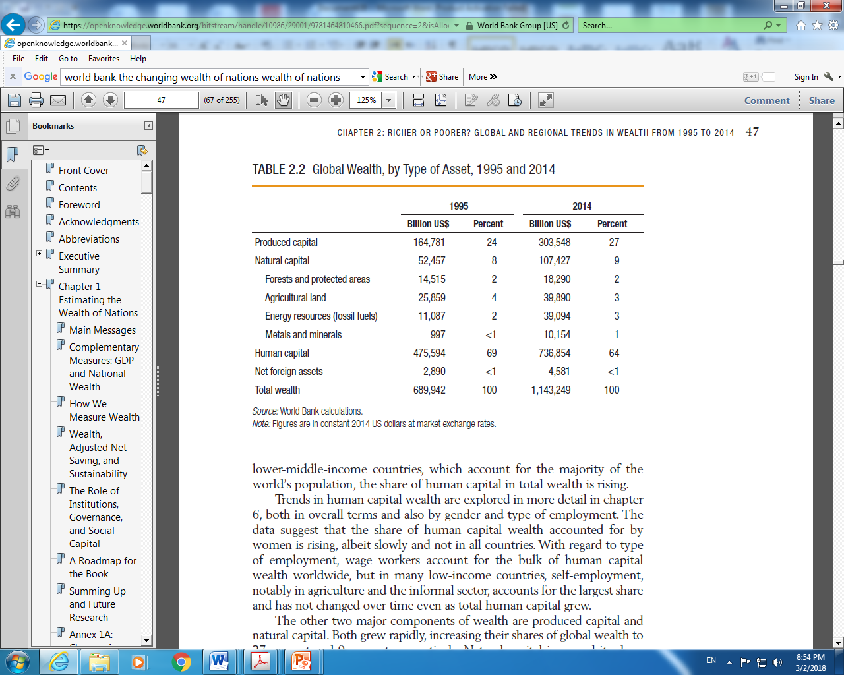

Slide 7
How to increase human capital?
Specialization and division of labour
Education
Vocational training
A climate of creativity
Infrastructure
Competitiveness

Slide 8
Factors that determine human capital
Skills and qualifications
Education levels
Work experience
Social skills – communication
Intelligence
Emotional intelligence
Judgement
Personality – hard working, harmonious in an office
Habits and personality traits
Creativity. Ability to innovate new working practices/products.
Fame and brand image of an individual. e.g. celebrities paid to endorse a product.
Geography – Social peer pressure of local environment can affect expectations and attitudes.
(https://www.economicshelp.org/blog/26076/economics/human-capital-definition-and-importance/)

Slide 9
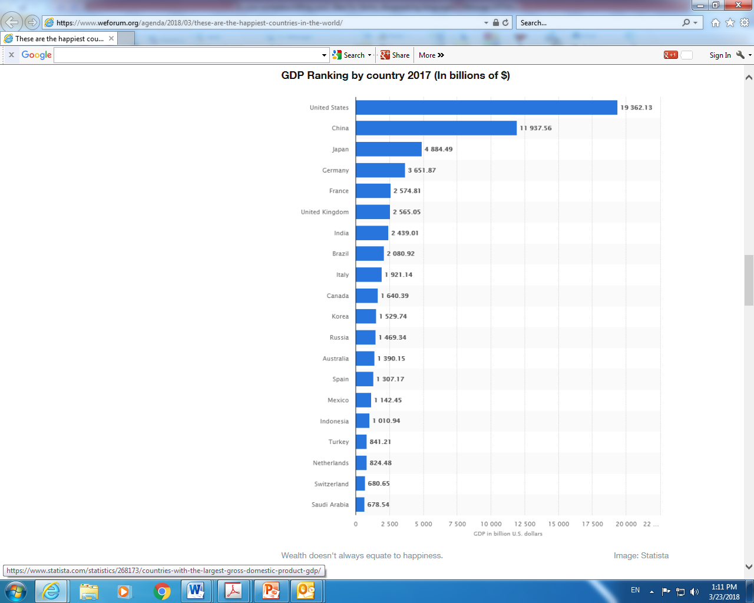

Slide 10
Wealth of GCC
World Bank, 2018
Country | Total wealth | Produced capital | Natural capital | Human capital | Net foreign assets | Share of human capital %
Bahrain | 270,311 | 76,788 | 14,027 | 157,679 | 21,816 | 58.3
Kuwait | 1,123,144 | 74,879 | 591,229 | 271,628 | 145,408 | 24.2
Oman | 277,574 | 49,045 | 95,238 | 125,278 | 8,013 | 45.1
Qatar | 1,597,125 | 217,846 | 660,305 | 562,650 | 156,323 | 35.2
Saudi Arabia | 512,869 | 66,347 | 252,186 | 156,869 | 37,467 | 30.0
UAE | 738,270 | 125,657 | 259,428 | 278,205 | 74,981 | 37.7
MENA | 158,892 | 23,984 | 70,137 | 54,871 | 9,900 | 34.5

Slide 11
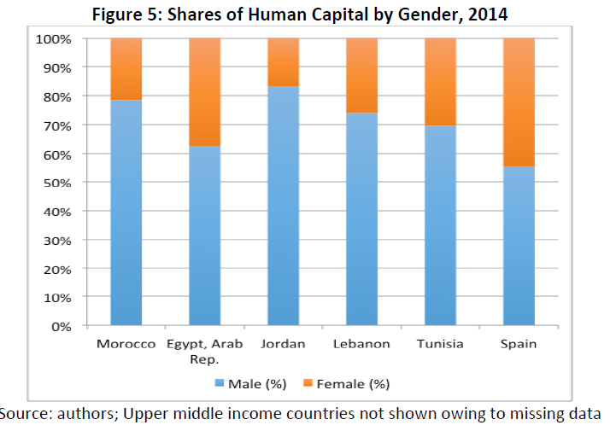

Slide 12
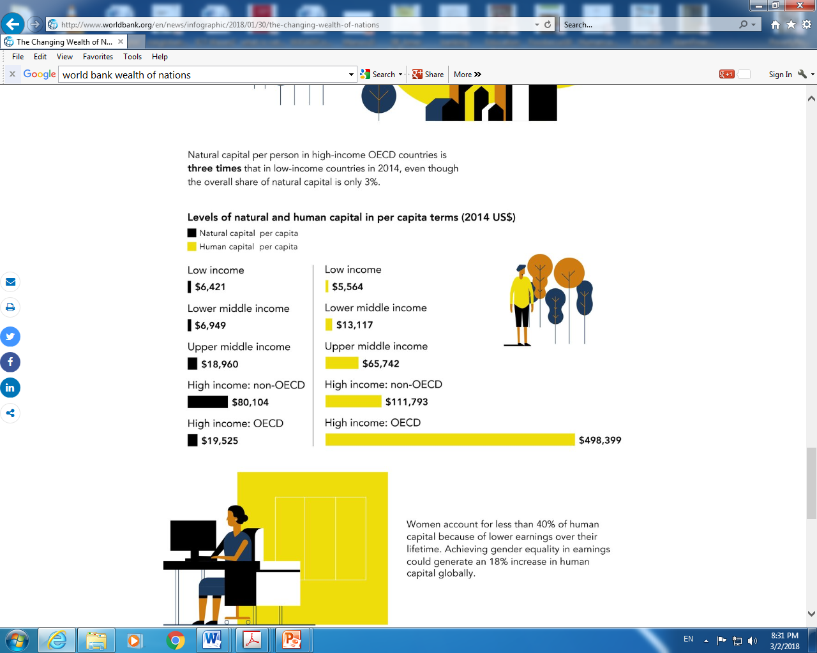

Slide 13
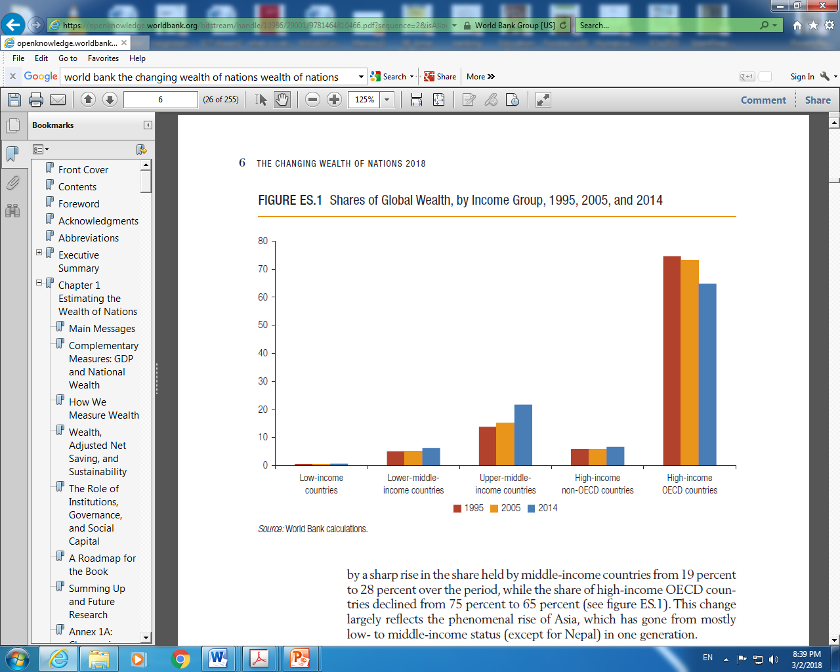

Slide 14
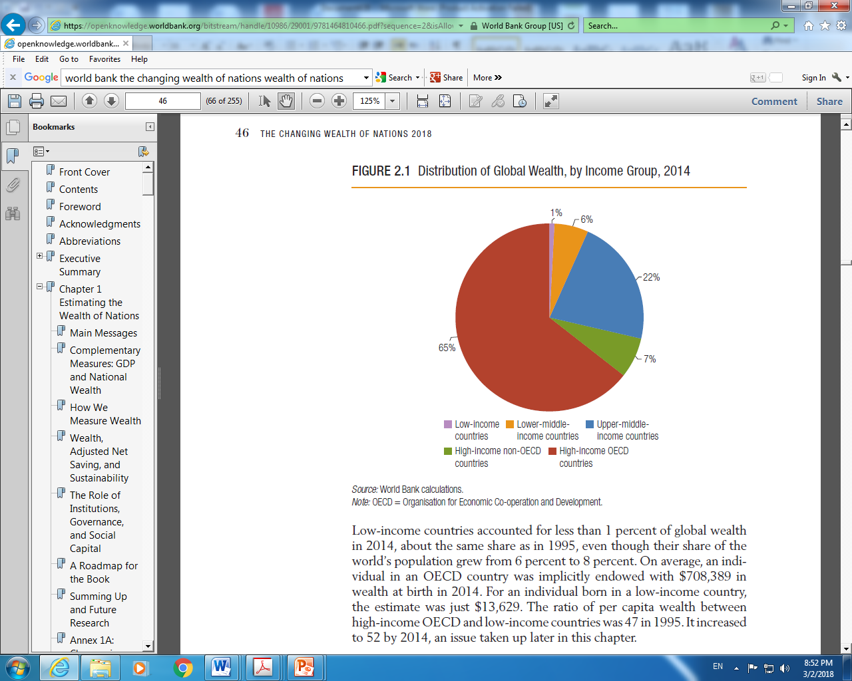

Slide 15
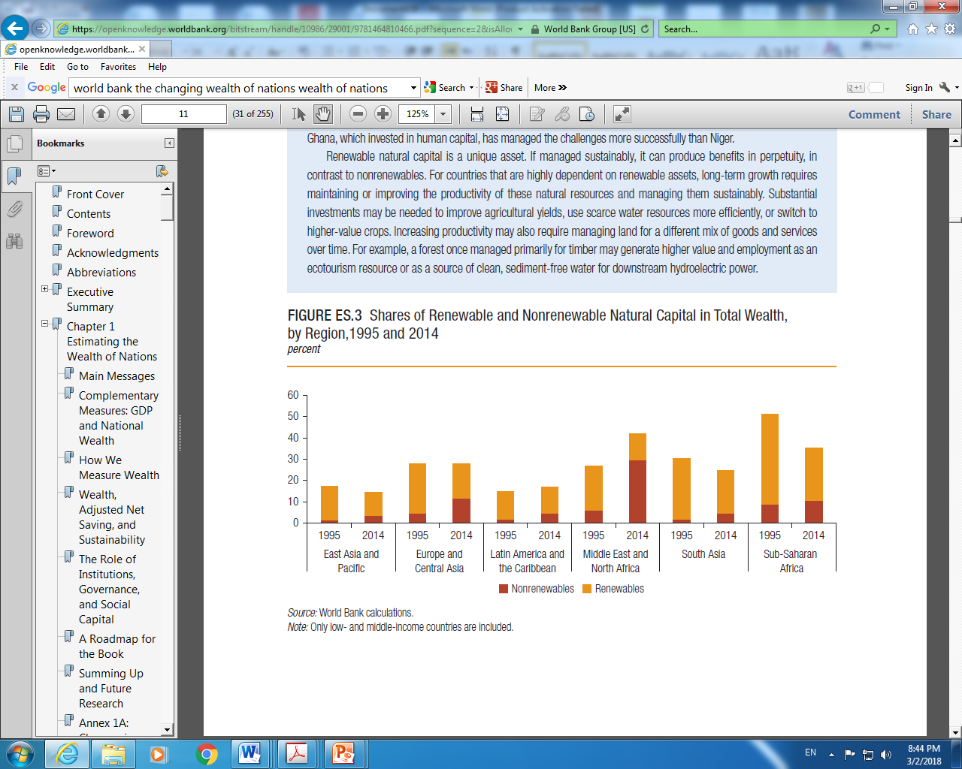

Slide 16
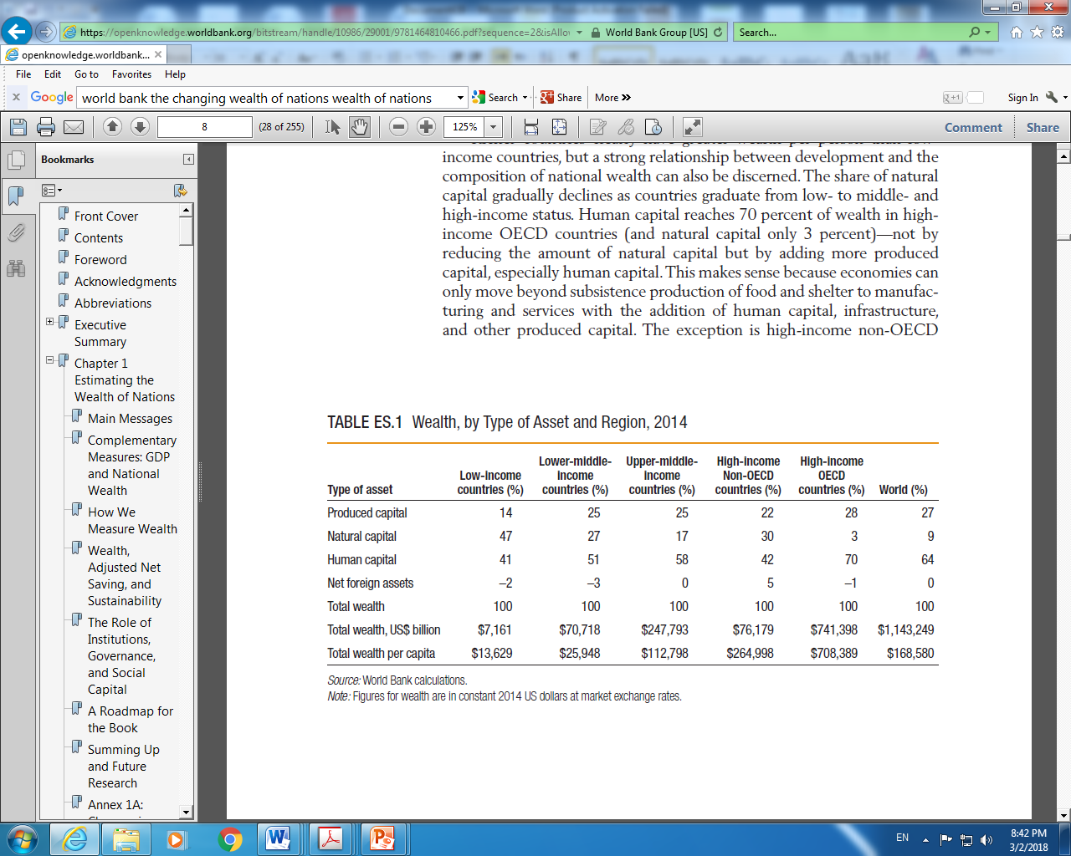

Slide 17
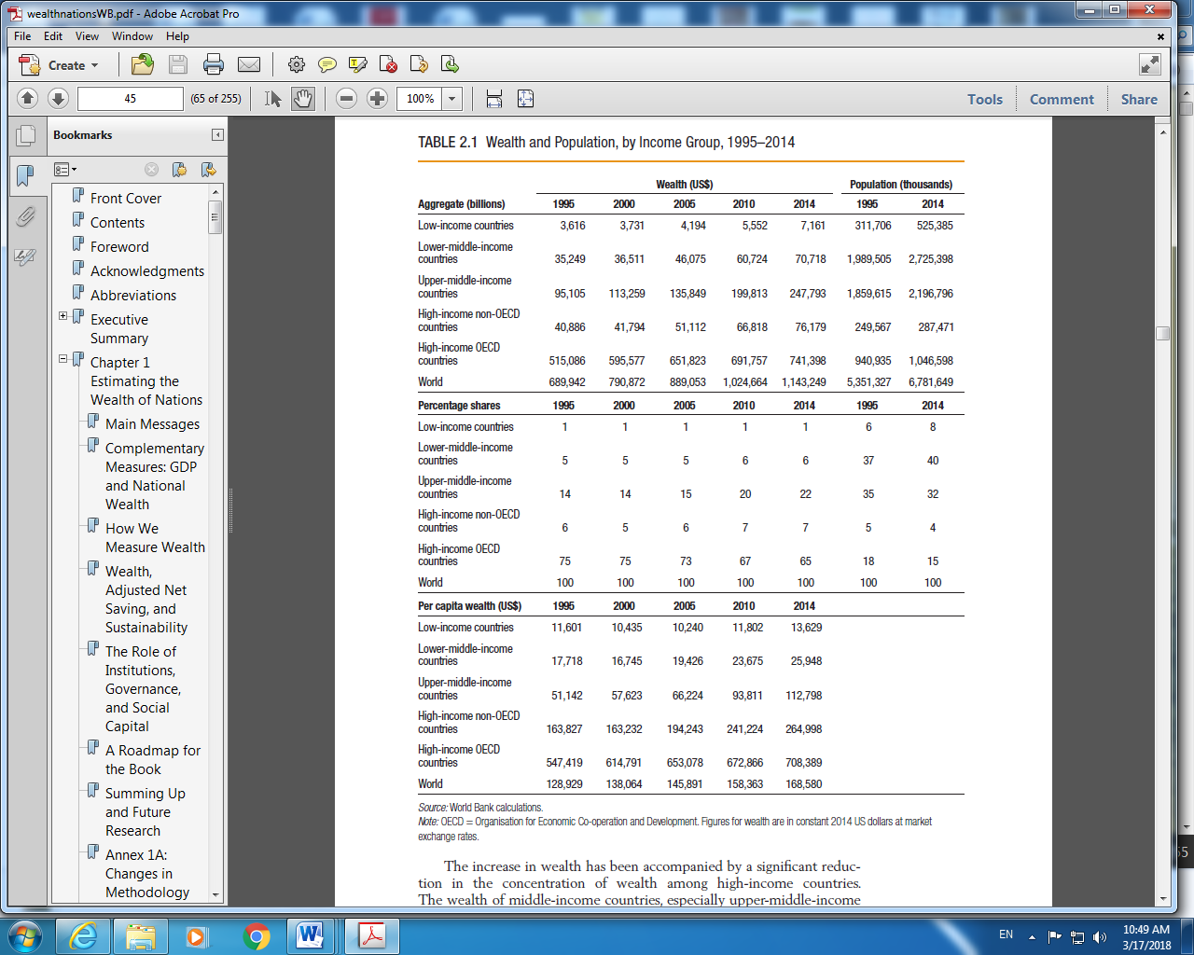

Slide 18
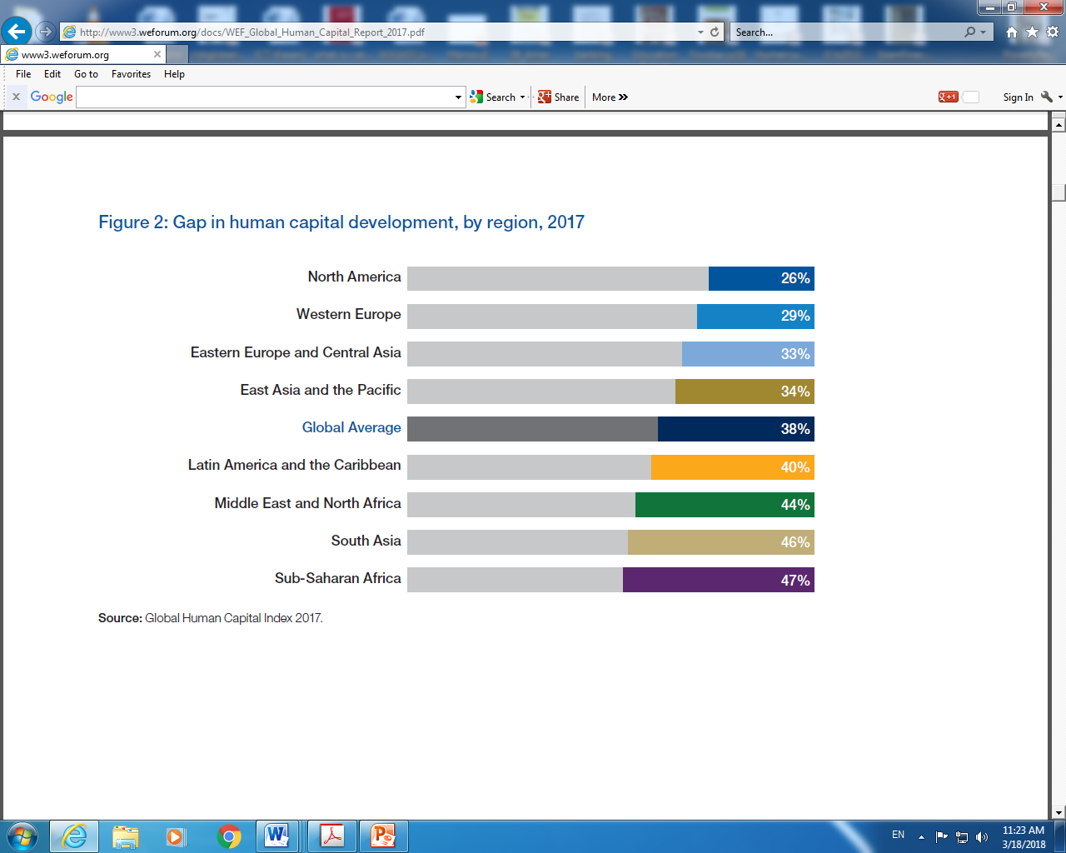

Slide 19
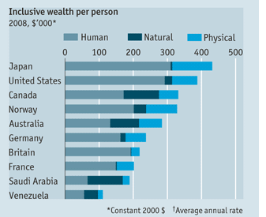
Human capital represents 88% of Britain's wealth and 75% of America's. The average Japanese has more human capital than anyone else. Saudi Arabia depends less on human capital than other nations

Slide 20
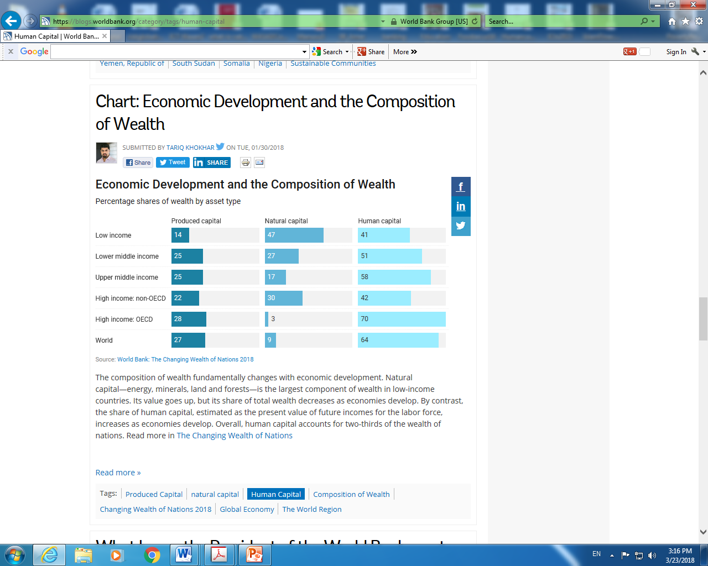

Slide 21
One hundred $100 bills ($10,000) makes a 1.09cm-thick stack, so a million dollars stacked is a little over a meter, a billion dollars is a little over a kilometer, and $241 trillion makes a 262,000km-high stack, which reaches 68% of the way to the moon.

Slide 22
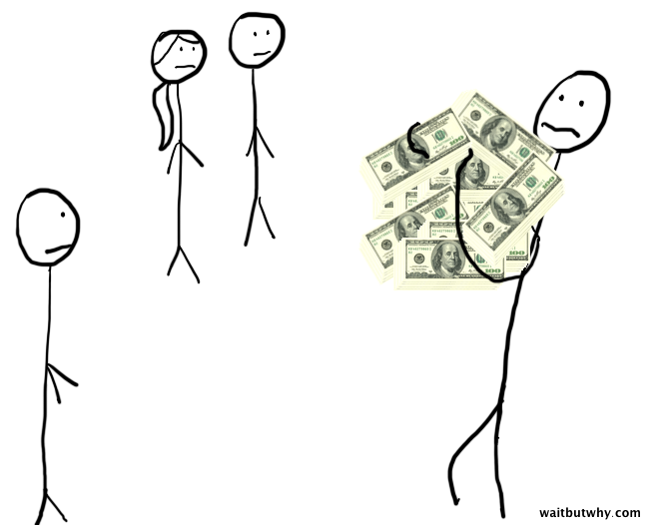

Slide 23
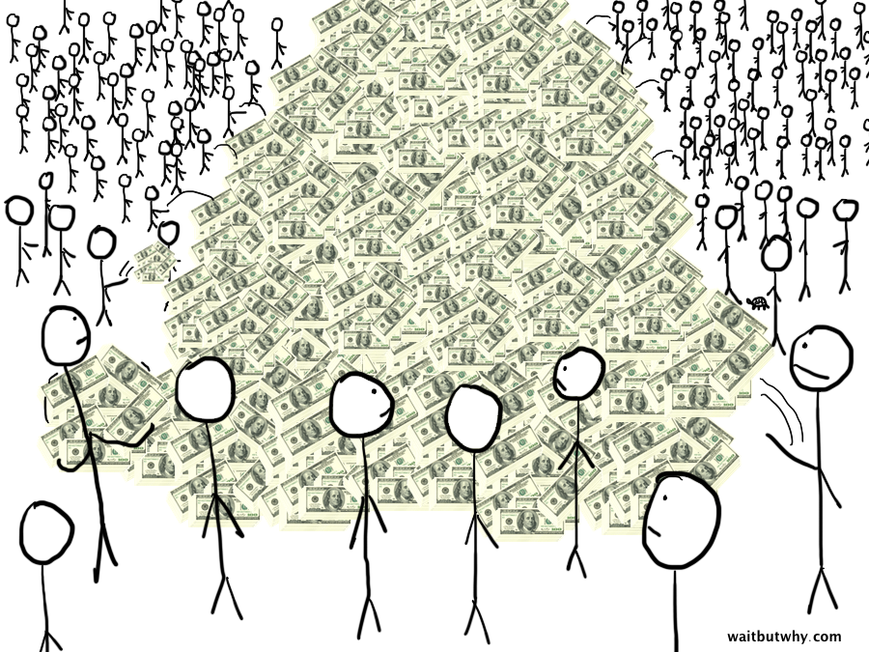

Slide 24
What would happen if every single individual (currently 7 billion) sell everything they own, liquidated any investments, and withdrew whatever cash they have in bank accounts? How much money would be in that pile? The combined wealth of all the people of the world is $241 trillion. ($241,000,000,000,000.)

Slide 25
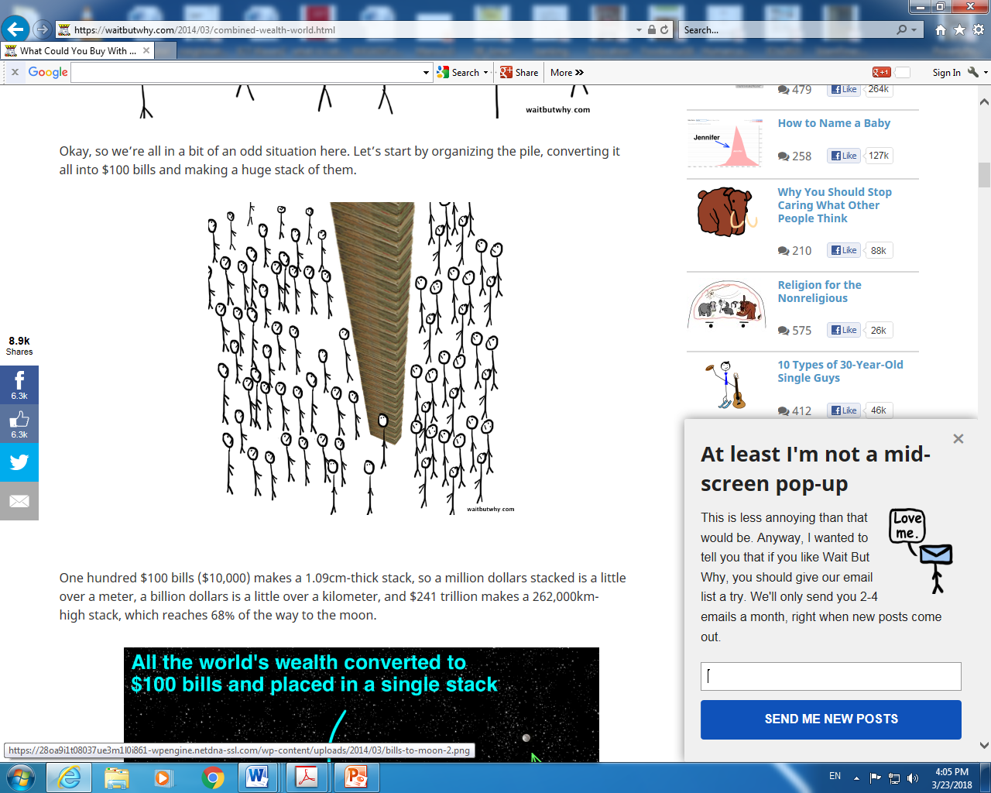
The combined wealth of all the people of the world is $241 trillion

Slide 26
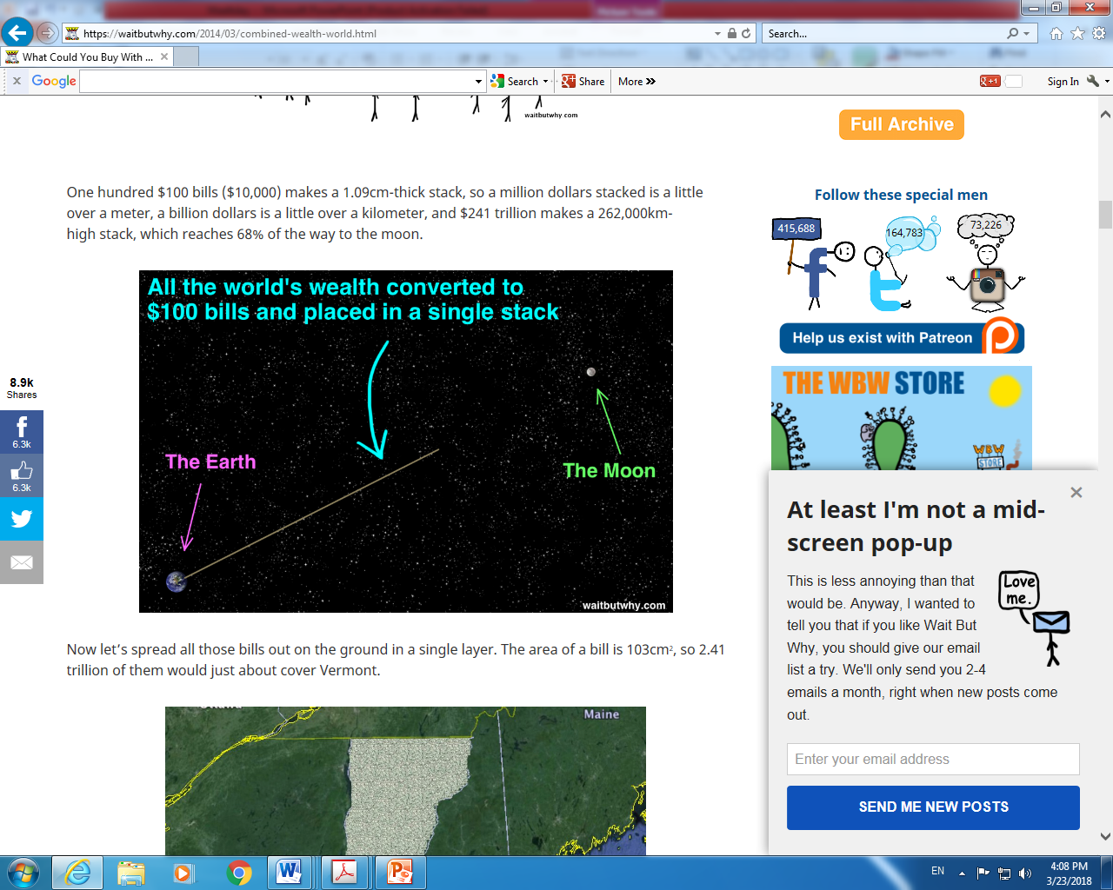

Slide 27
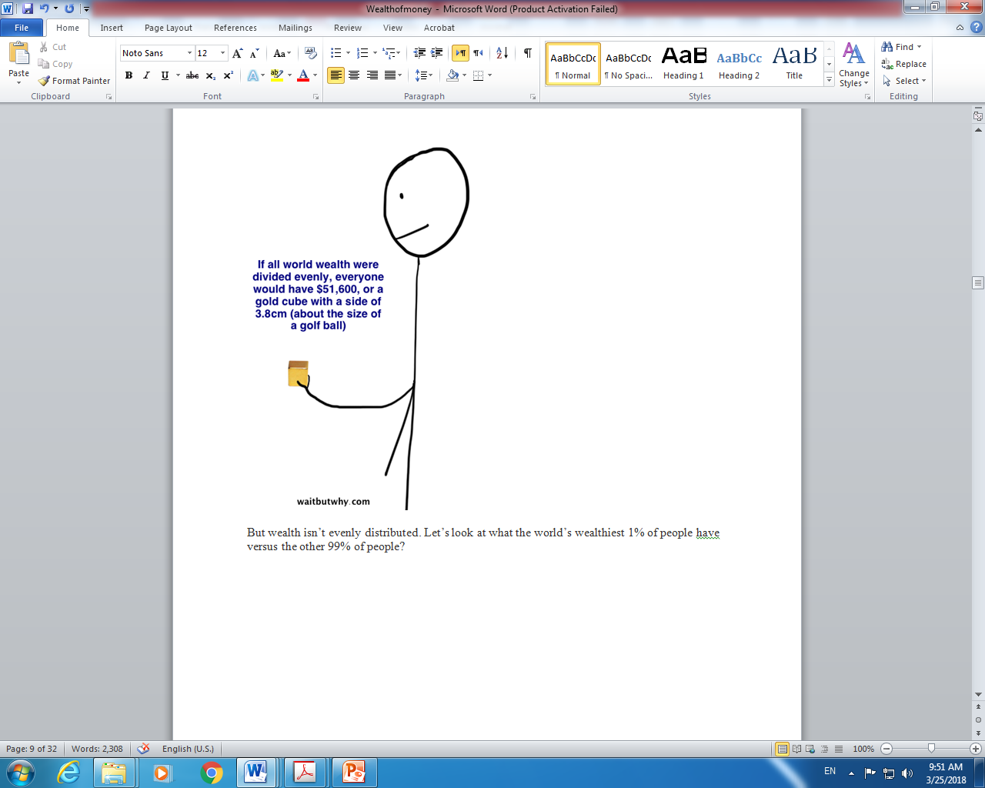

Slide 28
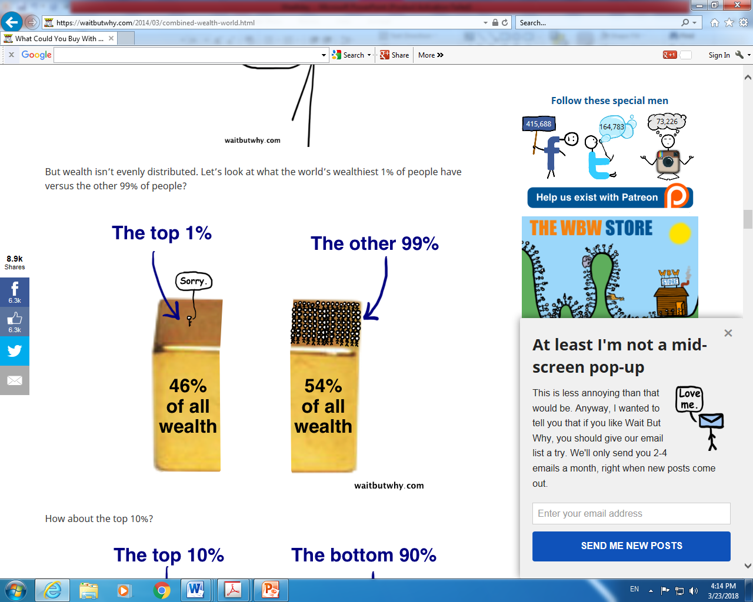

Slide 29
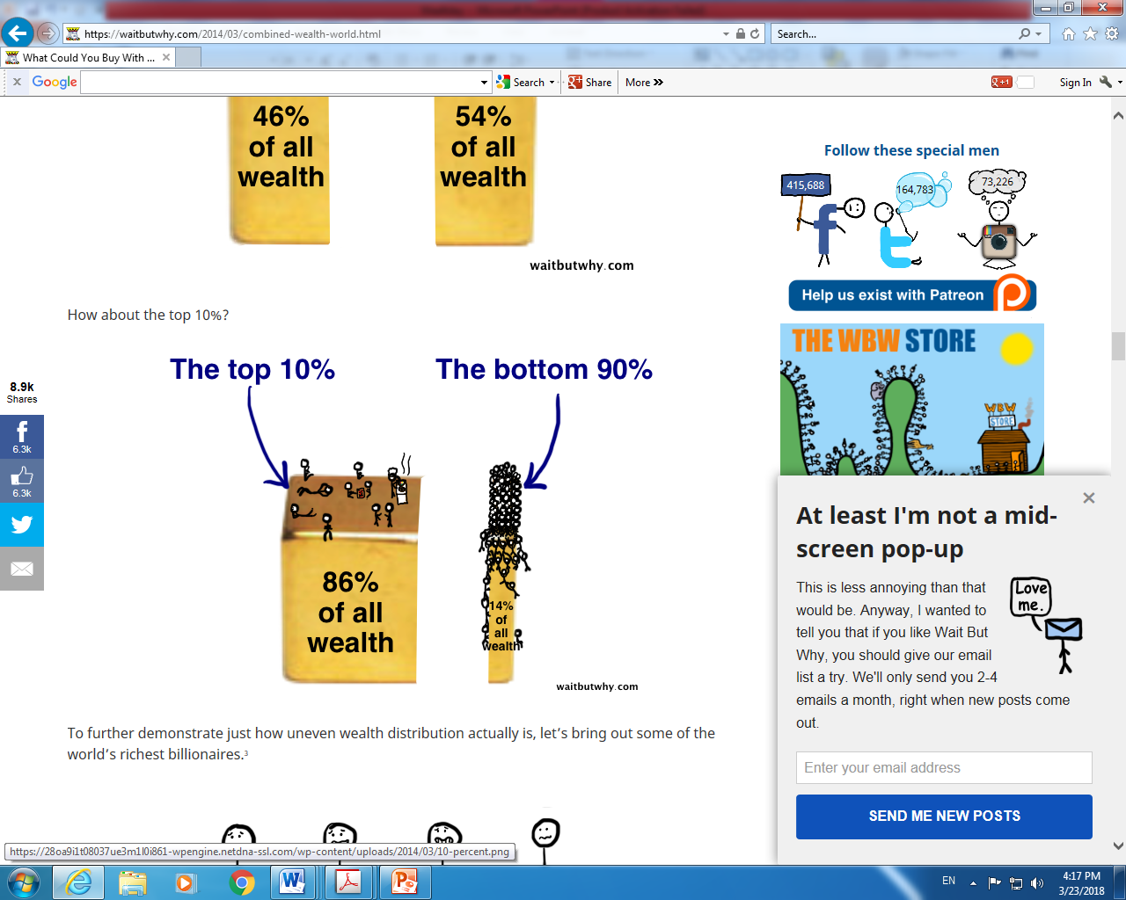

Slide 30
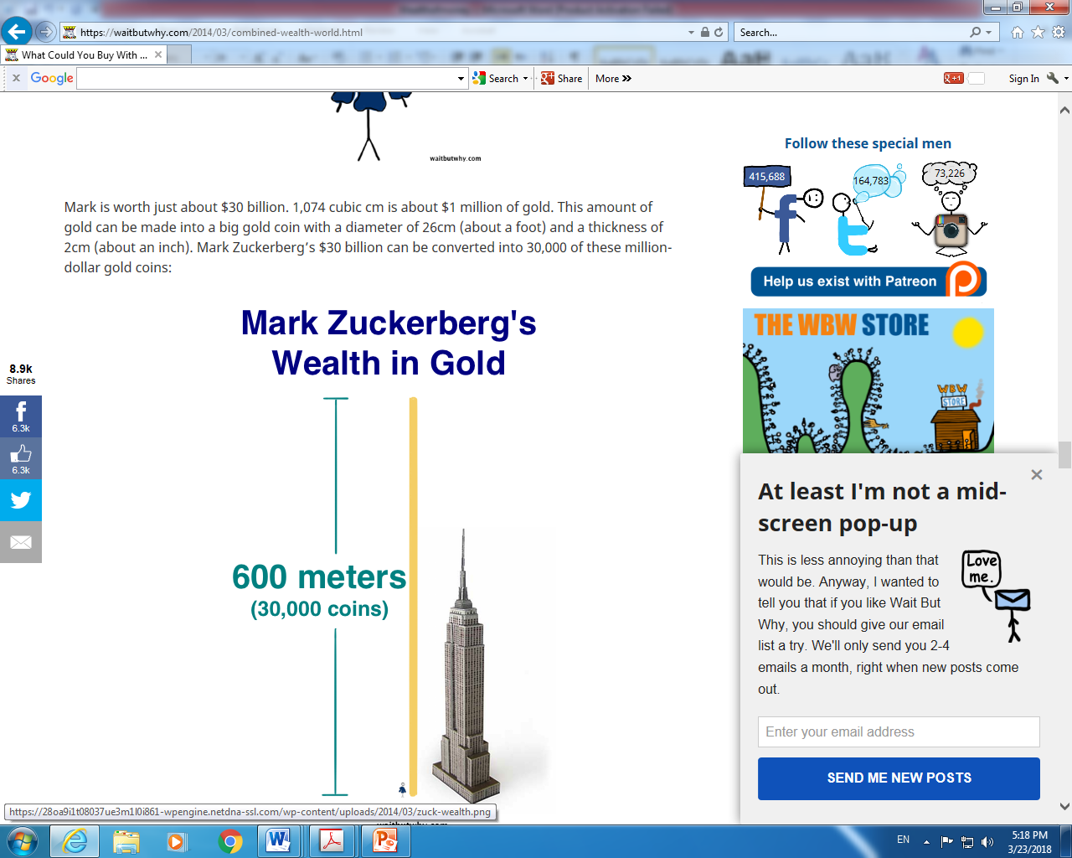

Slide 31
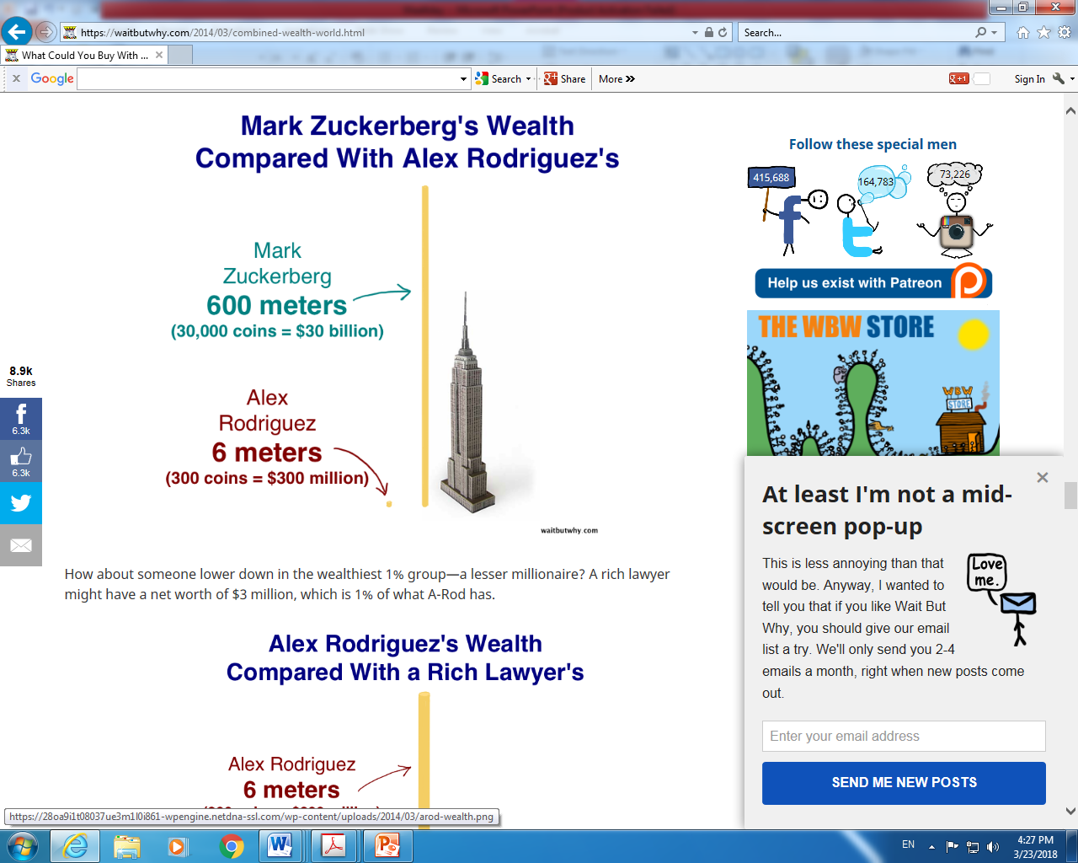

Slide 32
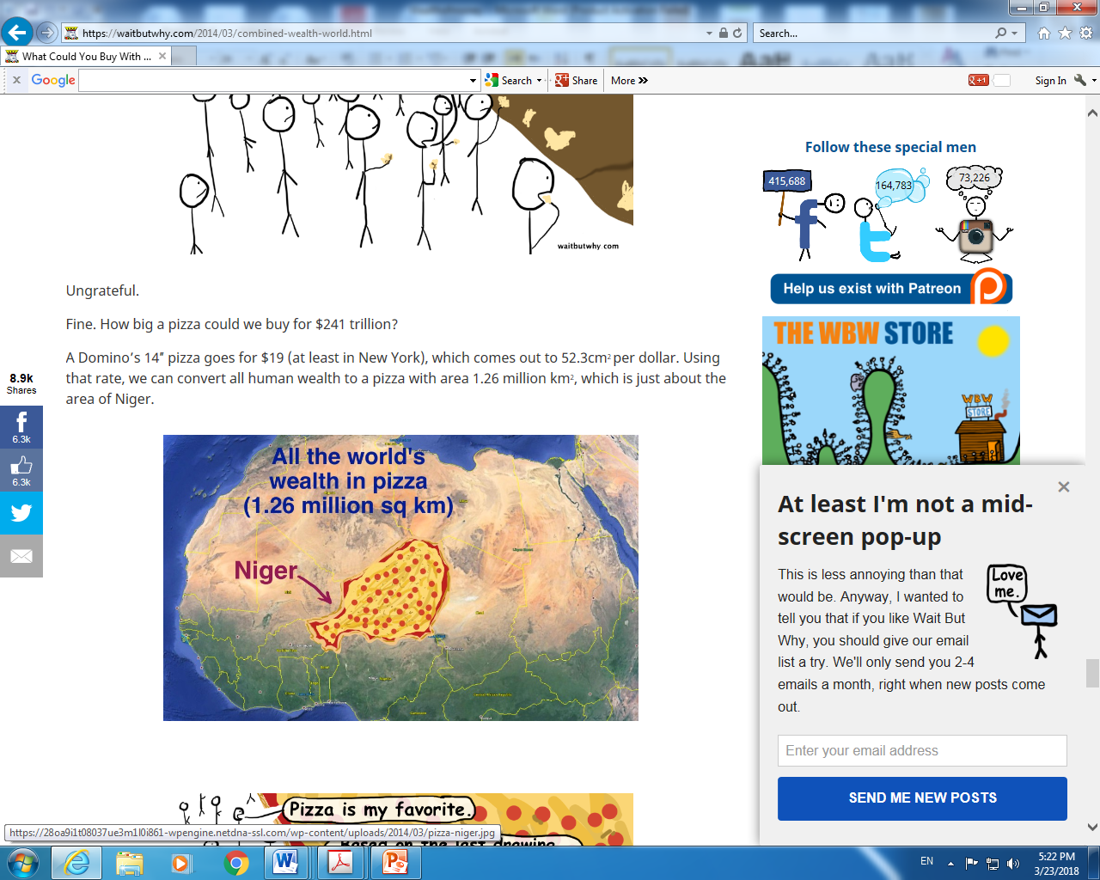

Slide 33
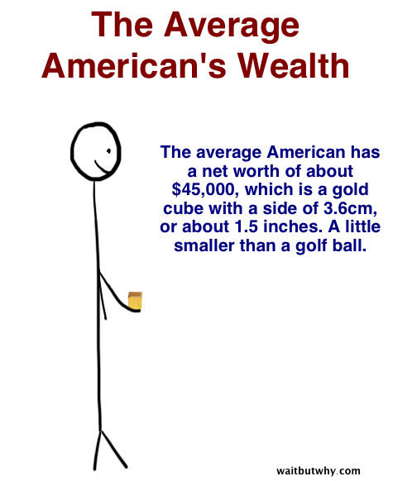

Slide 34
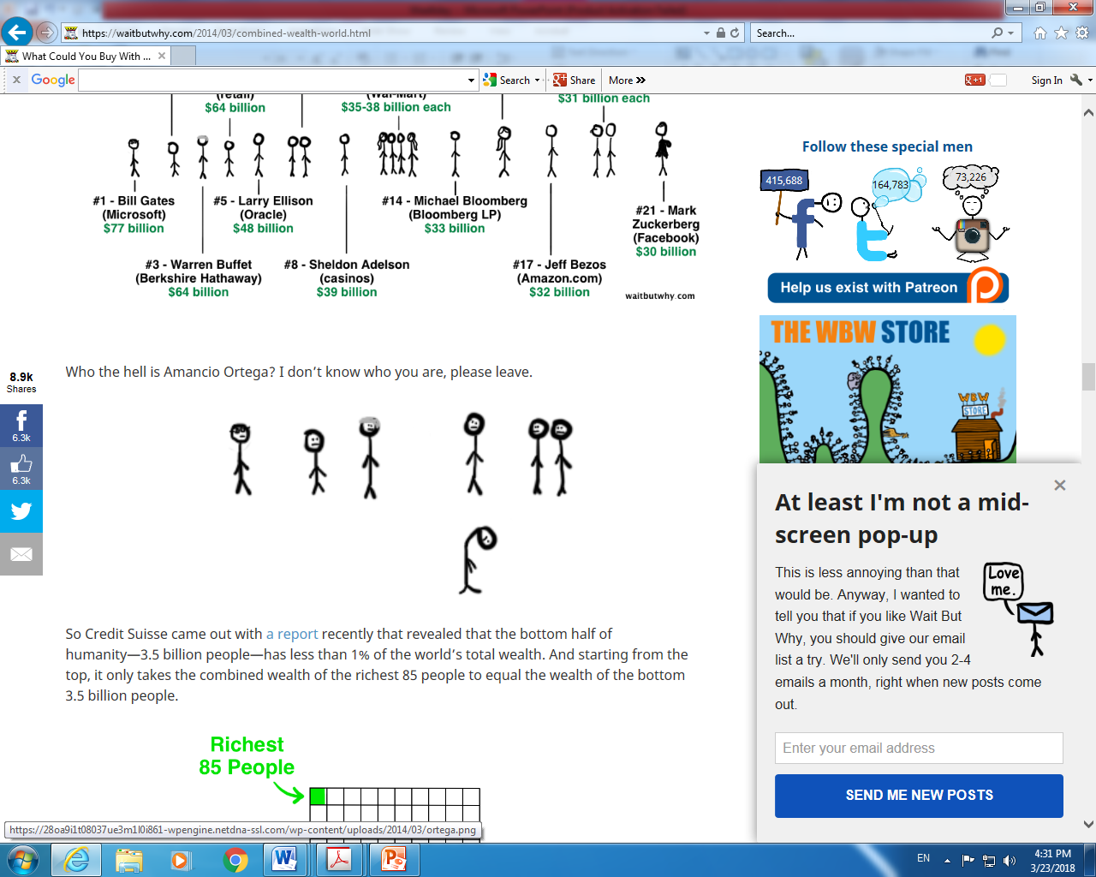

Slide 35
Trends in World Wealth per Capita, 2014
World | 1995 | 2000 | 2005 | 2010 | 2014
Total wealth per capita ($US) | 128,929 | 138,064 | 145,891 | 158,363 | 168,580
Human capital per capita ($US) | 88,874 | 96,478 | 97,707 | 102,170 | 108,654
Human capital as share of total (%) | 69 | 70 | 67 | 65 | 64

Slide 36
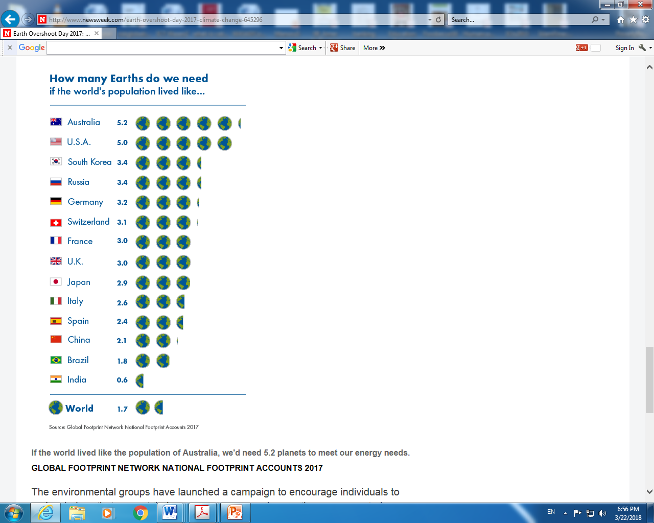

Slide 37
Mars only valued at 10,000 pound, while Venus is said to be worth less than a penny

Slide 38
Middle East and North Africa, 2014
 | 1995 | 2000 | 2005 | 2010 | 2014
Total wealth per capita ($US) | 91,203 | 95,076 | 113,731 | 143,965 | 158,892
Human capital per capita ($US) | 35,620 | 39,177 | 44,513 | 50,440 | 54,871
Human capital as share of total (%) | 39 | 41 | 39 | 35 | 35

Slide 39
What is the Earth Worth?

Slide 40
What is the Earth Worth?
It worth $5 quadrillion i.e.
$5, 000,000,000,000,000

Slide 41
If you buy the Earth and all the humans on it
Each human is worth on average $129,000, based on a Stanford research study. So multiply that by 7 billion, and you get a whopping $903,000,000,000,000 ($903 trillion). That's an incredible amount of money. A scientist valued the Earth at a whopping $5,000,000,000,000,000 ($5 quadrillion, or $5 million billion).
To top it off, if you had $5 quadrillion dollars, and you saw $80 billion on the ground (Bill Gates wealth), you'd probably not pick it up. It's only 0.0016% of your wealth, after all. Who needs $80 billion?
https://www.quora.com/How-much-would-buying-the-Earth-cost

Slide 42
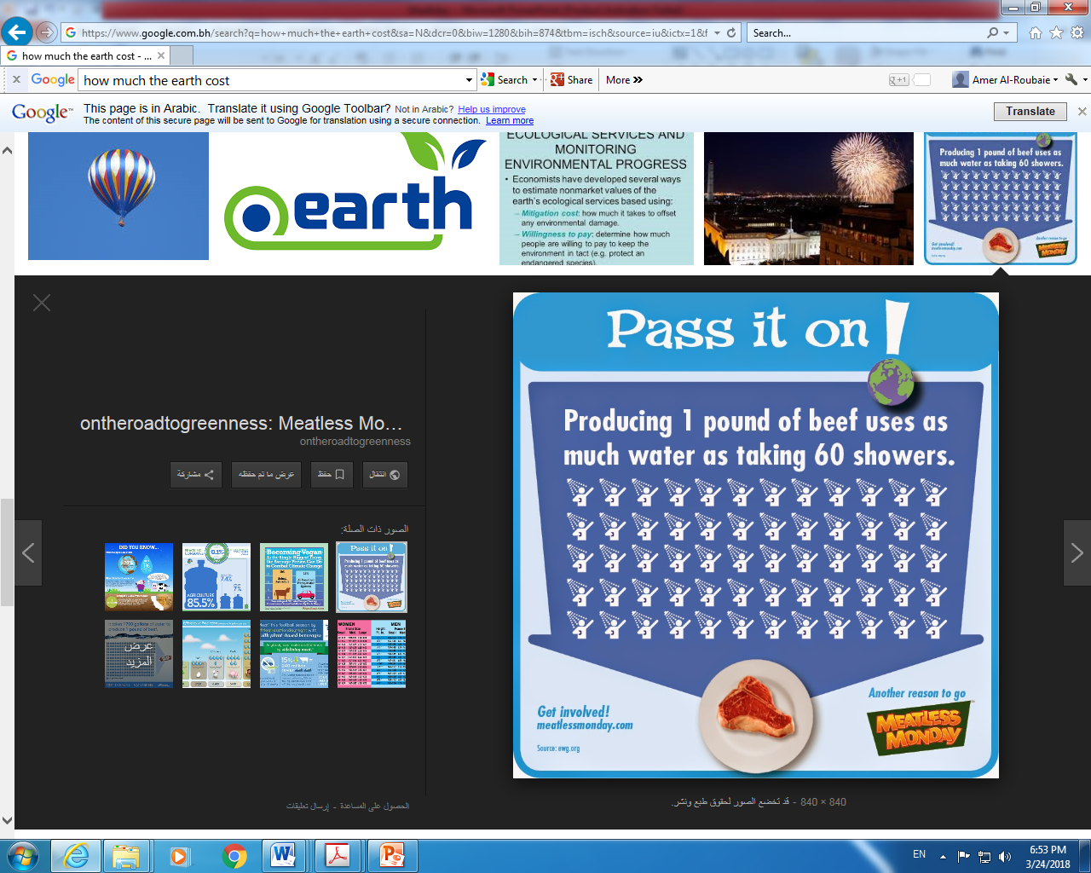

Slide 43
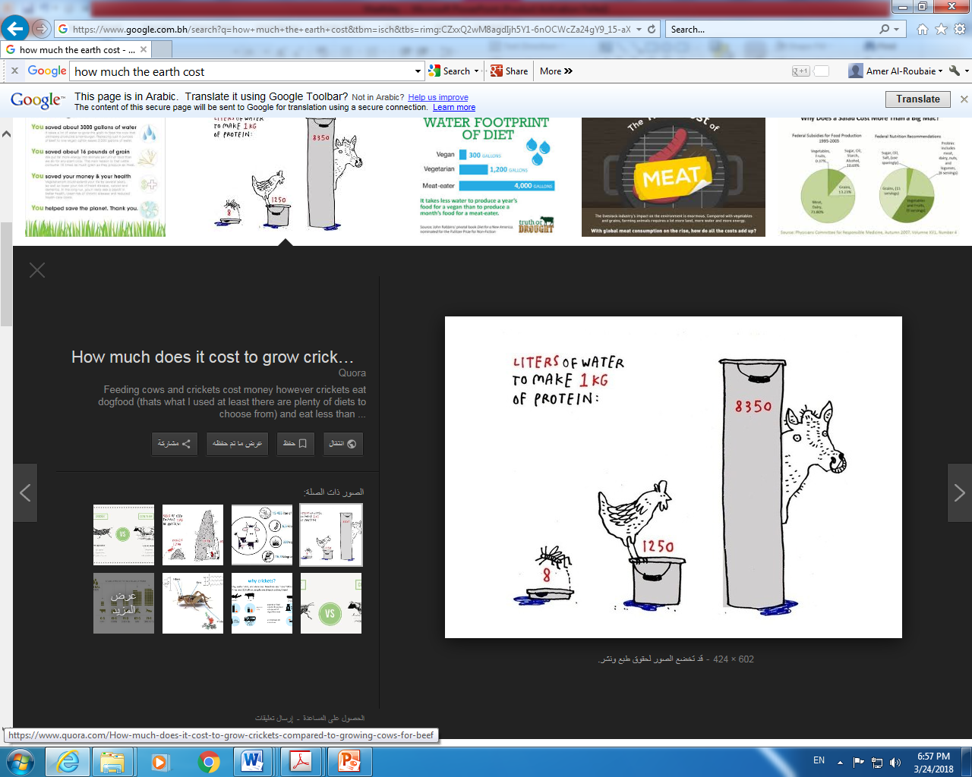

Slide 44
