Slide 1
An Automated Mobile-Based Micro-Learning to Enhance Students’ Retention of Concepts and Skills
Hasan Kadhem
IT Department
College of IT
hkadhem@ahlia.edu.bh
Ahlia Research Forum – 22nd April 2018

Slide 2
Outline
Introduction
The Problem
Solution Overview
Related Work
Methodology
Results
Challenges
Conclusion

Slide 3
Introduction
Introduction
Problem
Solution
Related Work
Methodology
Results
Challenges
Conclusion
The use of mobile devices has become a part of our daily routine.
Researchers and teachers have been exploring different ways to use mobile devices in education to support learning and teaching.

Slide 4
The Problem
Introduction
Problem
Solution
Related Work
Methodology
Results
Challenges
Conclusion
The ability of students to retain information for future use is worthwhile in any subject.
Students’ retention of concepts and skills is a noticeable problem in different subjects
Concepts and theories are built upon each other as students progress through a curriculum and courses.

Slide 5
Solution Overview
Introduction
Problem
Solution
Related Work
Methodology
Results
Challenges
Conclusion
Our approach to improve students’ retention:
Delivering micro-learning through mobile devices.
Convert the lecture content into multiple bite-sized chunks, then send them to students’ mobile devices at different times during a day.

Slide 6
Related Work
Introduction
Problem
Solution
Related Work
Methodology
Results
Challenges
Conclusion
There are many related literatures to improve students’ retention of concept and skills for different subjects such as math, statistics, languages and IT:
Different assessment techniques, one-minute paper, web-based micro-questions, and group discussion.
Many researchers studied the use of mobile apps to support IT education:
Most of these studied and apps are designed just to teach programming courses.
The effect of using mobile based assessments and evaluation.
The effect of using mobile-based games on student’s performance.

Slide 7
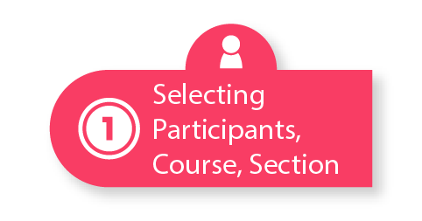
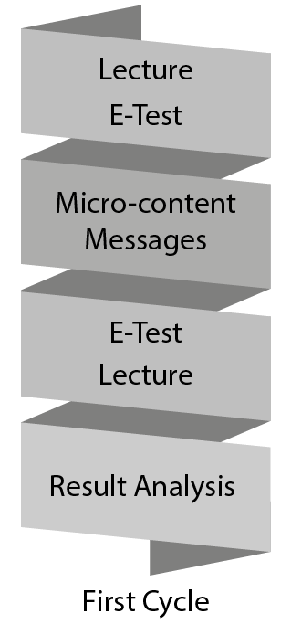
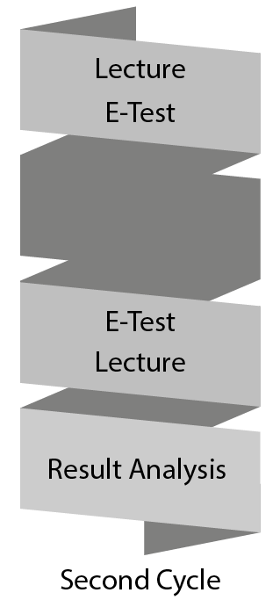
Methodology
Introduction
Problem
Solution
Related Work
Methodology
Results
Challenges
Conclusion
First Cycle:
Lecture (CPU Scheduling)
Followed by 10 minutes test
Micro-content messages from 8:00 AM to 8:00 PM
Two set of E-test on Moodle
Different questions, but evaluate same ILOs
6 questions:
4 multiple-choice questions to evaluate A1
2 fill in the blank questions to evaluate B1
Second Cycle:
Lecture (Storage Management)
Followed by 10 minutes test
No micro- content messages
Two topics:
CPU Scheduling
Storage Management
Two ILOs:
(A1) Concepts and Theories
(B1) Problem Solving
4th level course operating system
22 Students
lecture content is summarized and chunked into 24 messages (Text: 140 character, Images, and short video <3 minutes)
Schedule micro-content messages to be sent to all students from 8:00 AM to 8:00 PM

Slide 8
Results
Introduction
Problem
Solution
Related Work
Methodology
Results
Challenges
Conclusion
Average retention rate:
First cycle
(Mobile Micro-learning)
(b) Second cycle
(No Micro-learning)

Slide 9
Results
Introduction
Problem
Solution
Related Work
Methodology
Results
Challenges
Conclusion
Messages read rate:

Slide 10
Challenges
Introduction
Problem
Solution
Related Work
Methodology
Results
Challenges
Conclusion
Time: chunking lecture notes into small parts, and scheduling messages.
Students have different time table and various activities, so sending messages for all students at the same time is not effective.
Requirements for an automated solution are:
Ability to summarize and chunk lecture notes into micro-content messages, considering different messages types (text, images, and video).
Ability to learn from student’s read history records to schedule future messages.

Slide 11
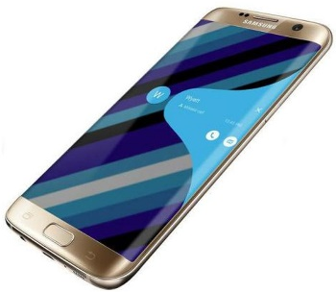
Challenges
Introduction
Problem
Solution
Related Work
Methodology
Results
Challenges
Conclusion
Lecture Notes
Text
Images
Videos
Summary,
Related Multimedia
Small Messages
Text
Image
Video
Automatically Scheduling

Slide 12
Challenges
Introduction
Problem
Solution
Related Work
Methodology
Results
Challenges
Conclusion
From an IT perspective, these challenges and requirements involves researches in different areas:
Summarization and text mining techniques for automatic chunking.
Big data research to identify the most related materials (multimedia content such as videos, and images) to the lecture content.
Machine learning algorithm to automatically scheduling messages for different students based on the best readable time.

Slide 13
Conclusion
Introduction
Problem
Solution
Related Work
Methodology
Results
Challenges
Conclusion
We conduct a well-defined case study to measure the effectiveness of using mobile-based micro-content messages on students’ retention.
The results show a noticeable improvement on student’ retention using mobile micro-learning compared with the normal lecture cycle.
We propose an important IT challenges and research directions for developing an automated solution for mobile micro-learning that supports both student and instructor.

Slide 14
Thank You!
Questions???

