Slide 1

Exploring DOM-Based Cross Site Attacks
Dr. Ammar Aldallal
Computer Engineering Department

Slide 2

Outline
Introduction
Web users threats
Types of cross site scripting
What is DOM Cross Site
Example
Defending against DOM Cross Site
Conclusion

Slide 3
Introduction
The dynamic web applications are quite complex in nature.
Using web applications becomes more and more popular on a daily basis,
This motivates the hackers to commit cyber-crimes such as cross-site scripting.
This connectivity has raised a major security threat since attacker will be able to access personal and sensitive information.

Slide 4
Web Users Threats
The Open Web Application Security Project has listed top-10 threats of Web Application, among are:
Injection
Broken Authentication and Session Management
Cross- site scripting (XSS)
Insecure Direct Object References
Un-validated Redirects and Forwards
Sensitive Data Exposure

Slide 5
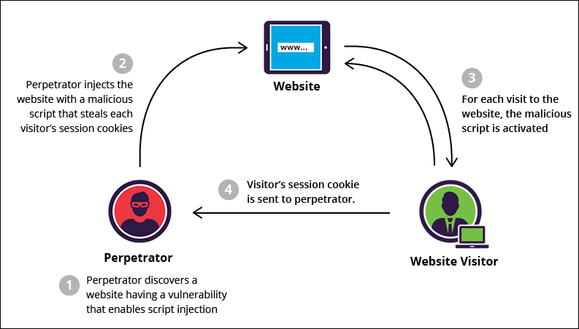
Definition of Cross- Site Scripting (XSS)
In XSS hacker attacks authentic web page with his malicious code therefore when user visits the web page the script is downloaded
From: The Five Most Prevalent Web Threats Today And What You Can Do About Them, © Imperva, Inc. 2017

Slide 6
Types of Cross- site scripting (XSS)
There are three types of Cross- site scripting (XSS)
  Non-Persistent (reflected) Cross- site scripting
  Persistent Cross- site scripting
  DOM-Based Cross- site scripting

Slide 7
Types of Cross- site scripting (XSS)
Non-Persistent (reflected)Cross- site scripting
  means that malicious code is not persistently stored in a vulnerable server, but it is immediately echoed by the vulnerable server back to a victim
Persistent Cross- site scripting
  means that the malicious code is persistently stored in a server’s storage, and may later be embedded in an HTML page sent to the victim.

Slide 8
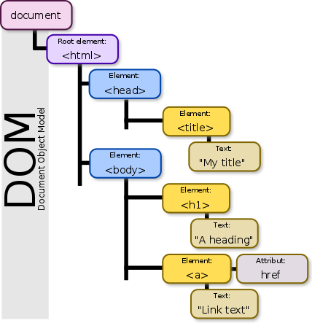
What is DOM
The Document Object Model is a convention for representing and working with objects in an HTML or XML document.

Slide 9
What is DOM (Cont.)
Basically all HTML documents have an associated Document Object Model , consisting of objects representing the document properties from the point of view of the browser.
Whenever a script is executed on client-side, the browser provides the code with the DOM of the HTML page where the script runs, thus, offering access to various properties of the page and their values, populated by the browser from its perspective

Slide 10
DOM based XSS
DOM cross site scripting attack relies on inappropriate handling, in the HTML page, of the data from its associated DOM, resulting in:
  Steal the cookies of the user or
  Change the page's behavior as the attacker like.
Notes:
DOM Based XSS (or as it is called in some texts, “type-0 XSS”) is an XSS attack wherein the attack payload is executed as a result of modifying the DOM “environment” in the victim’s browser used by the original client side script, so that the client side code runs in an “unexpected” manner. That is, the page itself (the HTTP response that is) does not change, but the client side code contained in the page executes differently due to the malicious modifications that have occurred in the DOM environment.

Slide 11
DOM based XSS
Among the objects in the DOM, there are several which the attacker can manipulate in order to generate the XSS condition, and the most popular, from this perspective, are the
  document.url,
  document.location
  document.referrer

Slide 12
Example of a DOM-Based XSS Attack
Consider the URL:
http://www.example.com/userdashboard.html
The HTML source of the URL would look like this:
<html>
<head>
<title>Custom Dashboard </title>
...
</head>
Main Dashboard for
<script>
var pos=document.URL.indexOf("context=")+8; document.write(document.URL.substring(pos,document.URL.length));
</script>
...
</html>

Slide 13
Example (Cont.)
The result of
http://www.example.com/userdashboard.html?context=Bader
would be a customized dashboard for Bader, containing at the top the string: “Main Dashboard for Bader”.
The malicious script can be embedded in the URL as follows
http://www.example.com/userdashboard.html?context=<script>SomeFunction(somevariable)
http://www.example.com/userdashboard.html#context=<script>SomeFunction(somevariable)
Next, the browser finds the malicious code in the HTML body and executes it, thus finalizing the DOM XSS attack.
Notes:
When the browser arrives to the script which gets the user name from the URL, referencing the document.urlproperty, it runs it and consequently updates the raw HTML body of the page, resulting in
... Main Dashboard for <script>SomeFunction(somevariable)</script> ...Next, the browser finds the malicious code in the HTML body and executes it, thus finalizing the DOM XSS attack. In reality, the attacker would hide the contents of the payload in the URL using encoding so that it is not obvious that the URL contains a script.
Note however, that some browsers may encode the < and > characters in the URL, causing the attack to fail. However there are other scenarios which do not require the use of these characters, nor embedding the code into the URL directly, so these browsers are not entirely immune to this type of attack either.

Slide 14

Encoding the attack
In reality, the attacker would hide the contents of the payload in the URL using encoding so that it is not obvious that the URL contains a script.
https://www.example.com/userdashboard.html?S=9D4405D724CF323366E301EE382E30D758E92016D05221520B4A03F5394315BCABECDDCB3F8658ACA81432EF438CB855267978CD413EB7D7BCD3B6191ED884F15116745843535824

Slide 15
Defending against DOM-based XSS attacks
Because some browsers may encode the “<“ and ”>”
  characters in the URL, the attack will fail.
However there are other scenarios which do not require the use of these characters, so these browsers are not entirely immune to this type of attack.

Slide 16
Defending against DOM-based XSS attacks
Effective conceptual defense methods against the DOM XSS include:
  Avoiding client-side sensitive actions such as rewriting or redirection, using client-side data.
  Inspecting and securely handling references to DOM objects,such as URL, location and referrer.
  Using intrusion prevention systems which are able to inspect inbound URL parameters and prevent the inappropriate pages to be served.

Slide 17
Defending against DOM-based XSS attacks
Difficult to detect by server-side attack detection and prevention tools
Testing of the effectiveness of the sanitization methods in place, or for discovering the DOM XSS vulnerabilities can be performed
  Manually attempting to exploit them,
  Using automated tools that perform automatic penetration testing against this type of vulnerabilities,
  Using various payloads and mounting points.

Slide 18
Conclusion
The DOM based cross-site is used to operate and retrieve the objects in HTML object.
Different methods are used in DOM based cross-site scripting when the client sends unreliable data just to interpret the JavaScript.
Finally, the objective of this presentation is to let the user be familiar with this type of cross-site scripting attack; hence, browse cautiously and safely to prevent DOM-based XSS attacks.
Use updated web browser.

Slide 19

Thank you
Questions & Answers

