Slide 1

Simulation of A&E Disaster Situations:
introductory case
CBE
Tillal Eldabi

Slide 2


Talk plan
Why Simulate
DES components
Simulation of A&E departments
  Typical KPIs
Case study
Lessons

Slide 4
When to use Simulation?
Study and experiment with internal interactions of a complex system.
Observe the effect of system alterations on model behaviour.
Reinforce analytic solution methodologies.
Experiment with new designs or policies before implementation.
For training and learning.

Slide 5

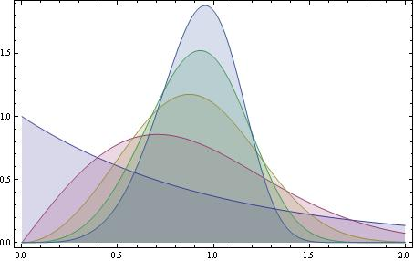
DES typical structure
resources
input
model
output
Waiting time
Utilization rate
Time in process

Slide 6
Simulation of Emergency Departments
It is one of the most studied topics
Simple in structure
However complex in operations
Susceptible to swift overcrowding
Life critical stage in the healthcare

Slide 7
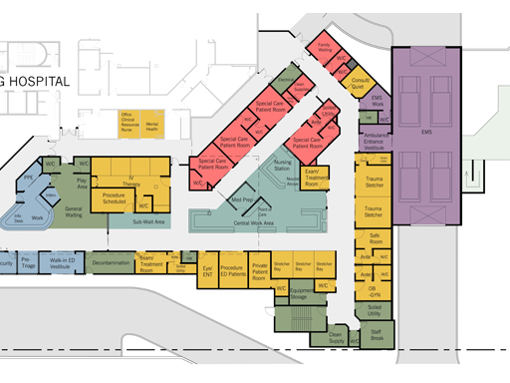

Slide 8
Main KPIs
LOS
Waiting time
Treatment time
Staff utilization

Slide 9
Case study
Main characteristics of our system
  Conceptual model of patients’ flow
  Categories and percentages
  Arrival rates
  Resources allocation
  HDP

Slide 10
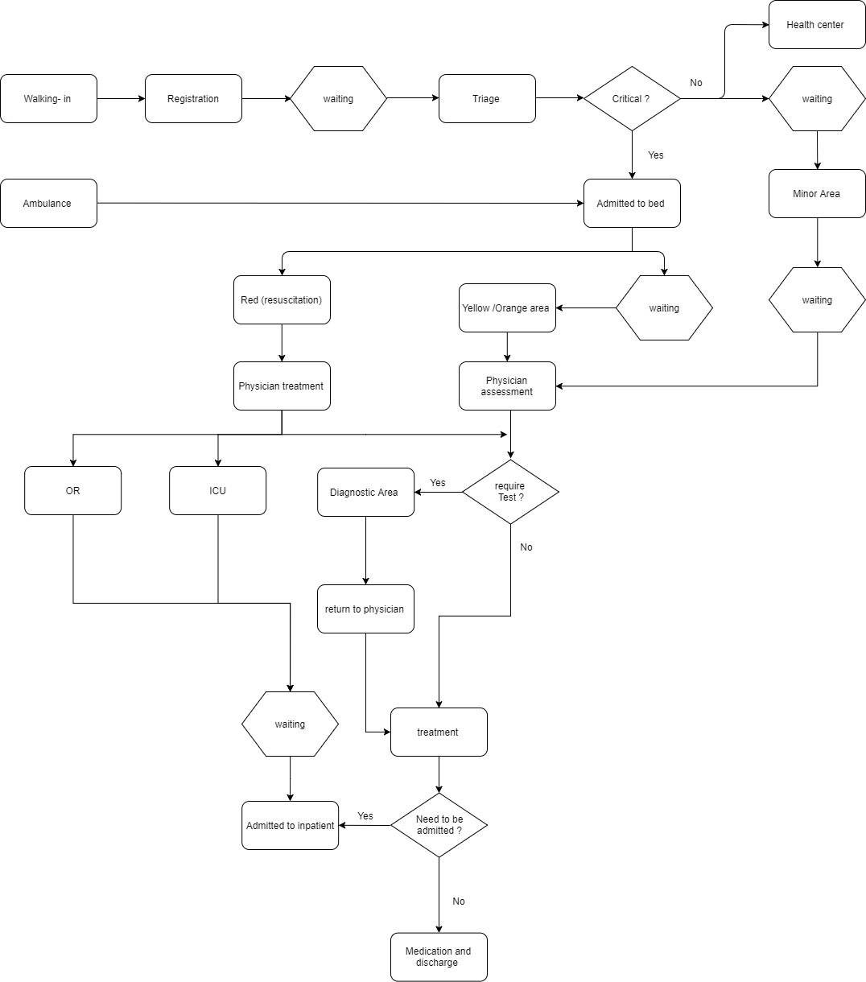
Conceptual Model

Slide 11
Patients arrivals by category

Slide 12
Arrival rates per time period
Distribution name | Time | Type | Average time (min)
arr1 | 0:00 | Exponential | 4.29
arr2 | 1:00 | Exponential | 13.13
arr3 | 8:00 | Exponential | 5.88
arr4 | 13:00 | Exponential | 10.00
arr5 | 16:00 | Exponential | 4.53

Slide 13
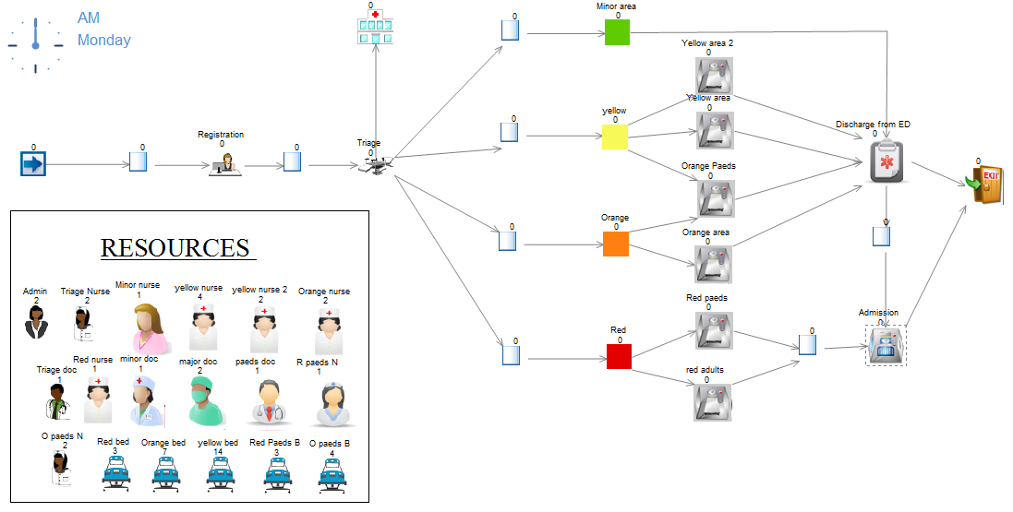
The base model

Slide 14
Validation: arrivals per hour

Slide 15
Disaster scenario modelling
The arrival distribution changed to reflect the increase in number of patients arriving
  A bus crash supposed to have happened at 1:00 am and the rescue lasted until 2:20
  Where average time change from 13.13 minutes to 4 minutes,
  total number of arriving patient s will increase from 218 to 278 patient.

Slide 16
Patients arrival (disaster scenario)

Slide 17
LOS Difference of % by category – Bus crash

Slide 18
Hospital Disaster Plan (HDP)
Even though this sudden increase in patient surge only lasts for short time, the patient flow will be affected by this increase and delays treatment
Two main changes will be implemented according to HDP:
  First, to eliminate green area and joining green patients with blue patient to be sent to healthcare centres or hospital out patients.
  Second, to reduce the admission waiting time to 20 - 60 minutes instead of 20 - 240 minutes.

Slide 19
LOS Difference of % by category - HDP

Slide 20
LOS Difference of % by category – Simulated plan
(adding 2 major doctor to HDP)

Slide 21
Overall comparison

Slide 22
Conclusions
The current HDP works to reduce pressure, whilst adding 2 doctors helps even more
A simple simulation model could help plan for all types of disasters and improve sustainability.
It is promising in terms of saving money when planning a physical disaster drill.
Limitations
  This is a very simplified model and did not take into consideration the involvement of the rest of the hospital.
  Lack of relevant data and awareness are the biggest barriers for the use of simulation in this region.
  Availability of more data outlet and technology will lead to an improved utilisation of simulation.

