Slide 1
Optimal Experience in Teaching
Mohamed Hasan Mohamed
College of Arts and Science
Your name

Slide 2
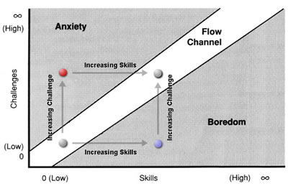
Optimal Experience (OE)

Slide 3
High Skills + Low Challenges = Boredom
Complacency
Does not recognize hazards, sees only opportunities
No need to change
Having Mode
Negative emotions: Pride,…

Slide 4
High Challenges + Low skills = Anxiety
A false sense of urgency
Does not recognize opportunities, sees only hazards
Everything needs to change
Doing Mode
Negative emotions: Desire/Anger/Fear

Slide 5
High Challenges + High skills = Flow (OE)
A true sense of urgency
Recognizes both opportunities and hazards
I’m perfect just as I am, but I need to change
Being Mode
Positive emotions: Courage/Acceptance/Love

Slide 6
Being in the Flow
1. What does teaching mean to me?
service/altruism
success
just a job
money
fame

Slide 7
Being in the Flow
2. What are the feelings associated with each meaning?
happiness
freedom
pleasing God

Slide 8
Being in the Flow
3. Can I have access to these feelings without them?
Yes.
Then, they are not a problem.
They are subservient to higher goals..
Now, my Being (I am happy without them) gives meaning to my Havings and Doings.

