Slide 1

Does Corporate Governance influence Earnings Management in Listed Companies in Bahrain Bourse?
Accounting & Economics Dept.
College of Business & Finance
Dr. Bahaaeddin Alareeni

Slide 2


Outlines
  Introduction
  Study problem
  Study importance
  Research Methodology
  Analysis and Results
  Conclusion
Notes:
Here are the main points I am going to cover

Slide 3
Introduction
  Over the past few decades, there have been a number of well-known scandals (e.g., WorldCom and Enron).
  Researchers found that Earnings Management (EM) practices are typically at the core of such scandals.
  Managers use some of the flexibility allowed by accounting policies and practices to affect accounting profits.
  Fraud cases in the stock markets have proven the existence of unethical behavior and revealed a need for transparency and reliability in firms’ financial reports.
  High-profile corporate failures have heightened global awareness of the importance of corporate transparency, reliability and accountability.

Slide 4
Introduction
Regulators have established CG Codes to maintain investor interests, improve confidence in stock markets, protect information transparency, mitigate conflicts of interest and increase auditor independence.
A high CG level may prevent EM practices, which could decrease the magnitude of company failures/bankruptcies and thus positively affect shareholders and other related parties.
Many prior studies have investigated this relationship.
(developed countries)
The studies have shown progress in the quality of earnings due to the implementation of CG.

Slide 5
Introduction
Much less is known about this relation in developing countries, particularly GCC countries.
The results on this relationship differ between studies depending on several factors such as industry, sample size, year of data and economic environment.
For instance, in India and China, Sarkar et al. (2008) and Gulzar (2011) found a significant positive association between CEO duality and EM; namely, boards that have directors with multiple functions exhibit higher EM.
By contrast, the findings of Castañeda (2000) did not support a positive impact of CEO duality on EM and showed that majority owners occupy dual roles in 85% of Mexican listed firms.

Slide 6
Study Problem
There is a real need to test the relationship between CG and EM in different economic environments using recent time periods and industries and, more specifically, in the context of GCC countries.
The situation in Bahrain remains questionable. Bahrain has recently begun experiencing economic difficulties as a result of increasing oil prices.
Ultimately, the high price of oil could affect the whole economy and, consequently, firms’ activities, increasing the possibility of losses in Bahrain.
This could motivate Bahrain firms to forgo some principles of CG and practice EM.
Notes:
As an example GCC country,

Slide 7
Study Problem
Therefore, this study aims to detect the EM behavior of firms listed on Bahrain Bourse and show whether companies practice management of positive (income-increasing) discretionary accruals (DA) or management of negative (income-decreasing) DA.
Further, this study analyzes the effect of a set of CG characteristics (internal ownership, board independence, board size, and CEO duality) on EM behavior.

Slide 8

Study Problem
Therefore, this study aims to detect the EM behavior of firms listed on Bahrain Bourse and show whether companies practice management of positive (income-increasing) discretionary accruals (DA) or management of negative (income-decreasing) DA.
Further, this study analyzes the effect of a set of CG characteristics (internal ownership, board independence, board size, and CEO duality) on EM behavior.
Earnings Management Behavior
Management of Positive (income-increasing) DA or Management of negative (income-decreasing) DA.

Slide 9

Study Problem
Therefore, this study aims to detect the EM behavior of firms listed on Bahrain Bourse and show whether companies practice management of positive (income-increasing) discretionary accruals (DA) or management of negative (income-decreasing) DA.
Further, this study analyzes the effect of a set of CG characteristics (internal ownership, board independence, board size, and CEO duality) on EM behavior.
EM behavior

Slide 10
Study Importance
This study is the first to focus on the relationship between CG characteristics and EM in companies listed on Bahrain Bourse.
The study enriches the CG and EM literature by covering the Bahrain context, which have not been sufficiently examined in relation to this topic.
Further, the results of this study provide a clear picture of the level and quality of EM practices in Bahrain Bourse to multiple parties, such as auditors, credit institutions, and financial statement users in general.

Slide 11
The Relationship between CG and EM
Jiraporn et al. (2008) argued that EM damages the value of firms by decreasing financial reporting quality.
CG characteristics can restrict the discretionary behavior of managers (Mersni et al., 2016).
For example, board governance can directly affect managers’ decisions and activities.
Consequently, good board governance can use internal control systems to control EM.
Many prior literature has documented how the characteristics and ownership structure of a board can limit EM because independent directors do not seek self-interests such as executive compensation.

Slide 12
Variables and Hypotheses
Internal Ownership
Board Size
CEO Duality
Board Independence
Independent Variables
-
Dependent Variable
-
EM practices
+
-

Slide 13
Design and Research Methodology
1- Sample size:
Companies listed on Bahrain Bourse and selected based on the following criteria:
Classification of the company as an industrial or service company;
available company data for five years for the period 2011-2015.
Our final sample of 20 firms is shown in Table 1.
Table 1: Sample selection
# | Sector | Listed firms | Excluded firms | Study sample | Study observations
1 | Service Sector | 15 | 0 | 15 | 75
2 | Industrial Sector | 5 | 0 | 5 | 25
 | Final Sample | 20 | 0 | 20 | 100

Slide 14
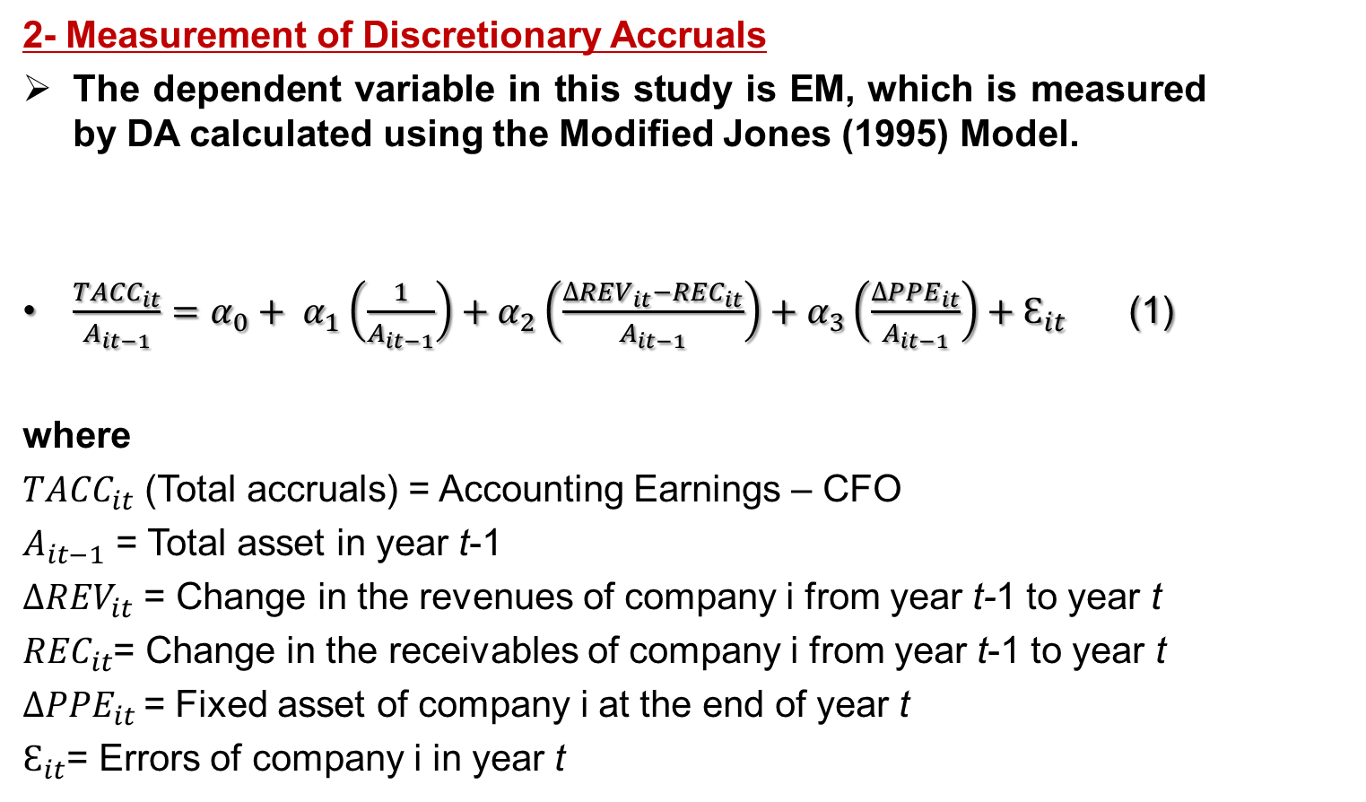
Design and Research Methodology
2- Measurement of Discretionary Accruals
The dependent variable in this study is EM, which is measured by DA calculated using the Modified Jones (1995) Model.
$\frac{{TACC}_{it}}{A_{it−1}}=α_{0}+ α_{1}\left(\frac{1}{A_{it−1}}\right)+α_{2}\left(\frac{{∆REV}_{it}−{REC}_{it}}{A_{it−1}}\right)+α_{3}\left(\frac{{∆PPE}_{it}}{A_{it−1}}\right)+Ɛ_{it}$ (1)
where
${TACC}_{it}$ (Total accruals) = Accounting Earnings – CFO
$A_{it−1}$ = Total asset in year t-1
${∆REV}_{it}$ = Change in the revenues of company i from year t-1 to year t
${REC}_{it}$= Change in the receivables of company i from year t-1 to year t
${∆PPE}_{it}$ = Fixed asset of company i at the end of year t
$Ɛ_{it}$= Errors of company i in year t

Slide 15
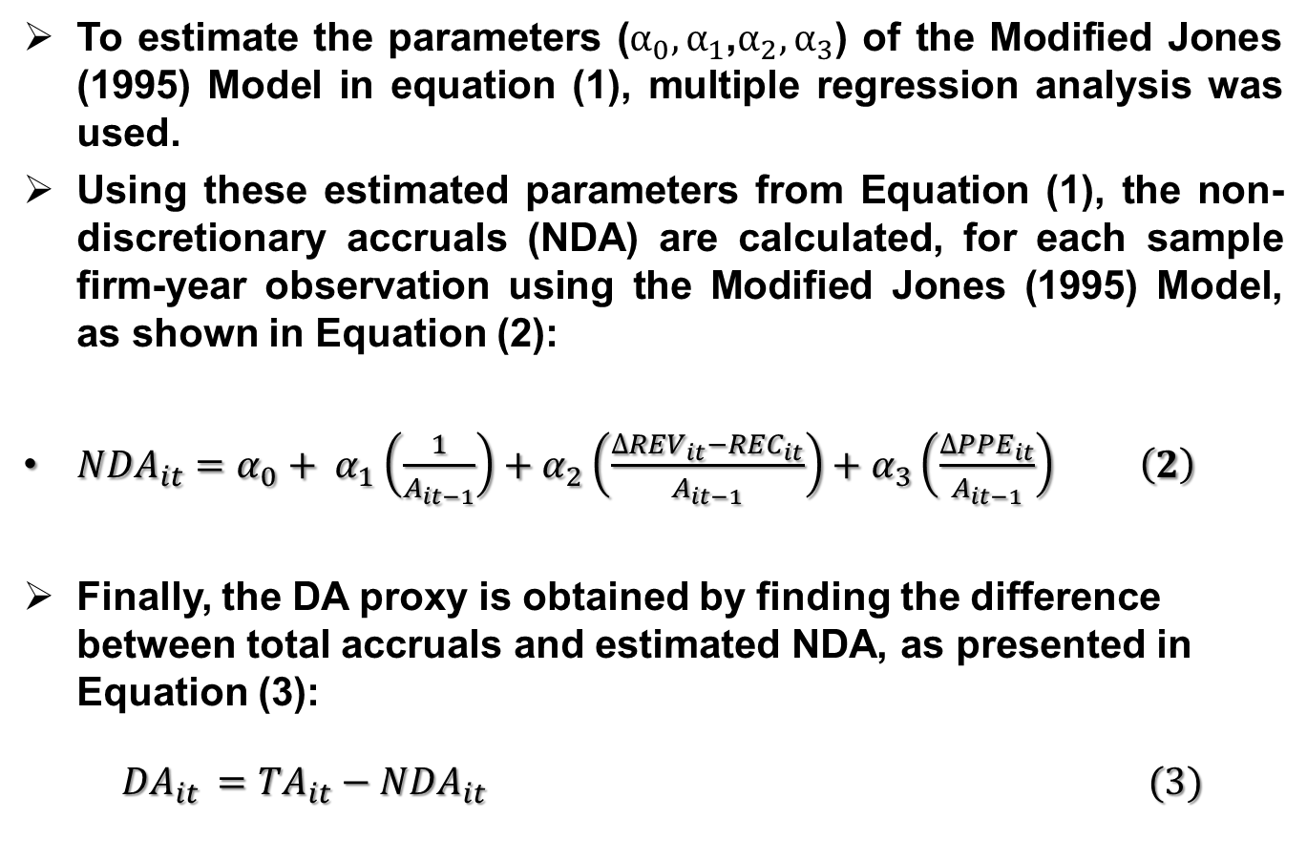
Design and Research Methodology
To estimate the parameters (${α_{0},α}_{1}$,$α_{2}, α_{3}$) of the Modified Jones (1995) Model in equation (1), multiple regression analysis was used.
Using these estimated parameters from Equation (1), the non-discretionary accruals (NDA) are calculated, for each sample firm-year observation using the Modified Jones (1995) Model, as shown in Equation (2):
${NDA}_{it}=α_{0}+ α_{1}\left(\frac{1}{A_{it−1}}\right)+α_{2}\left(\frac{{∆REV}_{it}−{REC}_{it}}{A_{it−1}}\right)+α_{3}\left(\frac{{∆PPE}_{it}}{A_{it−1}}\right) \left(2\right)$
Finally, the DA proxy is obtained by finding the difference between total accruals and estimated NDA, as presented in Equation (3):
${DA}_{it }={TA}_{it}−{NDA}_{it} (3)$

Slide 16
The Study model and Variables
Independent Variables
Internal Ownership
Board Size
CEO Duality
Board Independence
-
Dependent Variable
-
EM practices
+
-
Control Variables
(AGROWTH , EPS, FLEV, TA)

Slide 17

Design and Research Methodology
$Abs\left({DA}_{it}\right)= α_{0}+ α_{1}\left(INTOWN\right)+α_{2}\left(BOARDS\right)+α_{3}\left(DUALITY\right)+α_{4}\left(BOARDIND\right)+α_{5}\left(AGROWTH\right)+α_{6}\left(EPS\right)+α_{7}\left(FLEV\right)+α_{8}\left(TA\right)+Ɛ_{it}$
Table 2: Description of the study variables
Variable | Definition | Description
Abs (DA) | Absolute Value of Discretionary Accruals | absolute value of discretionary accruals, estimated using the Modified Jones (1995) Model as shown in equation 3
INTOWN | Internal Ownership | measured by the property ratio of managers in the company’s shares
BOARDS | Board Size | measured by the total number of board members
DUALITY | President–CEO Duality | measured by a dummy variable equal to 1 if the chairman and CEO are the same person in company i and 0 otherwise
BOARDIND | Board Independence | indicates the presence of independent directors or non-executive directors on the board; takes a value of 1 when the board of directors contains one or more independent directors and 0 otherwise
AGROWTH | Assets Growth | measured by the annual change in total assets
EPS | Earnings per Share | a company’s earnings per share
FLEV | Financial Leverage | measured by total debt to total assets
TA | Total Assets | the natural logarithm of company’s total assets at the end of year t

Slide 18
Analysis and Results
1- Descriptive Analysis
Table 3: Descriptive analysis of the study variables.
Variable | Mean | Median | Maximum | Minimum | Std. Dev.
Abs (DA) | 0.0543 | 0.0300 | 0.5200 | 0.0001 | 0.084192
INTOWN | 6.2602 | 3 | 40.8 | 0 | 9.756218
BOARDS | 9.4578 | 10 | 16 | 7 | 1.425390
DUALITY | 0.1927 | 0 | 1 | 0 | 0.396873
BOARDIND | 0.3614 | 0 | 1 | 0 | 0.483340
AGROWTH | 3.1902 | 3.3684 | 51.1767 | -15.7301 | 9.040546
FLEV | 1.5192 | 1.3201 | 2.7903 | 1.0199 | 0.478508
TA | 4.5625 | 4.4200 | 7.1700 | 2.5400 | 1.145403
EPS | 0.0347 | 0.0292 | 0.1500 | -0.1688 | 0.040417

Slide 19
Analysis and Results
1- Descriptive Analysis
Table 4: Pearson’s correlations
Variable | Abs(DA) | AGROWTH | FLEV | TA | EPS | BOARDIND | BOARDS | DUALITY | INTOWN
Abs (DA) | 1
 | -----
AGROWTH | -0.004 | 1
Sig. | (0.483) | -----
FLEV | 0.009 | -0.083 | 1
Sig. | (0.465) | (0.205) | -----
TA | -0.177* | 0.023 | 0.443** | 1
Sig. | (0.039) | (0.411) | (0.000) | -----
EPS | -0.204* | 0.318** | -0.136 | 0.065 | 1
Sig. | (0.021) | (0.001) | (0.089) | (0.259) | -----
BOARDIND | -0.046 | 0.239** | 0.119 | 0.206* | 0.063 | 1
Sig. | (0.326) | (0.008) | (0.120) | (0.020) | (0.266) | -----
BOARDS | -0.175 | -0.118 | 0.587** | 0.133 | -0.077 | -0.119 | 1
Sig. | (0.056) | (0.144) | (0.000) | (0.116) | (0.244) | (0.142) | -----
DUALITY | 0.063 | -0.030 | -0.215* | -0.239** | -0.281** | -0.016 | -0.093 | 1
Sig. | (0.265) | (0.385) | (0.016) | (0.008) | (0.002) | (0.437) | (0.201) | -----
INTOWN | 0.044 | 0.001 | 0.127 | 0.043 | -0.041 | -0.043 | 0 .128 | -0.067 | 1
Sig | (0.333) | (0.496) | (0.103) | (0.334) | (0.341) | (0.334) | (0.124) | (0.254) | -----

Slide 20
Analysis and Results
1- Regression Results
Table 6: Time fixed effects model
Variable | Coefficient | Std. Error | t-Statistic | Prob.
Control variables
AGROWTH | 0.000897 | 0.000895 | 1.001696 | 0.3198
EPS | -0.610491 | 0.301727 | -2.023322 | 0.0467
FLEV | 0.062802 | 0.062448 | 1.005666 | 0.3178
TA | 0.063824 | 0.064468 | 0.990013 | 0.3252
Independent Variables
BOARDS | -0.030843 | 0.009283 | -3.322744 | 0.0015
BOARDIND | 0.076733 | 0.029078 | 2.638829 | 0.0105
DUALITY | 0.017500 | 0.073935 | 0.236695 | 0.8135
INTOWN | 0.042286 | 0.017028 | 2.483308 | 0.0151
C | 0.316749 | 0.282850 | 1.119850 | 0.2675
R-sq: Within 0.266 Between 0.212 Overall 0.211 |  | F-statistic |  | 9.2213
 |  | Prob(F-statistic) |  | 0.0000

Slide 21
Analysis and Results
1- Regression Results
H₁: Internal ownership negatively affects EM practices
H₂: Board size negatively affects EM practices.
H₃: CEO duality positively affects EM practices.
H₄: Board independence negatively affects EM practices.
The study results
Positive Impact
Negative Impact
No significant relationship
Positive impact

Slide 22
Conclusion
The study results indicate that the listed companies in Bahrain are relatively engaged in practicing EM through income-increasing DA.
The relationships between variables must be tested for each country, particularly when countries have different environmental factors.

Slide 23
Conclusion
EM is negatively related to board size, confirming that a large board is more likely to reduce the EM level.
The board size in Bahrain plays a vital role in protecting the interests of shareholders and restrict EM practices in Bahrain.
Board independence is positively related to EM, confirming that a larger number of independent directors is associated with a higher level of EM practices.
This relationship reflects the situation in Bahrain, which differs from that in developed and some developing countries; independent directors in Bahrain have many duties and roles in other firms and thus cannot control the companies’ activities and, more specifically, EM practices.

Slide 24
Conclusion
The findings showed that internal ownership is positively related to EM, confirming that internal ownership can have a negative impact on the firms, since the greater manager’s authority may lead them to make accounting decisions which reverberate personal aims, hence, lead them to engage in EM.
The findings showed that CEO duality does not have any effect on EM in Bahrain.
The relationship between EPS and Abs (DA) is negative, suggesting that EM increases as EPS decrease.
Furthermore, no significant relationship was found between a company’s assets growth level or financial leverage or its total assets and EM practices for the listed companies in Bahrain.

Slide 25
Limitation and Future research
A limitation of this study is the absence of some financial data. Some companies were ignored because their data were not available in the Bloomberg database or from the website of Bahrain Bourse.
Further, this study was conducted in Bahraini Bourse, which limited the study sample compared to similar studies.
Finally, the study did not include all CG characteristics due to a lack of available data.
In addition, this research could be extended to a larger number of companies by, for example, including all GCC or MENA countries because the GCC and MENA countries may have similar economic environments.

Slide 26


Support
Feedback
Thank you all !
Notes:
If you have questions or problems, Mendeley have a dedicated support team in place to help out. You can raise a support ticket via the website, or contact them via email or Twitter.
If you have ideas or suggestions about how Mendeley could be improved, Mendeley would love to hear them. We try to take suggestions from the community into account when developing new features.

Slide 27


