Slide 1


Detection and Monitoring Intra/Inter Crosstalk in Optical Network on Chip
Dr. Ahmed Jedidi
Assistant Professor / Chairperson of computer Engineering Department
College of Engineering Ahlia University Bahrain
ajedidi@ahlia.edu.bh

Slide 2



What are we going to talk about today?

Slide 3

You know what, …
Why are multiprocessor architectures more and more popular?
Network on Chip Trend (NoC)
Crosstalk in optical communication
Detection and monitoring Crosstalk noise in ONoC

Slide 4
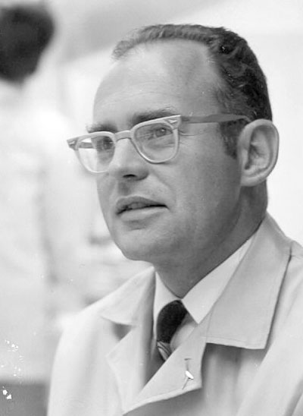
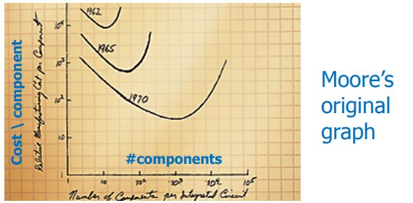
New Challenges :
Technology progress:
  Nbr transistors & density
Moore’s Law (Gordon Moore – 1965) “The complexity for minimum component costs has increased at a rate of roughly a factor of two per year

Slide 5

New Challenges :
Embedded Applications ++ complex and varied.
  Need a performing HW.
  Reduce consumption energy
  HW/SW Design, implementation and verification simple
  (Time to Market)

Slide 6
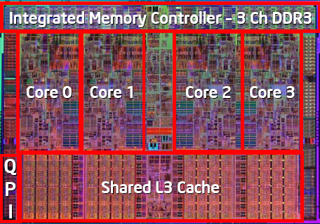
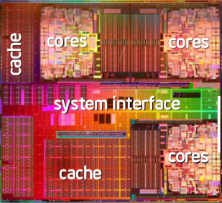

Solution : Multiply processors
Better use of transistors.
  Reuse unit.
Extensibility
  Add new cores
Optimization HW/SW

Slide 7
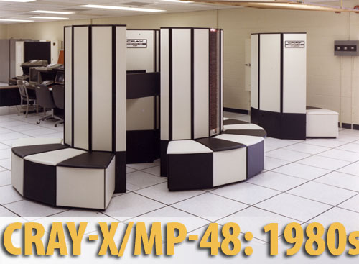
Multiprocessors…my grandfather told me the story…
"Don’t be encumbered by past history, go off and do something wonderful"
Robert Noyce, co-fondateur d'Intel Corp.
MPSoC different than the classic multiprocessor architectures:
  1 chip = Processors, Caches, Noc, FPGA, …
  New models of programming

Slide 8
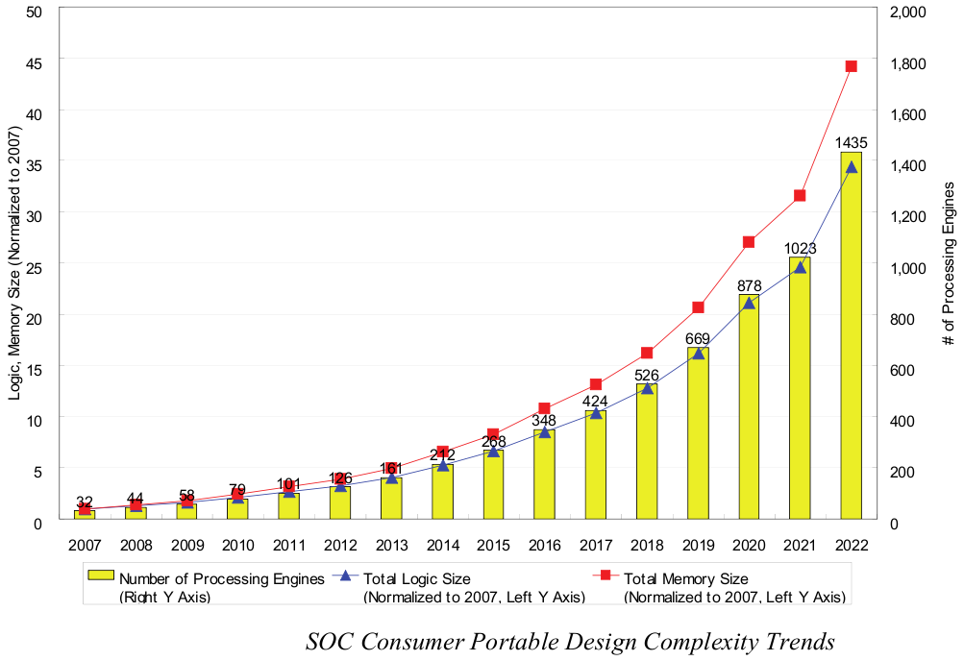
MPSoC Chalenges: Number of PEs

Slide 9
Typical MPSoC Architecture
Core+cache
Memory Unit
(DRAM, SRAM, SPR, ..)
Core+cache
Memory Unit
(DRAM, SRAM, SPR, ..)
Network-On-Chip
HW accelerator (FP, FFT, JPEG, ..)
I/O
USB, BT, CAN
I/O
USB, BT, CAN
I/O
USB, BT, CAN…
Reconfigurable Logic

Slide 10
Energy Efficiency
Need for efficiency (power + energy):
Why worry about energy and power?
„Power is considered as the most important constraint in embedded systems“
[in: L. Eggermont (ed): Embedded Systems Roadmap 2002, STW]

Slide 11
Low Power vs. Low Energy Consumption
  Minimizing the power consumption is important for
    the design of the power supply
    the design of voltage regulators
    the dimensioning of interconnect
    short term cooling
  Minimizing the energy consumption is important due to
    restricted availability of energy (mobile systems)
      limited battery capacities (only slowly improving)
      very high costs of energy (solar panels, in space)
    cooling
      high costs
      limited space
    dependability
    long lifetimes, low temperatures

Slide 12
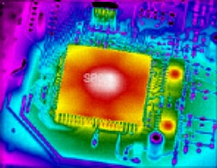
Thermal Dissipation
Energy consumption== Temperature:
  High temperature :
    Decrease the performance
    Cause breakdowns
    Decrease Mean Time To Failure «MTTF
Decreasing the temperature increases the life of the Chip

Slide 13
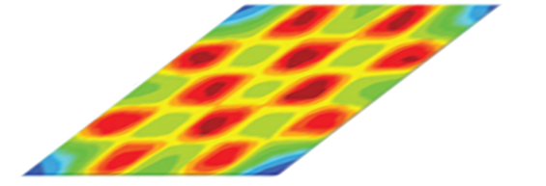


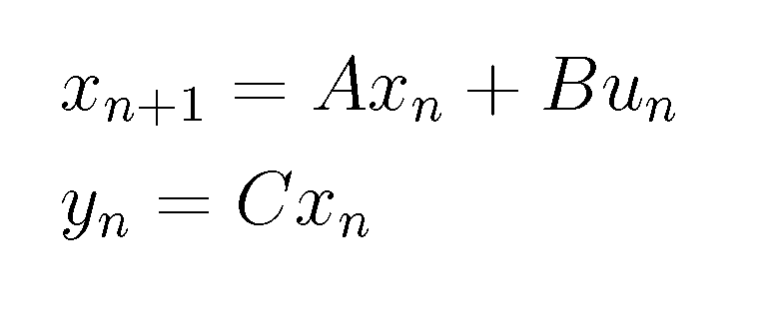

Thermal & Power Modeling
T_{j}
Task_{j}
P_{j}
Modello
Termico
Modello di
potenza
Thermal
model
Power
model
P=g(task,f)
P_{n,j}
T_{n,j}
task
task
task

Slide 14
Network On-Chip Communications
Growing number of cores → Networks-on-Chip (NoC)
Shared, packet-switched, optimized for communications
  Resource efficiency
  Design simplicity
  IP reusability
  High performance
But no true relief in power dissipation
IBM Cell ~30-50% of chip power budget
allocated to global interconnect

Slide 15
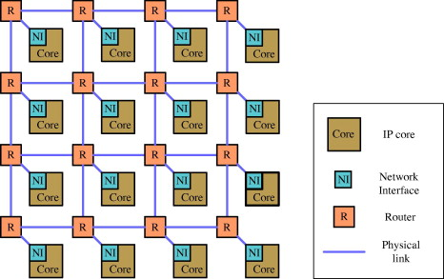
Network On-Chip Communications
Modern Processors contain multiple cores integrated into a single chip
Hundreds of cores on a single chip will soon be possible due to Technology Scaling
On-chip Communication Networks that connect the cores (commonly called Network-on-Chips or NoCs) are becoming critical components in such processors
(Source: http://sips.inesc-id.pt/~nfvr/msc_theses/msc12ac/)
Reference:
N. E. Jerger and L.-S. Peh, "On-chip networks," Synthesis Lectures on Computer Architecture, vol. 4, no. 1, pp. 1–141, Jan. 2009.

Slide 16
Metrics for judgement of NoCs :
Bandwidth Density
Energy Efficiency
Latency
Scalability

Slide 17
Why Photonics?
Photonics changes the rules for Bandwidth-per-Watt.
Photonics:
Modulate/receive ultra-high bandwidth data stream once per communication event.
Broadband switch routes entire multi-wavelength stream.
ELECTRONICS:
Buffer, receive and re-transmit at every router.
Each bus lane routed independently. (P ∝ N_{LANES})
TX
RX
TX
RX
RX
RX
RX
RX
TX
TX
TX
TX

Slide 18
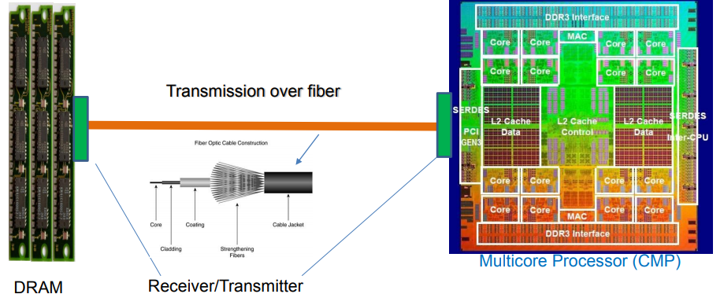
Photonics in computing system today
Optical link
• Uses monolithic integration that reduces energy consumption
• Utilizes the standard bulk CMOS flow
• Cladding is used to increase the total internal reflection ➔ reduces data loss

Slide 19
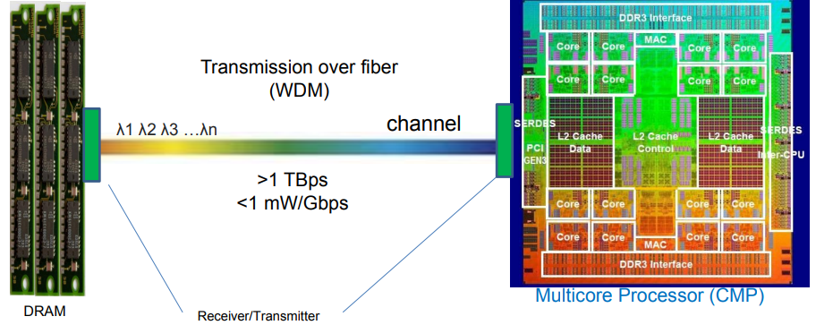
Photonics in computing system today
WDM, DWDM
Supports WDM that improves bandwidth density
DWDM can transports tens to hundreds of wavelengths per fiber.
Integrated Tb/s optical link on a single chip is ongoing

Slide 20
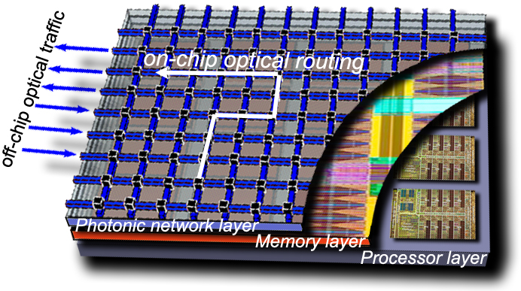
MPSoC Vision

Slide 21
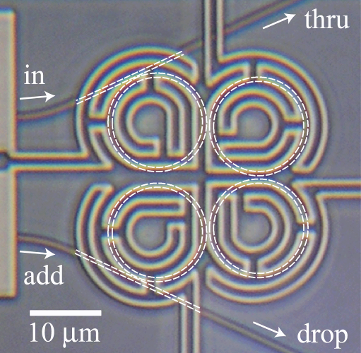
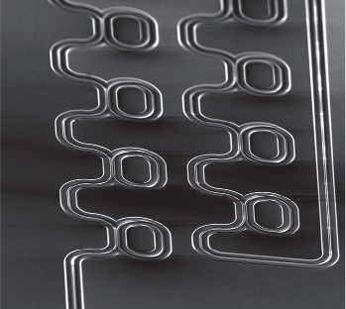
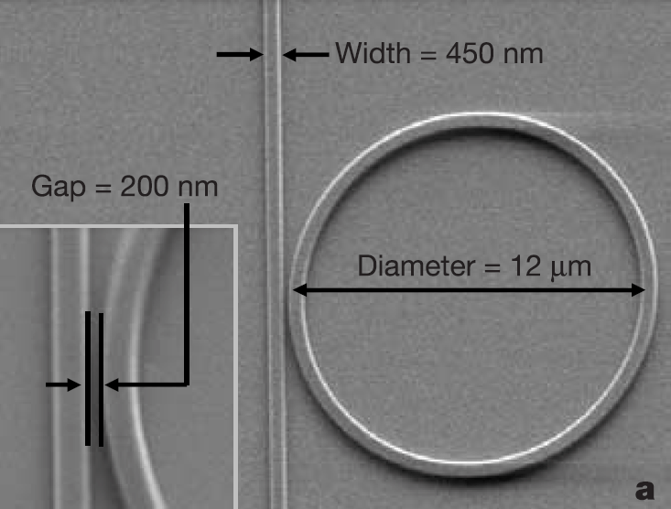
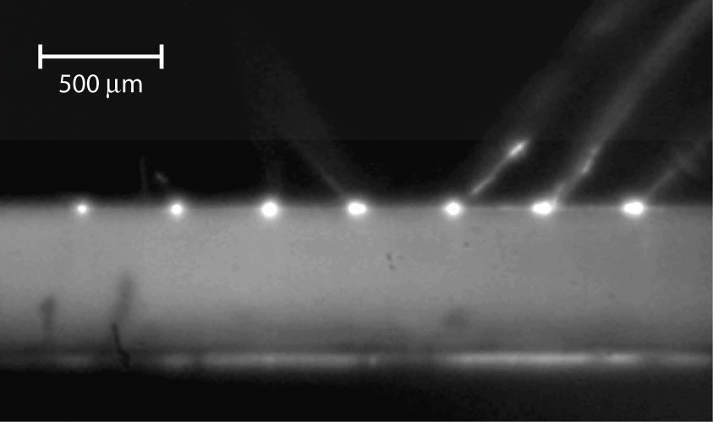
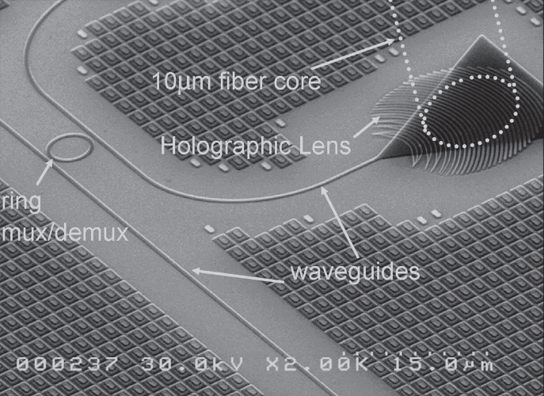
Silicon Photonic Integration
MIT, 2008
Cornell, 2005
IBM, 2007
Luxtera, 2005
UCSB, 2006

Slide 22
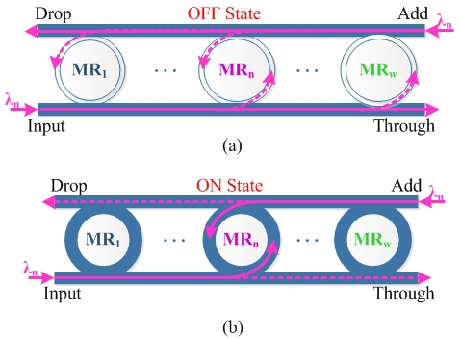
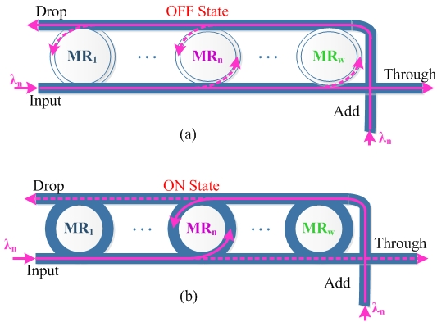
Basic Optical Devices
Micro-Resonator (MRs)
The parallel switching element (PSE)
The crossing switching element (CSE).

Slide 23
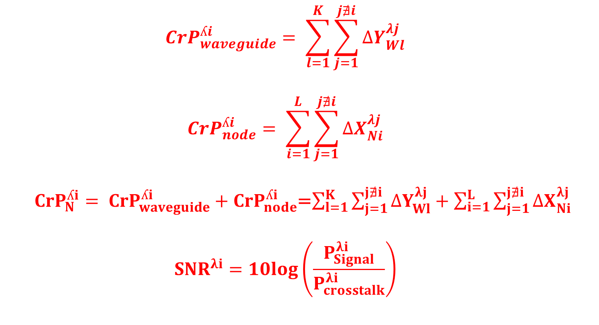
Crosstalk noise in basic devices
$${CrP}_{waveguide}^{ʎi}= \sum_{l=1}^{K}{\sum_{j=1}^{j∄i}{{∆Y}_{Wl}^{λj}}}$$
$${CrP}_{node}^{ʎi}= \sum_{i=1}^{L}{\sum_{j=1}^{j∄i}{{∆X}_{Ni}^{λj}}}$$
${CrP}_{N}^{ʎi}= {CrP}_{waveguide}^{ʎi}+{CrP}_{node}^{ʎi}$=$\sum_{l=1}^{K}{\sum_{j=1}^{j∄i}{{∆Y}_{Wl}^{λj}}}+\sum_{i=1}^{L}{\sum_{j=1}^{j∄i}{{∆X}_{Ni}^{λj}}}$
$${SNR}^{λi}=10log⁡\left(\frac{P_{Signal}^{λi}}{P_{crosstalk}^{λi}}\right)$$

Slide 24
Crosstalk noise in ONoC

Slide 25
Crosstalk Detection and monitoring

Slide 26
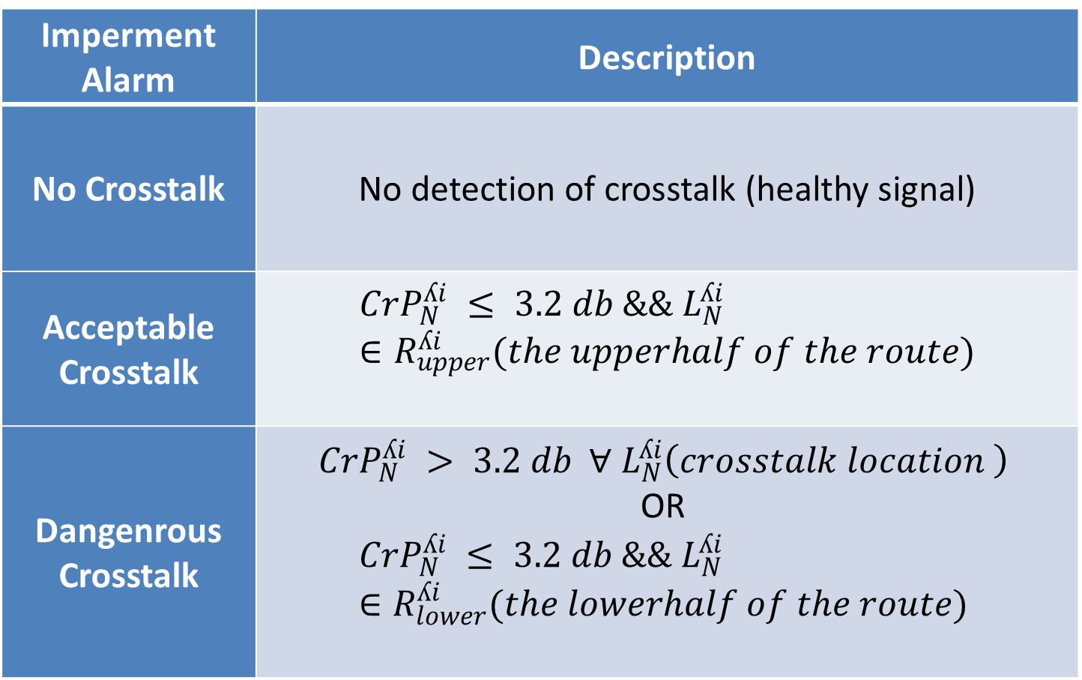
Crosstalk Detection and monitoring
Imperment Alarm | Description
No Crosstalk | No detection of crosstalk (healthy signal)
Acceptable Crosstalk | $${CrP}_{N}^{ʎi} ≤ 3.2 db \&\& L_{N}^{ʎi} ∈R_{upper}^{ʎi}(the upperhalf of the route)$$
Dangenrous Crosstalk | $${CrP}_{N}^{ʎi} > 3.2 db ∀ L_{N}^{ʎi}\left(crosstalk location \right)$$ OR $${CrP}_{N}^{ʎi} ≤ 3.2 db \&\& L_{N}^{ʎi} ∈R_{lower}^{ʎi}(the lowerhalf of the route)$$

Slide 27
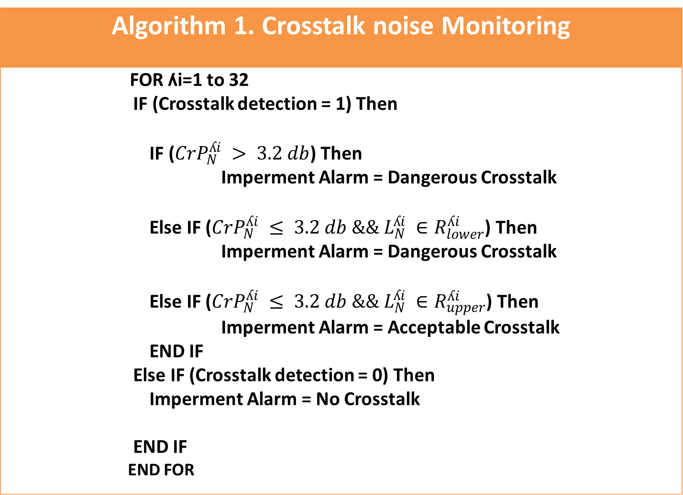
Crosstalk Detection and monitoring
Algorithm 1. Crosstalk noise Monitoring
FOR ʎi=1 to 32 IF (Crosstalk detection = 1) Then IF (${CrP}_{N}^{ʎi} > 3.2 db$) Then Imperment Alarm = Dangerous Crosstalk Else IF (${CrP}_{N}^{ʎi} ≤ 3.2 db \&\& L_{N}^{ʎi} ∈R_{lower}^{ʎi}$) Then Imperment Alarm = Dangerous Crosstalk Else IF (${CrP}_{N}^{ʎi} ≤ 3.2 db \&\& L_{N}^{ʎi} ∈R_{upper}^{ʎi}$) Then Imperment Alarm = Acceptable Crosstalk END IF Else IF (Crosstalk detection = 0) Then Imperment Alarm = No Crosstalk END IF END FOR

Slide 28
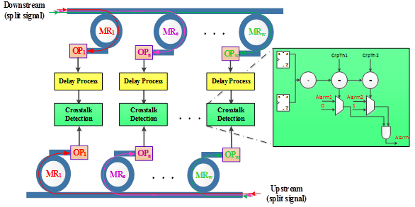
Crosstalk Detection and monitoring

Slide 29
Crosstalk Detection and monitoring

Slide 30
Crosstalk Detection and monitoring

Slide 31
Conclusion:
MPSoC is one of the solution to satisfy the performance required by the new embedded applications .
Network on Chip is one of the problem of MPSoC
Optical Network on Chip promising a solution for the new MPSoC
Crosstalk noise one of the serious problem in ONoC
Detection and monitor crosstalk noise is indispensable to guarantee high performance for MPSoC

Slide 32


