Slide 1
Center of Statistical Analysis
Correlation and Regression Analysis
CSA-C
Presented By:
EL Hajjar, Said
Associate Professor, Ahlia University
Second Semester, 2017

Slide 2
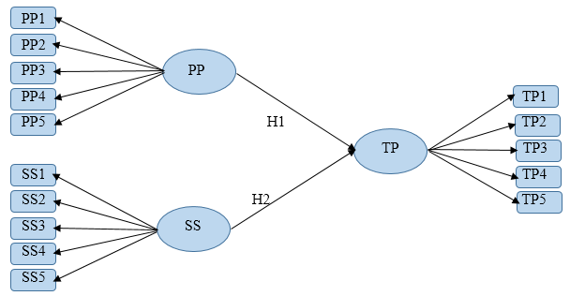
We need to study the correlation between the independent variables PP and SS with the dependent variable TP.
Activity 1: Correlation
Notes:
1
Items (statements) designated are scored 1,2,3,4 and 5, respectively for responses Strongly Disagree, Disagree, Undecided, Agree, and Strongly Agree
2
Independent = X, Dependent = Y

Slide 3
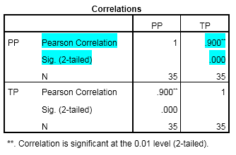
We need to study the correlation between the independent variables PP and SS with the dependent variable TP.
Activity 1: Correlation(Case I )
There is strong positive linear correlation between TP and PP ( r = 0.9), this correlation is significant ( p-value = 0.000 < 0.01)
Notes:
1
Items (statements) designated are scored 1,2,3,4 and 5, respectively for responses Strongly Disagree, Disagree, Undecided, Agree, and Strongly Agree
2
Independent = X, Dependent = Y

Slide 4
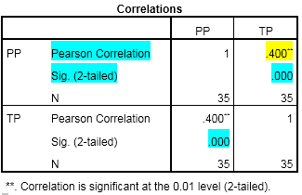
We need to study the correlation between the independent variables PP and SS with the dependent variable TP.
Activity 1: Correlation(Case II )
Although there is weak positive linear correlation between TP and PP ( r = 0.4), this correlation is significant ( p-value = 0.000 < 0.01)
Notes:
1
Items (statements) designated are scored 1,2,3,4 and 5, respectively for responses Strongly Disagree, Disagree, Undecided, Agree, and Strongly Agree
2
Independent = X, Dependent = Y

Slide 5
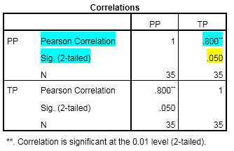
We need to study the correlation between the independent variables PP and SS with the dependent variable TP.
Activity 1: Correlation(Case III )
There is strong positive linear correlation between TP and PP ( r = 0.8); however, this correlation is not significant ( p-value = 0.050 > 0.01)
Notes:
1
Items (statements) designated are scored 1,2,3,4 and 5, respectively for responses Strongly Disagree, Disagree, Undecided, Agree, and Strongly Agree
2
Independent = X, Dependent = Y

Slide 6
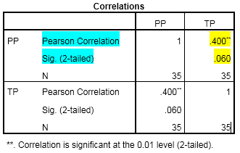
We need to study the correlation between the independent variables PP and SS with the dependent variable TP.
Activity 1: Correlation(Case IV )
There is weak positive linear correlation between TP and PP ( r = 0.8) and this correlation is not significant ( p-value = 0.060 > 0.01)
Notes:
1
Items (statements) designated are scored 1,2,3,4 and 5, respectively for responses Strongly Disagree, Disagree, Undecided, Agree, and Strongly Agree
2
Independent = X, Dependent = Y

Slide 7
Output: Effect of PP on TP
Activity 1I: Regression Analysis (Case I )
81.1% of the variation in TP is explained by a portion variation in PP.
Moreover, the independent variable PP does explain a significant portion of the variation in the dependent variable TP ( p-value = 0.000 < 0.05)
Notes:
1
Items (statements) designated are scored 1,2,3,4 and 5, respectively for responses Strongly Disagree, Disagree, Undecided, Agree, and Strongly Agree
2
Independent = X, Dependent = Y

Slide 8
Output: Effect of PP on TP
Activity 1I: Regression Analysis (Case I )
Estimated Regression Line :
Moreover, there is sufficient evidence that PP affects TP ( p-value = 0.000 < 0.05 ). (Positive Effect)
-Note that 0.052 is the portion of TP not explained by PP.
-Value of TP will increase, on average, by 1.095 unit value of PP for each one unit increase in PP value.
Notes:
1
Items (statements) designated are scored 1,2,3,4 and 5, respectively for responses Strongly Disagree, Disagree, Undecided, Agree, and Strongly Agree
2
Independent = X, Dependent = Y

Slide 9
Output: Effect of PP on TP
Activity 1I: Regression Analysis (Case II )
10.1% of the variation in TP is explained by a portion variation in PP.
However, the independent variable PP does explain a significant portion of the variation in the dependent variable TP ( p-value = 0.000 < 0.05)
Notes:
1
Items (statements) designated are scored 1,2,3,4 and 5, respectively for responses Strongly Disagree, Disagree, Undecided, Agree, and Strongly Agree
2
Independent = X, Dependent = Y

Slide 10
Output: Effect of PP on TP
Activity 1I: Regression Analysis (Case II )
Estimated Regression Line :
Moreover, there is sufficient evidence that PP affects TP ( p-value = 0.000 < 0.05 ). ( Negative Effect )
-Note that 0.052 is the portion of TP not explained by PP.
-Value of TP will decrease, on average, by 1.095 unit value of PP for each one unit increase in PP value.
Notes:
1
Items (statements) designated are scored 1,2,3,4 and 5, respectively for responses Strongly Disagree, Disagree, Undecided, Agree, and Strongly Agree
2
Independent = X, Dependent = Y

Slide 11
Output: Effect of PP on TP
Activity 1I: Regression Analysis (Case III )
1.1% of the variation in TP is explained by variation in PP.
And, the independent variable PP does not explain a significant portion of the variation in the dependent variable TP ( p-value = 0.102 > 0.05)
So, No need to proceed. PP does not influence TP
Notes:
1
Items (statements) designated are scored 1,2,3,4 and 5, respectively for responses Strongly Disagree, Disagree, Undecided, Agree, and Strongly Agree
2
Independent = X, Dependent = Y

Slide 12
Output: Effect of PP on TP
Activity 1I: Regression Analysis (Case IV )
10.1% of the variation in TP is explained by a portion variation in PP.
However, the independent variable PP does explain a significant portion of the variation in the dependent variable TP ( p-value = 0.000 < 0.05)
Notes:
1
Items (statements) designated are scored 1,2,3,4 and 5, respectively for responses Strongly Disagree, Disagree, Undecided, Agree, and Strongly Agree
2
Independent = X, Dependent = Y

Slide 13
Output: Effect of PP on TP
Activity 1I: Regression Analysis (Case IV )
Estimated Regression Line :
Moreover, there is no sufficient evidence that PP affects house price ( p-value = 0.070 > 0.05 ). ( No Effect )
So, PP does not influence TP
Notes:
1
Items (statements) designated are scored 1,2,3,4 and 5, respectively for responses Strongly Disagree, Disagree, Undecided, Agree, and Strongly Agree
2
Independent = X, Dependent = Y

Slide 14
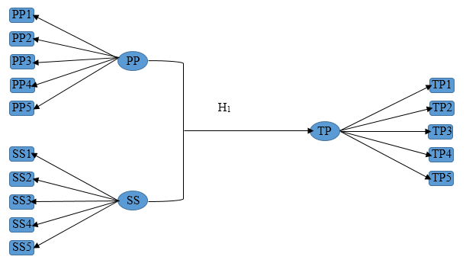
Consider the following Model
Activity III: Multiple Regression Analysis
Notes:
1
Items (statements) designated are scored 1,2,3,4 and 5, respectively for responses Strongly Disagree, Disagree, Undecided, Agree, and Strongly Agree
2
Independent = X, Dependent = Y

Slide 15
Step2 : Continue / OK .We get the output:
Multiple Regression Analysis
87.3% of the variation in TP is explained by a portion variation in PP and SS.
Moreover, the independent variables PP and SS do explain a significant portion of the variation in the dependent variable TP ( p-value = 0.000 < 0.05)
Notes:
1
Items (statements) designated are scored 1,2,3,4 and 5, respectively for responses Strongly Disagree, Disagree, Undecided, Agree, and Strongly Agree
2
Independent = X, Dependent = Y

Slide 16
Step2 : Continue / OK .We get the output:
Multiple Regression Analysis
Estimated Regression Line :
Value of TP will increase, on average, by 0.769 unit for each 1 unit increase in the value of PP, net of the effects of changes due to SS score.
Value of TP will increase, on average, by 0.454 unit for each 1 unit increase in the value of SS, net of the effects of changes due to PP score.
Moreover, there is sufficient evidence that overall PP and SS affects TP ( p-value for PP = 0.000 < 0.05 and p-value for SS = 0.000 < 0.05.
Notes:
1
Items (statements) designated are scored 1,2,3,4 and 5, respectively for responses Strongly Disagree, Disagree, Undecided, Agree, and Strongly Agree
2
Independent = X, Dependent = Y

Slide 17
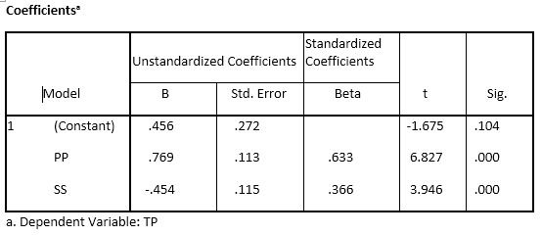
Step2 : Continue / OK .We get the output:
Multiple Regression Analysis
Estimated Regression Line :
Value of TP will increase, on average, by 0.769 unit for each 1 unit increase in the value of PP, net of the effects of changes due to SS score.
Value of TP will decrease, on average, by 0.454 unit for each 1 unit increase in the value of SS, net of the effects of changes due to PP score.
Moreover, there is sufficient evidence that overall PP and SS affects TP ( p-value for PP = 0.000 < 0.05 and p-value for SS = 0.000 < 0.05.
Notes:
1
Items (statements) designated are scored 1,2,3,4 and 5, respectively for responses Strongly Disagree, Disagree, Undecided, Agree, and Strongly Agree
2
Independent = X, Dependent = Y

Slide 18
End
Freedom is the first five minutes of your born. Afterwards, they decide your name, your nationality, your religion, your sect,…. And you will spend your whole life struggling and defending stupidly about things you did not select.
Ziad AL Rahbani
THANK YOU
Notes:
1
Items (statements) designated are scored 1,2,3,4 and 5, respectively for responses Strongly Disagree, Disagree, Undecided, Agree, and Strongly Agree
2
Independent = X, Dependent = Y

