Slide 1
Center of Statistical Analysis
Normality test, Descriptive Analysis, and Reliability & Construct Validity
CSA-B
Presented By:
EL Hajjar, Said
Associate Professor, Ahlia University
Second Semester, 2017

Slide 2
Data Analysis
Acceptable sample size for a given population size
It is highly recommended to find the response rate before proceeding in any analysis.
Response rate = ( number of received responses / total number of distributed questionnaire ) ;
this sample response rate should be more than or equal to 30 % of parent data ( Sekaran, 2003).
- Here are two methods to calculate the required sample size:
1- Calculation Method if population size is known
N = Population size;
e = acceptable margin of error for the mean to be estimated. 3% is a reasonable figure to be assumed
as margin of error. (Krejcie and Morgan,1970)
p = Percentage Value ( 0.5)
Z = critical value (acceptable risk); Value of z is based on the risk that you choose (α) ; it is determined
through z-Table. Recommended values of α are 5% or 1% risk .

Slide 3
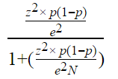
Data Analysis
(Continued)
Example
Suppose that the number of distributed questionnaire is 400, and the number of received responses is 385. then:
Response rate = ( number of received responses / total number of distributed questionnaire ) = 385 / 400 = 0. 9625, which is 96.25 % sample response rate ≥ 30%
.Calculation Method
Suppose N = 500, 95% confidence level(z= 1.96), and the margin of error is e = 0.03.

Slide 4
Data Analysis (Continued)
Population Size | Sample Size per Margin of Error 95% Confidence Level
 | ±3% | ±5% | ±10%
500 | 345 | 220 | 80
1,000 | 525 | 285 | 90
3,000 | 810 | 350 | 100
5,000 | 910 | 370 | 100
10,000 | 1,000 | 385 | 100
100,000+ | 1,100 | 400 | 100

Slide 5
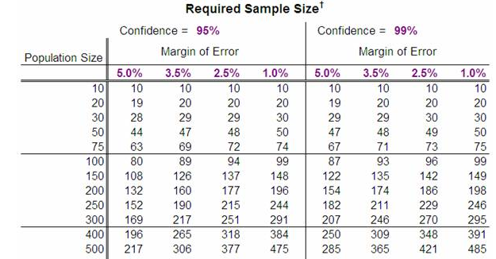
Data Analysis (Continued)
Sample Size Table - The Research Advisors
research-advisors.com/tools/SampleSize.htm

Slide 6
Data Analysis
2) Acceptable sample size for an unknown
population size
Where the population is unknown, the sample size can be derived by computing the minimum sample size required for accuracy in estimating proportions by considering the standard normal deviation set at 95% confidence level ( z = 1.96), a sample proportion of 50% ( p = 0.5 ) a margin of error 5% ( e = ± 0.05).
( Mensah, 2014)

Slide 7
Normality test
Describe the balance of the distribution: Skewness and Kurtosis.
- Skewness: Acceptable range for values is [-2, 2]
- Kurtosis: Acceptable range for values is [-3, 3]
Reference: (Hair et al., 2010).
With small sample size, the impact of Skewness and Kurtosis might not make a significant difference in further analyses.
Reference: (Tabachnick and Fidell, 2001).

Slide 8
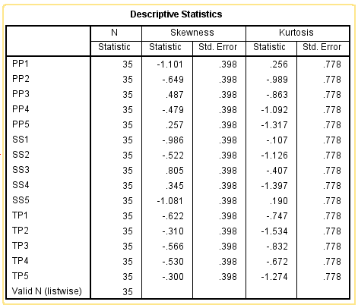
Normality test (case 1)
(Continued)
Data are normally Distributed
Skewness Score ϵ [-2, 2 ]
and
Kurtosis Score ϵ [-3, 3 ]

Slide 9
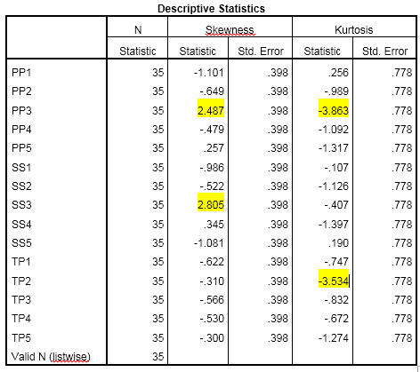
Normality test (case II )
(Continued)
Data are approximately normally Distributed
Although PP3 & SS3 Skewness Scores fell outside the range of [-2, 2 ] and PP3 &TP2 Kurtosis Scores fell outside the range of [-3, 3 ], there is no statistical reason to drop them. Due to the sample size, the impact of Skewness and Kurtosis might not make a significant difference in further analyses (Tabachnick and Fidell, 2001).

Slide 10
Frequency Table : Family Income in Dollars per year
Description of Data
 | Frequency | Percent | Valid Percent | Cumulative Percent
Valid Less than 14 K 14K - 19,999 20K - 49,999 50K or more Total Missing System Total | 2 8 52 62 124 4 128 | 1.6 6.3 40.6 48.4 96.9 3.1 100.0 | 1.6 6.5 41.9 50.0 100.0 | 1.6 8.1 50.0 100.0

Slide 11
It analyzes the respondent’s personal Information . Output (Age)
Description of Data
Frequency: Count of interviews in survey. These counts are
useful if you want to calculate different percentage categories.
Percent: Percentages of all respondents, with those who did not answer or said they did not know included.
Valid Percent: Percentages of all respondents who answered the question with an opinion on it. Respondents who did not answer or said they did not know are not included.
Cumulative Percent :This adds up percentages from top to bottom as you go. It is just there to make the arithmetic easier.

Slide 12
Frequency Table : Family Income in Dollars per year
Description of Data
124 out of the 128 parents have valid data. You can see the "valid percent" are slightly higher than the "percent" because the 4 missing cases have been removed from consideration.
 | Frequency | Percent | Valid Percent | Cumulative Percent
Valid Less than 14 K 14K - 19,999 20K - 49,999 50K or more Total Missing System Total | 2 8 52 62 124 4 128 | 1.6 6.3 40.6 48.4 96.9 3.1 100.0 | 1.6 6.5 41.9 50.0 100.0 | 1.6 8.1 50.0 100.0
Note that sometimes you need to do some recalculating on your own. Here is an example from the Frequencies table above: "Eight percent of respondents reported their family income to be less than $19,999 per year." The 8% figure comes from adding the valid percent from two rows (1.6 for those less than 14K and 6.5 for those from 14 K to 19,999).
In the final report, we recommend rounding percentages to the nearest whole number. We lose a little accuracy this way, but avoid frightening math-phobic people. So we would round 14.4 to 14 and 14.6 to 15. But which way would you round 14.5? Here is the rule of Thumb we follow: round .5 to the nearest even number. Therefore, 14.5 would round down to 14, but 15.5 would round up to 16, the nearest even number. In this way there is no systemic bias upward or downward.

Slide 13
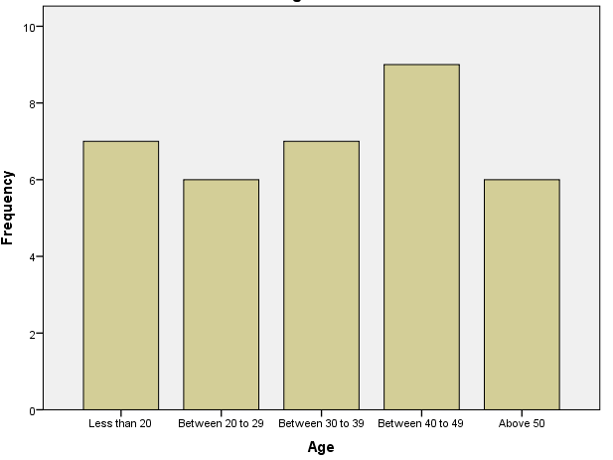
Age: Bar charts
Description of Data
A bar graph (or bar chart) is perhaps the most common statistical data display used by the media. A bar graph breaks categorical data down by group, and represents these amounts by using bars of different lengths. It uses either the number of individuals in each group (also called the frequency) or the percentage in each group (called the relative frequency).

Slide 14
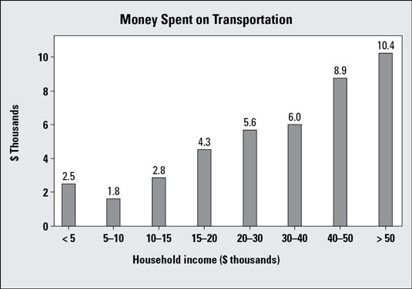
Description of Data
This particular bar graph shows how much money is spent on transportation for people in different household-income groups. It appears that as household income increases, the total expenditures on transportation also increase. This makes sense, because the more money people have, the more they have available to spend.
But would the bar graph change if you looked at transportation expenditures not in terms of total dollar amounts, but as the percentage of household income? The households in the first group make less than $5,000 a year and have to spend $2,500 of it on transportation. (Note: The label reads “2.5,” but because the units are in thousands of dollars, the 2.5 translates into $2,500.)

Slide 15
Description of Data
This $2,500 represents 50% of the annual income of those who make $5,000 per year; the percentage of the total income is even higher for those who make less than $5,000 per year. The households earning $30,000–$40,000 per year pay $6,000 per year on transportation, which is between 15% and 20% of their household income. So, although the people making more money spend more dollars on transportation, they don’t spend more as a percentage of their total income. Depending on how you look at expenditures, the bar graph can tell two somewhat different stories.

Slide 16
Description of Data
Another point to check out is the groupings on the graph. The categories for household income as shown aren’t equivalent. For example, each of the first four bars represents household incomes in intervals of $5,000, but the next three groups increase by $10,000 each, and the last group contains every household making more than $50,000 per year. Bar graphs using different-sized intervals to represent numerical values (as indicated in the image) make true comparisons between groups more difficult. (However, the government probably has its reasons for reporting the numbers this way; for example, this may be the way income is broken down for tax-related purposes.)

Slide 17
Description of Data
One last thing: Notice that the numerical groupings in the image overlap on the boundaries. For example, $30,000 appears in both the 5th and 6th bars of the graph. So, if you have a household income of $30,000, which bar do you fall into? This kind of overlap appears quite frequently in graphs, but you need to know how the borderline values are being treated. For example, the rule may be “Any data lying exactly on a boundary value automatically goes into the bar to its immediate right.” (Looking at the image, that puts a household with a $30,000 income into the 6th bar rather than the 5th.)

Slide 18
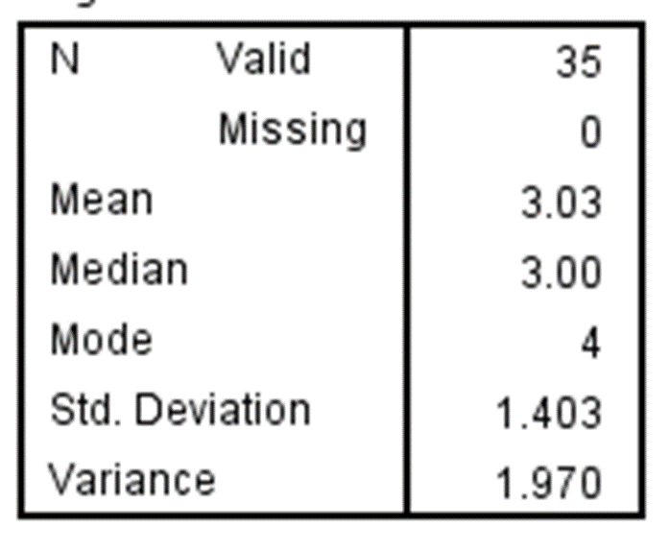
Measuring Data
Central tendency refers to the idea that there is one number that best summarizes the entire set of measurements, a number that is in some way "central" to the set.
The mode is the measurement that has the greatest frequency, the one you found the most of. Although it isn't used that much, it is useful when differences are rare or when the differences are non numerical. The prototypical example of something is usually the mode. The mode for our example is 4. It is the grade with the most people (4).

Slide 19
Measuring Data
The median is the number at which half your measurements are more than that number and half are less than that number. The median is actually a better measure of centrality than the mean if your data are not normally distributed. The median for our example is 3.00. Half the people scored lower, and half higher (and one exactly).
The mean is just the average. This is the most used measure of central tendency, because of its mathematical qualities. It works best if the data is normally distributed. One interesting thing about the mean is that it represents the expected value if the distribution of measurements were random! The mean for our example is 3.03.

Slide 20
Standard Deviation
Measuring Data
Standard deviation can be difficult to interpret as a single number on its own. Basically, a small standard deviation means that the values in a statistical data set are close to the mean of the data set, on average, and a large standard deviation means that the values in the data set are farther away from the mean, on average.
The standard deviation measures how concentrated the data are around the mean; the more concentrated, the smaller the standard deviation.
A small standard deviation can be a goal in certain situations where the results are restricted, for example, in product manufacturing and quality control. A particular type of car part that has to be 2 centimeters in diameter to fit properly had better not have a very big standard deviation during the manufacturing process. A big standard deviation in this case would mean that lots of parts end up in the trash because they don’t fit right; either that or the cars will have problems down the road

Slide 21
Standard Deviation
Measuring Data
But in situations where you just observe and record data, a large standard deviation isn’t necessarily a bad thing; it just reflects a large amount of variation in the group that is being studied. For example, if you look at salaries for everyone in a certain company, including everyone from the student intern to the CEO, the standard deviation may be very large. On the other hand, if you narrow the group down by looking only at the student interns, the standard deviation is smaller, because the individuals within this group have salaries that are less variable. The second data set isn’t better, it’s just less variable.

Slide 22
Standard Deviations
Same mean, but different standard deviations:
Data A
Mean = 15.5
s = 3.338
11 12 13 14 15 16 17 18 19 20 21
Data B
Mean = 15.5
s = .9258
11 12 13 14 15 16 17 18 19 20 21
Data C
Mean = 15.5
s = 4.57
11 12 13 14 15 16 17 18 19 20 21

Slide 23
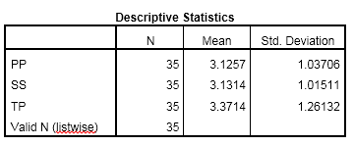
Measuring Data (Continued)
Descriptive statistics
- Shows the perceptions of respondents to variables.
As shown, Respondents revealed that SS is the first important factor that may lead to influence the dependent variable (TP)( mean = 3.1314, Std. Deviation = 1.01511).The least important factor is PP( mean = 3.1257, Std. Deviation = 1.03706). Among the variables, the most important effective factor in the model is TP (Mean=3.3714, Std. Deviation =1.26132).

Slide 24
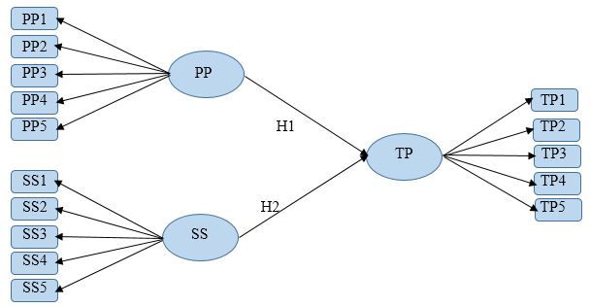
We need to study the reliability and validity of the constructs and items in this model. Note that here we use 10 -30% of the collected dataset.
Activity 1: Reliability & Construct Validity

Slide 25
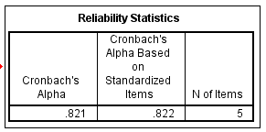
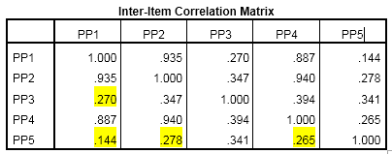
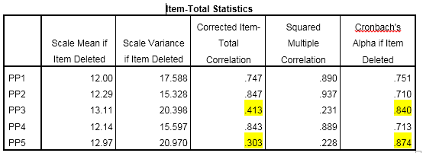
Assume the following outputs:
Activity 1 (Case I )
There is statistical reason to drop out the items PP3 and PP5

Slide 26
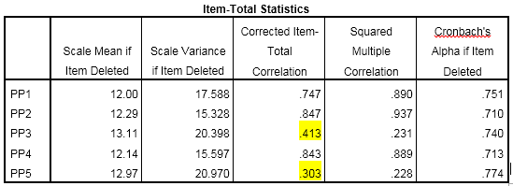
Assume the following outputs:
Activity 1 (Case II )
There is no statistical reason to drop out the items PP3 and PP5

Slide 27
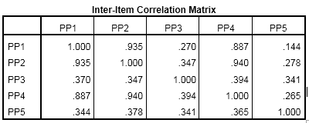
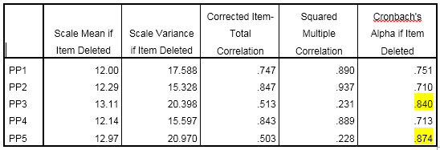
Assume the following outputs:
Activity 1 (Case III )
There is no statistical reason to drop out the items PP3 and PP5

Slide 28
End
THANK YOU

